Slide 1
SARA Probabilistic Model, Update
Supply Analysis Working Group
Pete Warnken
Resource Adequacy
April 17, 2020
Notes:
Welcome to

Slide 2
New Wind Output Modeling Approach, Overview
Incorporated UL hourly wind profiles for 1980-2017
Scaled up the profiles based on incremental new installed capacity sine 2017 and expected planned capacity based on the preliminary summer SARA report
  New profiles from UL for 1950-2019 are expected next week
Fit probability distributions for the wind values for each of the eight daily summer Peak Load Season hours (HE 1:00 pm – 8:00 pm)
Calculated correlation coefficients between the wind output distributions, and applied them in the Monte Carlo simulation to appropriately narrow the range of wind output outcomes across the eight hours

Slide 3
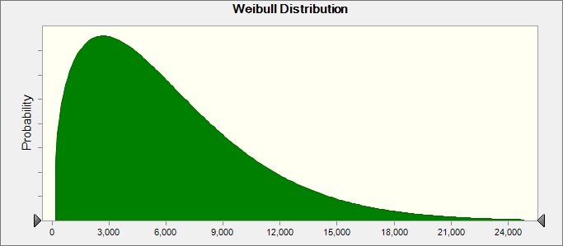
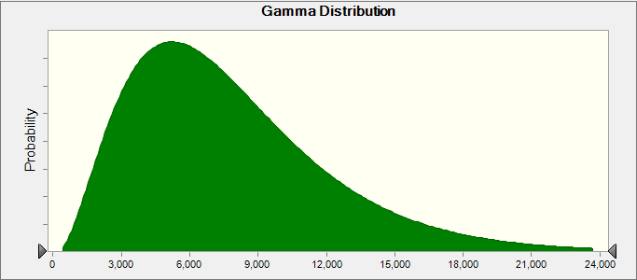
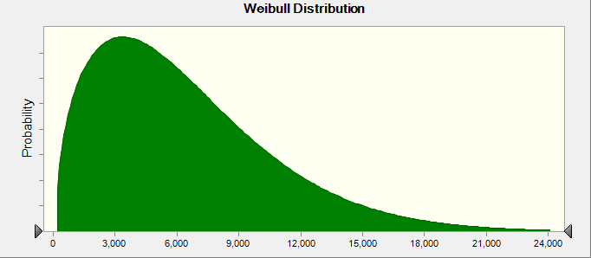
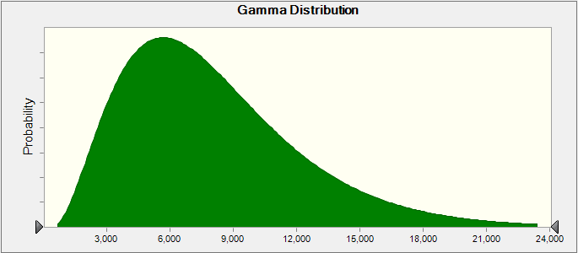
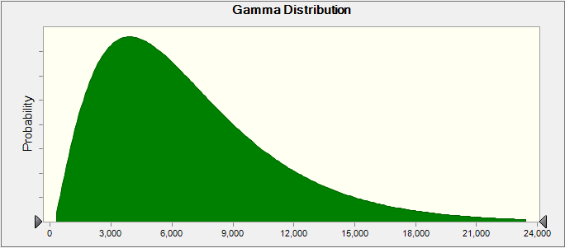
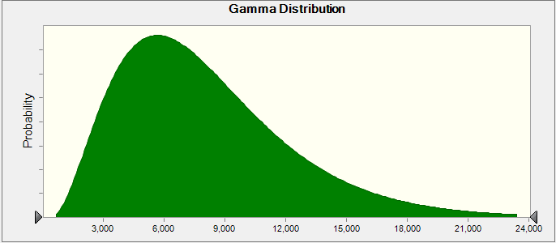
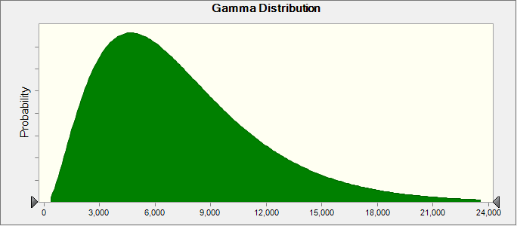
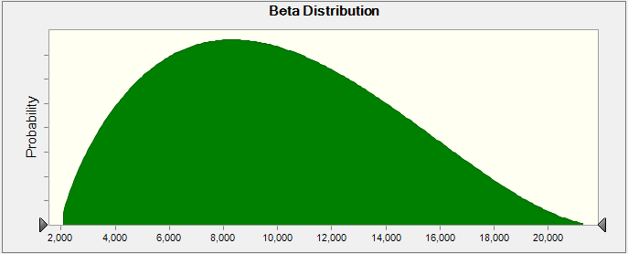
Wind Output Distributions for Each Hour
Hour Ending 1:00 pm
Hour Ending 5:00 pm
Hour Ending 2:00 pm
Hour Ending 6:00 pm
Hour Ending 3:00 pm
Hour Ending 7:00 pm
Hour Ending 4:00 pm
Hour Ending 8:00 pm

Slide 4
Correlation Coefficients for Load and Wind

Slide 5
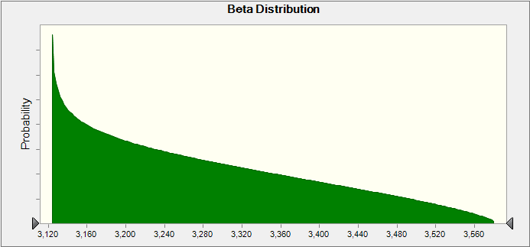
Modeling PUN Net Injection
Adopted approach similar to wind output
  Fit a probability distribution to PUN net injection time series for each of the eight modeled hours
  Determine correlations with load (82%)

Slide 6
Observations and Findings
New approach incorporates a wide range of meteorological patterns in line with ERCOT’s reserve margin studies
1,000-trial model run resulted in a 50th percentile value of 6,933 MW for HE 5:00 pm; peak average capacity contribution for Preliminary Summer SARA is 6,924 MW
New approach reduces simulation run-time by 70%

Slide 7
Next Steps
Incorporate solar probabilistic modeling
Incorporate new wind and solar profile data; update probability distributions and correlations
Set up Risk Assessment Sensitivity Chart and other graphic tools
Update model with Final Summer SARA
Consider modeling other resources probabilistically
Present next version of the model at SAWG (June?)

