Slide 1
Supply Analysis Working Group Meeting
NOIE Response Rate for the Annual 2019 Unregistered Distribution Generation Report
April 17, 2020

Slide 2
Annual DG Reporting required for 2020
All NOIEs required to report Annual values
Reports due Mar 1 unless reported quarterly (>2 MW of “<50kW”)
Provides exemption for first year
Annual Unregistered DG report posted April 10, 2020
http://mis.ercot.com/misapp/GetReports.do?reportTypeId=13544&reportTitle=Unregistered%20DG%20Installed%20Capacity%20Quarterly%20Report&showHTMLView=&mimicKey
Minor confusion on reporting resulted in some delays (some entities not sure what to provide)
66 of 110 NOIEs responded.
34 of 35 NOIEs with >100 MW peak load responded
53 of 56 NOIEs with > 30 MW peak load responded.
Top 56 NOIEs represent 97% of NOIE peak load
13 NOIEs report > 2 MW of “<50kW”

Slide 3
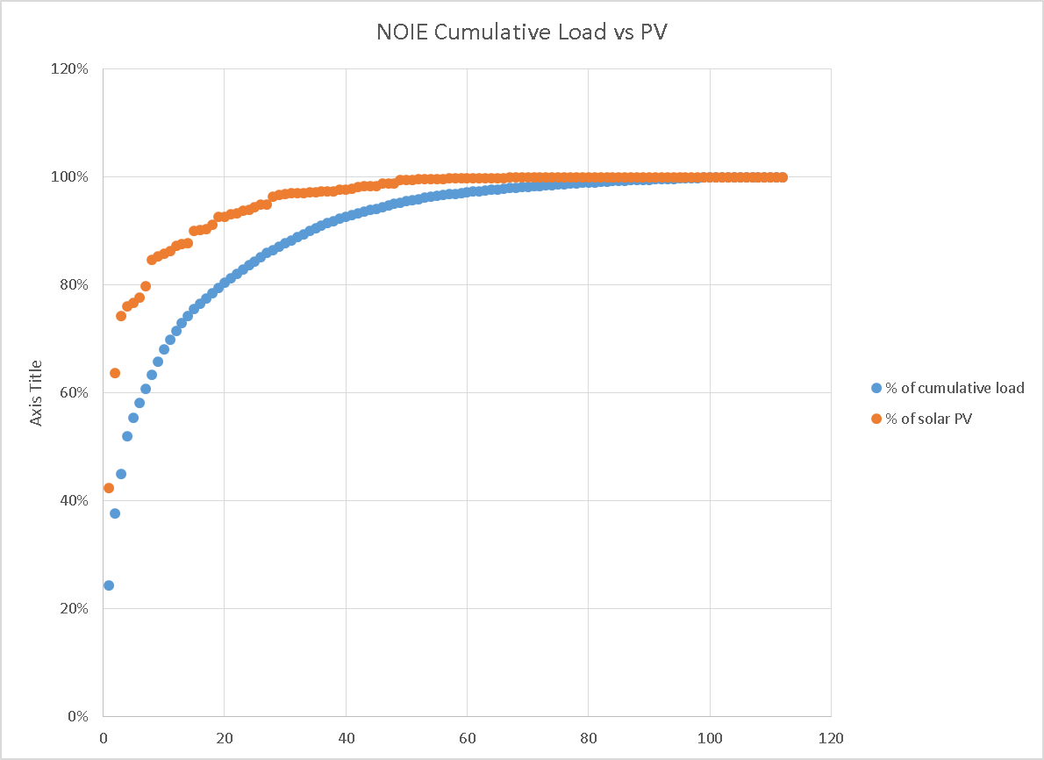
Comparing NOIE Load to NOIE Installed DG
100 MW
>30 MW

