Slide 1
Discussion of RTF-5
Distributed Generation
April 16, 2020

Slide 2
Status of NPRR RTF- 5 for DG
Initial proposed language reviewed at Oct 10, 2019 RTF meeting
  http://www.ercot.com/content/wcm/key_documents_lists/172671/RTF-5_DG_Updates.pptx
Distributed Generation (< 10 MW / < 60 kV)
  4 Separate types of registration requirements
  5 Different ERCOT categories

Slide 3
Current Generation Framework
http://www.ercot.com/content/wcm/key_documents_lists/130715/Resource_Matrix_for_Generators.pptx

Slide 4
Observations about DG*
Three categories of DG > 1 MW
  Distribution Generation Resource (DGR)
    Currently modeled in ERCOT Network Model
      Section 3.10.7.2(1)
  Settlement Only Distribution Generator (SODG)
    Currently mapped in ERCOT Network Model
      Section 3.10.7.2(3)
  Unregistered Distribution Self Generator
    No visibility
SODG Registration issues
  Section 16.5(5) “DG with an installed capacity greater than one MW, the DG registration threshold, which exports energy into a Distribution System, must register with ERCOT.”
    There are differing interpretations of the phrase “exports to distribution system”
*For the purposes of this discussion, the term DG will also include Distribution-connected Energy Storage

Slide 5
DG Visibility to ERCOT
ERCOT DER Reliability Paper http://www.ercot.com/content/wcm/lists/121384/DERs_Reliability_Impacts_FINAL.pdf
  ERCOT requires Improved Visibility into DER.
    Mapping DG > 1 MW
NERC is pushing to account for DER in ERCOT models
  NERC Planning Committee is publishing new reliability guidelines regarding DER.
    https://www.nerc.com/comm/PC/System%20Planning%20Impacts%20from%20Distributed%20Energy%20Re/2019-11_DER_A_Guideline_Webinar.pdf
Propose requiring any DG > 1 MW to register with ERCOT

Slide 6
Proposal
Three categories of DG > 1 MW
  (owner of equipment may choose registration based on desired market participation)
  Distribution Generation Resource
  Settlement Only Distribution Generator
  Unregistered Distribution Self Generator*
Maintain “intent” of distribution self-generator where there is no desire to be settled for unintentional export of energy:
  ERCOT will only require mapping information for reliability similar to SODG
  No telemetry requirements
  No registration as a Resource Entity (market participant)
  No metering or settlement changes
  No QSE required
*note term does not exist in ERCOT protocols

Slide 7
Language
However, by “registering”, these self-generating DGs, they aren’t really in the category of “unregistered DG”
The structure for these self-generating DGs would not involve any settlements from ERCOT.
Therefore, the proposal would be to categorize these as “Non-Settled Distribution Generators”.

Slide 8
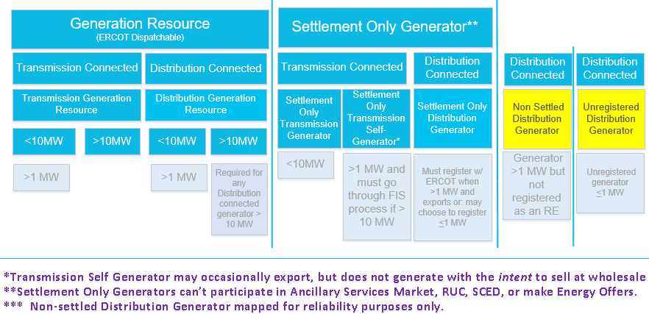
Proposed Revision to RTF Generation Framework
***

Slide 9
Proposal
ALL DG* > 1 MW would be visible to ERCOT
  Distribution Generation Resource (DGR)
    Provide Resource Registration data (RARF) to model in ERCOT Network Model
    Registration as DGR
    Registration as a Resource Entity for settlements (settled per protocols)
  Settlement Only Distribution Generator (SODG)
    Provide Resource Registration data (RARF) to map in ERCOT Network Model
    Registration as SODG if they export to the distribution system.
    Registered as a RE for settlements (settled per NPRR917)
  Non Settled Distribution Generator (NSDG)
    Provide Resource Registration data (RARF) to map in the ERCOT network model
    Not registered as a RE since no exports so no settlements required.

