Slide 1
Credit Exposure Update
Spoorthy Papudesi
Credit Work Group
ERCOT Public
April 15, 2020

Slide 2
Monthly Highlights Feb 2020- Mar 2020
Market-wide average TPE increased from $ 406.6 million to $ 459.5 million
TPE increased mainly due to higher Real-Time and Day- Ahead Settlement Point Prices in March compared to February
Discretionary Collateral is defined as Secured Collateral in excess of TPE,CRR Locked ACL and DAM Exposure
Average Discretionary Collateral slightly decreased from $ 1,264.1 million to $1,226.9 million
The decrease in Discretionary Collateral is largely due to increase in TPE
Number of active Counter-Parties remained flat
No unusual collateral call activity

Slide 3
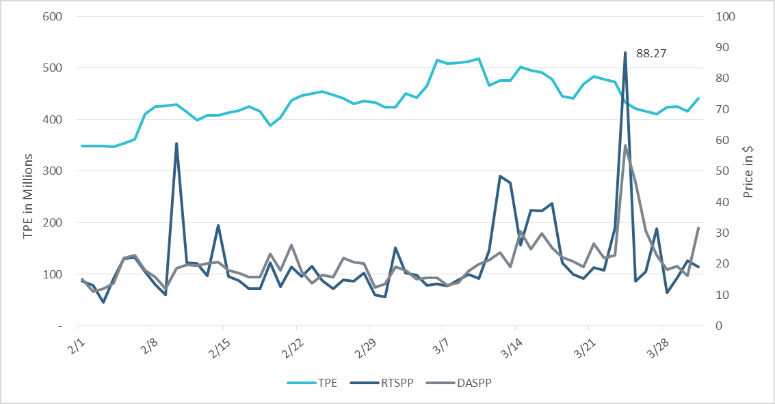
TPE/Real-Time & Day-Ahead Daily Average Settlement Point Prices for HB_NORTH Feb 2020– Mar 2020

Slide 4
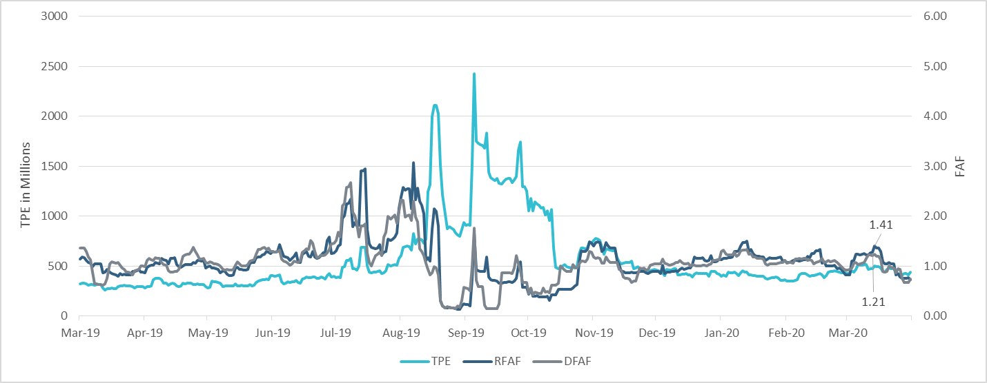
TPE and Forward Adjustment Factors Feb 2019- Feb 2020

Slide 5
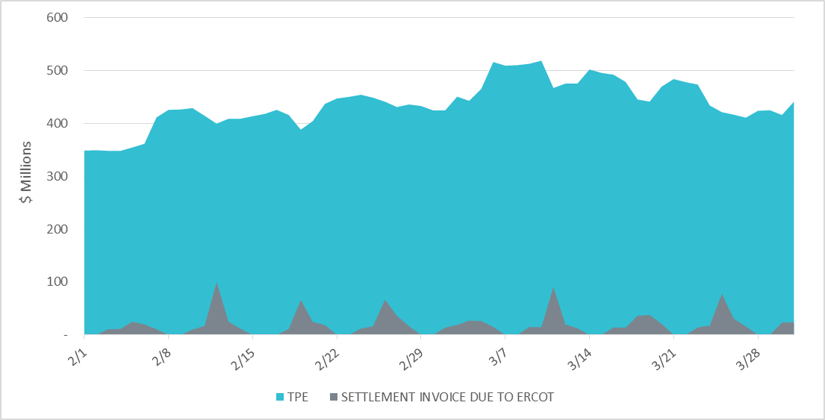
Settlement Invoice Charges/TPE Feb 2020- Mar 2020

Slide 6
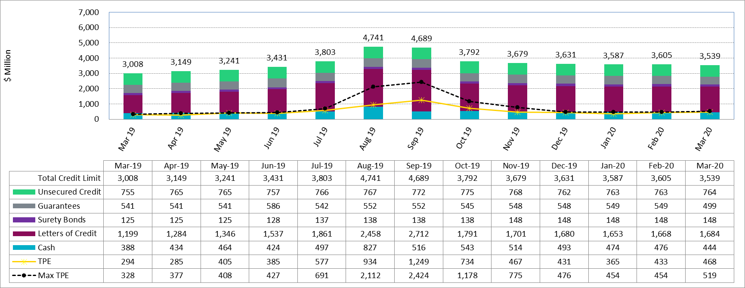
Available Credit by Type Compared to Total Potential Exposure (TPE)
*Numbers are as of month end except for Max TPE

Slide 7
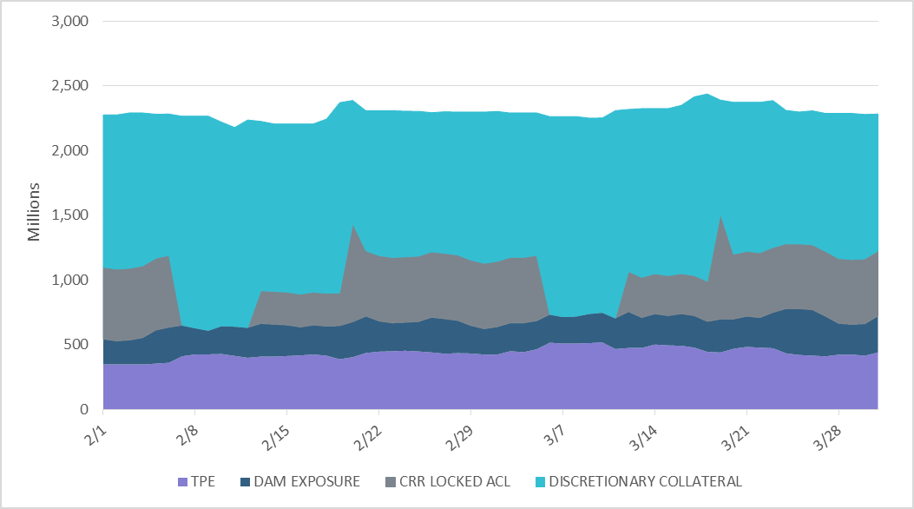
Discretionary Collateral Feb 2020- Mar 2020
At a Counter-Party level, no unusual changes were noted
Note: Discretionary collateral doesn’t include Unsecured Credit Limit or parent guarantees

Slide 8
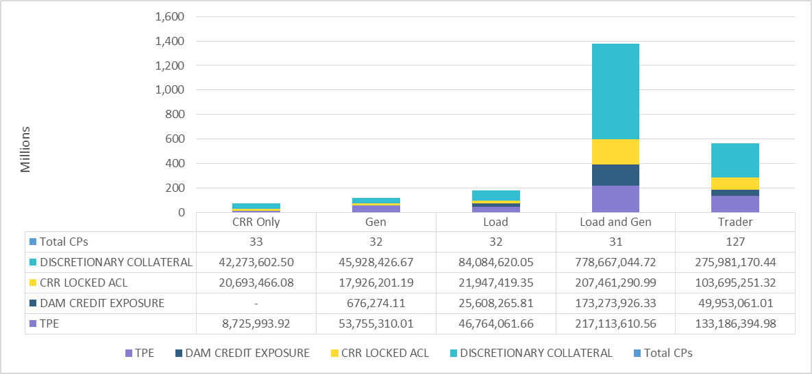
TPE and Discretionary Collateral by Market Segment- Mar 2020
Load and Generation entities accounted for the largest portion of discretionary collateral

Slide 9
Appendix

Slide 10
Summary of Distribution by Market Segment
Note: Excess collateral doesn’t include Unsecured Credit Limit and is defined as Collateral in excess of TPE

Slide 11
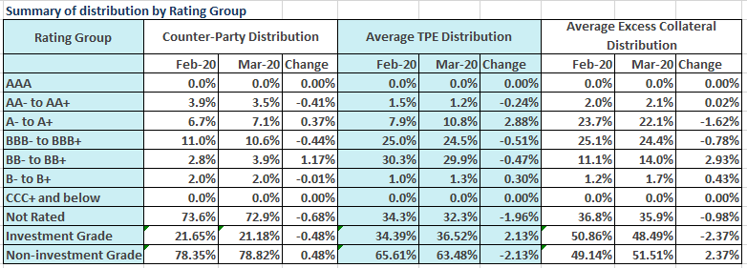
Summary of Distribution by Rating Group

Slide 12
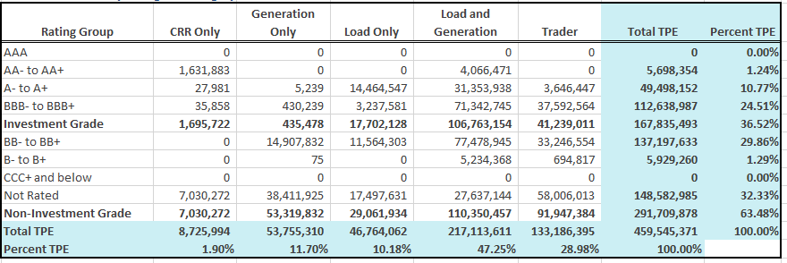
Distribution of TPE by Rating and Category

Slide 13
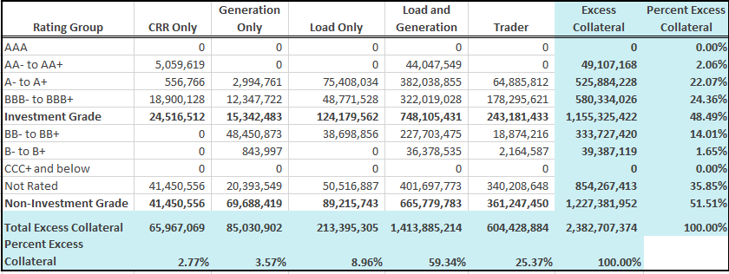
Distribution of Excess Collateral by Rating and Category

Slide 14
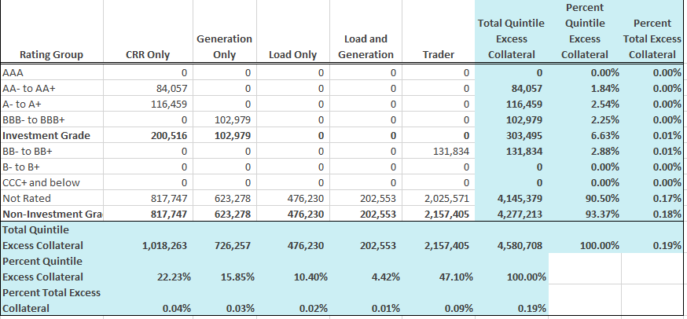
Bottom Quintile Distribution of Excess Collateral by Rating and Category

Slide 15
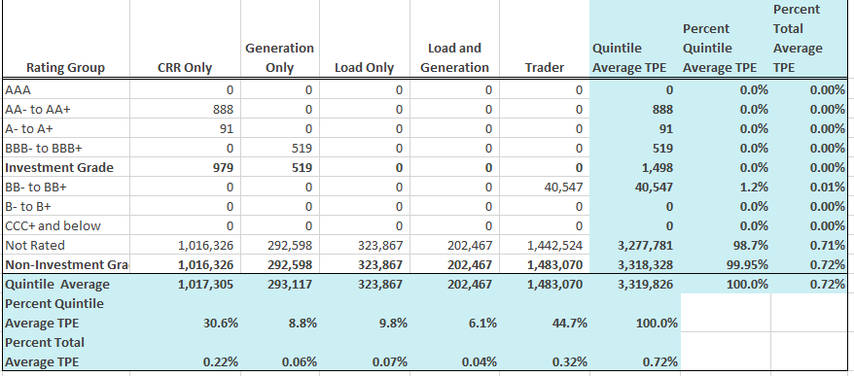
Bottom Quintile Distribution of Average TPE by Rating and Category

Slide 16
Questions

