Slide 1
ERCOT Frequency Control Report
March 2020
ERCOT
Operations Planning
PDCWG | April 15th, 2020

Slide 2
Summary of March 2020
CPS1: 169.66%
Current CPS1 12-Month Rolling Average: 174.49%
2 BAAL Exceedances
6 hourly CPS1 score below 100%
BAAL-003 Events have updated through 2019
2018 BAAL-003 FRM Performance: -843.17
2020 RMS1 Statistics
Mean: 15.70 mHz
Min: 12.25 mHz
Max: 19.80 mHz
Energy Statistics
Total Energy: 28,190,392 MWh
Wind Energy: 7,349,959 MWh
Percent Energy from Wind: 26.07%
Solar Energy: 419,973 MWh
Percent Energy from Solar: 1.49%
Minimum System Inertia
Mean: 171,265
Max: 200,438 on Mar 17th
Min: 139,592 on Mar 8th
Notes:
Mean: 171,265
Max: 200,438 on Mar 17th
Min: 139,592 on Mar 8th

Slide 3
Frequency Control
CPS1, BAAL, & RMS1

Slide 4
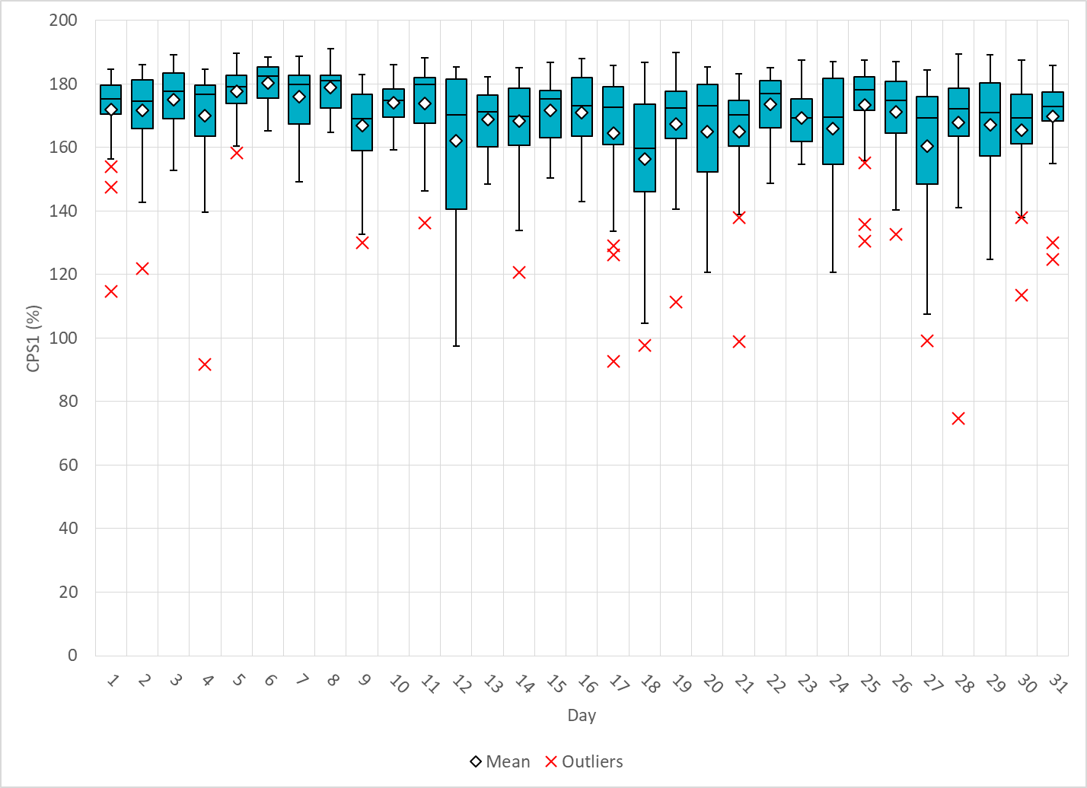
Hourly CPS1 by Day
Mar-20 CPS1 (%): 169.66
Notes:
Outliers:
3/4/2020: Large expected gen deviation at the beginning and the end of the hour from mostly wind resources. Wind down ramp at the tail of the hour.
3/17/2020: Large expected gen deviation at the beginning of the hour from mostly wind resources.
3/18/2020 : Loss of generation event.
3/21/2020 : Large expected gen deviation at the end of the hour.
3/27/2020: Large expected gen deviation at the end of the hour.
3/28/2020: Large expected gen deviation throughout the first half of the hour.

Slide 5
BAAL Exceedances & Violations
There were 2 BAAL exceedances in March
Notes:
BAAL Exceedances related to the FME on 3/18/2020

Slide 6
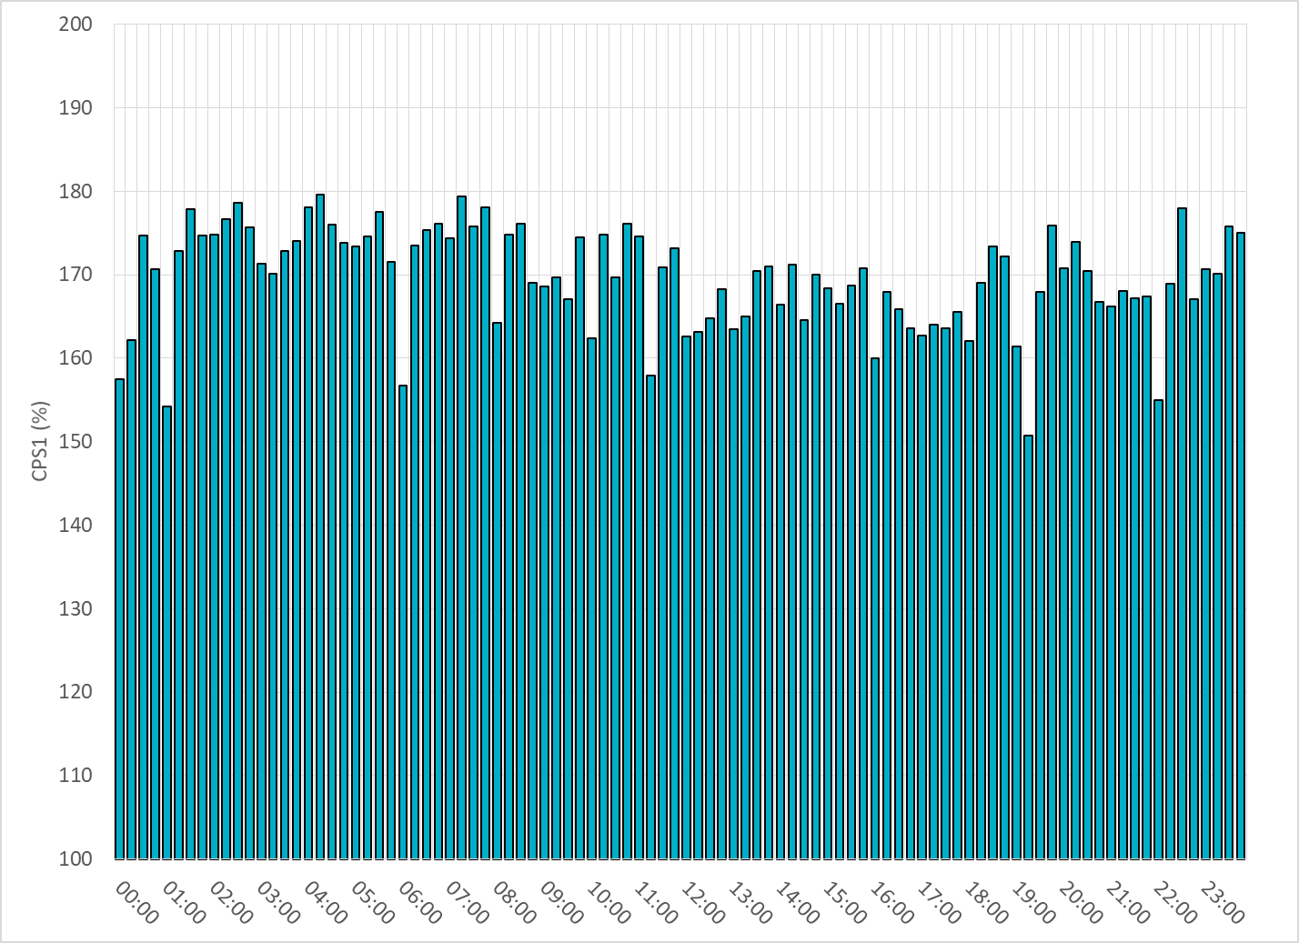
15-Minute Average CPS1%
Mar-20 CPS1 (%): 169.66

Slide 7
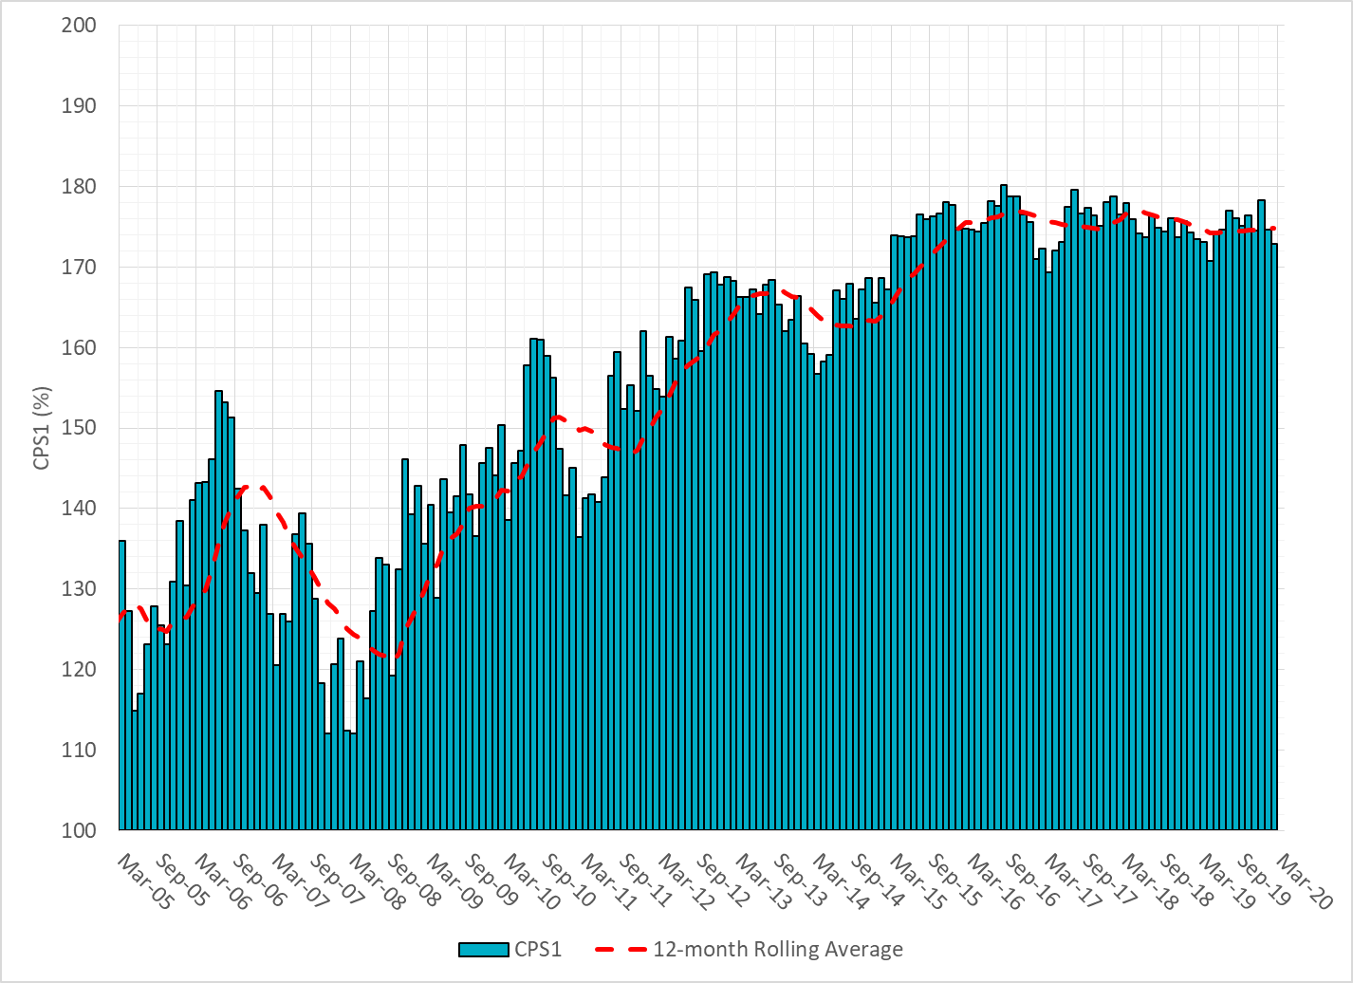
12-Month Rolling Average CPS1
Current 12-Month Rolling Average: 174.49%

Slide 8
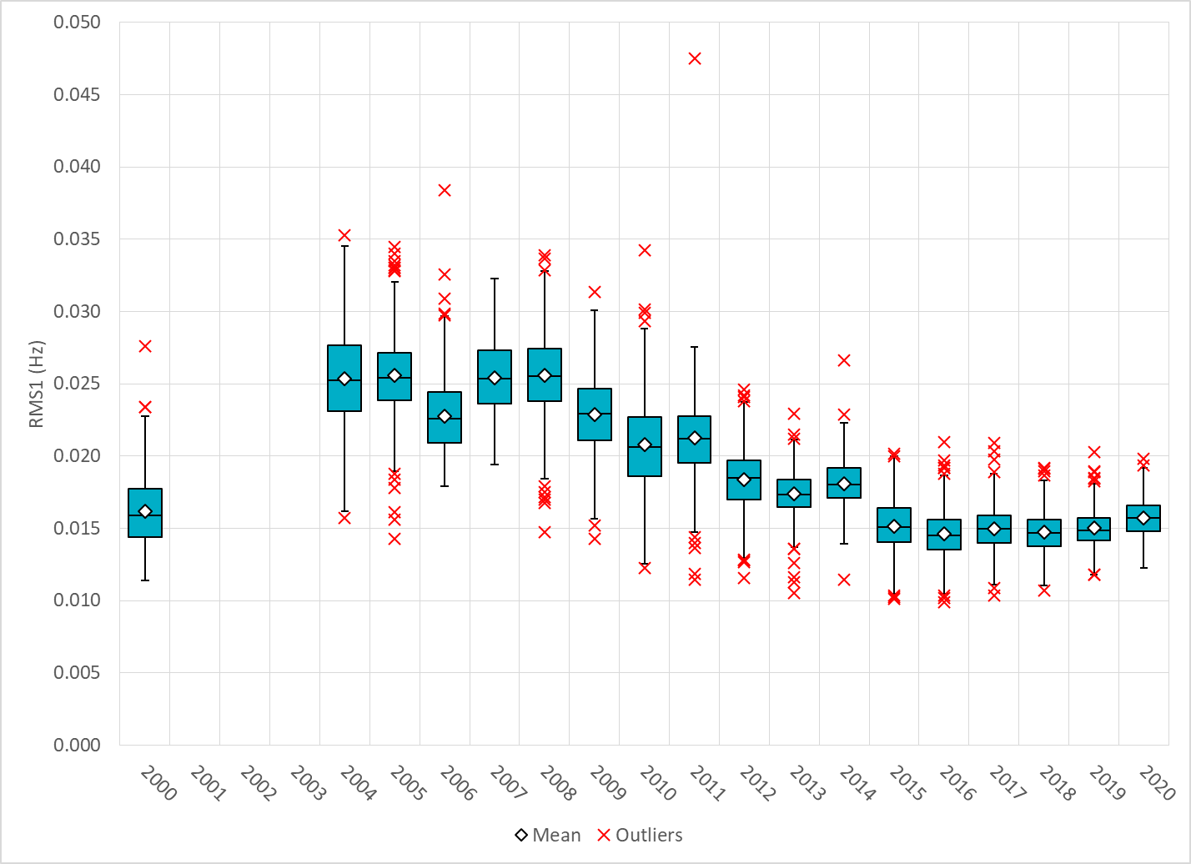
Daily RMS1 of ERCOT Frequency by Year

Slide 9
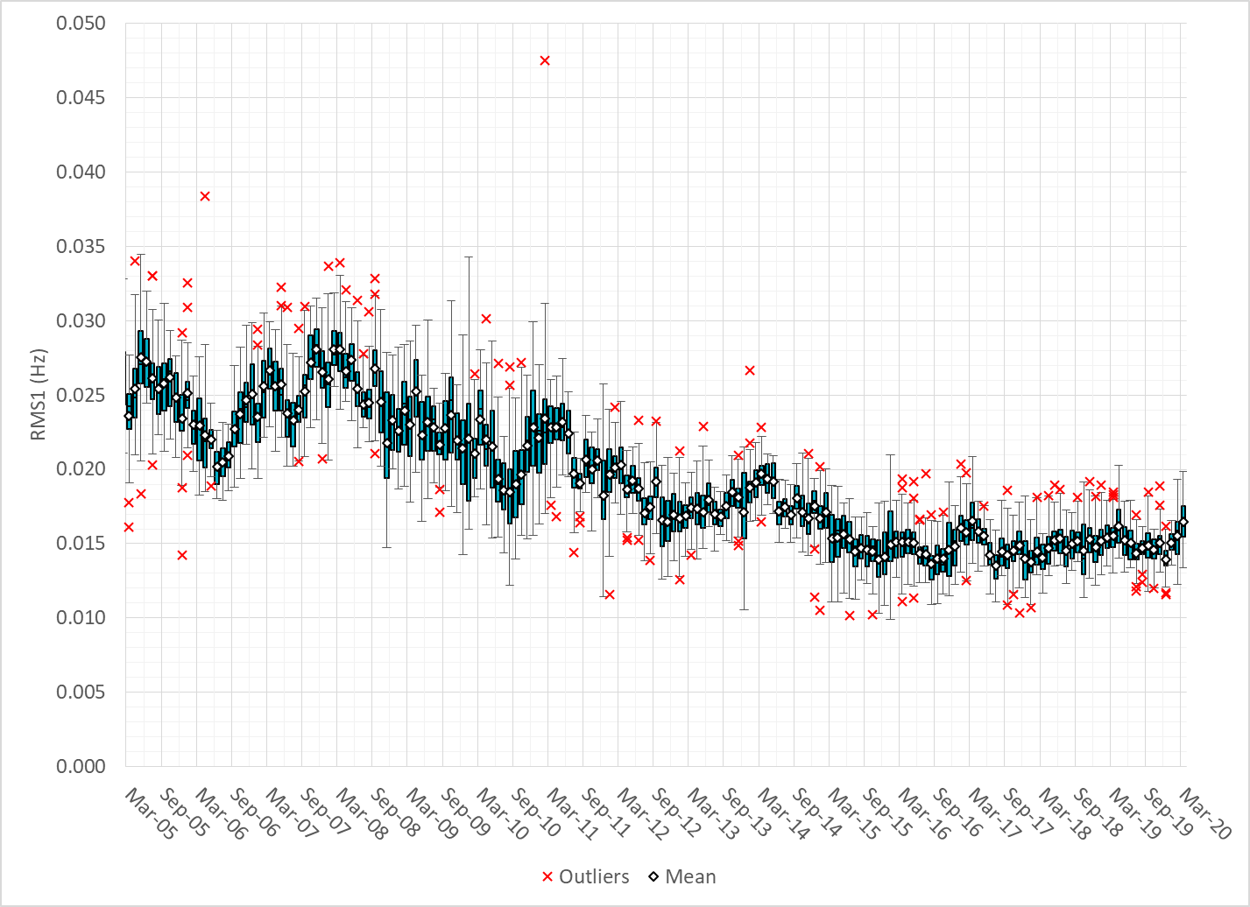
Daily RMS1 of ERCOT Frequency by Month

Slide 10
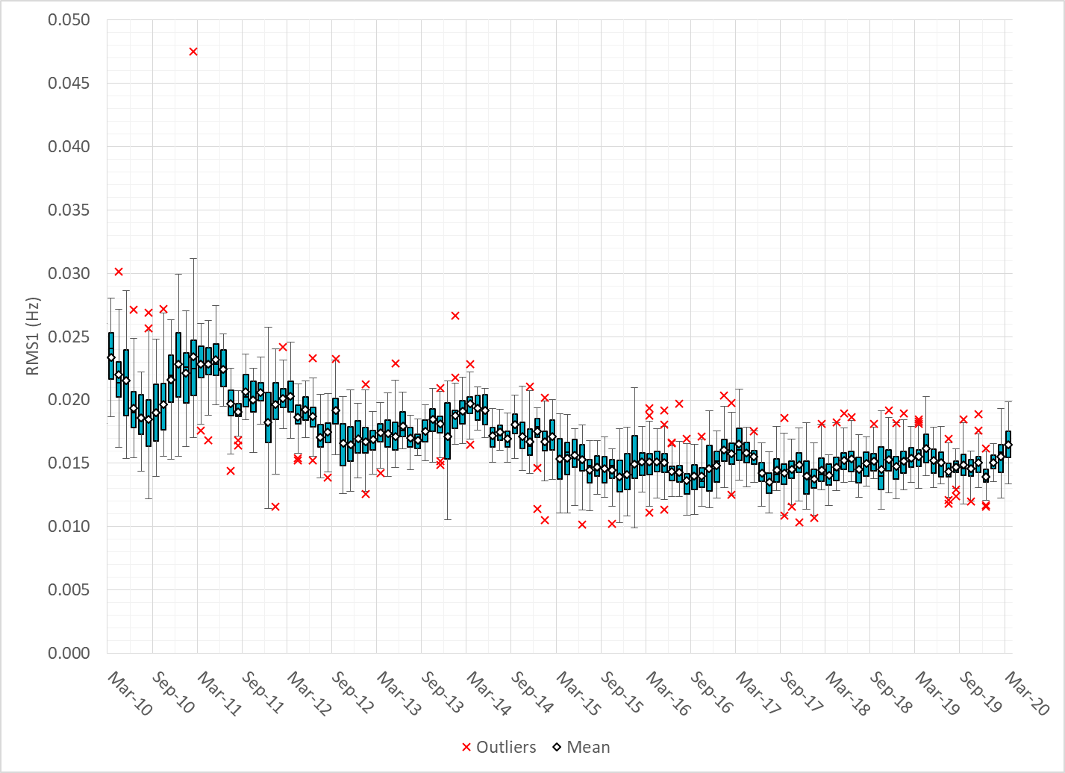
Daily RMS1 of ERCOT Frequency by Month

Slide 11
Frequency Profile Comparison

Slide 12
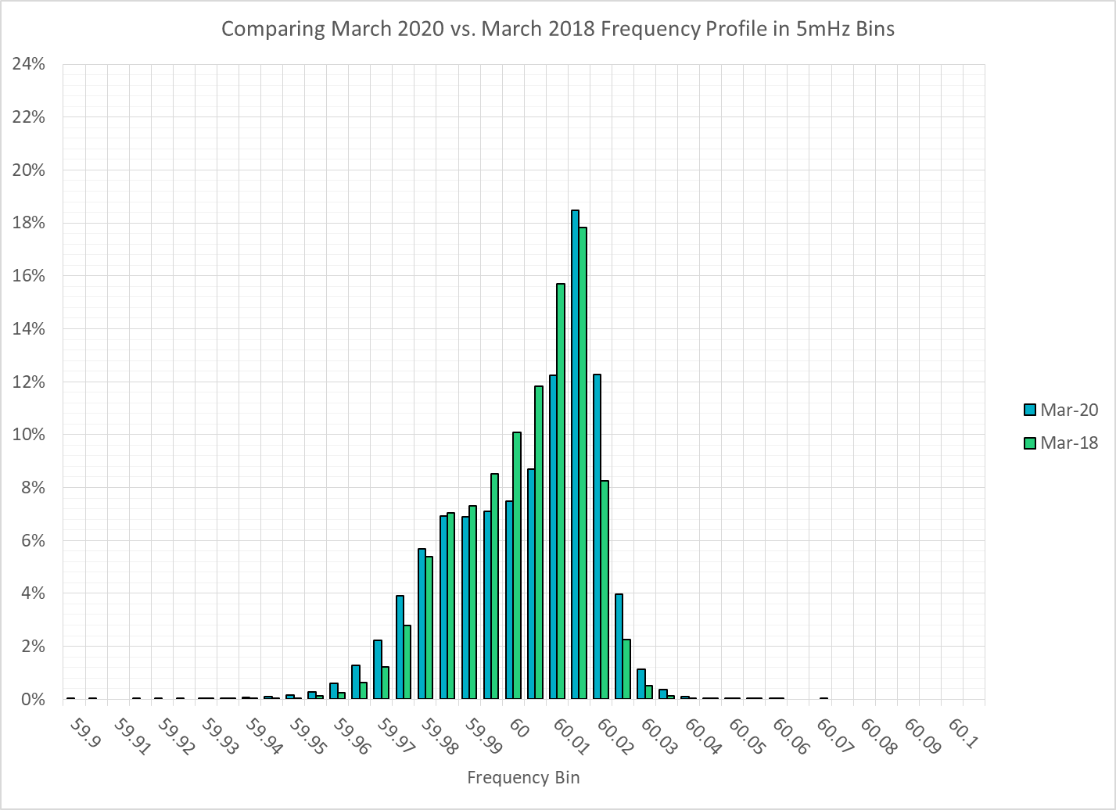
Frequency Profile Comparison

Slide 13
Frequency Profile Comparison

Slide 14
Time Error Correction

Slide 15
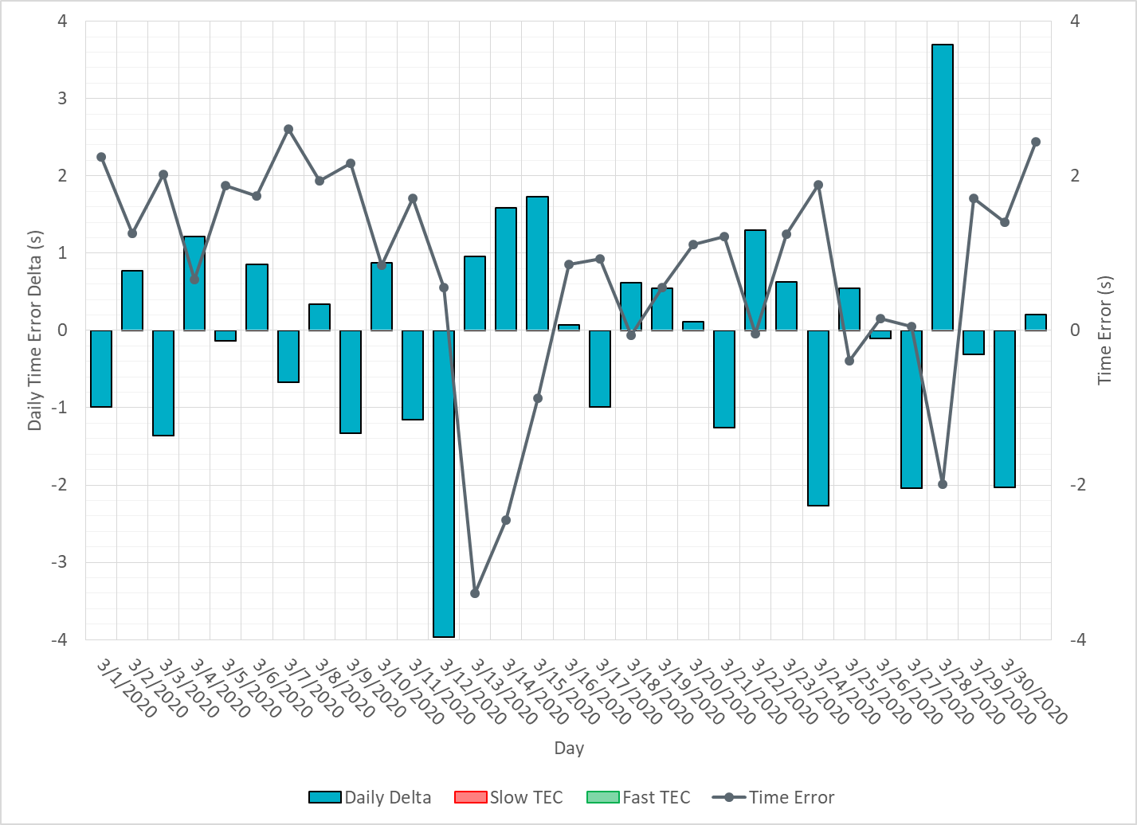
ERCOT Daily Time Error

Slide 16
Time Error Corrections Log Summary
There have been no time error corrections since December 2016

Slide 17
BAL-003 Performance

Slide 18
Op. Year 2018 BAL-003 Selected Events – Update
Notes:
BAL-003

Slide 19
Op. Year 2018 BAL-003 FRM Performance - Update
Notes:
OP2018: FRO = -381.0, FRM_median = -843.17, FRM_average = -959.7
OP2019: FRO = -381.0
OP2020: FRO = -425.0, FRM_median = -811.14, FRM_average = -892.5

Slide 20
ERCOT Energy Statistics

Slide 21
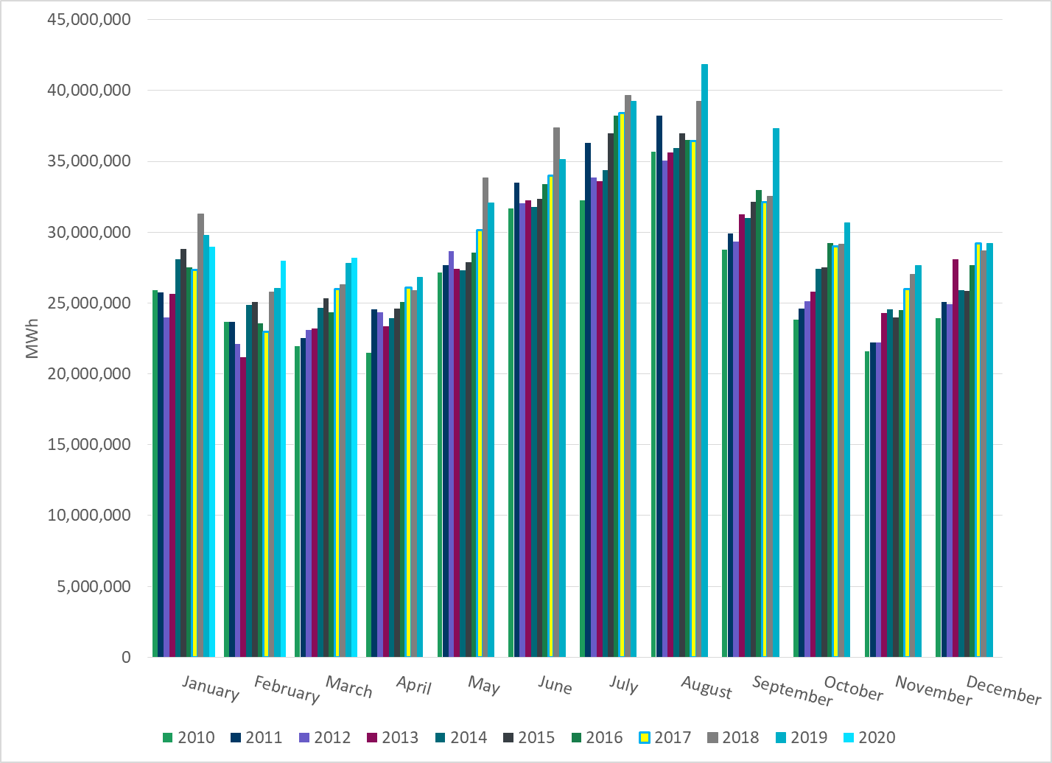
Total Energy
Notes:
28,190,392 MWh

Slide 22
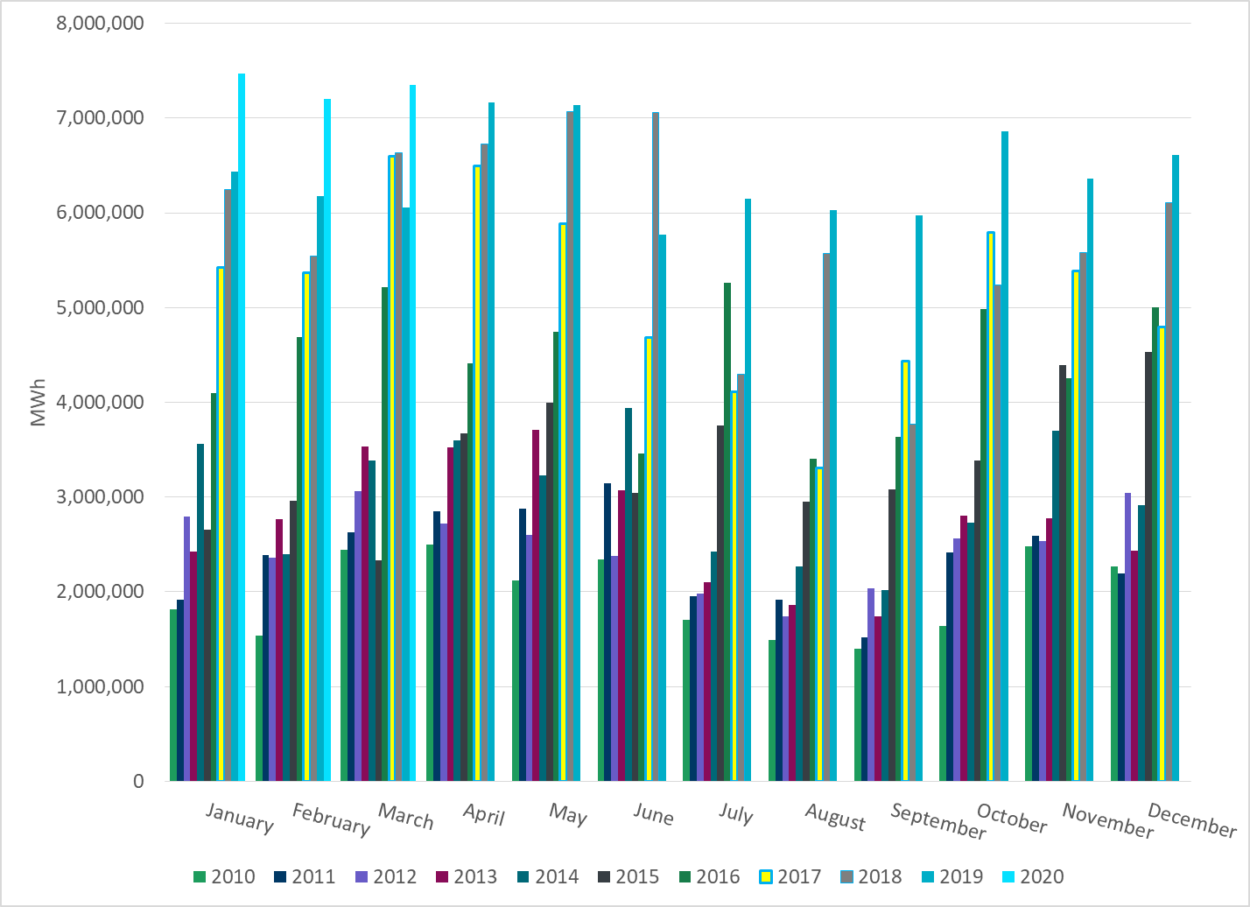
Total Energy from Wind Generation
Notes:
7,349,959 MWh

Slide 23
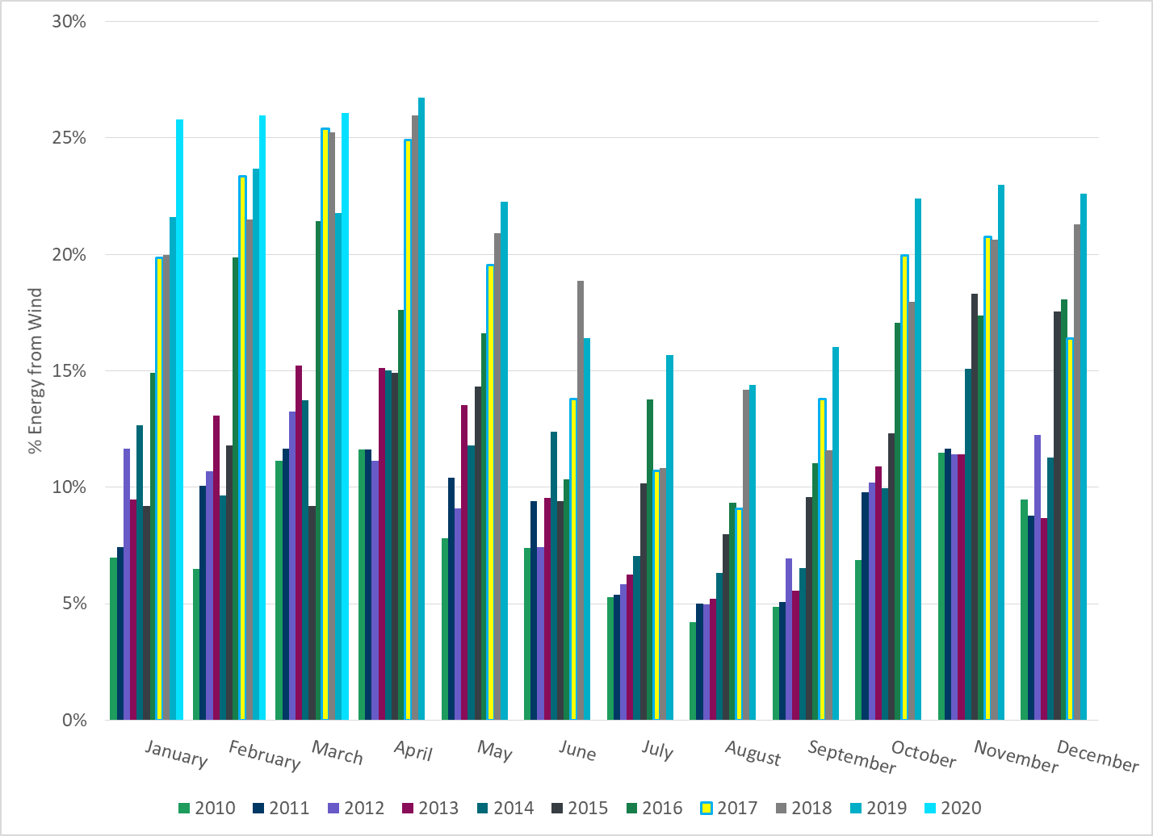
% Energy from Wind Generation
Notes:
26.07%

Slide 24
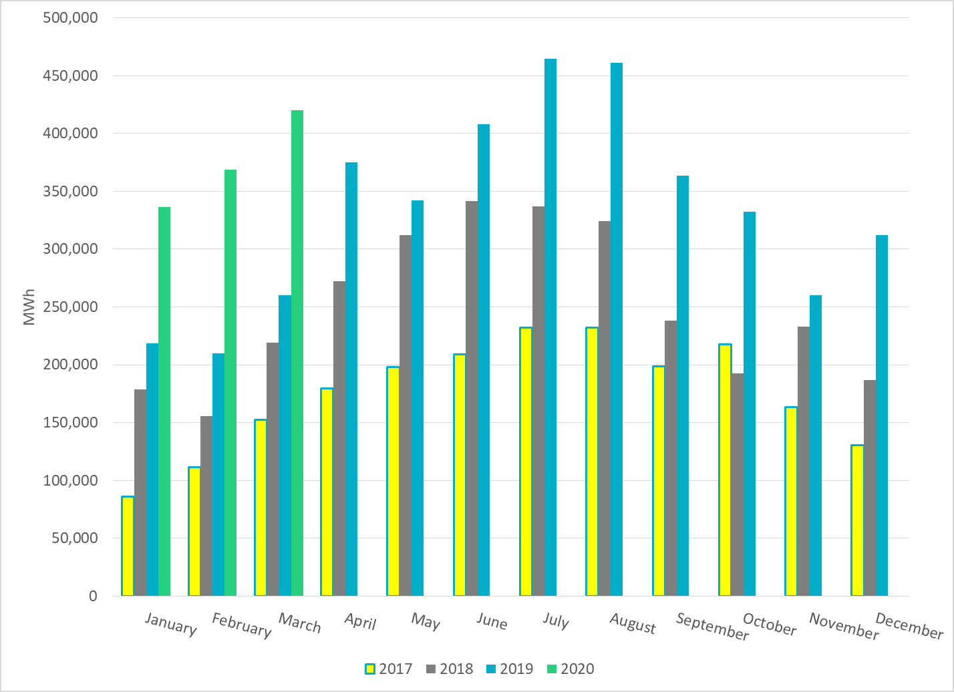
Total Energy From Solar Generation
Notes:
419,973 MWh

Slide 25
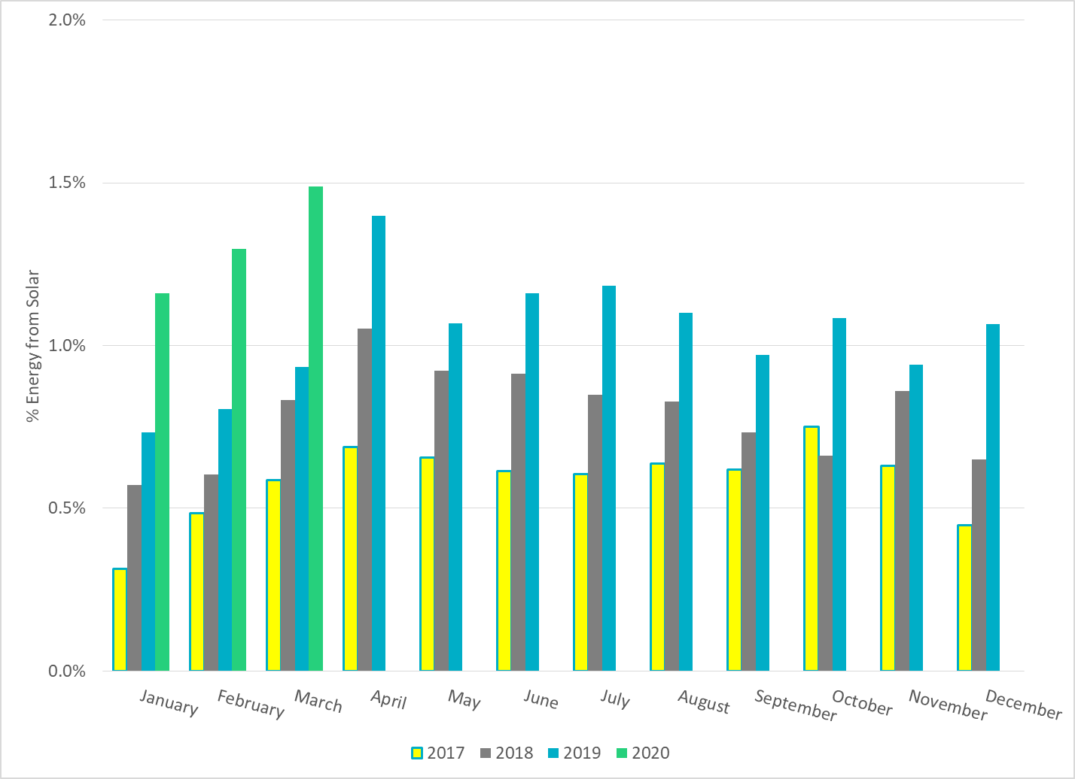
% Energy from Solar Generation
Notes:
1.49%

Slide 26
ERCOT System Inertia

Slide 27
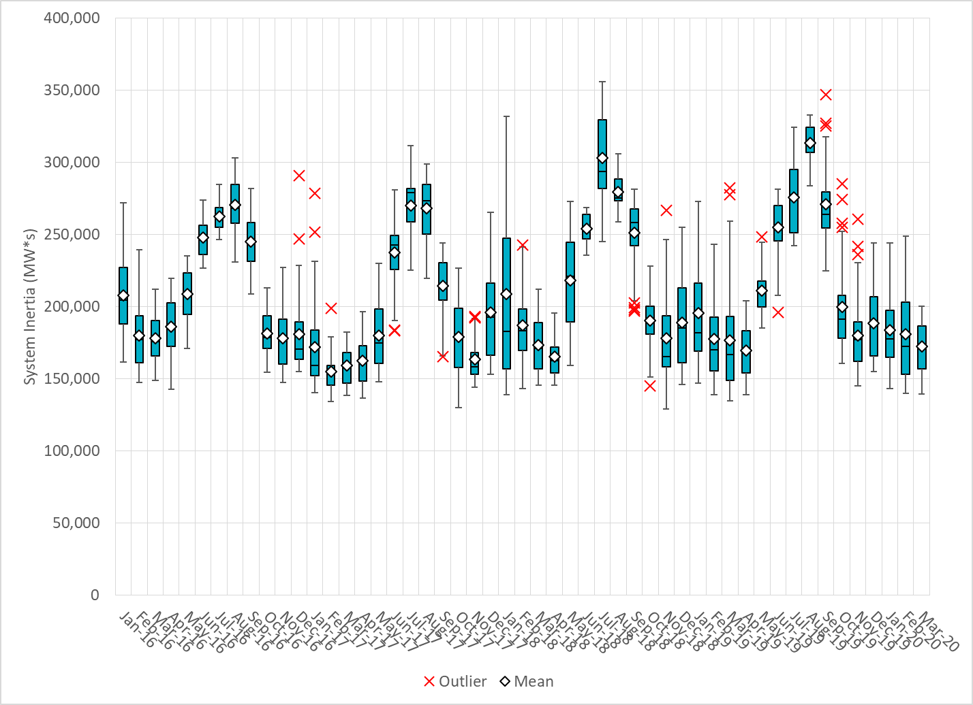
Daily Minimum System Inertia
Notes:
Minimum Inertia = 139,592 MW*s on 3/8/2020
Previous Minimum was 128,759 MW*s on 11/18/2018.
Data:
Mean: 171,265
Max: 200,438 on Mar 17th
Min: 139,592 on Mar 8th

Slide 28
Questions?
Thank you!

