Slide 1
NPRR 995 (RTF-6): Settlement Only Storage
Paul Wattles
ERCOT Staff
BESTFORCE
April 16, 2020

Slide 2
NPRR 995
NPRR 995 (RTF-6) (Longhorn Power on behalf of Broad Reach Power) proposes to create, refine and organize definitions around Settlement Only Energy Storage (SOES)
It also proposes that SOES should be settled for both charging discharging at either nodal prices or zonal prices
BESTF KTC-7.4: ‘SODG/SOTG settled at nodal pricing while charging and discharging’
This KTC is pending at BESTF

Slide 3
Background
NPRR 917 -- approved August 2019 with scheduled implementation in 2021
Settlement Only Generators (SODG and SOTG) will transition from zonal to nodal pricing for MW injected into ERCOT System
10-year optional grandfathering
NPRR 986 – approved February 2020 with scheduled implementation in 2021
Energy Storage Resources (ESRs) will be settled at a nodal price for both discharging (injecting) and charging (withdrawing)
ESR charging will be settled at nodal irrespective of whether it is receiving Wholesale Storage Load treatment

Slide 4
Background
PUC Subst. Rule 25.501:
(f) Nodal energy prices for resources. ERCOT shall use nodal energy prices for resources. Nodal energy prices for resources shall be the locational marginal prices, consistent with subsection (e) of this section, resulting from security-constrained, economic dispatch.
(h) Zonal energy prices for loads. ERCOT shall use zonal energy prices for loads that consist of an aggregation of either the individual load node energy prices within each zone or the individual resource node energy prices within each zone. Individual load node or resource node energy prices shall be the locational marginal prices, consistent with subsection (e) of this section, resulting from security-constrained, economic dispatch. ….

Slide 5
SOES and nodal settlement
Assumptions for this discussion:
There is no retail Load behind the point of common coupling
Only Load is the SOES charging Load and auxiliary Load
Sites with retail Load will be discussed at a future BESTF meeting
NPRR 917: Injections by Settlement Only Generators have been approved for nodal settlement, thus equivalent in stature to a resource (in PUC 25.501(f) terminology)
SOES will have same stature in ERCOT markets as SODG and SOTG

Slide 6
SOES and nodal settlement
Question: Can auxiliary Load at an SOES be priced at a nodal price (same as charging Load)?
If yes, metering can be at the point of common coupling (as long as there is no co-located retail Load)
If no, the charging Load would need to be metered separately from the auxiliary Load
Charging Load would be priced at nodal and auxiliary Load priced at zonal
SOES Settlement will require more discussion, and Settlement equations will be needed

Slide 7
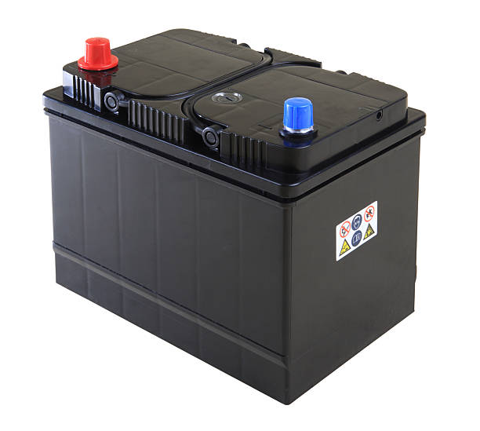
Questions?

