Slide 1
NPRR928
Cybersecurity Incident Notification
Brandon Gleason, Senior Corporate Counsel
Mike Allgeier, Director of Critical Infrastructure Security
April 1, 2020

Slide 2
Overview
NPRR928 Summary
Implementation
Post-Cybersecurity Incident Analysis and Communication
Notifications
Areas to Examine for Reconnection Determination
Questions

Slide 3
NPRR928 Summary
Requires Market Participants notify ERCOT in the event of a “Cybersecurity Incident” on a computer network or system that interfaces with an ERCOT network or system.
Defines Cybersecurity Incident as:
“A malicious or suspicious act that compromises or disrupts a computer network or system that could foreseeably jeopardize the reliability or integrity of the ERCOT System or ERCOT’s ability to perform the functions of an independent organization under the Public Utility Regulatory Act (PURA).”

Slide 4
NPRR928 Summary Cont.
Facilitates communication in the event of a Cybersecurity Incident by:
requiring the designation of a Cybersecurity Contact;
promulgating a Notice of Cybersecurity Incident reporting form;
mandating Market Participants notify ERCOT in the event of a Cybersecurity Incident on a computer network or system that interfaces with an ERCOT network or system upon determination by the MP; and
requiring ERCOT issue a Market Notice to all Market Participants if the computer networks or systems of ERCOT or MPs may be impacted.

Slide 5
Implementation
Market Notice issued March 2, 2020, notified Market Participants of two-phase implementation of NPRR928.
Partially implemented on March 13, 2020, in order to allow current Market Participants to submit Cybersecurity Contact information to ERCOT through a Notice of Change of Information (NCI).
To be fully implemented on April 3, 2020, at which point notification of a Cybersecurity Incident within the scope of the requirement is required upon determination by a Market Participant.

Slide 6
Post-Cybersecurity Incident Analysis and Communication
Notification
Mitigation & Recovery
Lessons Learned
Detection & Assessment
ERCOT Execution Team, Market Participants, and Governmental Cybersecurity Oversight Agencies
Reporting & Communication
Receive notification via NCSI@ERCOT.COM, phone, or news
Evaluate the incident internally to determine risks
Determine if event impacts MPs or ERCOT
Remove risks associated with the incident
Notifications
Conduct post-event analysis
Reinstate the connectivity
Conduct lessons learned

Slide 7
Notifications
Who may be notified of a Cybersecurity Incident?
All Market Participants get “general information” via Market Notice if the computer networks or systems of ERCOT or Market Participants may be impacted by a Cybersecurity Incident.
Governmental Cybersecurity Oversight Agencies in accordance with the terms of the ERCOT Protocols.
Directly connected TSPs/DSPs when a Resource Entity or QSE representing a Resource Entity submits a Notice of Cybersecurity Incident.
Under Protocol Section 1.3.6(1)(g) ERCOT may disclose Protected Information to TSPs/DSPs engaged in operating activities, provided a confidentiality agreement is in place.

Slide 8
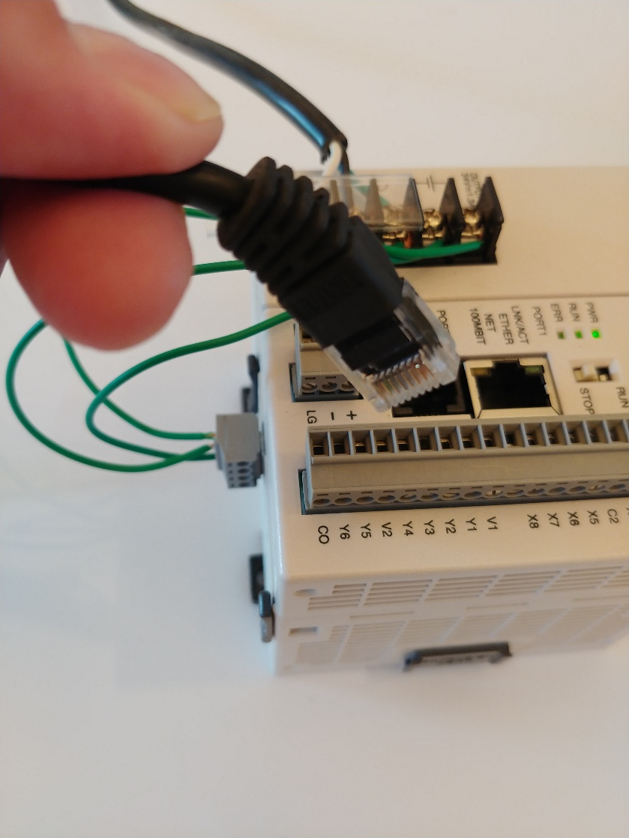
Areas to Examine for Reconnection Determination
Type of Cybersecurity Incident
Denial of service attack
Control system ransomware
Impact
WAN firewall outage
Loss of one redundant server
Resolution
Temporarily loss of access
Restore server from backup

Slide 9
Questions?

