Slide 1
MIS and ERCOT.com User Workshop
March 25, 2020

Slide 2
Agenda
MIS Home Page Design Review
MIS Notices Feedback
Topic Categorization Exercise Demo
MIS Category Page Review
Planning Page Feedback

Slide 3
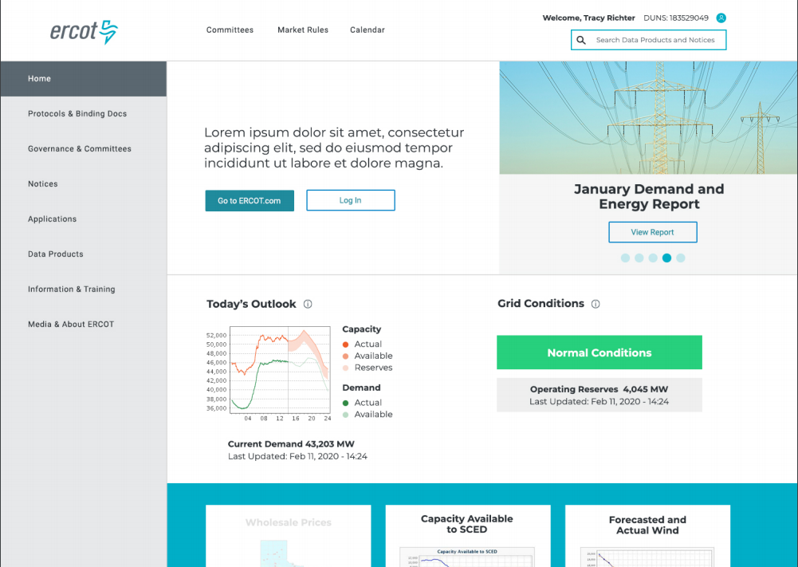
MIS Home Page Review

Slide 4
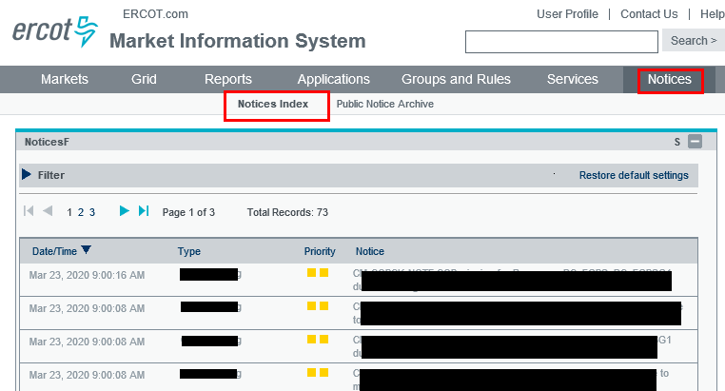
MIS Notices Feedback
How is this information used? Are there any pain points?

Slide 5
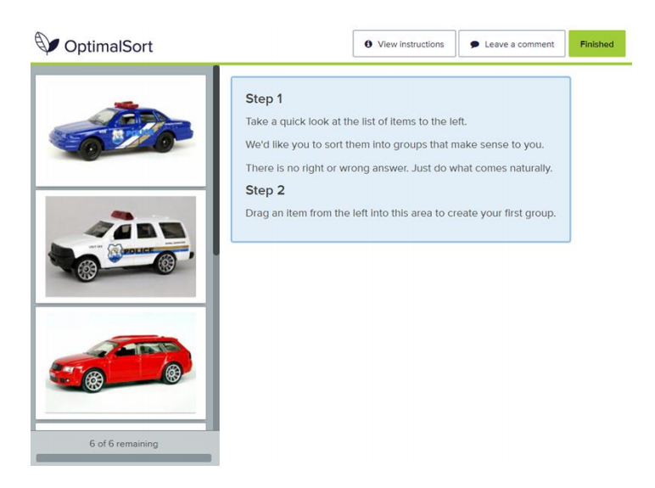
Categorization Exercise Demo
https://5zy06184.optimalworkshop.com/optimalsort/24r7ie6a

Slide 6
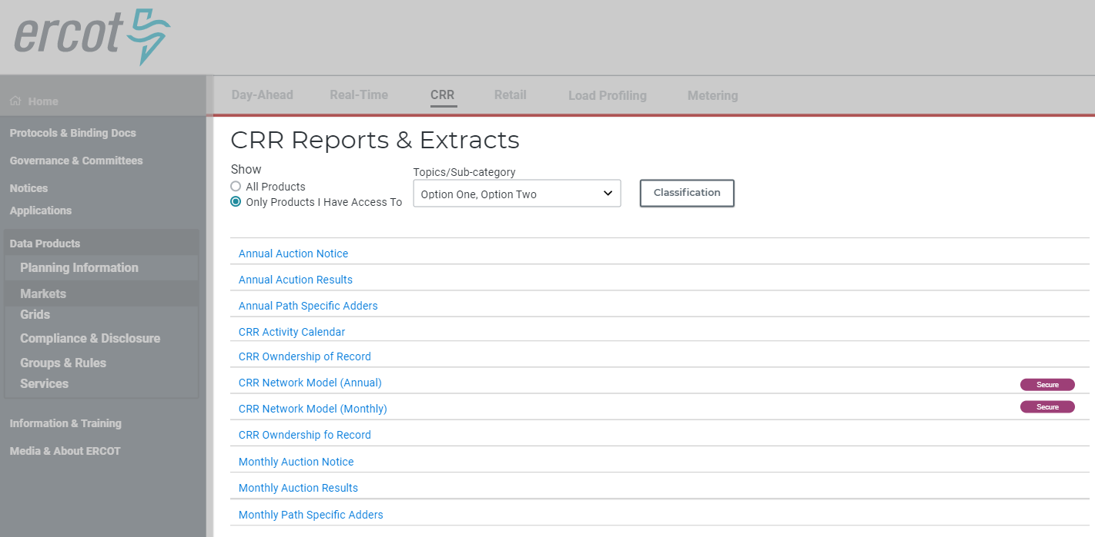
MIS Category Page Review

Slide 7
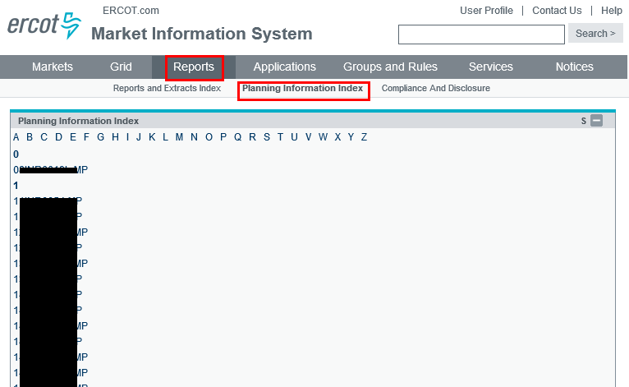
MIS Planning Page Feedback
How is this information used? Are there any pain points?

Slide 8
Thanks again for the feedback!
Please complete the Categorization Exercise. Please share with other users.
https://5zy06184.optimalworkshop.com/optimalsort/24r7ie6a
Keep an eye out for MIS User Survey.
Next meeting is April 22.
The Sandbox MIS Release is May 22.
Feedback to webmaster@ercot.com is welcome any time.

