Slide 1











Taxonomy Facet Data Gathering Session
March 25, 2020

Slide 2
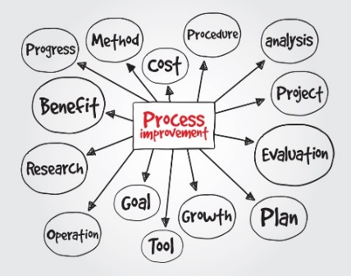



Agenda
Icebreaker Activity
Why Categorize Content?
Online Activity
Wrap-up

Slide 3
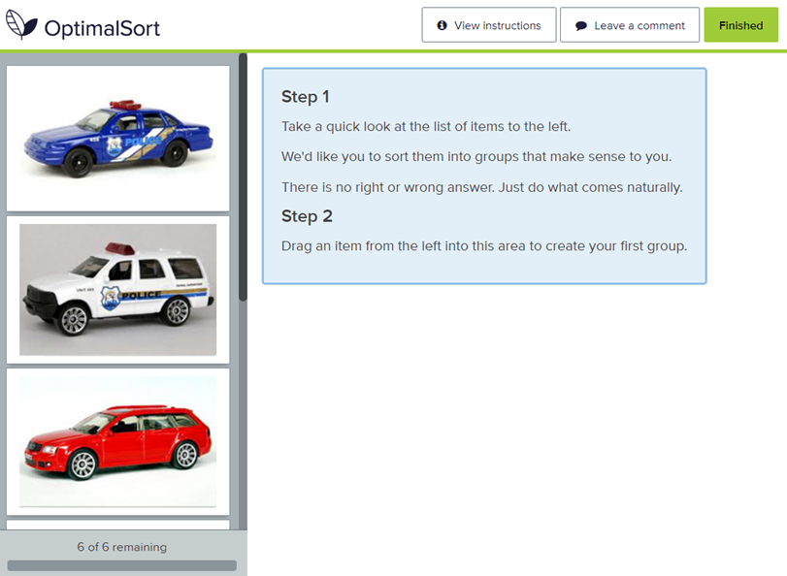
Icebreaker
Following this meeting, you will receive an email message with a link to this activity

Slide 4
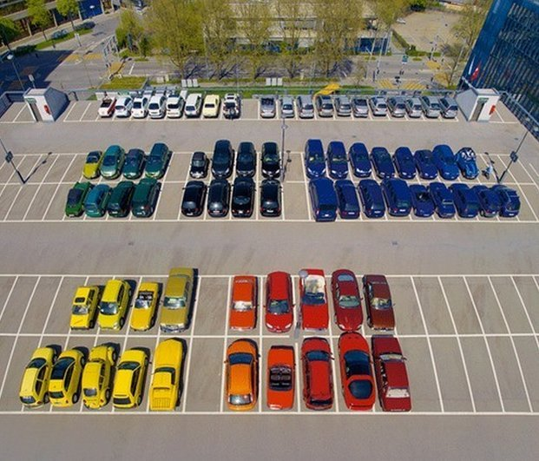
How did you sort?
By color?
By type?
By function?
By usage?

Slide 5
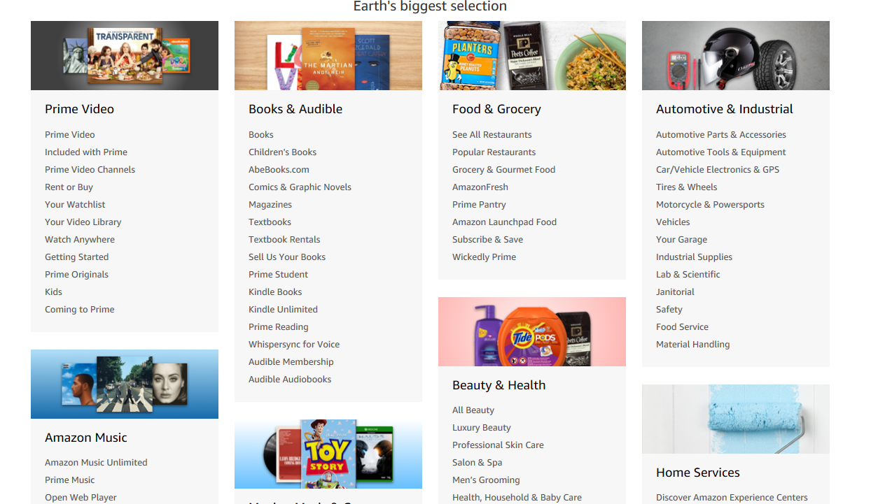
Why Categorize Content?

Slide 6
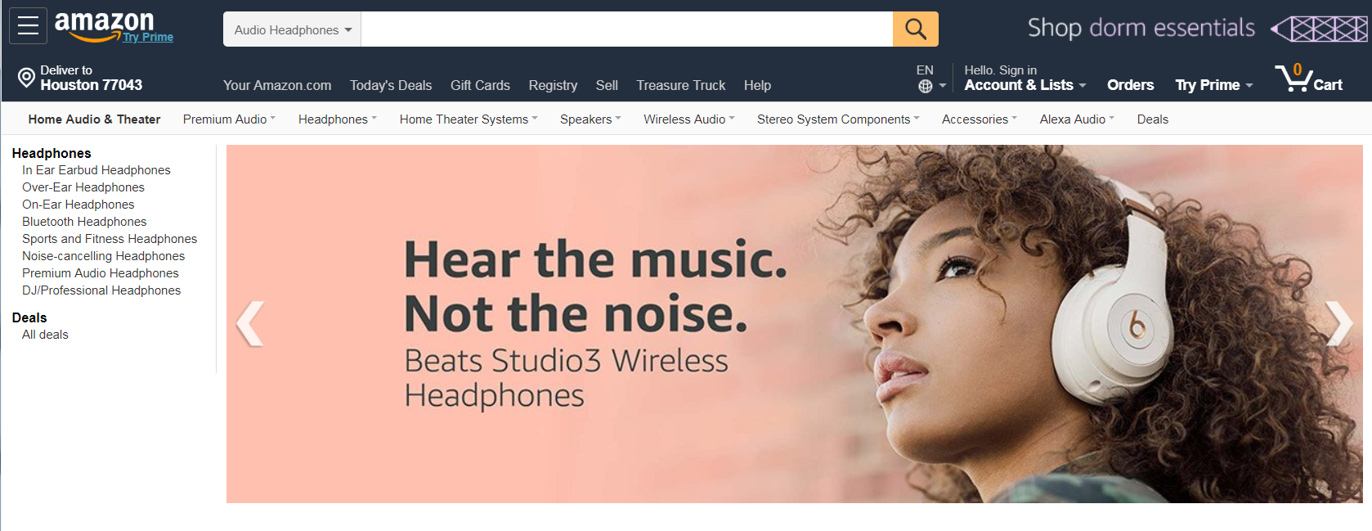
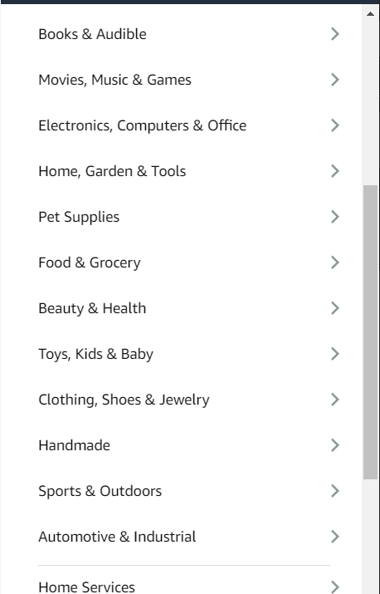
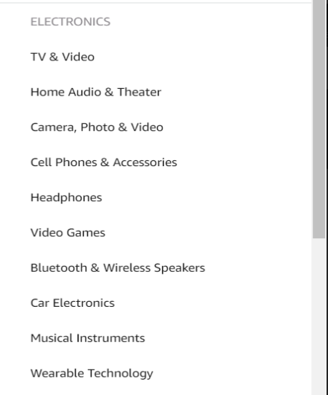
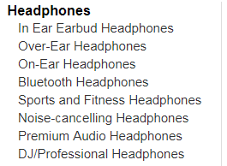
Amazon’s categories help users from the Top-Down….
Notes:
Everything in Amazon is assigned to some foundational categories that help get you down to the general area of items you are looking for.
Once there, you are given more granular choices that are specific to that area

Slide 7
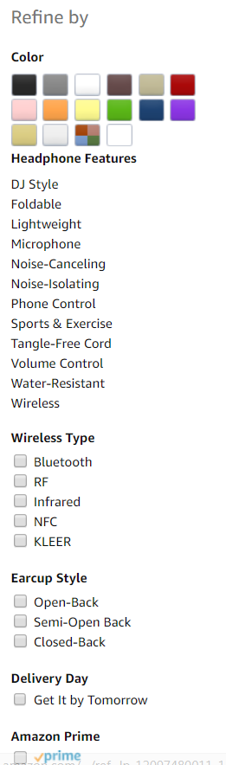
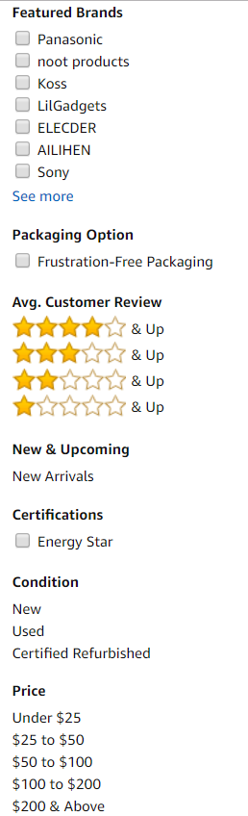
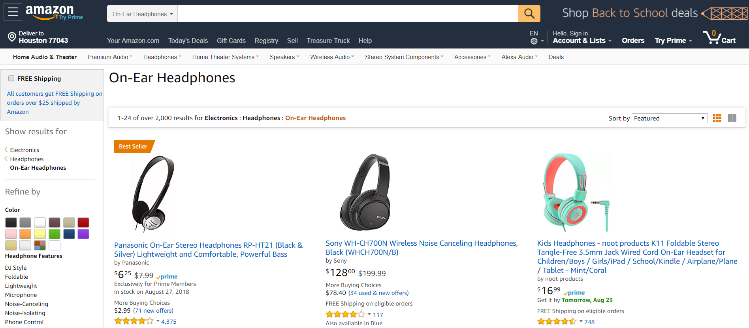
…and the Bottom-up

Slide 8
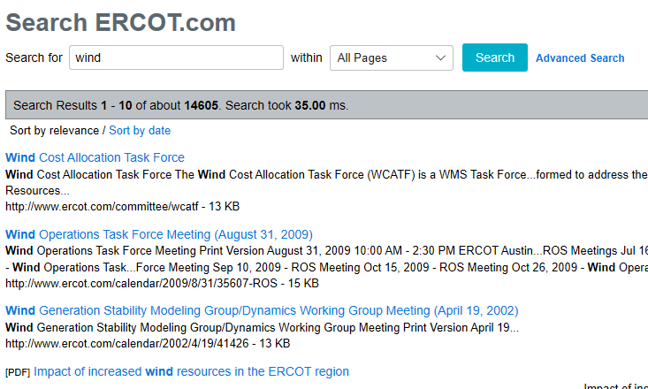
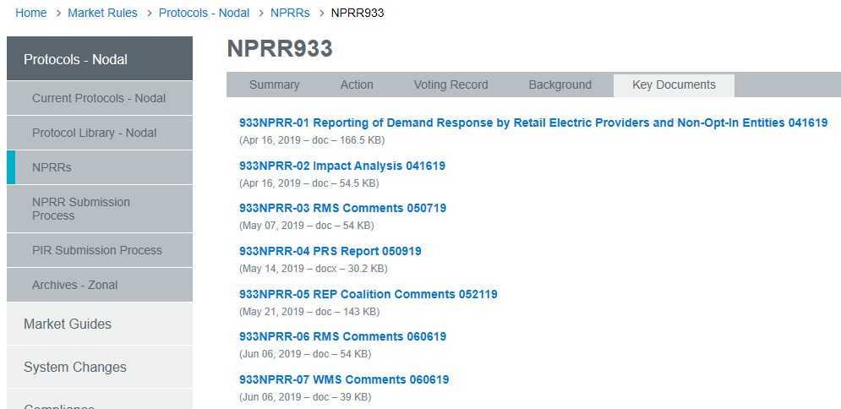
Applying Facets to Content
Identify everything about something AND all things associated with one thing
All things about “wind”
All items related to a single revision request

Slide 9

Identifying our Current Focus
External stakeholders searching ERCOT.com
  Market participants
  Public users
  Researchers
  Media
Internal stakeholders who are not SMEs in the content

Slide 10
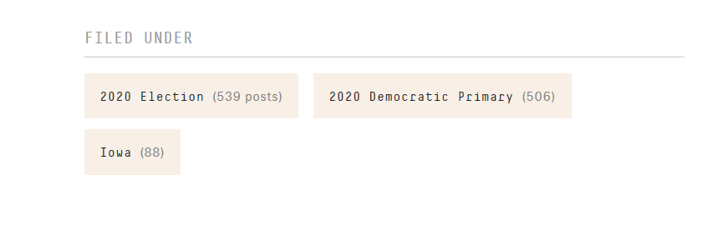
Applying Facets to Content
Tag search results and create “buckets” of related content
FiveThirtyEight (https://projects.fivethirtyeight.com/polls/)

Slide 11
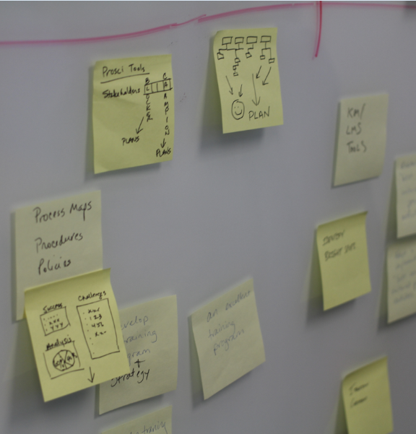
Online Activity
Link to the Activity will be provided in a follow-on email

Slide 12
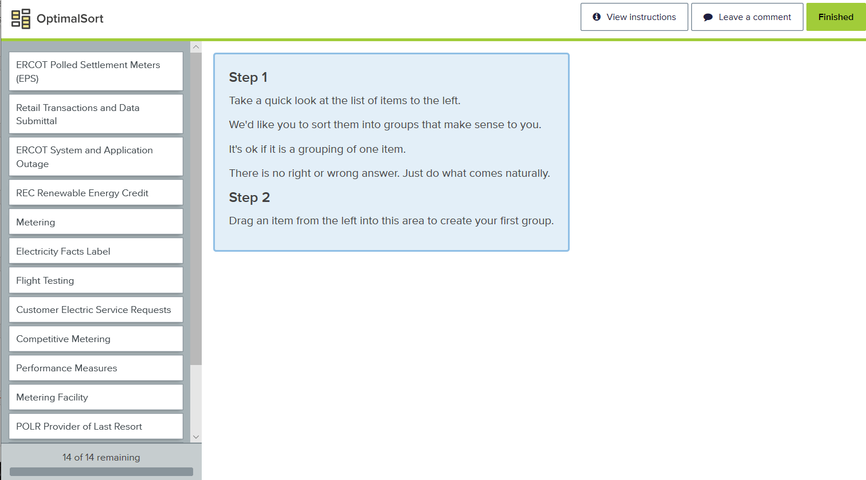
Activity 1
At any point you may Leave a Comment by clicking on the button at the top right hand of the screen. You may want to leave a comment if, for example, something is missing you would want to add, or if you see something you feel doesn't belong with these 14 concepts.
Following this meeting, you will receive an email message with a link to this activity. Please complete all Activities by April 2, 2020

Slide 13





Thank You
Claudette Lloyd and Kathy Jordan
+1713 294 7278 +1713 818 9286
clloyd@AccessSciences.com
kjordan@AccessSciences.com

