Slide 1
Late Payment Enforcement Provisions
CWG / MCWG
ERCOT Public
March 24, 2020

Slide 2
Late Payment Enforcement Provisions
Late Payment # | ERCOT Actions |  | Enforcement Provisions
1 | Review, or | Level I Enforcement | Increase to or provide 110% collateral for min. 60 days
2 | Level I Enforcement, or | Level II Enforcement | 110% collateral in cash or LC for 60 days
3 | Level II Enforcement, or | Level III Enforcement | Warning or terminate SFA
4 | Terminate SFA

Slide 3
Late Payment Enforcement Provisions
Late Payment # | ERCOT Actions |  | Enforcement Provisions
1 | Review, or | Level I Enforcement | Increase to or provide 110% collateral for min 60 days
2 | Level I Enforcement, or | Level II Enforcement | 110% collateral in cash or LC for 60 days
3 | Level II Enforcement, or | Level III Enforcement | Warning or terminate SFA
4 | Terminate SFA
Note that a third late payment with Level III Enforcement can lead to termination of the Standard Form Agreement. This could conflict with the SFA:
Section 8. Default
Event of Default
(1)..Provided further that if such a material breach, regardless of whether the breaching Party cures the breach within the allotted time after notice of the material breach, occurs more than three (3) times in a 12-month period, the fourth such breach shall constitute a Default.

Slide 4
Late Payment Enforcement Provisions
If Protocol provisions conflict with the Standard Form Agreement, the SFA governs: Protocol section 1.1(6), “If any provision of any Agreement conflicts with any provision of the Protocols, the Agreement prevails to the extent of the conflict.”
Elimination of the conflict eliminates the option to terminate on the third late payment.

Slide 5
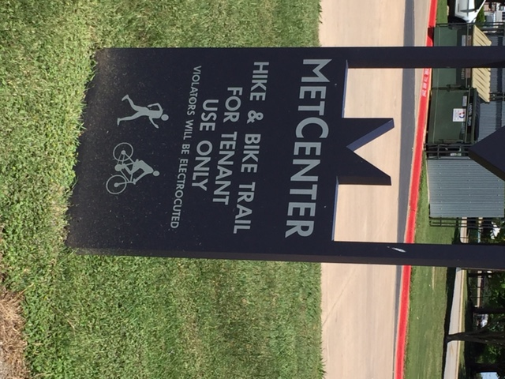
Late Payment Enforcement Provisions
Questions

