Slide 1
Update on proposed Solar PV Growth Projection
SAWG

Slide 2
S-Curve Growth Projections
Initial Methodology Proposed at April 12, 2019 SAWG Meeting
http://www.ercot.com/calendar/2019/4/12/172702-SAWG
Review of methodology at the Oct 31 SAWG meeting
http://www.ercot.com/content/wcm/key_documents_lists/190770/SAWG__Meeting_Solar_PV_Discussion_10-31-2019.pptx
Consensus that rather than have a single curve, the desire was to have 3 curves representing conservative, median, and high renewable growth scenarios
Review of conservative, median, and high renewables scenarios at the Dec 13, 2019 meeting
http://www.ercot.com/content/wcm/key_documents_lists/172749/SAWG__Meeting_12-13-2019_Solar_PV_Forecast_Discussion.pptx
Consensus 3 curves adopted

Slide 3
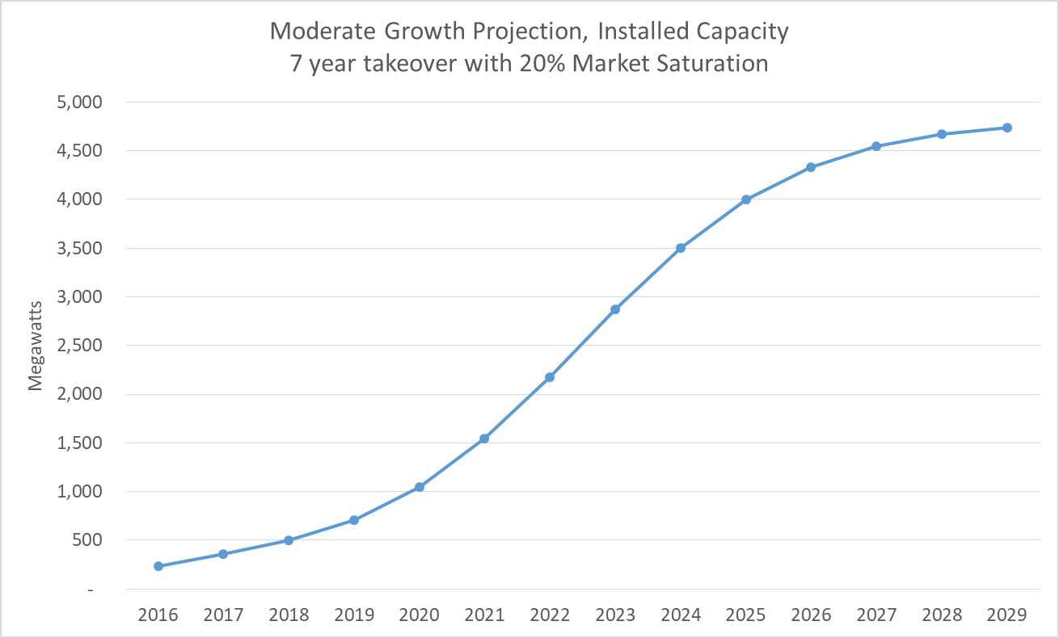
2019 Rooftop Solar PV Summary
Total of 710 MW for NOIES plus Competitive Choice areas
(http://www.ercot.com/calendar/2020/4/17/195744-SAWG)
Revised curves with 2019 Data (if needed)
Note Moderate Scenario projection for 2019 was 710 MW!

Slide 4
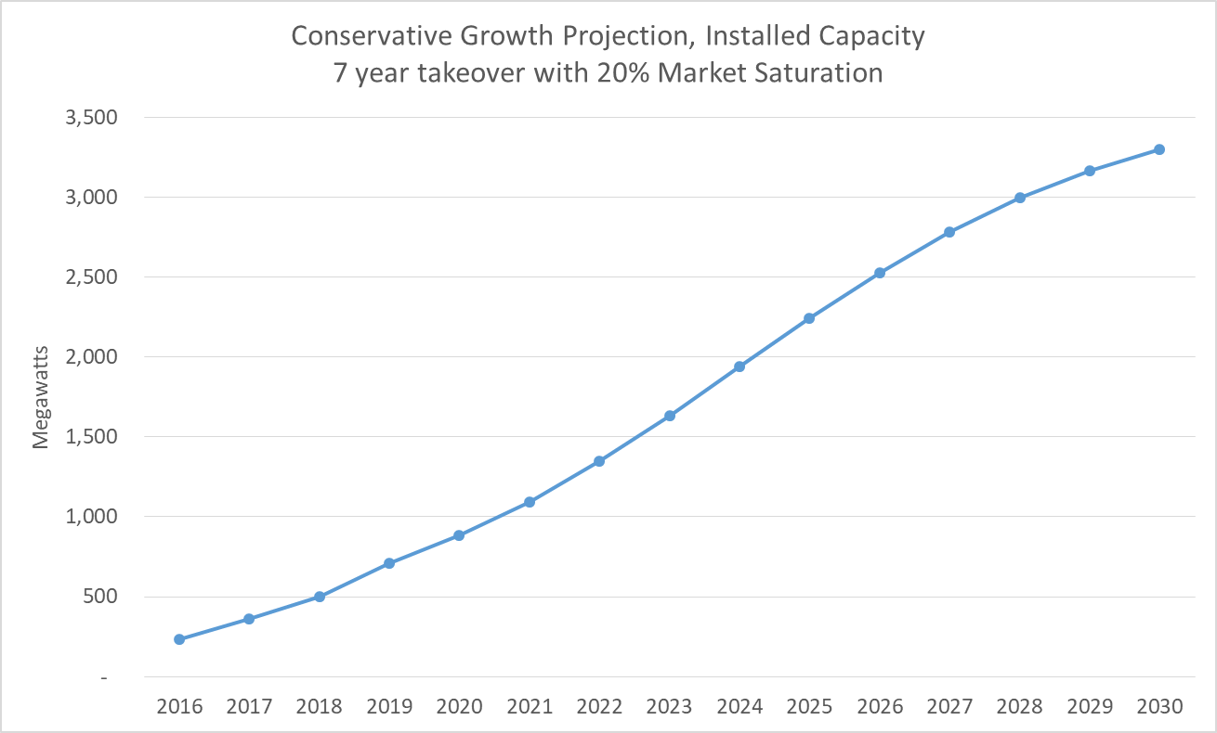
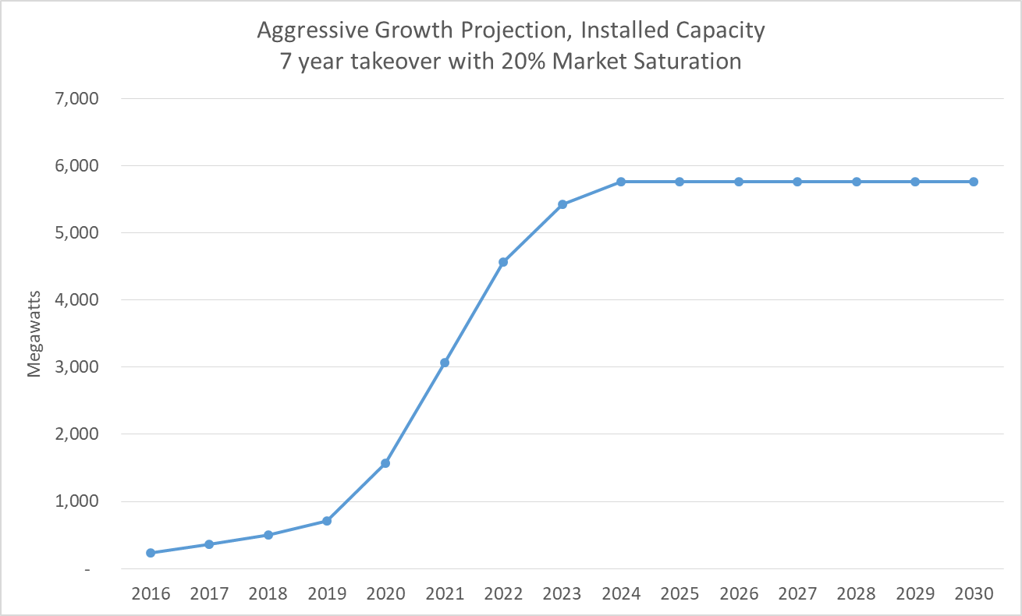
Scenario Results

Slide 5
Observations
Scenarios yield widely varying projections
Conservative reaches 3000 MW by 2029
Moderate reaches 3000 MW by 2024 and 4500 MW by 2027
Aggressive reaches 3000 MW by 2021 and 6000 MW by 2025
2016-2019 Data matches the “Moderate” profile best (so far).
Discussion?

