Slide 1
SWGR Cost Recovery Comparison
WMWG
March 23, 2020

Slide 2
Absent a Switch
If the SWGR had remained in the non-ERCOT control area, it would have received the DAM revenues.

Slide 3
Imbalance Created in Event of Switch
SWGR receives the DAM revenue
Also incurs RTM market costs due to its unavailability in RT in the non-ERCOT control area, which are significantly higher
The RTM revenue in ERCOT is insufficient to cover the RT imbalance

Slide 4
Switchable Generation Make-Whole Payment
SWMWAMT _{q,r} = (-1) * Max (0, (SWCG _{q,r,d} – SWRTREV _{q, r, d})) / SWIHR_{q,r,d}
SWMWAMT _{q,r} - Switchable Generation Make-Whole Payment—The Switchable Generation Make-Whole Payment to the QSE q, for Resource r, for the hour. Where for a Combined Cycle Train, the Resource r is the Combined Cycle Train.
SWCG _{q,r,d} - Switchable Generation Cost Guarantee—The sum of eligible Startup Costs, minimum-energy costs, operating costs, and other Switchable Generation approved costs for Resource r represented by QSE q for all instructed hours, for the Operating Day d. Where for a Combined Cycle Train, the Resource r is the Combined Cycle Train.
SWRTREV _{q,r,d} - Switchable Generation Real-Time Revenues – The sum of energy revenues for the Resource r, represented by QSE q, during all instructed hours for the Operating Day d. Where for a Combined Cycle Train, Resource r is the Combined Cycle Train.
SWIHR _{q,r,d} - Switchable Generation Instructed Hours—The total number of Switchable Generation instructed hours, for Resource r represented by QSE q, for the Operating Day d. When one or more Combined Cycle Generation Resources are committed by ERCOT, the total number of instructed hours is calculated for the Combined Cycle Train for all switchable instructed Combined Cycle Generation Resources.

Slide 5
Switchable Generation Make-Whole Payment
SWMWAMT _{q,r} = (-1) * Max (0, ( SWCG _{q,r,d} – SWRTREV _{q, r, d})) / SWIHR_{q,r,d}
SWCG _{q,r,d} = SWSUC_{q,r,d} + SWMEC_{q,r,d} + SWOC _{q,r,d} + SWAC _{q,r,d}
SWAC _{q,r,d} = SWFC_{q,r,d} + SWNEC_{q,r,d} + SWNASC_{q,r,d}
SWAC _{q,r,d} - Switchable Generation Approved Costs – The total amount of the calculation of financial loss, as submitted by the QSE q for the Resource r, as approved by ERCOT for the Operating Day d. Where for a Combined Cycle Train, the Resource r is the Combined Cycle Train.
SWFC _{q,r,d} - Switchable Generator Fuel Cost —The incremental fuel costs and fees for Resource r represented by QSE q for all instructed hours, for the Operating Day d. Where for a Combined Cycle Train, the Resource r is the Combined Cycle Train. Incremental fuel costs must be based on those costs incurred as described in Section 9.14.9.
*SWNEC _{q,r,d} - Switchable Generator Net Energy Imbalance Cost —The net energy imbalance costs for Resource r represented by QSE q for instructed hours, for the Operating Day d. Where for a Combined Cycle Train, the Resource r is the Combined Cycle Train. Net energy imbalance costs represent imbalance charges from non-ERCOT Control Area from the beginning of the ramp-down period in the other grid to two hours following the time ERCOT released the Resource.
*SWNASC _{q,r,d} - Switchable Generator Ancillary Services Imbalance Cost —The net Ancillary Services Imbalance costs for Resource r represented by QSE q for instructed hours, for the Operating Day d. Where for a Combined Cycle Train, the Resource r is the Combined Cycle Train. Net Ancillary Service Imbalance costs represent imbalance charges from non-ERCOT Control Area from the time of shutdown in the other grid to two hours following the time ERCOT released the Resource.
Notes:
GSEC’s comments will propose revisions to these two variables in the formula.

Slide 6
Make-Whole Payment Options
Under the current language in Section 6.6.12.1, ERCOT has interpreted this portion of the make-whole payment as the difference between the DAM and RTM in the non-ERCOT control area minus the ERCOT RTM revenues
However, to ensure the SWGR is made no worse off, ERCOT should fully consider the RT imbalance costs in the non-ERCOT control area

Slide 7
Total Revenues to Resource
Under the current interpretation, the SWGR would receive enough revenue to cover its RT imbalance cost, but it is short of the DAM clearing in the non-ERCOT control area
Under GSEC’s proposal, the make-whole payment is sufficient to bring the SWGR back to its DAM position

Slide 8
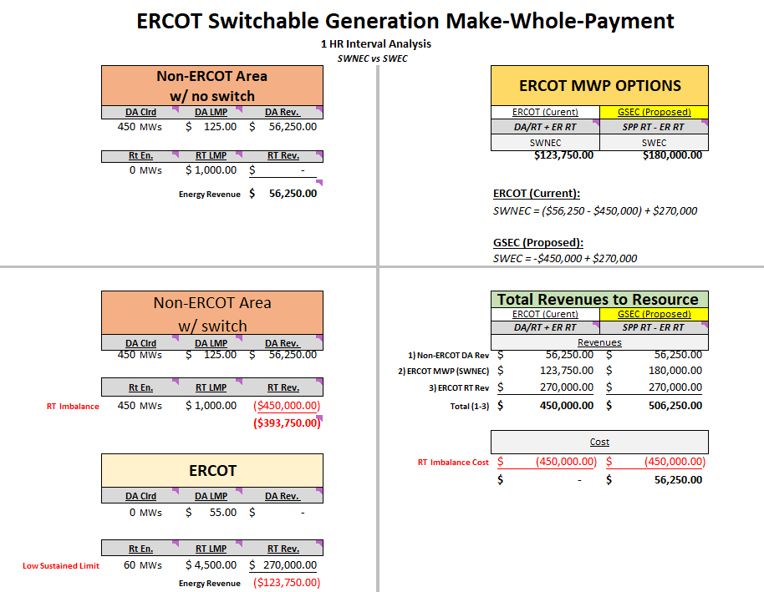
SWCG q,r,d = SWSUCq,r,d + SWMECq,r,d + SWOC q,r,d + SWAC q,r,d​
ERCOT (current): SWCG q,r,d = SWSUCq,r,d + SWMECq,r,d + SWOC q,r,d + $123,750​
GSEC (proposed): SWCG q,r,d = SWSUCq,r,d + SWMECq,r,d + SWOC q,r,d + $180,000

Slide 9
Recommended Change
To ensure SWGR units do not incur a loss, GSEC has revised the energy and ancillary service imbalance cost definitions in the cost guarantee equation to make clear reference to the inclusion of the real-time costs to ensure parity with the day-ahead market (DAM) revenues in the non-ERCOT control area in Section 6.6.12.1.

Slide 10
Questions?

