Slide 1
ERCOT Retail 101
2020_01 Retail 101
Notes:
Welcome to ERCOT Nodal Market Education. This program is designed to facilitate comprehension of Nodal Market rules and processes.

Slide 2
Welcome!
Greetings and Introductions
Notes:
Instructors introduce themselves
Class members introduce themselves

Slide 3
Housekeeping
Restrooms
Refreshments
Attendance sheet
Questions
Please silence smart phones & other electronics
Notes:
Also cover the handouts for the course.
Have students verify their email addresses on the sign-up sheet.
Encourage students to take active role in class with questions and participation in check points.

Slide 4
Legal
PROTOCOL DISCLAIMER
This presentation provides a general overview of the Texas Nodal Market and is not intended to be a substitute for the ERCOT Protocols, as amended from time to time. If any conflict exists between this presentation and the ERCOT Protocols, the ERCOT Protocols shall control in all respects.
For more information, please visit:
http://www.ercot.com/mktrules/nprotocols/
Notes:
This presentation provides a general overview of ERCOT’s Nodal Market design. It is based upon, but not intended to be a substitute for, the ERCOT Nodal Protocols, which may be amended from time to time.
It’s important to remember that when Protocols are referenced in this course, they may NOT be word-for-word. Should discrepancies exist between this course and the Protocols, the Protocols are the final authority.

Slide 5
Course Format
Concept
Scenarios
Examples
Discussions
Notes:
Our approach is shifting to place greater emphasis on Scenarios, Examples and Discussions in the learning process. In some cases, we will first introduce a concept and then immediately reinforce the concept with a scenario, example or discussion. In other cases, we will actually use scenarios to introduce the concept in the first place, and then provide some supporting details of how the concept has been implemented in the ERCOT Wholesale Markets.

Slide 6
Course Topics
Topics in this course include:
1
Retail Market Responsibilities
2
Market Rules
3
Retail Operations
4
Metering
5
Wholesale Settlement of Retail Load
6
Data Transparency and Availability
7
Issue Resolution

Slide 7
Module 1
Retail Market Responsibilities

Slide 8
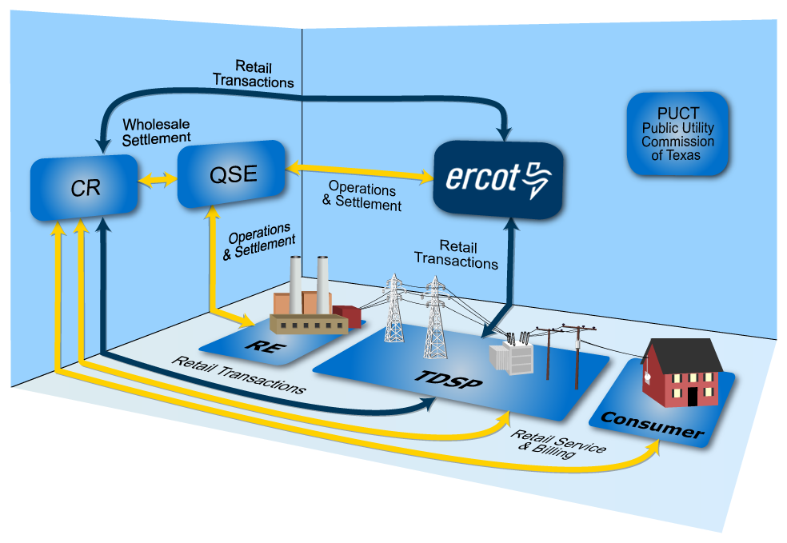
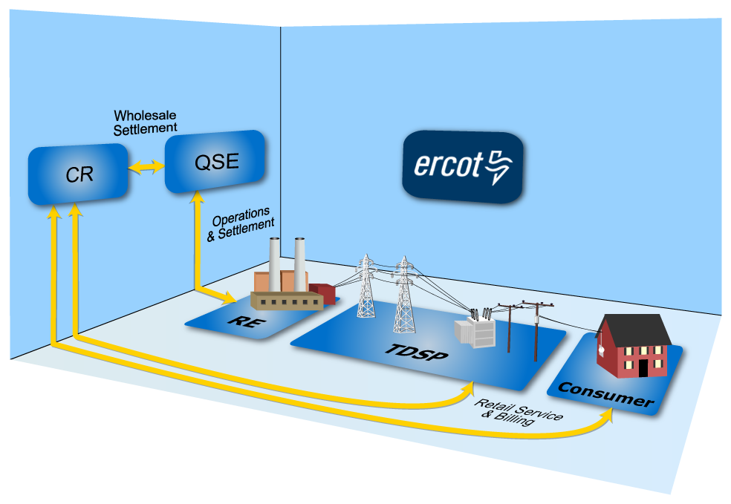
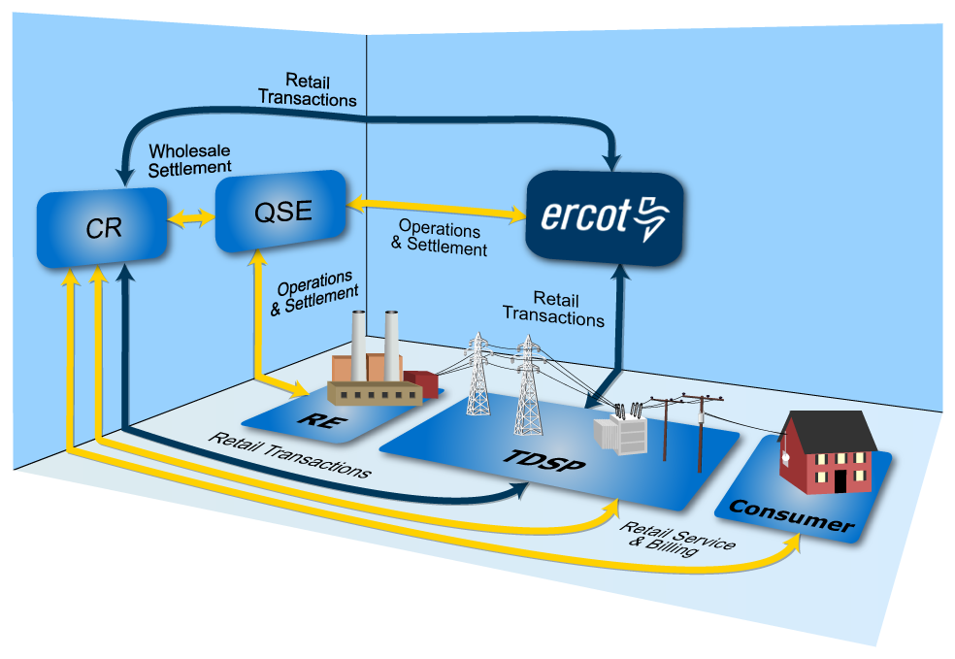
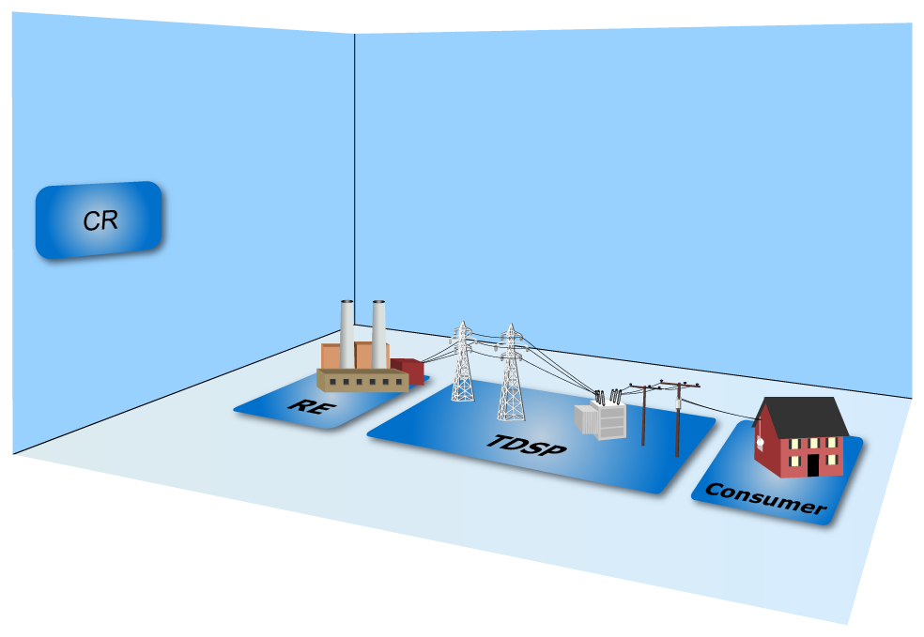
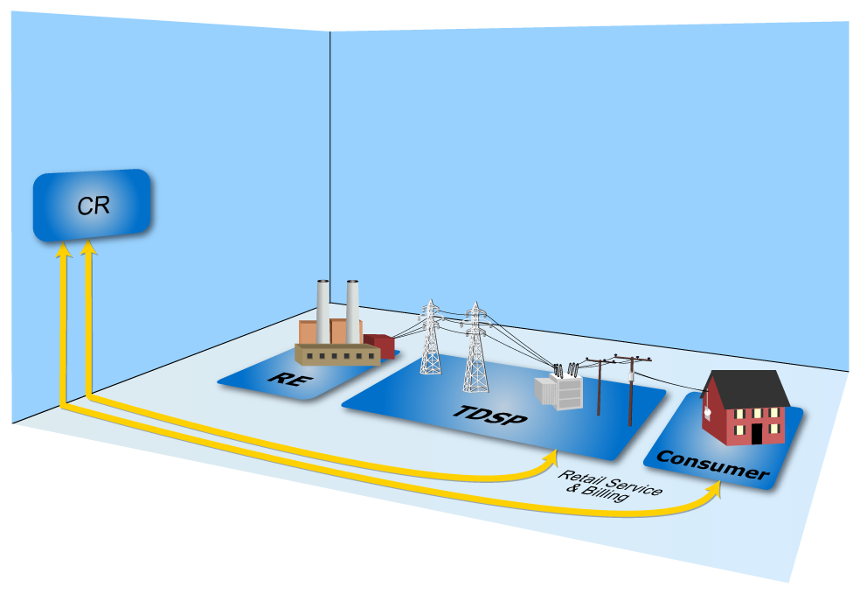
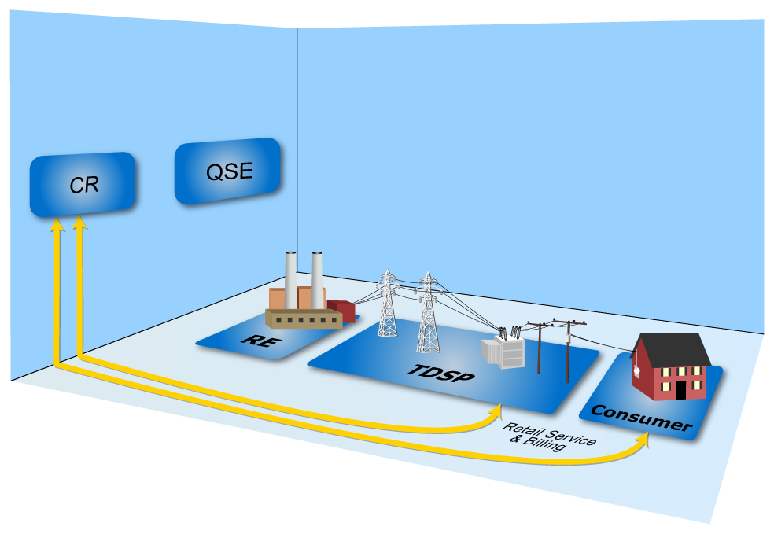
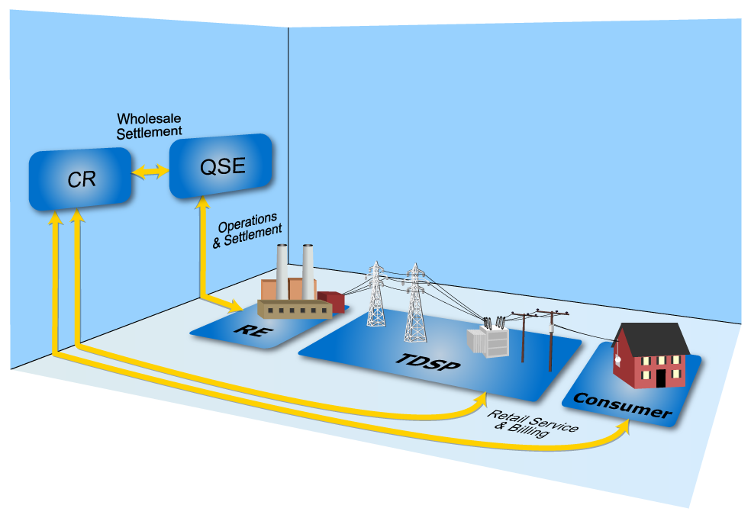
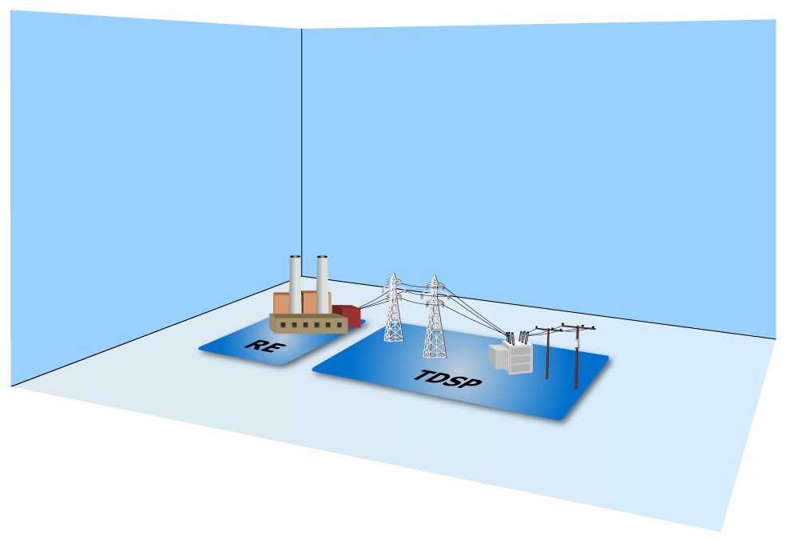
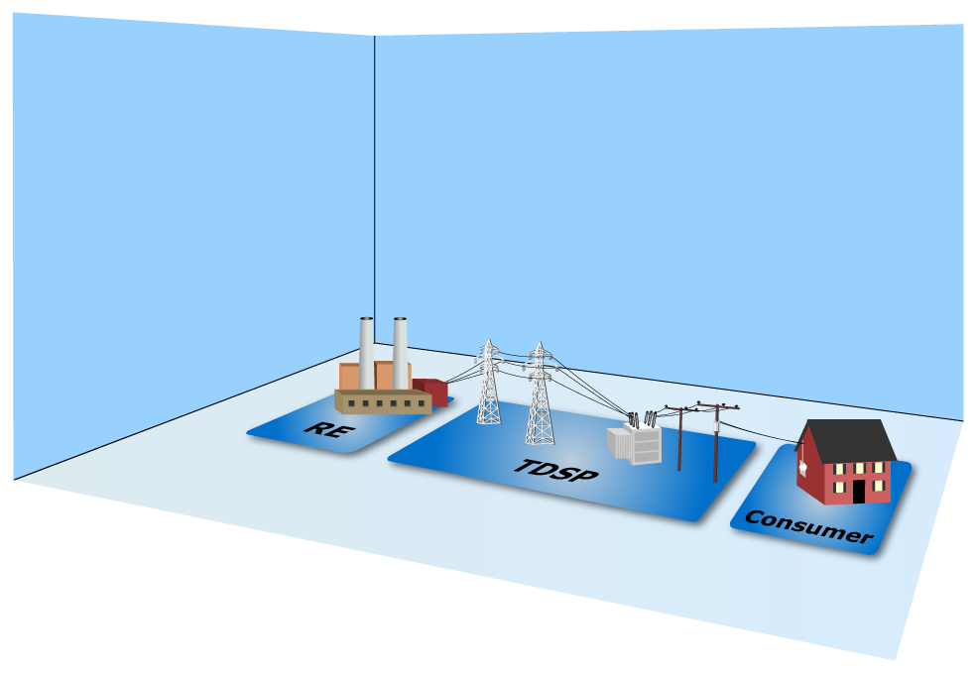
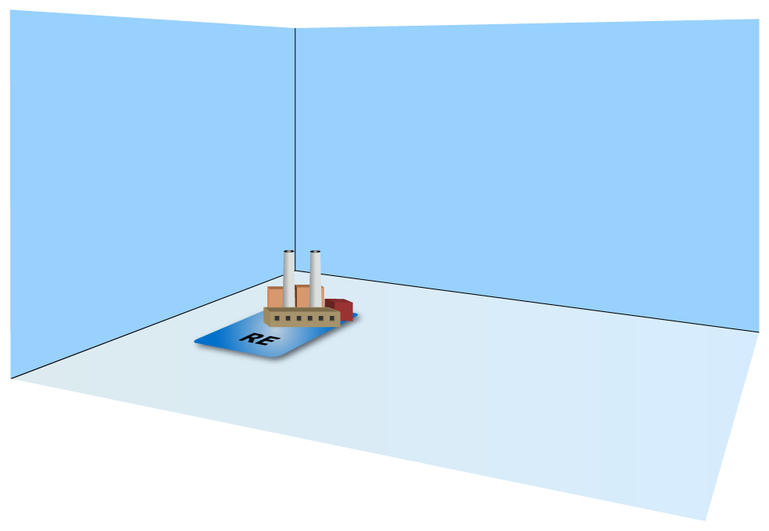
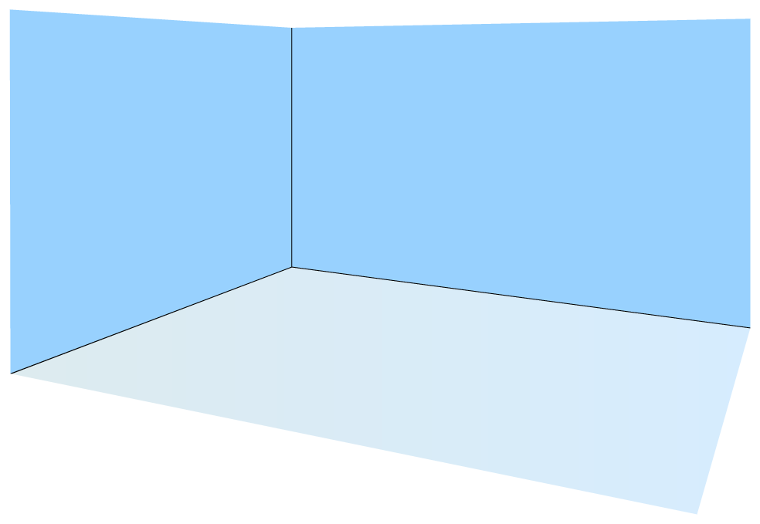
Relationships - Review
Notes:
Items to note:
Retail transaction flow only between the CR, TDSP and ERCOT
Wholesale Settlement only between ERCOT the QSE and the RE
The PCT maintains oversight over all MPs

Slide 9
Vertically Integrated Utilities
Reliability Coordinator
(ERCOT)
Generation
System Operations
Transmission
Distribution
Utility
Customers
Physical Power Flow
Scheduling and Dispatch
Notes:
Instructor should walk through the nature of a vertically integrated utility – all in one, customers served by “local” utility, etc.
At this point, ERCOT’s role was that of reliability coordinator. NERC was formed in the 1970s, after several significant blackouts in parts of the country. ERCOTs function was to facilitate reliable grid operations in accordance with NERC reliability standards. This function included advising the various utilities on best practices, but it also included coordinating occasional power transfers between the different utilities in order to maintain system reliability.

Slide 10
Retail and Wholesale Competition
System Operations
(ERCOT ISO)
System Operations
(ERCOT ISO)
Reliability Coordinator
(ERCOT)
Generation
System Operations
Generation
Wholesale
Marketers
Wholesale
Marketers
Transmission
Transmission
Distribution
Distribution
Retail Electric Providers
Utility
Retail Electric Providers
Physical Power Flow
Physical Power Flow
Scheduling and Dispatch
Scheduling and Dispatch
Financial Relationships
Financial Relationships
Customers
Customers
Physical Power Flow
Scheduling and Dispatch

Slide 11
Participants
Public Utility Commission of Texas
Electric Reliability Council of Texas
Qualified
Scheduling Entity
Load Serving Entity
Competitive Retailer

Slide 12
Load Serving Entities (LSEs)
An Electrical Cooperative or Municipally Owned Utility who has chosen NOT to opt in to retail competition.
Opt-In
An Electrical Cooperative or Municipally Owned Utility who has chosen to opt in to retail competition.
REP
Entities that sell electric energy to retail Customers in the areas of Texas where the sale of electricity is open to retail competition.
Notes:
Load serving entities (LSEs) provide electric service to end-use Customers. As mentioned in defining the audience for this course, LSEs include:
Retail Electric Providers – entities that sell electric energy to retail Customers in the areas of Texas where the sale of electricity is open to retail competition
Electrical Cooperatives – businesses owned by the people who use their services
Municipally-Owned Utilities – providers owned by the municipalities they serve

Slide 13
Competitive Retailer (CR) Responsibilities
Retail Electric Provider or Opt-In Entity
Service Retail
Customers
Negotiate Competitive
Contracts
Submit Electronic Transactions

Slide 14
Competitive Retailer (CR) Responsibilities
Meet Financial Responsibilities
Buy electricity at wholesale
Pay TDSPs for delivery costs
Pay and/or dispute invoices
Invoice retail Customers for their usage
Notes:
Buy electricity at wholesale – CRs must schedule power through a QSE. They may buy power through a number of methods including long term contracts, the day-ahead market or real-time.
Pay TDSPs for delivery charges – TDSPs are responsible for operating and maintain the transmission and Distribution systems. For that they receive a regulated rate set by the PUCT. CRs are responsible for paying these charges to the TDSP determined by how much power their customers use. They are allowed to pass this charge directly through to their customers.
Pay and/or dispute invoices – CRs are responsible for settling with their QSEs for power and services provided.
Invoice retail customer for their usage – CRs will finally invoice their end-use customers for the power that they have consumed. Billing is usually monthly, but can be done in other time periods.
For more information about CR’s Wholesale operations, see LSE201.

Slide 15
Competitive Retailer (CR) Responsibilities
Investigate Customer Switching Issues
CRs work with TDSPs and other CRs to resolve inadvertent gains and losses.

Slide 16
Registration and Qualification
A Competitive Retailer Must:
Register with the PUCT
Register with ERCOT
Complete Flight Testing through FlighTrak
Be represented by a Qualified Scheduled Entity
Notes:
Register with the PUCT – the first step in becoming a CR is registering with the PUCT.
Register with ERCOT – the CR must then complete the ERCOT LSE paperwork in order to be registered in ERCOT’s system
Complete Flight testing through FlighTrak – FlighTrak is the testing venue that ERCOT uses to verify that the CR is capable of processing the necessary transaction in the retail market.
Be represented by a QSE- Each CR must be represented in the market by a Qualified Scheduling Entity. A QSE is required in order to settle with ERCOT and submit schedules.

Slide 17
QSE Representation
Every CR Must Be Represented By a QSE
Choose one
OR
Become one

Slide 18
TDSP Responsibilities
Physical System
Operations
Retail System
Operations

Slide 19
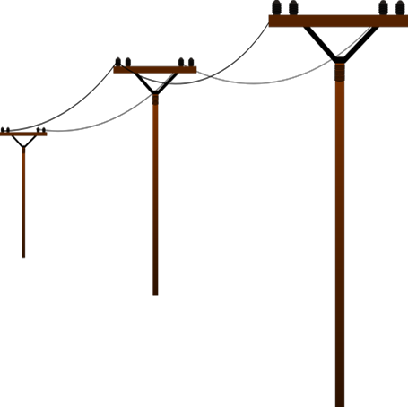
TDSP Responsibilities
Physical System Operations
Maintain reliable transmission and distribution system
Connect Customer Premise to ERCOT grid
Resolve power outages

Slide 20
TDSP Responsibilities
Retail System Operations
Create, Manage and Maintain ESI IDs
Facilitate Service Order Requests from CRs
Provide usage data for Settlement billing
Investigate customer issues

Slide 21
TDSP Responsibilities
The Anatomy of an ESI ID
10 xxxxx zzz .. zz
Where
10 | Electric industry prefix
xxxxx | Five digit DOE code for TDSP
zzz .. zz | Up to 29 alphanumeric characters assigned by TDSP
Notes:
When the TDSP sets up an ESI ID, they must follow a prescribed format defined in Protocol Section 15.
Every ESI ID today will begin with “10,” originally set up as a future placeholder, but holds no physical meaning today.
The next five digits (the Xs) are the most significant portion of the number for our purposes here, because they define the TDSP who set up the ESI ID in the first place. So this part of the code will tell a REP at a glance which TDSP services this premise.
The remaining digits are any combination of up to 29 alphanumeric characters, used at the TDSPs discretion.
For example:
Oncor add 0000 and a 7 digit Premise ID
Centerpoint uses 22 digits unique ID – the longest

Slide 22
TDSP Responsibilities
The Anatomy of an ESI ID
10 xxxxx zzz .. zz
DOE Number | TDSP Name
20404 | AEP TX North
03278 | AEP TX Central
08901 | CenterPoint
13830 | Nueces Electric Coop
44372 | Oncor Electric Delivery
40051 | Texas New Mexico Power (TNMP)
17699 | Oncor/SESCO

Slide 23
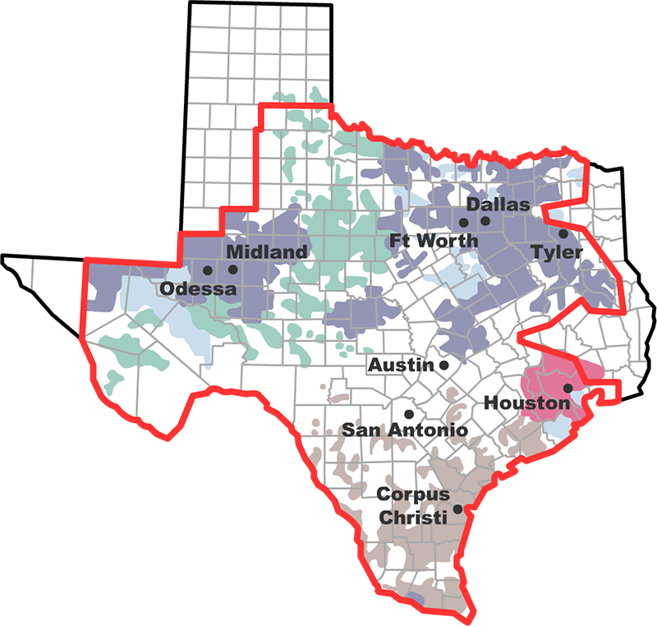
Where are the competitive meters
ONCOR
CenterPoint
TNMP
AEP

Slide 24
ERCOT Responsibilities
Physical System
Operations
Retail System
Operations
Notes:
ERCOT’s primary job is reliability. And open transmission access. ERCOT financially settles the competitive bulk-power wholesale market and administers retail switching for nearly 8 million premises in competitive choice areas.
ERCOT serves more than 25 million Texas customers
ERCOT:
90% of Texas Load
75% of load is competitive choice customers
78,000+ MW of generation
46,500+ miles of transmission
74,666 MW Peak demand – Aug 12, 2019

Slide 25
ERCOT Responsibilities
ERCOT Duties
Process retail transactions
Collect and distribute meter data
Establish profiles for all ESI IDs
Act as registration agent
Provide account management
Notes:
Process transactions – in excess of 5 million inbound and outbound transactions per month
Collect and distribute meter data – Over 7.5 million monthly 867 meter data transactions, plus additional activity for switches.
Establish Profiles for all ESIIDs. – produce 248 daily back-casted load profiles.
Registration agent – Register and maintain in excess of 2000 Market Participants (not counting IMRE and CP)
Account Management. –Each account assigned to one of 12 dedicated Account Managers

Slide 26
ERCOT.com

Slide 27
Exercise
Matching
QSE
LSE
CR
TDSP
RE
PUCT
PUCT | Responsible for making sure customers are protected and everyone follows the rules
QSE | The participant through which all transactions and money flows
CR | Primary point of contact for all end-use customers
TDSP | Manages poles, wires, meter reads and ESI IDs
RE | Owns and operates the generators
LSE | Services customers in competitive areas

Slide 28
Module 2
Market Rules
Notes:
Introduce self, area work and module
Even though retail market is deregulated in the competitive areas of state, there are rules that must be followed.
Clear, transparent rules make for an efficient electricity market and a level playing field.
Let’s take look at those rules

Slide 29
Hierarchy of Rules
Public Utility Regulatory Act (PURA)
PUCT Substantive Rules
ERCOT Protocols and Market Guides
Notes:
Purpose is to introduce you to those rules, what they are and where can find them
Give you better understanding of how the market got to where it is today
Definite hierarchy to the rules as you go down that hierarchy rules more specific

Slide 30
State of Texas Law
Public Utility Regulatory Act (PURA)
Defines the Public Utility Commission of Texas (PUCT)
Amended by Senate Bill 7 in 1999
PUCT and ERCOT responsible for determining specifics
Continues to evolve
Notes:
Texas Legislature enacted the Public Utility Regulatory Act (PURA) in 1975
which created the Public Utility Commission of Texas (PUCT)
To provide statewide regulation of the rates and services of electric and telecom utilities. We’ll focus on electric
Some 20+ year later SB 7 passed which was a bid deal – huge change
Allowed for restructuring of electric utility industry
with the unbundling of vertically integrated utilities and bringing in competition and customer choice to competitive areas which were the service areas of those bundled utilities
Say last 2 bullets
Legislative laws like PURA are high level –specifics left PUCT and ERCOT

Slide 31
Hierarchy of Rules
Public Utility Regulatory Act (PURA)
PUCT Substantive Rules
Notes:
2nd Tier
PUC’s mission is 3 fold:
Protect Customers
Foster competition
Promote high quality infrastructure

Slide 32
Public Utility Commission of Texas (PUCT) Rules
PUCT Substantive Rules
Implement PURA requirements:
Customer protection rules
Standard terms and conditions (Tariffs) for utilities
Electric Substantive Rules are contained in Chapter 25
Refer to PUCT Website for complete rules
Notes:
Not surprising that key section of Substantive rules are Customer Protections
And Tariffs (T&C’s) for the T& D companies (Wires) that remain regulated
Chapter 25, Subchapter R – 26 rules alone
25.214 - Tariffs

Slide 33
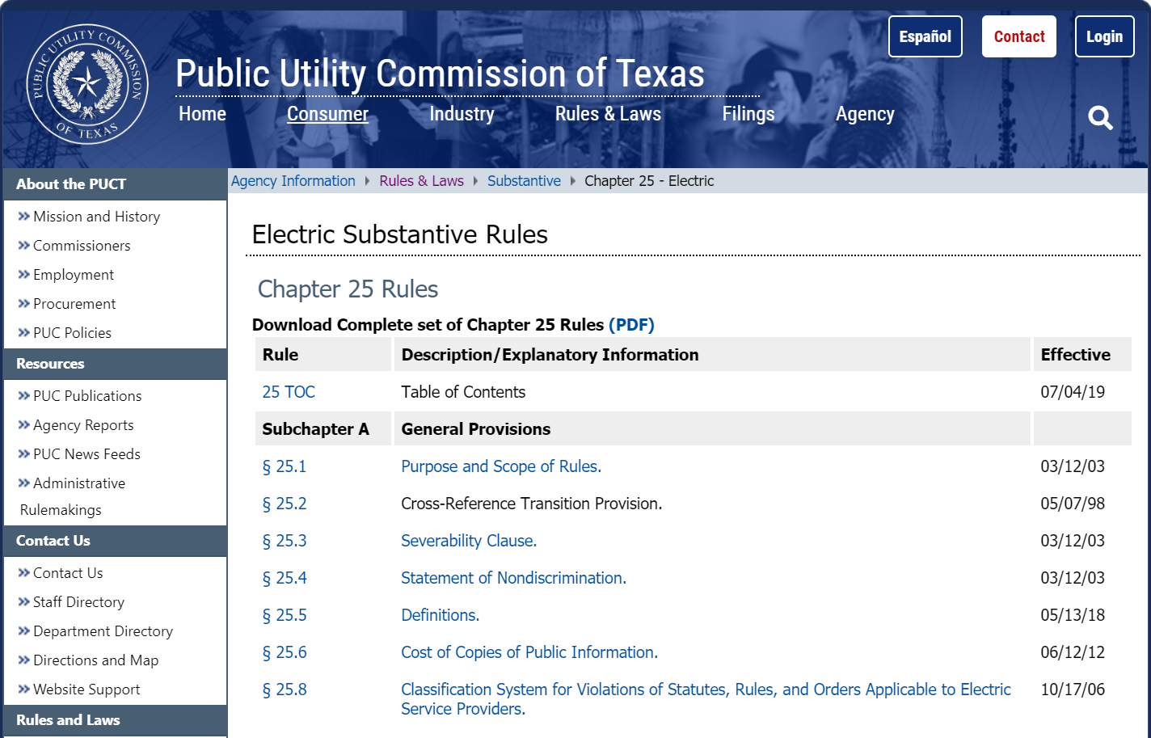
PUCT Substantive Rules

Slide 34
PUCT Substantive Rules
Customer Protection Rules (Part 1)
§ 25.471
General Provisions of Customer Protection Rules
§ 25.478
Credit Requirements and Deposits
§ 25.472
Privacy of Customer Information
§ 25.479
Issuance and Format of Bills
§ 25.473
Non-English Language Requirements
§ 25.480
Bill Payment and Adjustments
§ 25.474
Selection of REP
§ 25.481
Unauthorized Charges
§ 25.475
General REP Requirements and Information Disclosures to Customers
§ 25.482
Prompt Payment Act
§ 25.476
Renewable and Green Energy Verification
§ 25.483
Disconnection of Service
§ 25.477
Refusal of Electric Service
§ 25.484
Electric No-Call List

Slide 35
PUCT Substantive Rules
Customer Protection Rules (Part 2)
§ 25.485
Customer Access and Complaint Handling
§ 25.492
Non-Compliance with Rules or Orders
§ 25.487
Obligations Related to Move-In Transactions
§ 25.493
Acquisition and Transfer of Customers from one REP to Another
§ 25.488
Procedures for a Premise with No Service Agreement
§ 25.495
Unauthorized Change of REP
§ 25.489
Treatment of Premises with No Retail Electric Provider of Record
§ 25.497
Critical Load, Critical Care and Chronic Condition Customers
§ 25.490
Moratorium on Disconnect on Move-Out
§ 25.498
Prepaid Service
§ 25.491
Record Retention and Reporting Requirements
§ 25.500
Privacy of Advanced Metering System Information

Slide 36
Hierarchy of Rules
Public Utility Regulatory Act (PURA)
PUCT Substantive Rules
ERCOT Protocols and Market Guides
Notes:
3rd tier –even more specific
ERCOT Protocols and Market Guides

Slide 37
ERCOT Documents
ERCOT is responsible for …
Protocols
Outline the procedures and processes used by ERCOT and Market Participants.
Notes:
Protocols – are the What
Market Guides – are the How to - very specific

Slide 38
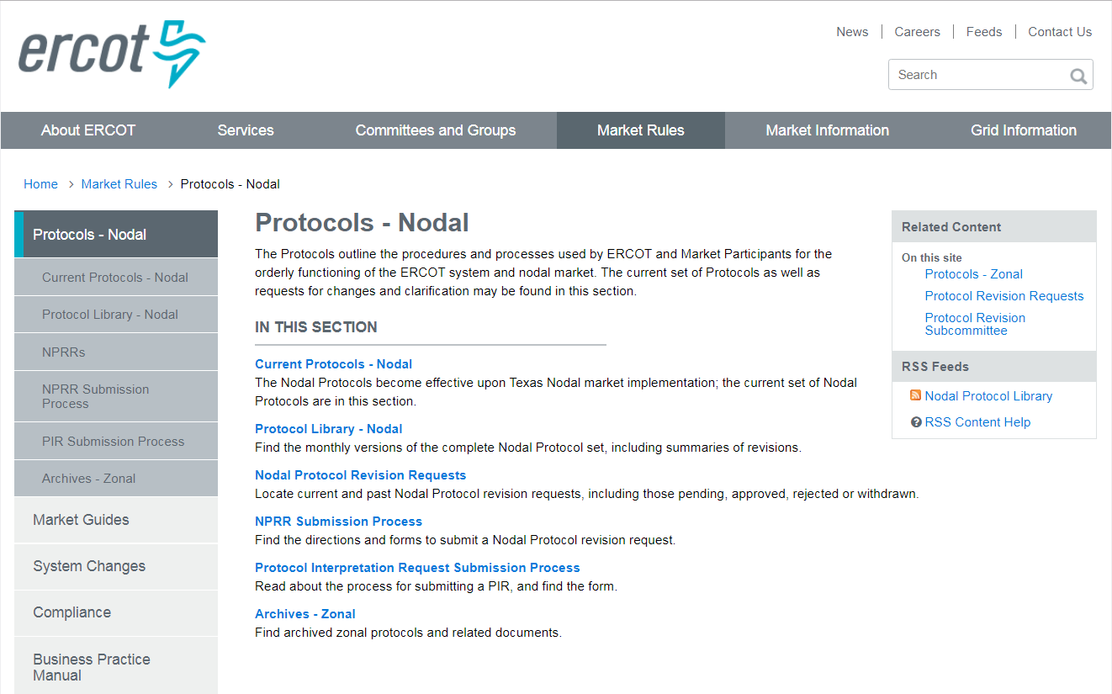
ERCOT Protocols
Notes:
Instructor should point out that current protocols are housed under the top link. However, all previous versions are also available under the “Protocol Library” link.
Instructor should also point out the “Other Binding Documents” link in the navigation bar and briefly mention that these other documents supplement the Protocols.
Other Binding Documents
Annual Load Data request
EPS Site Certification form
ERO Fee Guide
Load Profiling Guide
Texas Data transport Guides
Texas Market Test Plan
etc.
Business Practice Manual
ERCOT Market Notice Communication Process
Price Validation and Corrections
etc.

Slide 39
List of Protocols
Sections
Description
1-2
Construction and Definitions
3-8
System Operations and Wholesale Markets
9-11
Settlement & Billing; Metering; Data Aggregation
12
Market Information System (MIS)
13
Transmission & Distribution Losses
14
Renewable Energy Credit Trading Program
15
Customer Registration
16
Market Participant Registration & Qualification
18, 19
Load Profiling & TX SET
20
Alternative Dispute Resolution Process
21
Revision Request Process

Slide 40
ERCOT Documents
ERCOT is responsible for …
Protocols
Market Guides
Outline the procedures and processes used by ERCOT and Market Participants.
Based upon the ERCOT Protocols
Detailed reference documents
Notes:
Protocols – are the What
Market Guides – are the How to - very specific

Slide 41
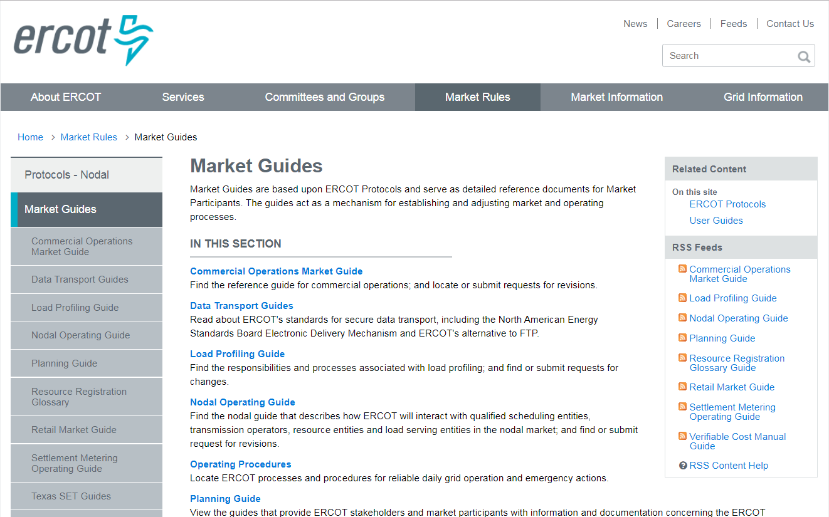
ERCOT Market Guides
Notes:
Market Guides
Retail Market Guide
Commercial Operations Market Guide
Settlement Metering Operating Guide
etc.
Key guides for the Retail Market
Depending on your job responsibilities will drive which ones you use
Retail Market Guide – key section 7 – Processes
TX Set Guides – EDI (Electronic Data Interchange) Transactions

Slide 42
Retail Market Guide Detail
Retail Market Guide Overview
Sections | Description
1-2 | Purpose; Definitions; Acronyms
3 | Retail Market Guide Revision Process
4-5 | PUCT & ERCOT
6 | RMS Working Groups
7 | **Market Processes**
8 | Municipally Owned Utilities & Co-ops
9 | Appendices

Slide 43
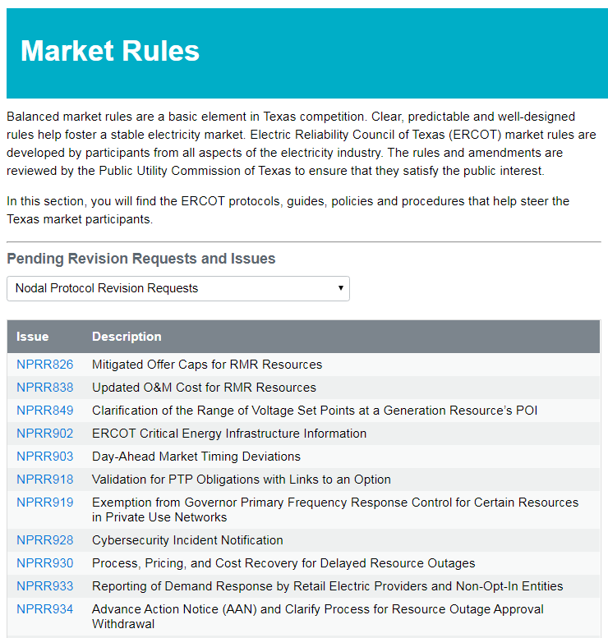
Revision Requests
Protocol And Market Guide Update Process
Created and edited by Market Participants
Changed from time-to-time by Revision requests
Changes approved by ERCOT Board of Directors or appropriate committee
Notes:
Protocol Revisions approved by the BOD
Guide Revisions usually approved by TAC, with some exceptions
Each Guide will have a revision process documents as part of the guide. (Usually within the first three sections)
Each guide has a page for Revision Requests
Revision Request - how to change a rule be it a Protocol or Market Guide
Who can do this: Market Participants ; ERCOT can as well
Where you can see them on ercot.com
To date are on NPRR (Nodal Protocol Revision Request) – up to 970 changes or NPRRs
GRR (Guide Revision Request

Slide 44
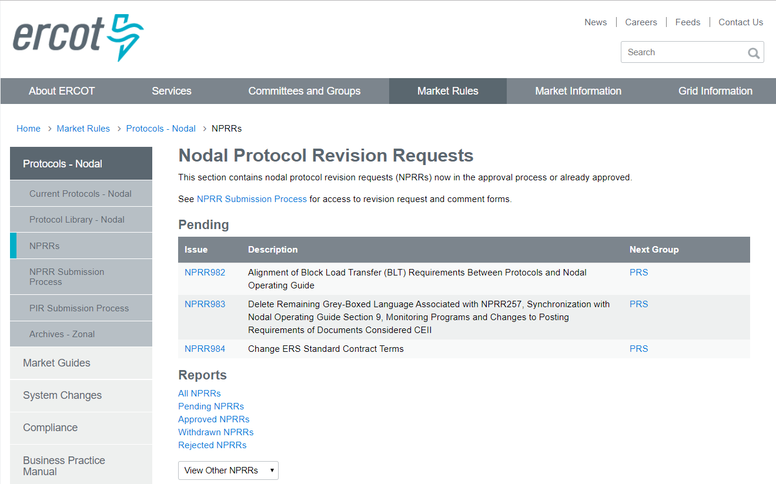
Nodal Protocol Revision Requests

Slide 45
Market Governance Structure
Board
Of Directors
Board and TAC
approve Protocols and Market Guides
Technical Advisory
Committee
(TAC)
Retail Market Subcommittee (RMS)
Reliability Operations Subcommittee (ROS)
Wholesale Market Subcommittee (WMS)
Protocol Revision Subcommittee (PRS)
Subcommittees recommend changes to the ERCOT Protocols and Market Guides
Notes:
This information can be found on the ERCOT website, under Committees and Groups. Available are:
Contacts for each group
Scheduled Meetings
Webex information
Agendas
Key Documents
Stakeholder Process - very robust stakeholder process where market activity and market issues are discussed

Slide 46
RMS and Working Groups
Retail Market Subcommittee (RMS)
Board
Of Directors
Technical Advisory
Committee
(TAC)
Working Groups
Profiling (PWG)
Texas Data Transport & MarkeTrak Systems (TDTMS)
Texas SET
Task Forces
Retail Market Training (RMTTF)
Retail Market Subcommittee (RMS)
Reliability Operations Subcommittee (ROS)
Wholesale Market Subcommittee (WMS)
Protocol Revision Subcommittee (PRS)
Notes:
As I go through this want to highlight who the chairs o vice chairs are – at break feel free to talk with them about how get involved, current topics under discussion
RMS – Jim Lee – Chair
Focus on retail issues and issues resolution and
Monitor PUC rulemakings as they apply to retail markets
Ensure the PUCT requirements are reflected in Protocols, retail market guides and TX SET (Texas Standard Electronic Transaction)
Working Group – where rubber meets road - help shape the change
Profiling – Chair – Sheri Weigand
Looking at rules and processes relating to Load Profiling
TDTMS - Kyle Patrick with Reliant
Data transport – software, tools, KPIs on ERCOT
performance, work ensure are keeping up with Standards (NAESB) as relates to EDI (electronic delivery of customer transactions
As well as Marketrak – issue resolution tool CRs and TDSPs have for customer issues
TX Set - Chair Diana Rehfeldt Look at new or modifications to existing electronic transactions, changes in retail mkt processes, work with ERCOT on testing processes for new CRs or additions or changes to existing CRs
RMTTF – Debbie McKeever – Oncor, Sheri Weigand, -TXU Energy, Tomas Fernandez – NRG Focused on Retail training – coordination and development. Work with ERCOT.

Slide 47
Module 3
Retail Operations

Slide 48
An Important Definition
Retail Transaction:
A Communication that enables and facilitates retail business processes in the deregulated Texas Electrical Market.
Involves REPs, TDSPs and ERCOT
Electronic Data Interchange (EDI) format, based on ANSI ASC X12 Standards
Notes:
1. EDI is concept of business’ electronically communicating
EDI is the electronic interchange of business information using a standardized format – allows company send info to another co electronically vs paper
2. Computer to computer exchange of business info in STANDARD FORMAT
Goes business system to bus system
No paper and no people in the EDI transaction
Greater accuracy , speed of communication
3 Because it’s processed by computers not human need have STANDARD FORMAT
Without standard format each companies systems may not be able talk to one another
. There are several EDI standards - ANSI is one of them
4. American National Standards Institute (ANSI)
Chartered
Accredited Standards Committee (ASC) X12 to develop uniform standards for inter-industry electronic exchange of business transactions, namely electronic data interchange
More than 300K companies worldwide using X12 DI standards in daily business transactions
5. Businesses typically use an EDI translator either in-house software or via an EDI Service Provider translate the EDI format so data can be used by their internal applications

Slide 49
Texas Standard Electronic Transactions (TX SET)
Retail Transactions Are Defined By TX SET Implementation Guides
Developed and maintained by TX SET Working Group
Protocol Section 19
Implementation Guides
Notes:
Protocol Section 19 – Texas standard Electronic Transaction - This Section of the Protocols contains an overview of the purpose and scope of the Texas Standard Electronic Transaction (TX SET), and a series of definitions identifying the use of each transaction.
Texas SET Implementation Guides – A series of guides by transaction type that provide details of the information contained within the electronic transactions used in the retail electric market. Each contains a guide, and other pertinent data for implementing the transaction.

Slide 50
TxSET Communication Flow - Example
NAESB
NAESB
NAESB
North American Energy Standards Board (NAESB)
Common communications protocol
Notes:
North American Energy Standards Board – industry led effort formed to create a seamless natural gas and electric power marketplace (both wholesale and retail)
Standards and Business Practices for transactions
Efficiency, electronic commerce standardization – speed of information
See Appendix in Retail Mkt Guide – shows Transaction Timing Matrix - shows how quickly they flow and the timeframes must respond by

Slide 51
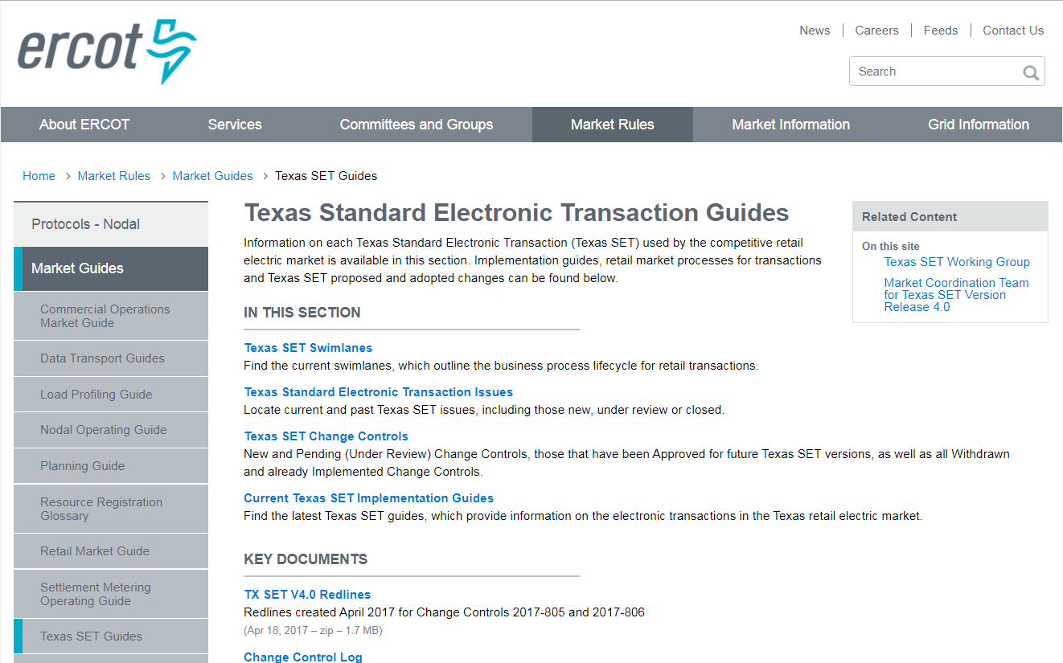
TX SET – Transaction Names & Pocket Card
Notes:
But for quick reference, there is also a Transaction Name Inventory posted on ERCOT.com, complete with a handy pocket card. We hope that you will find them as useful as we do.

Slide 52
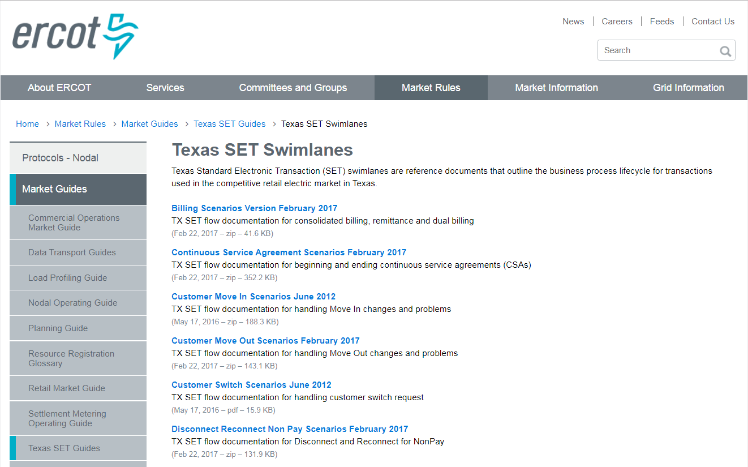
Swimlanes
Notes:
On the TxSET page there will be a link to the Swimlanes. These are business process diagrams for each business transaction.
Let’s take a closer look at Texas SET
Where find it and what resources are available to help you

Slide 53
Standard Transactions
Transaction Families
Request, Response, Maintenance for Enrollments, Drops, Switches, Maintenance & Request Consumption | 814_XX
Interval, Non Interval, Reads & Usage Data Historical and Monthly Activity | 867_XX
Reject Response to 810 or 867 Data | 824_XX
Notes:
Standard transaction families when look will have 3 digits then 2 additional digits which will describe what it is in that family of transactions
814s - ESI IDs and Relationships. Are many flavors (by 2 digits at end
867s – Premise Usage
824s – Reject Notification
On this page, 824 would be reject of Usage data (867)
These transaction families are transactions that INVOLVE ERCOT

Slide 54
Standard Transactions
Transaction Families
Statement, Settlement, Wire Charge Invoices | 810_XX
Payment and Advice through Bank | 820_XX
Maintenance Service Order - Work Orders, Meter Config. Details, Outage Notification | 650_XX
Reject Response to 810 or 867 Data | 824_XX
More detailed description in Protocol Section 19
Notes:
Here are more families of transactions that are point –to-point between the CR and TDSP. ERCOT is not involved.
810s – Invoices from TDSO to CR
820s – Payments
650s – Service Orders
824s – Reject Notification (for this slide, to Invoices

Slide 55
Swimlane - Example
Move Out
Scenario: Customer Initiated Move Out No CSA Associate with ESI ID
Transactions: 814_24, 814_25, 867_03, 810_02
Contacts Current CR to request Move Out
Note: If ERCOT receives invalid data on the 814_24 from the CR, ERCOT will respond back with an 814_25 and processing will be terminated.
If the TDSP rejects the 814_24, ERCOT will forward the rejection response back to the CR and processing will stop.
Customer
Sends 814_24 Move Out Request; May receive 814_25 Move Out Response (Reject)
Receives 814_25 Move Out Response
Receives 867_03 Final Meter Read and 810_02 TDSP Invoice
Current
CR
ERCOT
Receives 814_24 Move Out Request from Current CR and validates
ERCOT checks its database for a CSA CR; If a CSA CR is associated with the ESI ID, ERCOT will initiate a CSA Move-In process
Sends 814_24 Move Out Request to TDSP and forwards 814_25 Move Out Response to Current CR
Receives 867_03 Final Meter Read and forwards to Current CR; Updates registration database
TDSP
Receives 814_24 Move Out Request and sends 814_25 Move Out Response
Move Out Date
Performs Final Meter Read and sends 867_03 to ERCOT and 810_02 TDSP Invoice to CR
Notes:
In addition to Texas Set Guides have Swimlanes
This is an example of Swimlane to show you what they are and how you read them
It’s visual picture of the transactions and how each flows – encrypted data package of retail transactions that makes up a Move Out
Shows sequencing, whose involved, what each is doing
This is the swimlane for a Move-out. This is the swimlane for the process detailed on slide 41.

Slide 56
Putting It Together
Market Process
A series of retail transactions that must occur in a particular sequence
Move-out request
Move-out request
Move-out response
TDSP invoice
Move-out response
Final meter read
Final meter read
TDSP invoice
Notes:
This is a successful move-out transaction process flow. Each arrow details a business step that is implemented as an individual EDI transaction. This can be followed with the Swim-lane on slide 43.
Transactions in particular sequence sent (encrypted EDI package)
Gets validated against TX SET Standards and ANSI X 12 Standards

Slide 57
Three Main Processes
Move-In
Move-Out
Switch
Notes:
Retail business process transaction fall into three main categories.
Move-In
Move-Out
Switch
These are the three types of process that any CR entering the market will have to be able to demonstrate. May hear these referred to as Initiating Transactions – start the activity
ERCOT as Registration Agent is involved in all 3 of these main retail processes
We store the CR Registration information
Manage ESI ID to CR Relationships
There are also some other business process that are used as well:
Billing
Disconnect/Reconnect Non Pay
Mass transition
Switch Hold
Continuous Service Agreement
Unplanned outage
All of these can be found in the swimlanes.

Slide 58
Scenario – Retail Processes
Split into 5 groups
Each group will be identified as a Market Participant
Notes:
This exercise is designed to get the class to talk through the process of a retail switch.

Slide 59
Scenario – Retail Processes
Customer Decides to Select a New CR
?
?
Who does the customer call
Who does the customer call
?
?
What does the CR do
What does the CR do
?
?
Who has to know … Who does this
Who has to know … Who does this
?
?
What does the TDSP do
What does the TDSP do
?
?
Does anything else need to be done
Does anything else need to be done

Slide 60
Scenario –Retail Process
From
To
Transaction Type
ERCOT
Old REP
TDSP
New REP
ERCOT
Old REP
TDSP
New REP
Switch Request
814_01
Enrollment
Notification Request
814_03
Enrollment
Notification Response
814_04
CR Enrollment
Notification Response
814_05
Loss Notification
814_06
Final Usage
2
1
1
2
867_03F
Initial Meter Read
867_04
2
1
1
2
Notes:
The next scenario, a Switch Request, becomes more complicated. Notice that there are simply more transactions. Plus, this type Service Order Request involves two REPs!
[Instructor should facilitate as in previous scenarios]

Slide 61
Process Diagram
Switch
Scenario: Customer Switch, No Customer Objection
Transactions: 814_24, 814_25, 867_03, 810_02
Customr
Contacts New CR to switch providers
Receives and Evaluates Letter
Rescission Period expires with no objection
New CR
Sends 814_01 Switch Request & may receive 814_02 Switch Response
Receives 814_05 CR Enrollment Notification Response and 867_02 Historical Usage
Receives 867_04 Initial Meter Read
ERCOT
Receives 814_24 Switch Request from New CR and validates; May send 814_02 Switch Reject Response only if reject
Sends Notification Letter to Customer
Sends 814_03 Enrollment Notification Request to TDSP, forwards TDSP’s Response and 867_02 Historical Usage to CR
Sends 814_06 Loss Notification to Current CR in the morning 2 days prior to switch date.
Receives and forwards 867_04 Meter Reads & updates Registration database.
TDSP
Receives 814_03 Enrollment Notification Request and sends 814_02 Historical Usage if available
Switch
Date
Performs meter read and send 867_03 Final to ERCOT, 810_02 TDSP Invoice to CR and 867_04 Initial Meter Read to ERCOT
Current CR
Receives 814_25 Move Out Response
Receives 867_03 Final Meter Read and 810_02 TDSP Invoice

Slide 62
Module 4
Metering

Slide 63
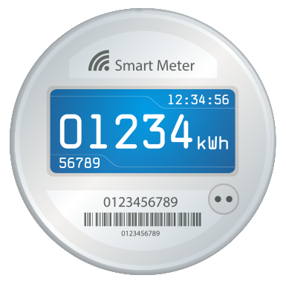
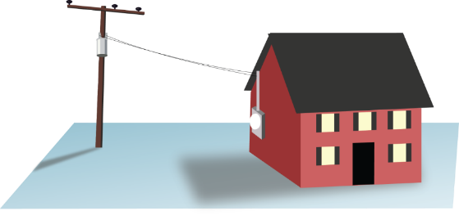
An Important Definition
Meter:
A device that measures electrical usage over a period of time.

Slide 64
Meter Math
What are we measuring?
WATTS = (Current) x (Voltage)
Ex: 100 W Light bulb
Energy = Watt-Hours
Ex: (10) x (100 W Light bulbs for 1 Hour)
= 1000 WHr (or 1 kWH)

Slide 65
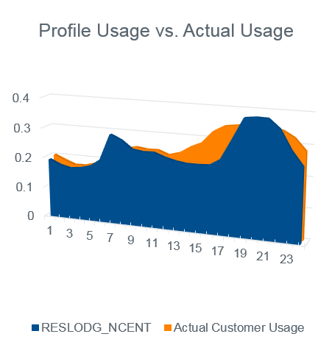
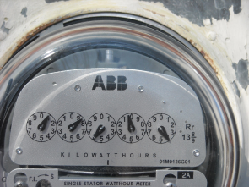
Non-AMS Meters
Non-IDR/Scalar/Analog Meter Characteristics
“Traditional” Meter
Scalar measurement for an entire month
Data must be shaped for Wholesale Settlement
Manual field activities

Slide 66
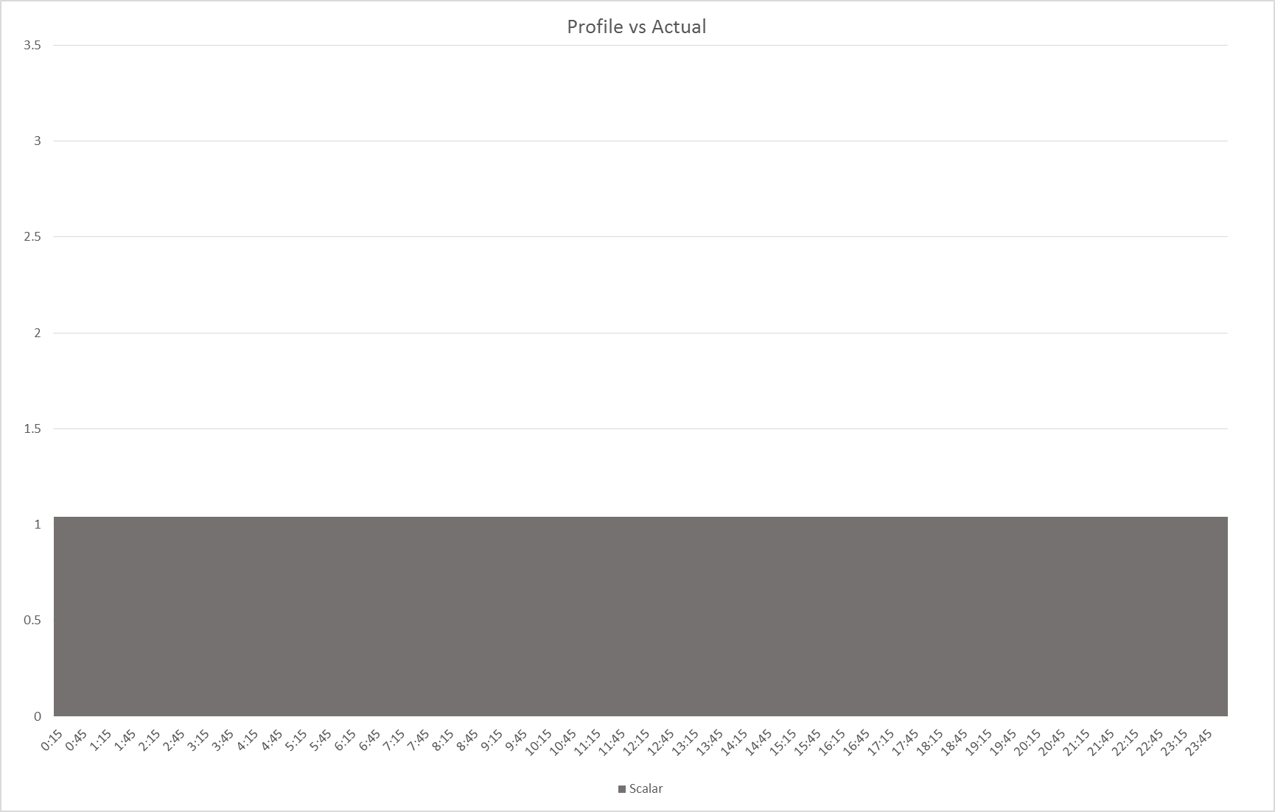
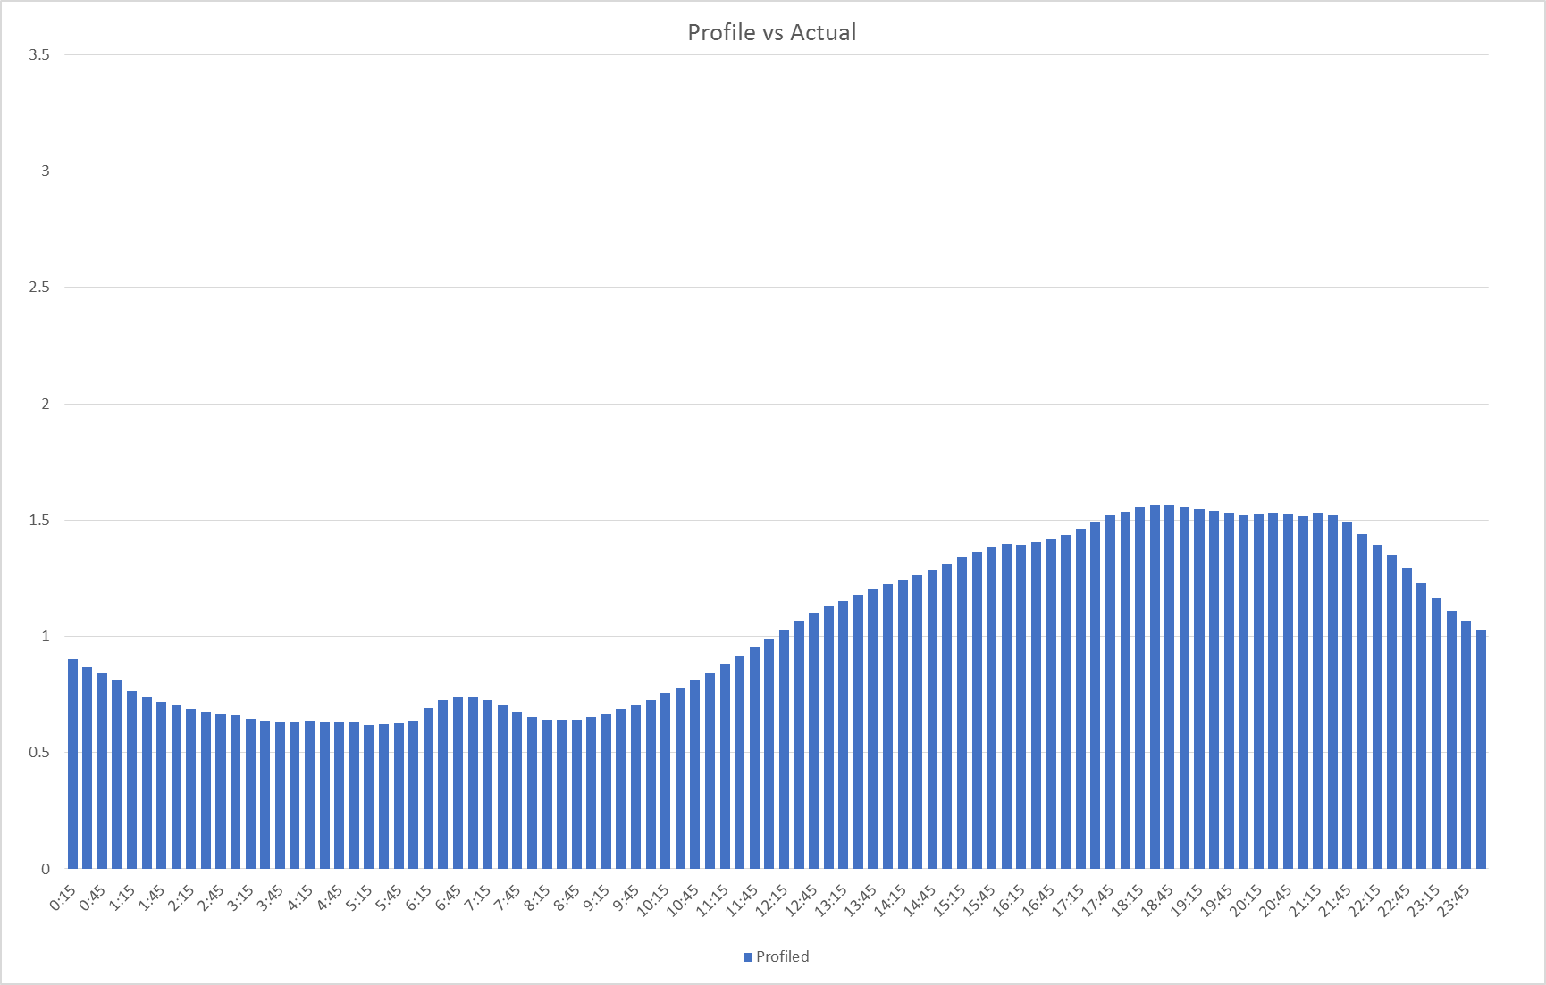
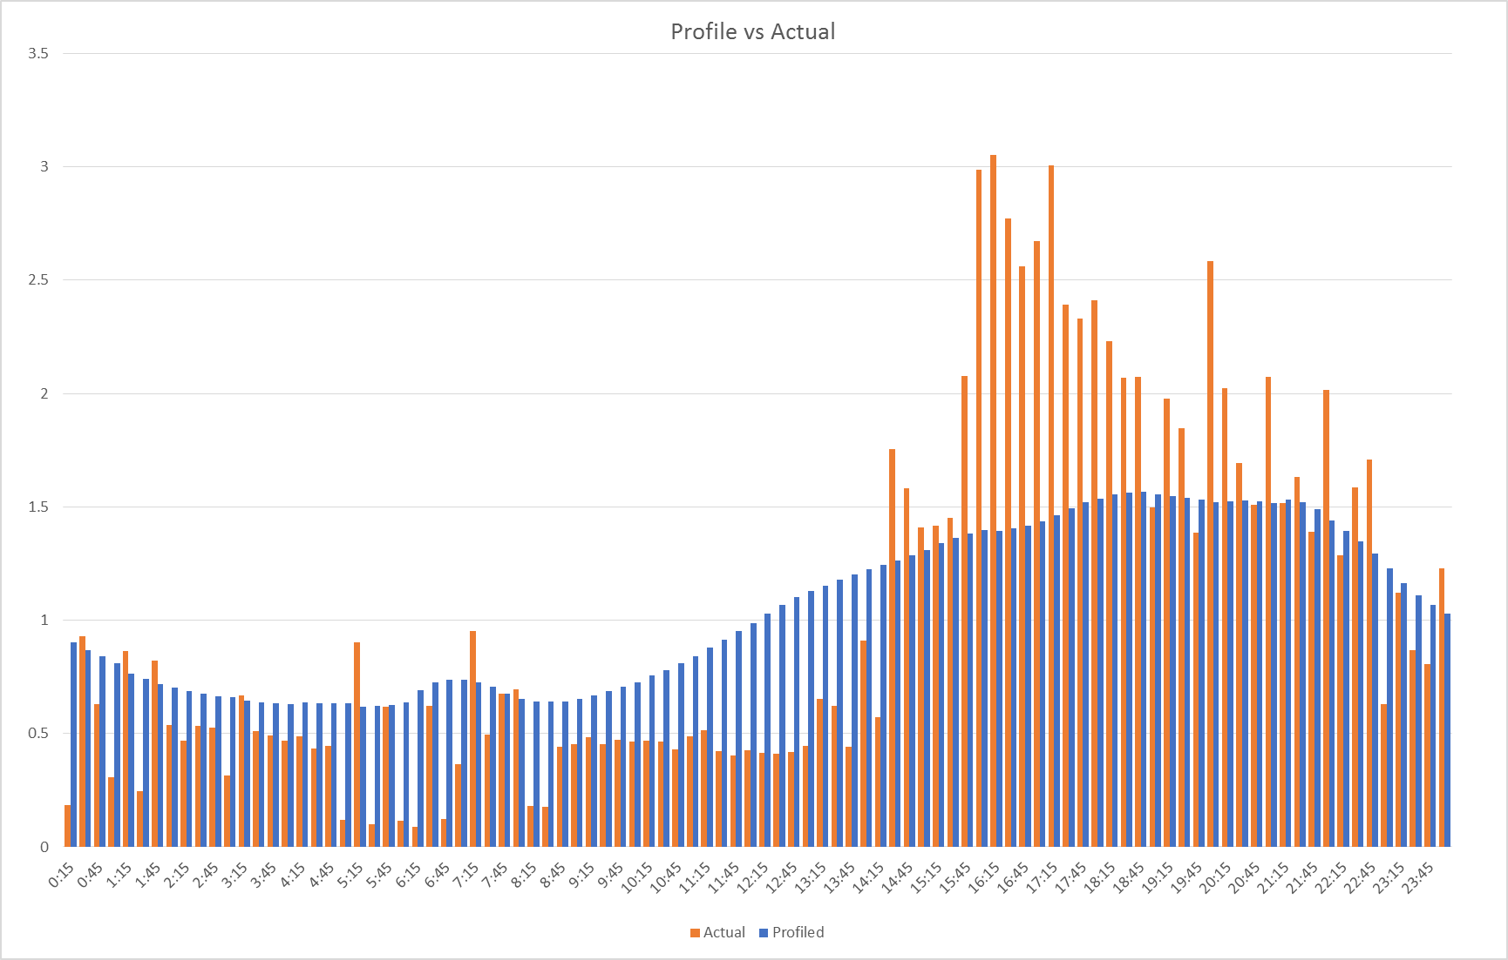
Scalar to Interval Data

Slide 67
Advanced Meter System (AMS) Meters
Characteristics
Wholesale Settlement ready
Remotely read
AMSR (≤ 200 amp)
Remote connect / disconnect
AMSM
Manual connect / disconnect

Slide 68
Interval Data
Non-Interval Data
Usage is recorded in ~30 day intervals
Data must be shaped for 15 minute Wholesale Settlement
VS
Interval Data
Usage is recorded in 15 minute intervals (96 intervals per 24 hrs)
Data is already shaped for 15 minute Wholesale Settlement

Slide 69
Non-AMS Meters
Interval Data Recorder (IDR) Meter Characteristics
Wholesale Settlement ready
Typically reported monthly
Predominantly on large customers > 700 kW/kVA demand
May require manual field activities

Slide 70
AMS Benefits
AMS benefits to the market
99.5% competitive load using interval data
REP and Customer can see actual usage
More accurate CR Settlement with QSE

Slide 71
AMS Benefits
AMS benefits to the market
73% actual data used on Initial Settlement
Faster execution of retail market processes
Notes:
The reason that on 73% of the actual data is used on Initial versus have 99.5% of competitive load on AMS meters is that the BUSIDR type has data provided monthly via 867 and account for somewhere around 305 of the total load.

Slide 72
AMS Transaction Processing Benefits
Enrollment type Initiating Transaction | AMS Remote (AMSR) | AMS Manual (AMSM) | Non-AMS
Move-In 814_16 | Same Day | 2 Business Days | 2 Business Days
Standard Switch 814_01 | Same Day | Same Day | Within Next 4 Business Days
Self Selected Switch 814_01 | Same Day | Same Day | At Least 2 Business Days
Move-Out 814_24 | Same Day | 2 Business Days | 2 Business Days
Notes:
Please note the different turnaround times for AMS and Non-AMS meters. Also AMS meters with remote connect/disconnect capabilities also have different turnaround times for Move-ins (and Disconnects for non-payment, as we shall see later)

Slide 73
AMS Data Flow
Adjusted Metered Load
Data Extract
Day 1
Day 2
Monthly
Interval
Data
Daily Interval
Data
Daily Interval Data
TDSP reads meters & performs VEE
Notes:
This is the flow for data from AMS meters. Other meters will have a different process, mostly with monthly packages of data.
<Click for animation> Load meter data is collected and sent to ERCOT by TDSPs. The TDSP performs the Validation Estimating and Editing function to ensure accurate meter data.
<Click for animation> The TDSP forwards the daily interval data from meters to ERCOT and also to Smart Meter Texas, a portal for both end use customers and CRs to access interval data
<Click for animation> On the second day after the meter read, the customers and CRs can access data through Smart Mater Texas.
<Click for animation> ERCOT make the interval data that it has received available to the CR through a data extract.
<Click for animation> Ultimately, ERCOT must roll all meter data up to the QSE level in order to settle the Wholesale Markets. ERCOT adjusts the metered load data to account for looses and other factors and calls it Adjusted Metered Load. Since ERCOT settles the Wholesale Markets on a fifteen minute interval, the QSEs’ Adjusted Metered Load must be calculated for each fifteen minute interval.

Slide 74
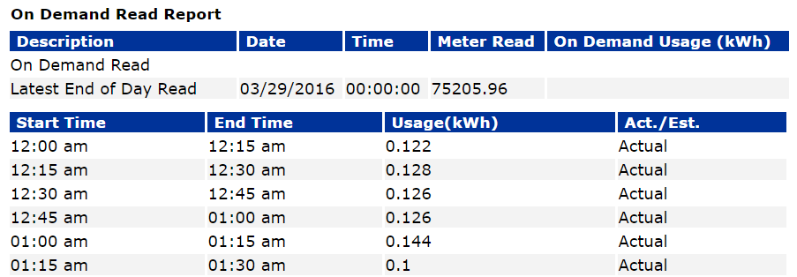
Smart Meter Texas
Adjusted Metered Load
Data Extract
Day 1
Day 2
Monthly
Interval
Data
Daily Interval
Data
Daily Interval Data
TDSP reads meters & performs VEE

Slide 75
AMS Benefits
Other AMS Benefits
Allows for pre-pay programs
Allows for demand response
Allows for Time-of-Use rate offerings
Improved service reliability
Early detection of faulty meters or tampering
Notes:
Allows for pre-pay- The greater timeliness of meter data allows for better prepay products, where a customer pays in advance to use a certain amount of electricity over a certain period of time.
Demand response - The greater precision and interval measure of meter data allows for further enhancement of demand response products.
Time-of-use - Having interval data for most customers allows REPs to offer the long-sought time-of-use pricing.
Service reliability – automated outage detection improves accuracy and timeliness of utility response
Early detection – automate detection of faulty of tampered meters

Slide 76
Question Bucket

Slide 77
Module 5
Settlement of Retail Load

Slide 78
Settlement Processes
ERCOT Invoice
QSE Charge
QSE Payment/Charge
CR Payment
CR Payment for Delivery
TDSP Delivery Charges
Bill
Bill
Meter Data
Notes:
ERCOT Settles the wholesale market for purchases and sales of energy and ancillary services with QSEs
<Click for animation> ERCOT uses the Adjustment Metered Load and Settlement Point Prices to determine the billing for energy used by QSE. ERCOT then sends an invoice to each QSE daily for payments and/or charges
<Click for animation> QSEs then pay or get paid by ERCOT
<Click for animation> the QSE will the invoice their CRs for any power consumed
<Click for animation> the CR will settle with their QSE
<Click for animation> the TDSP will submit charges to CRs for Transmission and Distribution fees.
<Click for animation> the CRs are responsible for reimbursing the TDSP for these fees
<Click for animation> the CR will then bill their end use customers.

Slide 79
Meter Data Flow
ERCOT Settles with QSE based on Adjusted Metered Load
Adjusted Meter Load
Unaccounted for Energy
Transmission Loss Factors
Distribution Loss Factors
Aggregation by QSE
Notes:
In every system there are losses that need to be accounted for. The total of raw meter reads will never equal the amount of generation at any given time. Adjusted Metered Load is a process to balance the load against the generation to ensure equitable settlement of power consumed.
<Click for animation> ERCOT receives the meter data for each premise from the TDSPs and stores it. Each ESIID is identified to a CR and a QSE. ERCOT rolls up the data by QSE, by interval, profile type, distribution loss factor, transmission loss factor, UFE zone and other factors.
<Click for animation> ERCOT uses the distribution loss identifier to apply distribution losses to the aggregated load, if applicable.
<Click for animation> ERCOT then applies Transmission losses to the load.
<Click for animation> Finally, ERCOT applies the correction for unaccounted for energy. UFE can be unaccounted for losses, theft, unmetered electricity or other errors.
<Click for animation> When all of the factors are applied, the total ERCOT load including all losses and UFE should equal exactly the amount of generation that was provided at every interval.

Slide 80
Settlement Timeline
Each Operating day is settled a minimum of three times
Most settlement is transacted on the Initial Settlement
ERCOT Real-Time Settlements Timeline
Operating Day
Day 5
Day 55
Day 180
Initial Statement
Final Statement
True-Up Statement

Slide 81
Discussion
Important Questions
?
What are the risks a CR faces
?
How does a CR mitigate these risks
?
With what

Slide 82
Module 6
Data Transparency & Availability
Notes:
In this module we’ll look at the data available to those in Retail Market and show you some of the tools help make your job easier

Slide 83
Market Information System Data Access
Also available on ercot.com
Available to all Market Participants
Only available to a specific Market Participant
Access managed by assigned roles
Notes:
There are 3 levels of access in ERCOT’s Market information System (MIS)
Go over 3
Secure and Certified managed by assigned roles on a digital certificate in terms of how you presently access MIS. This is by DUNS NUMBER. Specific access defined by users’ roles that your company User Security Administrator assigns to you based on your job responsibilities what need to access
FlighTrak new Flight Testing tool is accessed through different authentication

Slide 84
Market Information System Data Access
LOAD PROFILES
MARKET
PRICES
DLF and TLF
TDSP ESIID EXTRACT
LOAD FORECASTS
Public Data is also available on ercot.com
Notes:
Public data can be found in MIS as well as on ercot.com
TDSP ESIID Extract - Public extract that provides characteristic info on ESI IDs broken out by TDSP territory. Station code, service address – use for own database of ESI IDs in competitive area
Load Forecasts – Seven day forecasts of hourly system load.
Transmission and Distribution Loss factors – Forecasted and deemed actual loss factors used in the settlement process. Deemed actual distribution loss factors used in the ERCOT Settlement process which are calculated from the distribution loss coefficients submitted by DSPs and the ERCOT actual load.
Market Prices – Report of Real-Time wholesale prices at all Settlement Points. CRs pay Load Zone prices. 15 minute intervals
Load Profiles - Forecasted and backcasted Load profiles

Slide 85
Market Information System Data Access
TRANSMISSION OUTAGES
DEMAND & ENERGY MONTHLY REPORTS
TDSP MONTHLY LOAD REPORTS
Notes:
Monthly TDSP Load Report – includes TSP and DSP 15 minute Interval Load data for each Operating Day adjusted to exclude BLTs (Block Load Transfers) and DC Tie (Direct Current Tie exports.
Monthly Demand and Energy Reports – explained by name
Outage Reports – are several one example
Consolidated Transmission Outage Report – Proposed, Approved & Accepted, Rejected, Withdrawal of Approved/Accepted

Slide 86
Market Information System Data Access
DATA EXTRACTS
MARKET DATA TRANSPARENCY SERVICES
MARKET REPORTS
MARKETRAK REPORTS
Notes:
Reports and Extracts specific to each Market Participant Company – highest level – confidential data
Certified data is DUNS NUMBER specific private data.
Market Report – e.g. Potential Load Loss Report – Daily its extract of potential customer loss notifications based on ERCOT’s receipt of the TDSPs accepted response. Provides CRs advance notice that they are potentially losing a customer.
Will talk more about these top 2 boxes in next few slides

Slide 87
Extracts
ESIID Service History and Usage Extract
ESI ID Relationships and Characteristics
Provides data needed to perform shadow settlements of Retail load.
Supplemental IDR Required Interval Data Extract
Supplemental AMS Interval Data Extract
Subscribe
See ERCOT courses on MIS and Intro to Extracts
Subscribe
Subscribe
Notes:
ESI ID & Service History & Usage Extract Provides transparency to Market Participants for ESI ID level data that ERCOT utilitizes in Market Settlement . Also know as 727 Extract (SCR 727)
Start/Stop time for ESI ID Relationship
Other ESI ID-level data
Load Zone
Servicing TDSP
Profile Class
Usage Data by ESI ID
Monthly Meter Data
Available 3 days after data posts with ERCOT
This data along with Supplemental IDR Required Interval Data Extract and Supplemental AMS Interval Data Extract gives MPs the data they need to develop shadow settlement systems.
In order to get this you must subscribe. Key step once you have qualified new LSE entity and its active
We do have online courses on Market Information System and Extracts which are helpful to increase your understanding.

Slide 88
Data Extracts
SUBSCRIPTION REQUEST
CSV or XML
ERCOT
Taylor, TX
Great MP
Somewhere, TX
Notes:
In order to receive extracts, the Market Participant must subscribe to the service. Once a valid request has been received, the ERCOT extract system will produce the requested extracts on an ongoing basis and make them available to be downloaded by the requestor. While these extracts are in the form of a .csv or a .xml and may be readable by a human, they are intended to be loaded into a database and combined with other information to form a complete picture.
At a high level,
Data extracts are an automated delivery mechanism for certain packages of MIS data
May contain:
Customer info
Usage data
Settlement data
Packaged in 2 formats:
Comma Separated Value (.csv)
Extensible Markup Language (.xml)
You specify the format you want when you subscribe
You’ll need a DBA, database administrator to set up the database so information all comes together/assimilates properly and stays accurate as changes continue to occur in the market. Then you can turn that data into meaningful information with your queries and reports you set up

Slide 89
ERCOT Market Information List
Location
Frequency
Who can see it
Notes:
The ERCOT Market Information List or EMIL is the master list of all available extracts and reports available form ERCOT.
EMIL
Really encourage you to take some time and see what’s available
This is quickest way to do that – list of all Reports and Extracts that ERCOT has
Say 3 bullets
Can filter columns
I like go into Column that’s the Product Name and can filter AMS or Load

Slide 90
EMIL

Slide 91
Scenario
How to construct workable data extracts
Sign up for extracts
Create a database
Import extracts
Shadow your data

Slide 92
Scenario
How to construct workable data extracts
Sign up for extracts
Create a database
Import extracts
Shadow your data

Slide 93
Market Data Transparency Web Services
Notes:
The Market Data transparency tab on ERCOT.com provides the guiding documents for the ERCOT extracts. DDLs define the database for the extract to be loaded into. The Guides provide additional information on using various extracts.
Another tool – Web Services
For Ad hoc reports – enable you to do
Ad Hoc research on ESI ID Information
Refresh your database be sure is in sync with ERCOT’s – Registration Agent

Slide 94
Market Data Transparency Web Services
Provides Similar Information on Ad Hoc Basis
Notes:
MDT Web Services are an ad-hoc method of accessing some important data. This service is not intended to replace regular extracts.
Provides similar information to Extracts on Ad Hoc basis done with your queries
Request Data Base Refresh or ESI ID Service History and Usage Extract database – limited only once year as it taxing on ERCOT’s systems.
Detailed information provided in Mkt Data Transparency User Guide
Timing, how receive it, etc.

Slide 95
Discussion
What does a CR do with all this data?
Settlement reconciliation
Shadow settlement
Planning and forecasting
Troubleshooting
Data Validation
Notes:
General discussion about why a CR would need all this data.
To:
enroll customers
verify customer lists
search for dropped of missing customer in unintentionally gained customers
shadow settle
forecast

Slide 96
Module 7
Issue Resolution

Slide 97
Issue Resolution
Retail responsibilities
Investigate customer issues
Maintain customer records
Verify billing accuracy

Slide 98
Common Issues
Mistakes happen …
Missing Transactions
Usage & Billing Issues
Inadvertent Gains & Losses
Switch Hold
Notes:
Sometimes things don’t go as planned
Here’s some common issues you might encounter
Switch Hold – customer cannot switch if Switch Hold on account till pays money owed their current CR
Steps in this business process must be followed in certain sequence

Slide 99
Discussion
What tools are available to identify
& resolve issues?
ERCOT Extracts
ERCOT Reports
MIS Applications
MarkeTrak
Notes:
Tolls:
MarkeTrak
Find ESIID
Find transaction
Extracts
Phone

Slide 100
Issue Resolution
Market Participants turn to …
MarkeTrak
The Market issue resolution tool

Slide 101
Issue Resolution
Notes:
Let’s look at two of these applications in particular: Find ESIID and Find Transactions. Looking at this particular screenshot, bear in mind that your view may vary depending on the assigned roles from your digital certificate. If you believe you should have more links available to you, please contact your User Security Administrator (USA).
Some of your tools:
MarkeTrak
Find ESIID
Find Transaction

Slide 102
Issue Resolution
Goals of MarkeTrak
Facilitate resolution of issues between Market Participants
Discovery and visibility
Tracking and status
Enable historical reporting of issues

Slide 103
Scenario – Issues Resolution
What Happened?
Customer should be with CR #1
Customer is now receiving bills from CR #2
Notes:
This exercise can be done in teams. This slide set up the scenario. The following slides will provide the information the entities will see

Slide 104
Find ESIID – CR1
Notes:
The losing CR, #1, sees the following on the Find ESIID screen. Note that they are not listed as the REP of record. The ESIID is active. They can click on “View Transactions”

Slide 105
View Transactions – CR1
Notes:
Find Transaction for ESIID only– CR1 view. They can expand the + to see the transaction flow but they will only be allowed to see the details of the MVI since they submitted it. They can see there is a switch from another CR but no details.

Slide 106
View Transactions – CR1
Notes:
They can see there is a switch from another CR but no details.

Slide 107
Find ESIID – CR2
Notes:
This is the Find ESIID screen for the gaining CR, #2. They can see that the ESIID is active and that they are the Rep of record. Click on “Find Transactions” for more.

Slide 108
View Transactions – CR2
Notes:
Click the + on the Switch transaction.

Slide 109
View Transactions – CR2
Notes:
For the switch submitted by CR#2. This shows that the switch request was submitted by CR #2 and it was accepted and completed.

Slide 110
Clues
Customer didn’t initiate the switch
CR1 sees they are not REP of Record
CR1 doesn’t know who the other REP is
CR2 sees they are REP of Record
CR2 submitted switch for Aug 28, 2019
What Happened?
How Is It Fixed?
Notes:
Here is what we know.
What happened?
Why did CR #2 submit the switch?
Possible reasons:
Accident – wrong address
Intentional – bad actor
Customer got scammed
Customer unknowingly did it
Follow-up: How should customer know if they requested a switch?
Answer: They should have received a rescission card from ERCOT
How is it fixed?
MarkeTrak – issue can be logged by either party. The other part will get the issue and investigate. If the customer is to be moved back to CR #1, then a back-dated Move-In can be processed to make it happen on the day after the switch occurred.

Slide 111
MarkeTrak Issue Submission – CR2
See ERCOT courses on MarkeTrak
Notes:
12 courses on MarkeTrak – Topics by Module
Can access them that way – go into Module you need – the section you need as reference tool a your working, take the class. Take module at a time
Goal of these last two modules show you what tools are available and how to get to them – be it protocols, guides, Web Services, MarkeTrak, different Applications like Find ESIID, overall listing of all Reports & Extracts.

Slide 112
Course Conclusion

Slide 113
Recommended Courses
Pre-requisites
ERCOT Foundations – WBT
Market Participant Relationships – WBT
For more info, see …
TxSET – ILT
MarkeTrak – WBT
LSE 201 – ILT and WBT

Slide 114
Next Steps

Slide 115
Additional Resources
ERCOT Client Services Clientservices@ercot.com
ERCOT Mailing Lists http://lists.ercot.com/
ERCOT Nodal Market Protocols http://www.ercot.com/mktrules/nprotocols/
ERCOT Training http://www.ercot.com/services/training/
Market Education Contact Training@ercot.com

Slide 116
Got Feedback?
Scan this QR code to take the course survey!
https://www.surveymonkey.com/r/ERCOTILT

