Slide 1
Overview of EPRI’s GMD Workshop
March 3rd, 2020

Slide 2
Updates on EPRI Research of GMD Impacts on the Bulk Power System
EPRI GMD Supplemental Project Releases:
  Updated version of the Harmonic Tool (GICharm) v1.0:
  ID# 3002014854
  GIC Harmonic Analysis (Accompanying report): ID# 3002017447
  Transformer Thermal Impact Assessments for DC Withstand Capability: Examining the Impacts of GIC on Transformer Thermal Performance: ID# 3002017708
  Assessment Guide: GMD Harmonic Impacts and Asset Withstand Capabilities (Generator impact update): ID# 3002017707
  GMD Vulnerability Assessment and Planning Guide, reissued in December 2019: ID# 3002016209
Two-year research effort with EPRI concludes Q1 2020, with all remaining reports to be published by March 31, 2020.

Slide 3
Updates on EPRI Research of GMD Impacts on the Bulk Power System
EPRI Upcoming Research Product Releases:
  GIC Transformer Thermal Impact Assessment: Impact of Field Orientation on Transformer Thermal Screenings: ID# 3002017948
  Magnetohydrodynamic (MHD) Modeling for the Further Understanding of Geoelectric Field Enhancements (GEF) and Auroral Behavior during GMD Events: ID# 3002017952
  Furthering the Understanding of the Characteristics and Scales of GFE: ID# 3002017900
  Improving Conductivity Models for GIC Estimation: Guidance for Validation of GIC Models: ID# 3002017897
  Update of Earth Response Scaling Factors using Magnetotelluric (MT) Measurements: ID# 3002017899
  Non-Uniform Field : Coast Effect Assessment: ID# 3002017898

Slide 4
EPRI Preliminary conclusions
Results of Evaluating the Impact of Localized Geoelectric Field Hotspots on Transformer effective GIC current.
Most transformers impacted by an increase in GIC are within the hotspot area.
For the 200 km X 200 km geoelectric field enhancement, the overall incremental impact is modest, and it is not expected to lead to widespread stress in the system.
Most significant increases were observed in the Northeast (as opposed to other investigated locations, due to higher geoelectric fields)
The regionally-averaged geoelectric field time series, a hotspot T of 200°C can be reached with peak GIC(t) between 68A and 98A per phase.
The single-station geoelectric field time series, a hotspot T of 200°C could be reached with peak GIC(t) between 73A and 90A per phase.

Slide 5
epri Preliminary conclusions
Losses in the tertiary winding increases due to the core saturation, especially the Eddy losses increase significantly compared to the nominal condition without DC.
Study shows, that no critical steady-state temperatures are reached, even with 200 A DC per phase in the high-voltage winding.
Study shows, that the nominal condition of losses (nominal rating) can be easily exceeded due to GIC, but the nominal condition is not meaningful for the real thermal capability of the tertiary windings of the investigated transformers.
  The reason is, that the windings have to meet short-circuit ratings and are thus oversized. Therefore, the real thermal capability of winding is significant higher.
Took additional step to investigate in more detail different transformer designs with different tertiary winding ratings and e.g. GIC sensitive are single phase and three-phase, 5-limb transformers.

Slide 6
epri Preliminary conclusions
If CTC’s are used in delta windings: GIC does not appear to be an issue.
When flat conductors are used: GIC risks may occur (but not automatically)
  Size of additional short circuit limiting reactor inductance is important
  Units with flat conductors without short circuit limiting reactor are mostly affected
  Geometry of flat conductor, number of turns, etc. are also important
Calculated peak GIC(t) depends on storm orientation relative to the physical equivalent line orientation at the transformer terminals. Not all GMD events are likely to have the strong EW tendencies that the benchmark event does. This implies a measure of margin.
Additional data collection will be taken with long-term monitoring.
For all the simulations, Electric Field Enhancements (EFEs) occur in auroral latitudes >50°

Slide 7
epri Preliminary conclusions
Vibration Research
Study of 6 transformers through 174 storms of magnitudes K6, and above shown no vibrations above typical factory levels
Studies in the field & factory show vibration saturates at low <10A GICs
EPRI will continue to perform long term monitoring transformers in the field during GMDs, the following three types to be monitored:
    1-phase core-form transformer
    3-phase core-form transformer with a 3-limb core
    Shell-form transformer
Generators Harmonic Impact
Harmonics cause generator rotor heating
Generator protections available today ignore harmonics
Excessive rotor heating can cause catastrophic failure

Slide 8
Overall Recommendations by Los Alamos National Laboratory
Peaks in GMD are largely confined to the auroral zone. As the auroral zone expands during strong geomagnetic activity, this exposes locations further equatorward to GMD hazards.
Localized enhancements should be considered in impact assessments for regions that would reasonably expect to be in the auroral zone during a 1-in-100-year storm; considering the impact of localized enhancements outside of the auroral zone is unlikely to add value.
Impact assessments of localized enhancements should not use scale sizes smaller than 200 km; a 200 X 200 km area for localized enhancement, with the supplemental peak electric field, for impact analysis should provide a conservative estimate of the system impact.
The direction of the geoelectric field within the localized region can be treated as independent of the direction of the geoelectric field in the surrounding region.

Slide 9
Overall Recommendations by Los Alamos National Laboratory
The ability to account for not uniform geoelectric fields in impact assessment is highly recommended for more realistic scenario analysis.
Localized enhancements in GMD largely occur on the night side, with an increased rate around dawn.
Typical durations of localized enhancements around 2.5 minutes, with durations in excess of 8 minutes being rare. Multiple peaks may be present in any interval of geomagnetic activity.
The strength and direction of the localized enhancements are not found to have clear relationships to the storm strength (minimum Dst.) or spatial scale.
A statistical modeling approach has been presented to generate realistic time series of GMD. This approach can be used to generate scenarios with specified peak geoelectric field magnitudes.

Slide 10
Overall Recommendations by NASA
Taking into account the uncertainties in determining the precise auroral region location, the boundary residing in the 43-50 deg. band is consistent with the current benchmark latitude scaling that indicates order of magnitude increase in the geoelectric field amplitudes across the band of 40-60 deg. of geomagnetic latitude.
Consequently, not recommending changes to the geomagnetic latitude scaling in the current GMD benchmark.
For simulated events with stronger Dst (<-1000 nT) with occurrence rates less than 1-in-100 years, auroral boundaries moved down to 40 deg. of geomagnetic latitude.
Based on the analyses presented in NASA report, no recommendations are made for any new, specific scales for localized enhancements for 1-in-100-year scenarios at this time.

Slide 11
Overall Recommendations by NASA
Recommending modification to be made to the current GMD benchmark to account for the fact that Electric Field Enhancements are likely an auroral phenomenon. Modification would constitute application of localized enhancement only above the auroral boundary, which in the context of the benchmark would be located at 50 deg. of geomagnetic latitude. Utilities that have their footprint below 50 degrees of geomagnetic latitude would not need to account for the localized enhancements.

Slide 12
Conclusions by Computational Physics Inc. (CPI)
A reasonable, first-order comparison can be made between measured and estimated GIC from a reasonably accurate system model, using locally measured GIC and high-quality magnetic field observations.
The model updates made to the regionally averaged “1D” models using EMTFs as the basis are an improvement over the original “layer cake” 1D models in Region 19.
Using accurate substation grounding resistance is important to produce realistic GIC estimates.
Given system model parameter and other measurement uncertainties, no evaluation about the relative accuracy of RTF (Uniform Ground Response) vs EMTF (Non-Uniform Ground Response) can be made from this analysis.

Slide 13
CPI key points
Preferred direction of the geoelectric field (polarization) may occur at coast lines even when there is no intensity enhancement.
Ocean floor slope, wet sediment conditions and the width of the continental shelf should be taken into consideration in future modeling efforts.
Enhancements can be expected along the coast of Maine, a separate scaling factor is identified for coastal Maine that reflects the coast effect identified for the region.
Significant enhancements are unlikely elsewhere in the contiguous US, although conditions can be very locally different.
Scaling factors produce geo electric fields that are generally consistent with regionally averaged models, see CPI’s model.
The peak geoelectric field derived from the use of scaling factors is usually higher (21 out of 22 cases) than when using RTFs.
Scaling factors estimate GICs that are similar to other methods, within the modeling uncertainties.

Slide 14
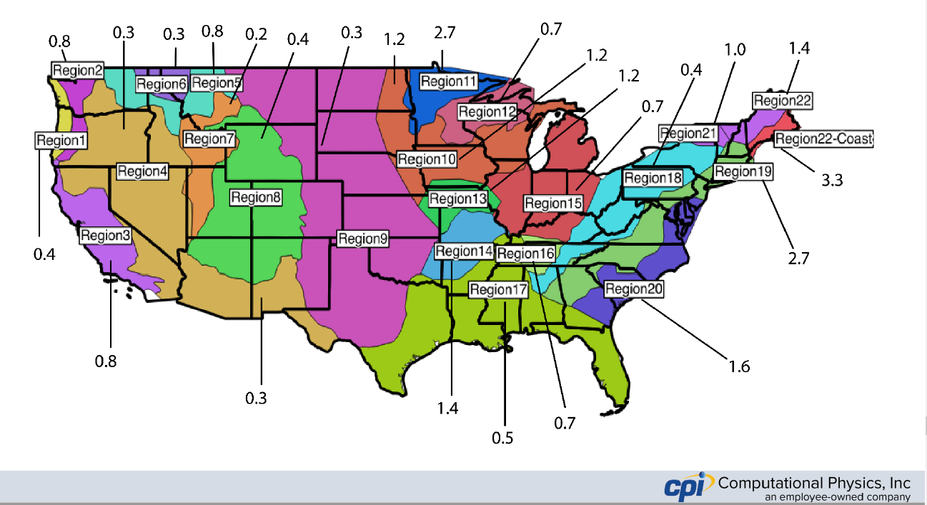
Computational Physics Inc.

Slide 15
NERC
NERC GMD Data Reporting Instruction (GMD DRI)
  Comments discussed with GMDTF in February
  NERC continues development of GMD data reporting application
  Collection to begin in Q4 2020

Slide 16

Updates on EPRI Research of GMD Impacts on the Bulk Power System

