Slide 1
Supply Analysis Working Group Report to WMS
March 4, 2020

Slide 2
SAWG Open Action Items from WMS
TAC Assignment: Review Methodology used to determine Peaker Net Margin (PNM) CONE
Assignment language changed by TAC 1/29/20
Status: in progress; update later in report
Review impacts on CDR from monthly generation interconnection report
Status: Need to discuss at SAWG and come back to WMS if direction needed
Review of Resource Adequacy forecasts and development of a Net Load forecast
Status:
In December ERCOT presented an update on IRR Contribution Comparisons and the difference in Peak Load versus Peak Net Load for both Summer and Winter Peaks.
Expecting further presentations from ERCOT as they get more information on wind peak average capacity contribution methodology from the AWS Truepower project and the battery storage capacity contribution
In February ERCOT presented Probabilistic SARA modeling; update later in report

Slide 3
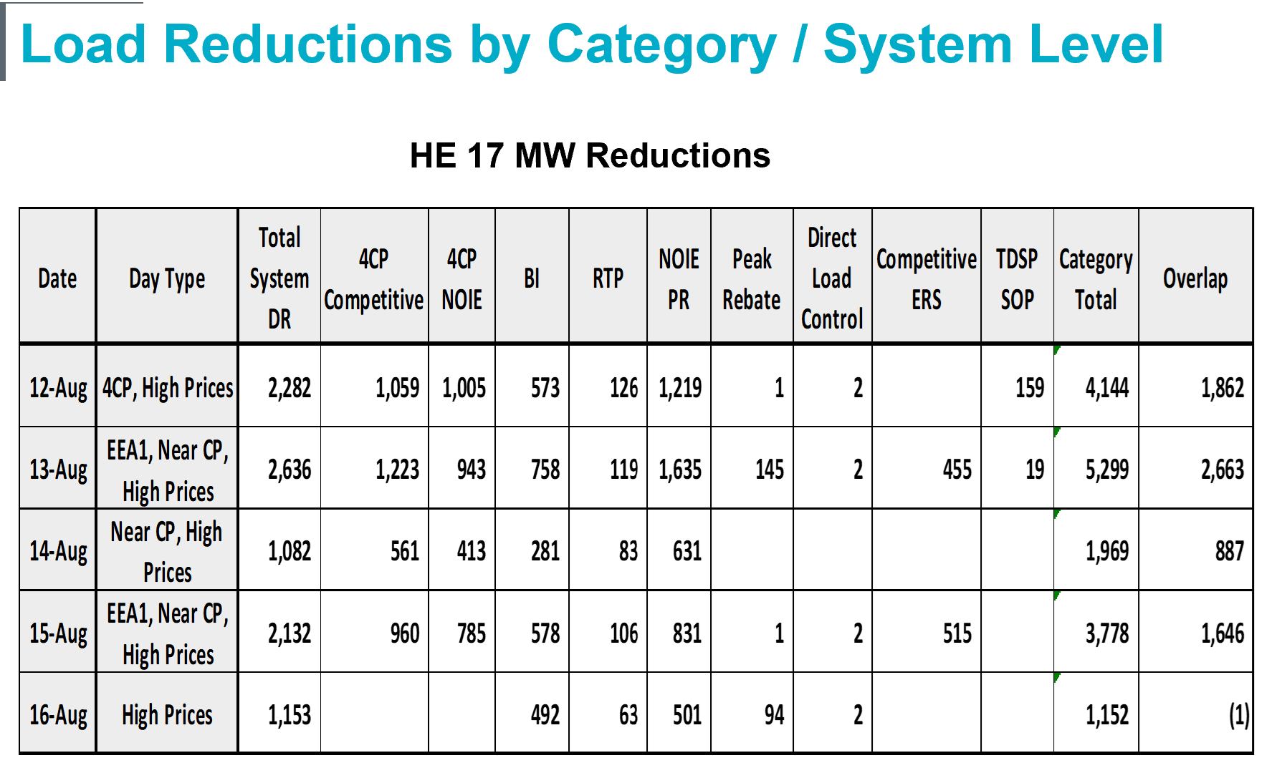
SAWG February Meeting – Demand Response Analysis Summer 2019
**ERCOT to present updated numbers at 3/4/20 WMS**
ERCOT presented numbers are from updated February 6th Commission memo
ERCOT: a lot of overlap in different program numbers; total system DR numbers likely understated

Slide 4
SAWG February Meeting – Battery Storage Capacity Contribution
ERCOT presented a summary of research studies:
Storage with sufficient duration is expected to contribute with 100% capacity over net peak load hours
For storage of a given duration there will be a max installed capacity after which it is no longer contributing 100% over the duration of net peak load
ERCOT current practices for storage capacity contribution:
Uses 0% capacity contribution for battery storage
Currently has not collected data on storage duration (h) or max energy (MWh)
Storage duration and maximum energy data will be available when NPRR1002 BESTF-5 “Energy Storage Resource Single Model Registration and Charging Restrictions in Emergency Conditions” is approved, implemented and information is updated by Resource Entities ~ 2 years

Slide 5
SAWG February Meeting – Battery Storage Capacity Contribution
Interim Solution:
ERCOT will collect storage duration and maximum energy information through EIA data and/or RFI (currently 124 MW installed; 402 MW with SGIA and Financial Security Posted 5.4 GW in the queue for 2022)
Storage will be included in CDR Resource Scenario Analysis tab, where net peak load hours are considered, but continue to be excluded from Reserve Margin calculations
Assign 100% capacity contribution to storage when duration is as long or longer than net peak load
Long-term Solution (once NPRR1002 BESTF-5 in effect):
ERCOT will start using data collected for CDR Reserve Margin calculation purposes
ERCOT will file an NPRR documenting methodology for calculating storage capacity contribution
For new storage resources, assign 100% capacity contribution to storage when duration is as long or longer than net peak load
ERCOT will calculate historic average capacity contributions across peak load and net peak load hours and may adjust the capacity contribution of storage in accordance with historic performance

Slide 6
SAWG February Meeting – Reporting Distributed Generation in the CDR
Currently CDR lists only Distribution Generation Resources (DGRs) and non-fossil fuel Settlement Only Distribution Generators (SODGs)
ERCOT presented proposals to include fossil fuel SODGs and unregistered DGs
CDR Mock-ups found here: http://www.ercot.com/calendar/2020/2/20/199688-SAWG

Slide 7
SAWG February Meeting – Probabilistic SARA
Probabilistic SARA:
Simulates a range of summer peak day hours, 1:00 pm – 8:00 pm, rather than just the single peak load hour
Risk variables defined using probability distributions and random selection of summer renewable MW output shapes for the eight-hour period
Creates an EEA risk profile: For each of the eight hours, the probability of Capacity Available for Operating Reserves being equal to or less than the four EEA declaration thresholds (EEA1, EEA2, EEA3, and EEA3 Load Shed)
SAWG participants thought this was helpful but will continue discussion on if and how to present this data more broadly
ERCOT will continue work on model and present updates to SAWG

Slide 8
SAWG February Meeting -- CONE Study Methodology Write-up
Background:
ERCOT presented language for a “CONE Study Methodology Draft” to be part of the “ERCOT Study Process and Methodology Manual for EORM MERM http://www.ercot.com/calendar/2019/12/13/172748-SAWG
We requested feed back for February SAWG
Only comments received from TCPA:
For Peaker Net Margin purposes a CONE parameter for natural gas-fired Combustion Turbine or peaker, must be used
If different technologies are to be used, those should each be done as a separate CONE
Next Steps:
No other feedback received
ERCOT to revise “CONE Study Methodology Draft” and bring back to SAWG
ERCOT to bring back draft NPRR language on Section 4.4.11 regarding updating the PNM threshold

Slide 9
Next Meetings
March 26, 2020
April 17, 2020

