Slide 1
PDCWG Report to ROS
Chair: Chad Mulholland, NRG
Vice Chair: Jimmy Jackson, CPS
ROS
March 5th, 2020

Slide 2
Report Overview & Notes
Report Overview
Meeting Minutes
BAL-001-TRE-1 FMEs & IMFR
3 FMEs in the month of January
Frequency Control Report

Slide 3
Meeting Minutes
PDCWG Meeting 2/12/2020
NPRR 863 and 960 Phase 1 Implementation Details (FFR)
Review of ERCOT Webex from January
NPRR 863 takes effect March 1, 2020
Battery & Energy Storage Integration
Discussed NOGRR 204, NPRR 989, and NPRR 987
Regulation & Frequency Control Reports

Slide 4
Frequency Measurable Events Performance

Slide 5
Frequency Measurable Events
There were 3 FMEs in December
1/1/2020 12:53:12
Loss of 1,210 MW
Interconnection Frequency Response: 1,169 MW/0.1 Hz
7 of 41 Evaluated Generation Resources had less than 75% of their expected Initial Primary Frequency Response.
6 of 41 Evaluated Generation Resources had less than 75% of their expected Sustained Primary Frequency Response.

Slide 6
Frequency Measurable Events
1/10/2020 20:54:10
Loss of 773 MW
Interconnection Frequency Response: 1,247 MW/0.1 Hz
12 of 63 Evaluated Generation Resources had less than 75% of their expected Initial Primary Frequency Response.
11 of 63 Evaluated Generation Resources had less than 75% of their expected Sustained Primary Frequency Response.
1/17/2020 10:01:06
Loss of 663 MW
Interconnection Frequency Response: 539 MW/0.1 Hz
5 of 24 Evaluated Generation Resources had less than 75% of their expected Initial Primary Frequency Response.
4 of 24 Evaluated Generation Resources had less than 75% of their expected Sustained Primary Frequency Response.

Slide 7
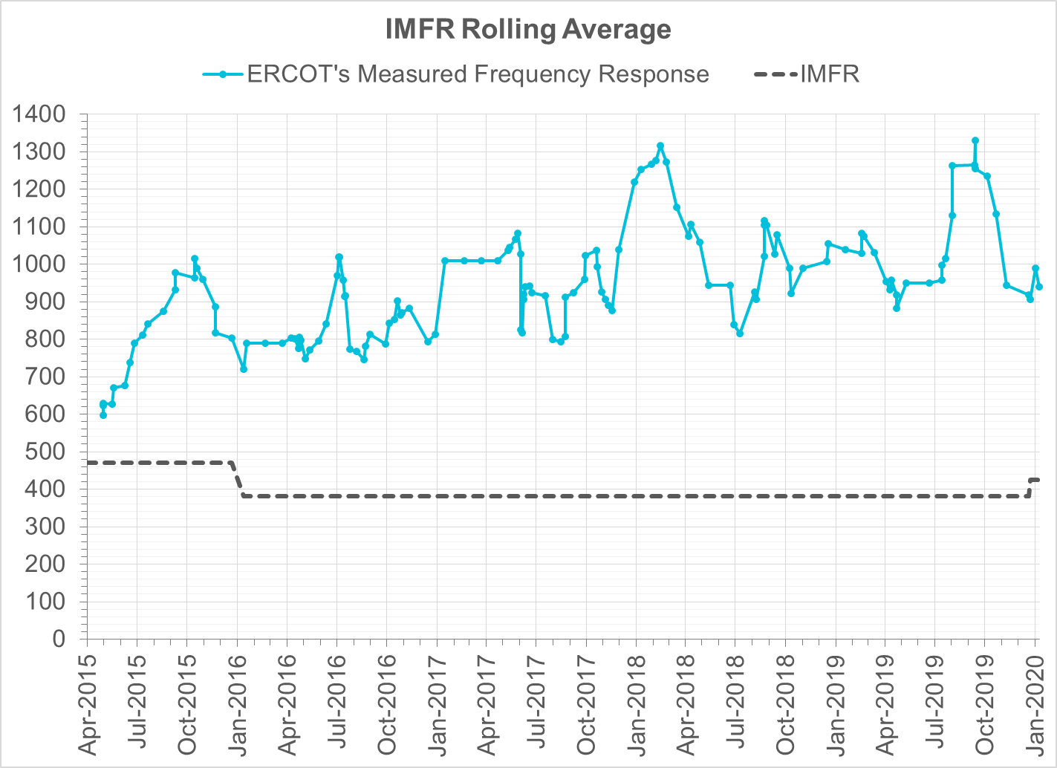
Interconnection Minimum Frequency Response (IMFR) Performance
IMFR Performance currently 939.60 MW/0.1Hz
Frequency Response Obligation (FRO): 425 MW/0.1 Hz

Slide 8
Frequency Control Report
November 2019

Slide 9
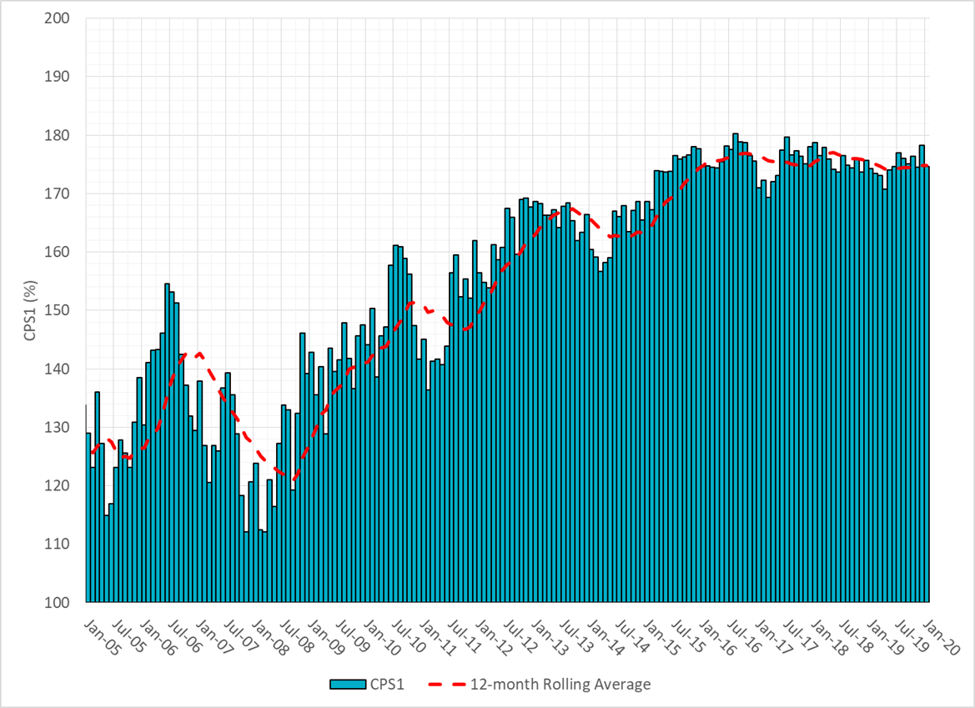
CPS1 Performance

Slide 10
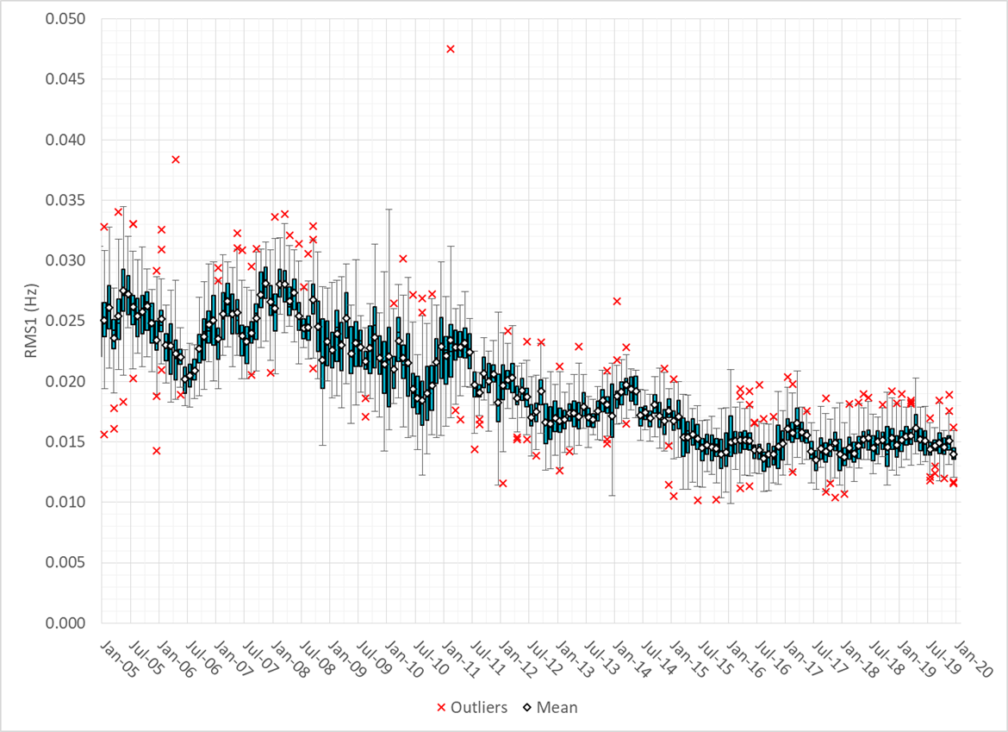
RMS1 Performance of ERCOT Frequency

Slide 11
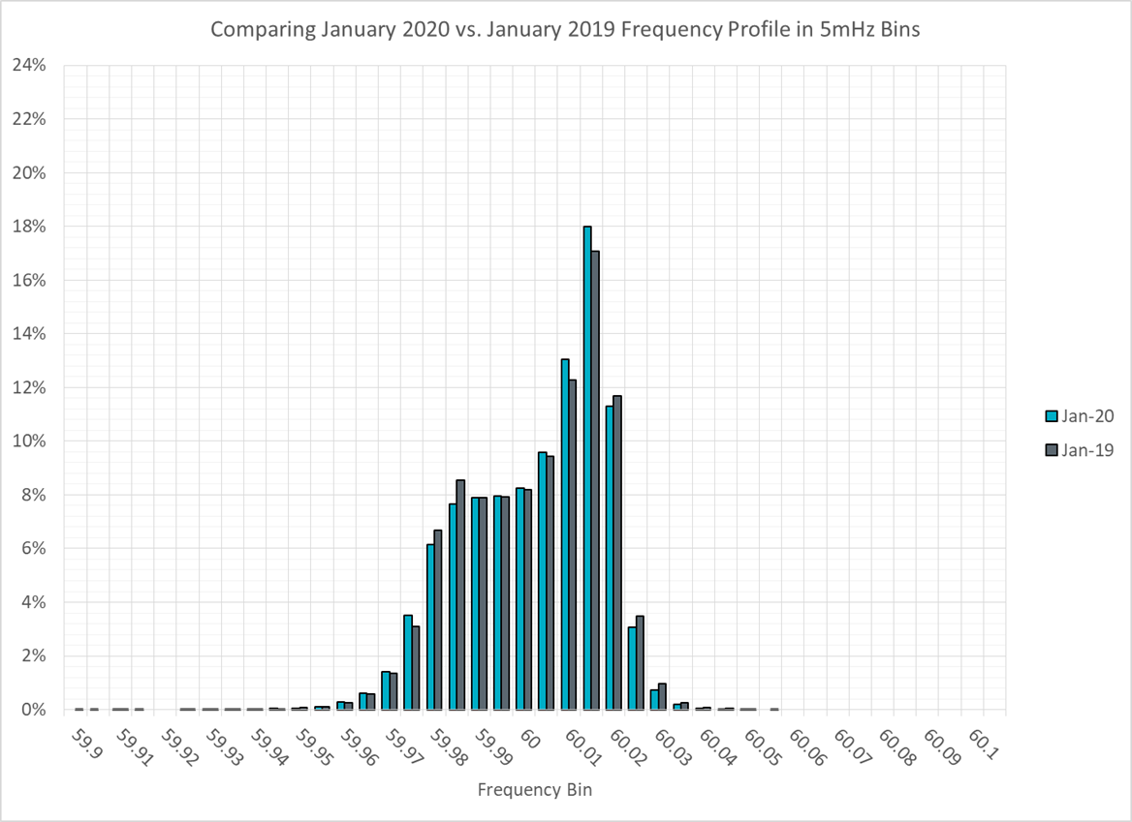
Frequency Profile Analysis

Slide 12
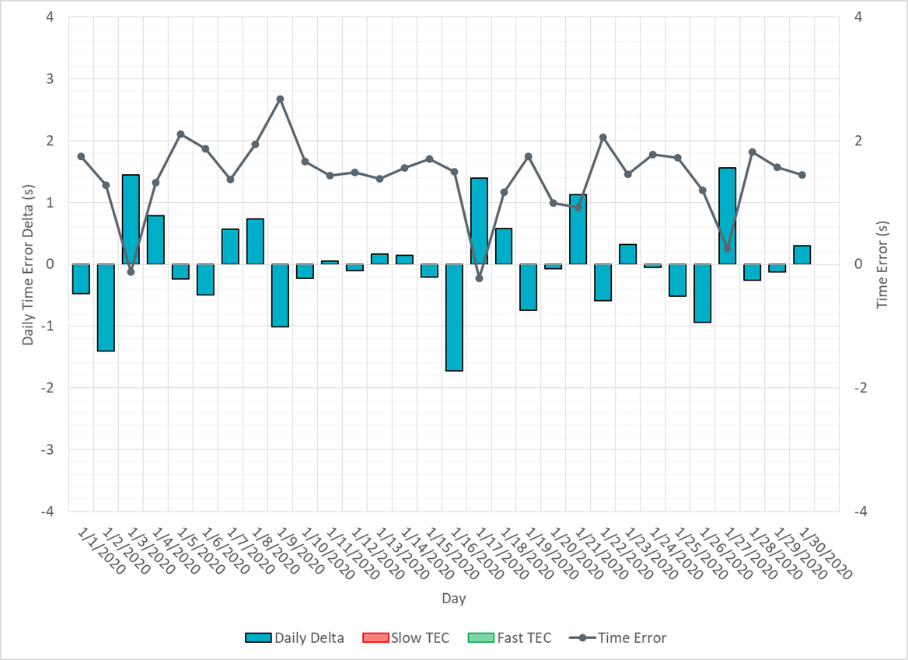
Time Error Corrections

Slide 13
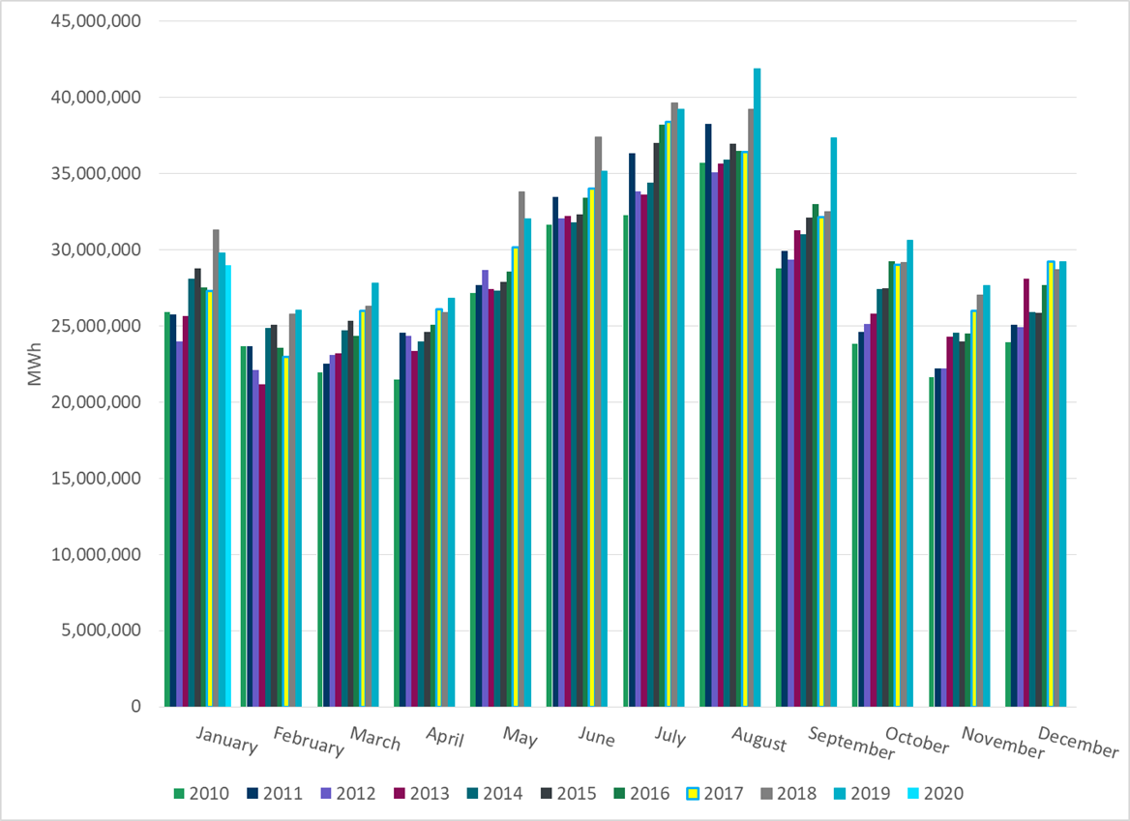
ERCOT Total Energy

Slide 14
ERCOT Total Energy from Wind Generation

Slide 15
ERCOT % Energy from Wind Generation

Slide 16
ERCOT Total Energy from Solar Generation

Slide 17
ERCOT % Energy from Solar Generation

Slide 18
Questions?

