Slide 1
DGR Interim Solution
Testing
Mario Alberto de la Garza
2/27/2020

Slide 2
DGR Interim Solution Testing
Background
Test Roadmap
Findings
Next Steps

Slide 3
Background
In The Past
Now
Transmission Network
Transmission Network
CIM Load
Stuff
DGR
Distribution Network

Slide 4
Background, Con’t
Pros Current Approach:
  Can participate in ERCOT Market
Cons Current Approach:
  TSPs modeling distribution network adds complexity for the State Estimator
  Data quality of distribution networks is questionable (more complexity to the State Estimator)
  TSPs may not be able to provide telemetry on the distribution network (bad visibility)
  Hard for downstream systems to distinguish between GRs and DGRs

Slide 5
DGR Interim Solution Testing
Background
Test Roadmap
Findings
Next Steps

Slide 6
Testing Roadmap
Objective: Find an interim solution to accommodate the increase of DGR requests to integrate to ERCOT without impacting State Estimator
Phase 3A
Loading CIM to EMS ITEST
Phase 4A
EMS ITEST Testing
Phase 1
Define
Interim Modeling Approach
Phase 2
Model Building
Phase 5
Document System Impacts and Changes
Phase 3B
Loading CIM to MMS ITEST
Phase 4B
MMS ITEST Testing

Slide 7
Phase 1 – Define Interim Modeling Approach
Satisfy multiple requirements from multiple departments
Total of 4 meetings prior to Phase 2
Groups that collaborated:
  Network Modeling
  EMMS Production Support
  Operations
  Grid Application Support
  CRR
  Day Ahead Market
  Market Validation
  EPS Metering

Slide 8
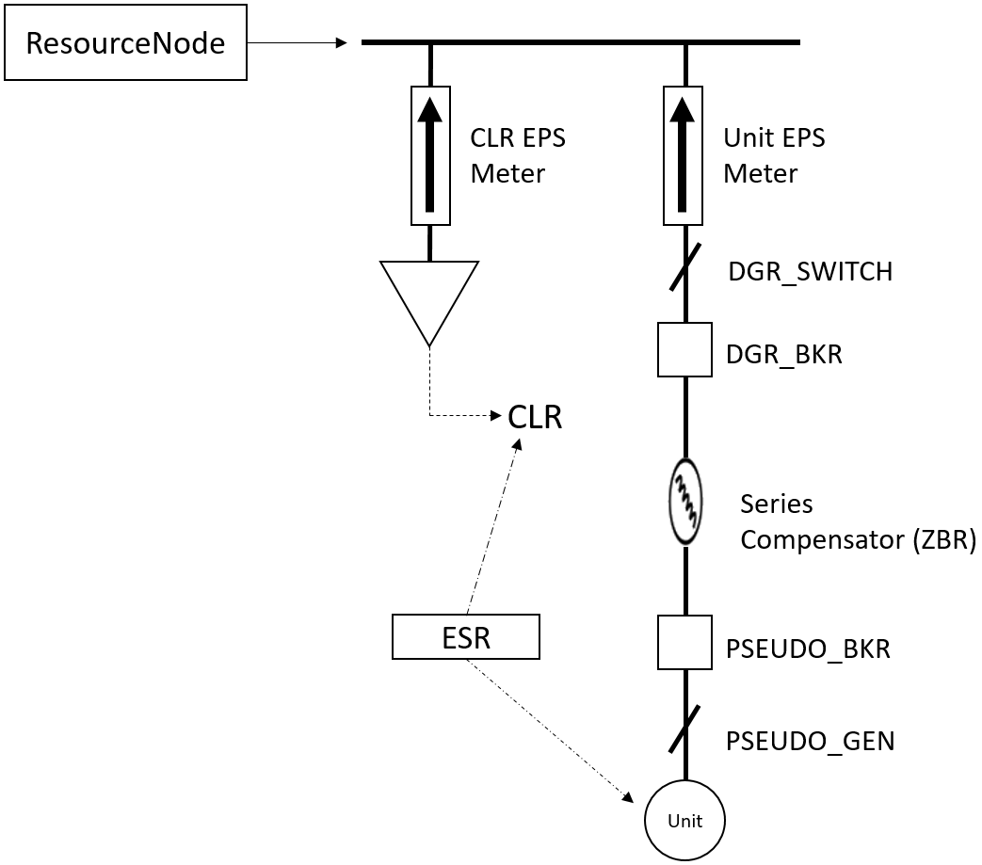
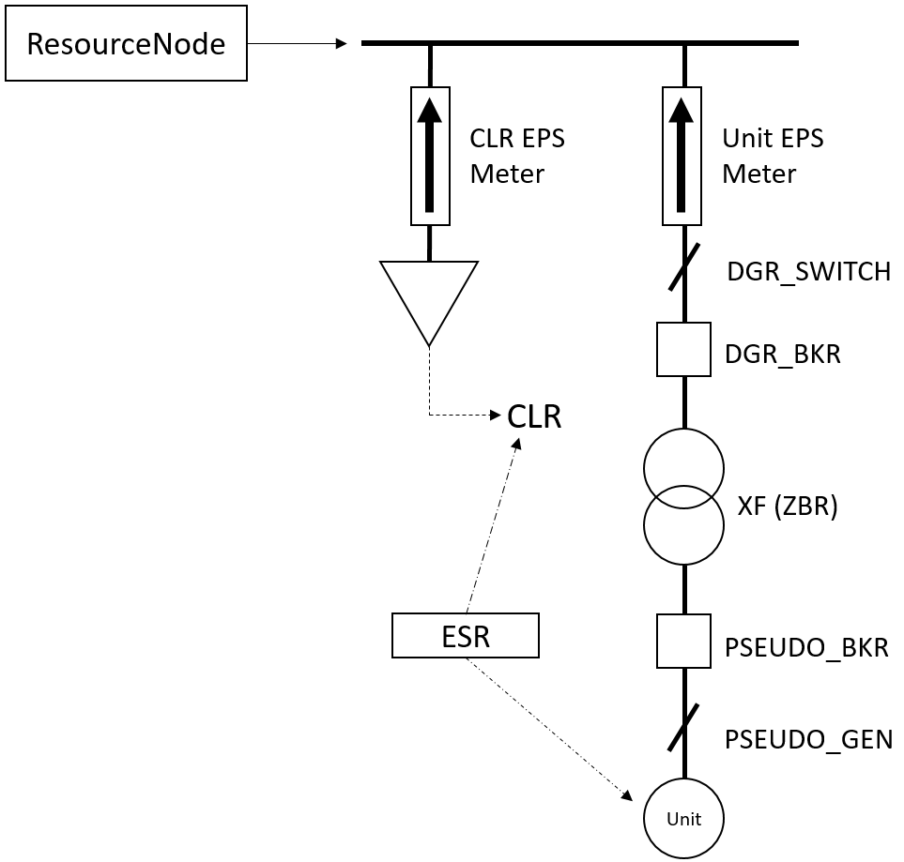
Phase 1, Con’t
Total of 6 options discussed
Two options picked, both DESR

Slide 9
Phase 2
Model Maintenance created the model changes
  Possibility to re-use them for additional testing
  Model Files were available on 1/31/2020
Model Administration build a Feb 11th model with the model changes
  Model was available on 2/4/2020

Slide 10
Phase 3
Started loading the CIM Model on 2/10/2020 to ERCOT ITEST environments
CIM Model Load completed on 2/11/2020
Issues were identified initially when loading the model but were corrected
No showstoppers to interim solution were identified

Slide 11
Phase 4
Business Owners notified to begin testing on 2/11/2020
Business Owners tested from 2/11/2020 through 2/21/2020
Testing included:
  Energy Management System, Network Stability and Security Analysis Applications
  Market Management System, Network Stability and Market Applications Verifications

Slide 12
DGR Interim Solution Testing
Background
Test Roadmap
Findings
Next Steps

Slide 13
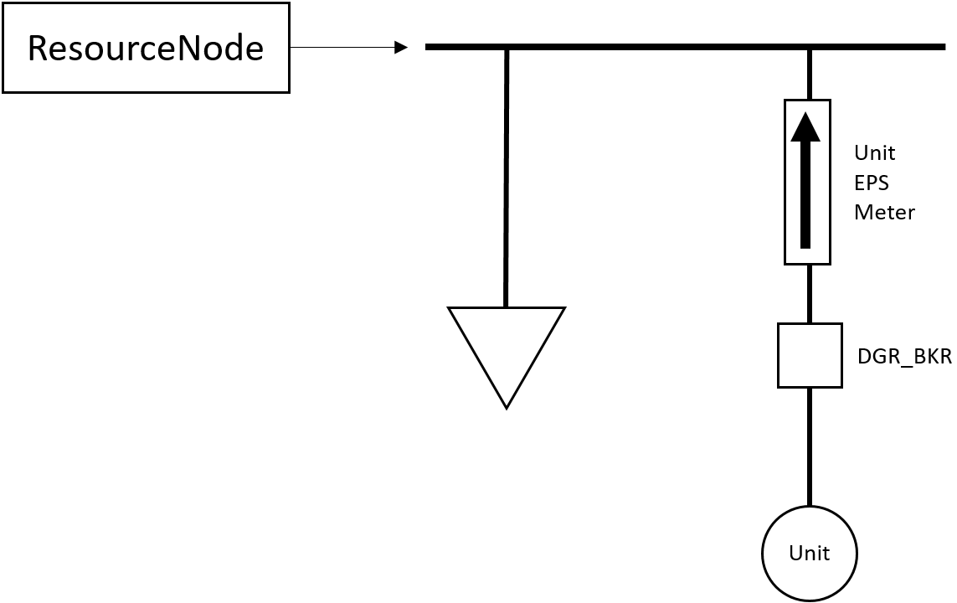
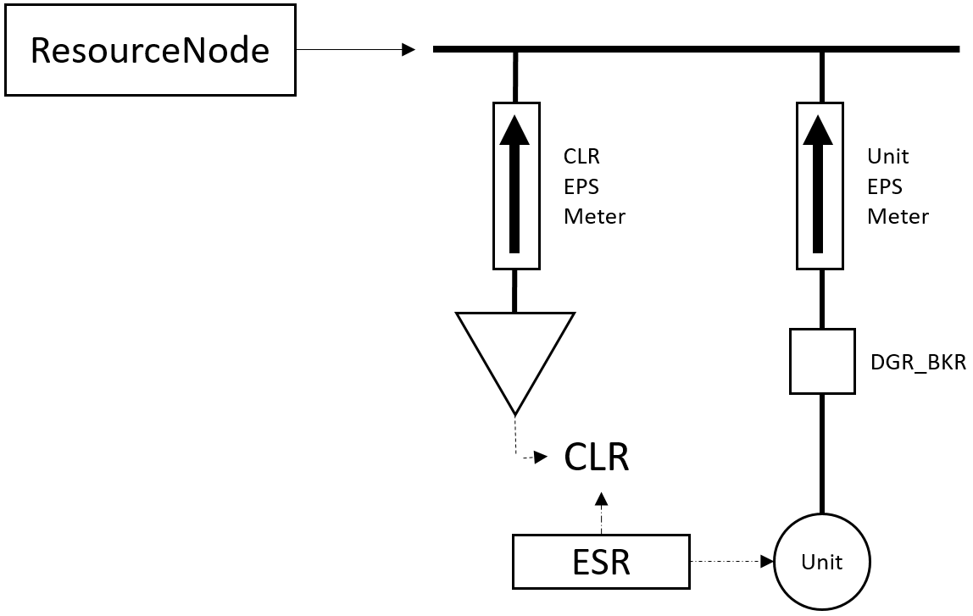
Findings
What has been determined:
  New Interim Modeling Requirements for Downstream System consumption
  System changes for the Energy Management System
  System changes for the Market Management System
  Possible RARF changes
DGR
DESR

Slide 14
DGR Interim Solution Testing
Background
Test Roadmap
Findings
Next Steps

Slide 15
Next Steps
Develop IA for implementing this interim solution
  Complete IA by mid March
NPRR and NOGRR posting will utilize the IA for this Interim Solution

Slide 16

Q & A
QUESTIONS?

