Slide 1
Settlement Timeline Credit Impact
Spoorthy Papudesi
Credit Work Group
ERCOT Public
February 19, 2020

Slide 2
Modifications to existing Parameters
For ”x” day reduction in Settlement Timeline,
RTLCNS included 5-x days of estimates
M1 value decreased by x
-Impacts MAXRTLE and DALE
M2 value decreased by x
-Impacts MAXURTA

Slide 3
Impact of settlement timeline reduction on TPE
*Base TPE as of 02/13/2020 is considered

Slide 4
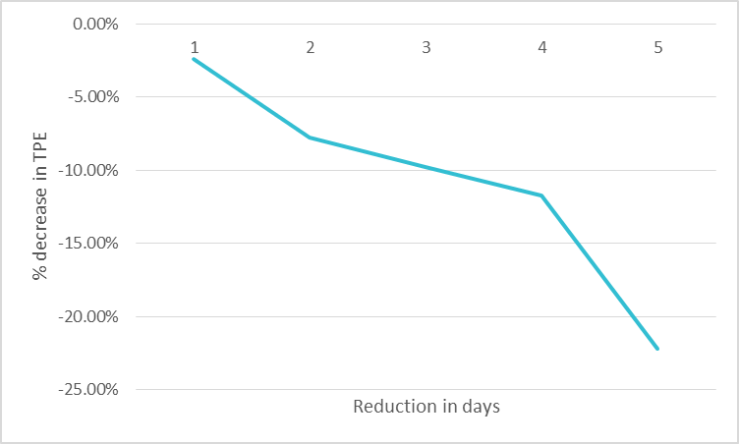
Impact of settlement timeline reduction on TPE
*Base TPE as of 08/13/2019 is considered

Slide 5
Questions

