Slide 1
Planning Guide Revision Request
DGR
Megan Miller
Feb 27, 2020

Slide 2
Overview
Summary of Changes
5.2 General Provisions
5.3 Interconnection Study Procedures for Large Generators
5.4 Interconnection Procedures for Small Generators
6.9 Addition of Proposed Generation to the Planning Models
Next Steps

Slide 3
Summary of Changes
Reorganized Planning Guide Section 5 to:
  Allow processes to be contained within appropriate sections
  Remove duplication
  Remove unnecessary language
  Cover start to commissioning
  Create a structure for large generators
    Simplify and organize
    Allow for new lanes
  Create small generator process
    Avoid confusion with FIS studies
    Organize the process to register
    Create ability to track and report
    Allow for orderly review and resolution of issues

Slide 4
Current Planning Guide Section 5

Slide 5
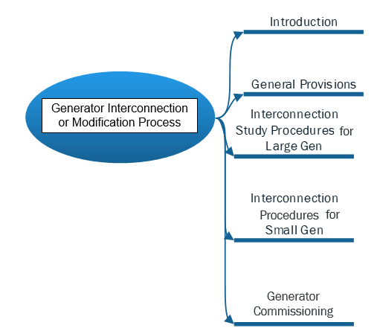
Future Planning Guide Section 5

Slide 6
5.2 General Provisions
Reorganized
Ordered the sequence of the initiation process
Moved several existing sub-sections into the new 5.2
  Applicability
  Confidentiality
  Renamed the section related to updating requested information
  Inactive Status
  Project Cancellations
  Interconnection Agreements and Procedures
    Other TSP Arrangements
    SGIA for Transmission-Connected Generators
    Added IA for Distribution-Connected Generators
    Provisions for MOUs and Co-ops

Slide 7
5.2 General Provisions continued
Applicability
  New Generators and Resources 1 MW or greater
  SOG
  Existing Generators that are modifying capacity or that are changing characteristics of generators or interconnection that need restudy
  Clarifying the use of the term generator and creating large and small generator terms

Slide 8
5.2 General Provisions continued
5.2.1 Applicability
(3) For the purposes of determining the appropriate requirements in this Section 5, ERCOT may require two or more separate generator interconnections to the same substation to follow the process applicable to large generators if, following the proposed change, those generators would have an aggregate nameplate capacity of 10 MW or greater, and the projects are proposed by the same Entity or Affiliates.

Slide 9
5.3 Interconnection Study Procedures for Large Generators
Several existing sub-sections were relocated into the new 5.3
  Security Screening Study
  Full Interconnection Study
    Proof of Site Control
    FIS Scoping Process
      Incorporated new feasibility for distribution projects 10 MW or greater
    FIS Description and Methodology
    FIS Elements (SS, SC, Stability, and Facility studies)
    FIS Report and Follow-up
  ERCOT Economic Study

Slide 10
NEW: Feasibility for Distribution Connected Large Generators
5.3.1 Security Screening Study
(7) For any GINR that proposes either a large generator that would be interconnected at distribution voltage or a qualifying modification to a large generator that is interconnected at distribution voltage, ERCOT will not initiate a screening study or propose any FIS scope meeting until the IE first provides written confirmation from the affected DSP stating that the DSP has evaluated the proposed project and has determined that the interconnection of the generator at distribution voltage is electrically feasible and does not, as proposed, violate the DSP’s tariff or any other applicable authority administered by the DSP. In conducting a screening study for such a GINR, ERCOT shall evaluate only the transmission-level impacts, if any, of the proposed generator, and the affected DSP shall provide ERCOT any information concerning the DSP’s facilities or the proposed generator interconnection as may be requested by ERCOT for the purpose of completing the screening study.

Slide 11
NEW: 5.4 Interconnection Procedures for Small Generators
5.4.1 Small Generator Review Meeting
(1) Within ten Business Days of the IE’s submission of the GINR, ERCOT will contact the TSP and or DSP to schedule the Small Generator Review Meeting. ERCOT will identify the relevant TSP and or DSP based upon a preliminary analysis of the most likely Point of Interconnection (POI), or for a distribution-connected GINR, the most likely transmission-level bus. If an IE has previously developed a small generator subject to this section 5, the IE may request to forgo the scope meeting and ERCOT may agree to forgo the scope meeting.
(2) During the small generator review meeting, the IE will present the proposed GINR addressing general information related to the project. Key information about the project goals such as if the project will be designated for SOG or GR. Special operating expectations if any and designated point of contact for all parties to work with during the interconnection process.
(3) The relevant TSP or DSP will facilitate a general discussion of any studies performed or necessary to be performed and will identify a designated point of contact for issues and questions during interconnection process.
(4) ERCOT will address relevant documentation and technical requirements that will be necessary to complete the process.

Slide 12
NEW: 5.4 Interconnection Procedures for Small Generators
5.4.2 Submission of Interconnection Agreement and TSP and/or DSP Studies and Technical Requirements
(1) As a condition for ERCOT’s acceptance of the Resource Registration form for a GINR involving a small generator, the following conditions must be met:
(a) The IE must submit a copy of a fully executed interconnection agreement with the TDSP, if required per section 5.2.8.
(b) The TDSP to which the generator is proposed to interconnect, or in the case of a modification described in Section 5.1.1(1)(c), the TDSP to which the generator currently connects, must provide written confirmation via email to ERCOT stating that all interconnection studies required by the TDSP have been completed, and indicating whether any operational limitations, including ramping limitations, maximum output limitations, or other restrictions, are expected to affect the generator’s operation. If the TDSP identifies operational limitations, the TDSP must describe those limitations.
(c) The TDSP must identify in writing via email to ERCOT any transmission or distribution system upgrades required to support the generator’s interconnection, the timeline for those upgrades, and the operational limitation on the generator’s operation in the interim.

Slide 13
NEW: 5.4 Interconnection Procedures for Small Generators
5.4.3 Reviews and Approval to Submit Model Information
(1) ERCOT shall provide for review of submitted Interconnection Agreements, TSP and DSP study findings, and technical requirements.
(2) ERCOT shall communicate within 10 business days the need for clarification or additional information. ERCOT shall provide a reason for any information that is not able to be approved or accepted.
(3) The IE shall have 10 business days to submit clarifications or additional information in response to ERCOT reviews.
(4) If the IE doesn’t respond within 10 business days then the ERCOT may place the project in inactive status. Once the IE provides the information then it may place the project in active status and ERCOT shall have 10 business days for reviews.
(5) Once the project has provided required agreements, studies and technical requirements and ERCOT reviews have been completed then the approval to submit Model information will be granted and the project may be included in ERCOT systems.

Slide 14
6.9 Addition of Proposed Generation to the Planning Models
Incorporating the RIOO system
Adding in applicable language for small generators to be included in appropriate models

Slide 15
Next Steps
Submit questions/redline feedback by March 13th
Bill Blevins
Bill.Blevins@ercot.com
(512)-248-6691

