Slide 1
Market Credit Working Group update to the Wholesale Market Subcommittee
Bill Barnes, NRG, Chair
Josephine Wan, Austin Energy, Vice Chair
3/04/2020

Slide 2
MCWG update to WMS
General Update
February 19 Joint MCWG/CWG Meeting
8 NPRRS reviewed for their credit impacts
903NPRR Day-Ahead Market Timing Deviations – No Credit Impact
973NPRR Add Definitions for Generator Step-Up and Main Power Transformer – No Credit Impact
990NPRR Relocation of Combined Cycle Train to Resource Attribute – No Credit Impact
953NPRR Addition of Relay Loadability Rating Definition – No Credit Impact
975NPRR Load Forecast Model Transparency – No Credit Impact
983NPRR Delete Remaining Grey-Boxed Language Associated with NPRR257, Synchronization with Nodal Operating Guide Section 9, Monitoring Programs and Changes to Posting Requirements of Documents Considered CEII – No Credit Impact
992NPRR Updated Day-Ahead Liability for NPRR863, Creation of ERCOT Contingency Reserve Service and Revisions to Responsive Reserve – Positive Credit Impact. More accurately reflect the Day-Ahead liability estimate impacts due to changes to Ancillary Services as reflected in NPRR863
993NPRR Grey Box Resolution re NPRR902 and NPRR928 – No Credit Impact

Slide 3
MCWG update to WMS
2020 Goals
Review the ongoing impact on market participant credit exposure and collateral requirements resulting from the incorporation of a forward price curve-based methodology
Clarify the market’s risk tolerance/appetite level and provide regular updates on credit exposure to the ERCOT Board
Evaluate and quantify potential market risk under current credit rules and examine a framework for reviewing rules in flight
Effectively communicate credit risk to the market
Examine current Protocol language to determine how effective current calculations capture actual credit risk
Review settlement timeline and determine if a reduction is feasible

Slide 4
MCWG update to WMS
Evaluate Shortening the Settlement Timeline
CWG/MCWG will be evaluating the potential to reduce the settlement timeline to less than OD + 5.
Since meter data availability is a primary factor in determining the optimal settlement timeline, CWG/MCWG will coordinate with RMS to schedule a workshop to review current timelines and potential to increase data availability sooner.
Stakeholders must weigh data accuracy vs. reduced credit exposure.
Less than 10% of IDR meter data is available at Initial Settlement (OD+5).
IDR meter data represents 25% to 35% of total ERCOT load.
Opportunity to reduce breach or default timelines?
 | ERCOT | PJM | ISO NE | NY ISO | SPP
Days to pay a settlement invoice | 2 | 3 | 2 | 2 | 4
Days to cure an invoice breach | 1 | 2 | 0 | 1 | 2
Days to post additional collateral | 2 | 2 | 1 | 2 | 2
Days to cure a collateral breach | 1 | 1 | 0 | 2 | 0

Slide 5
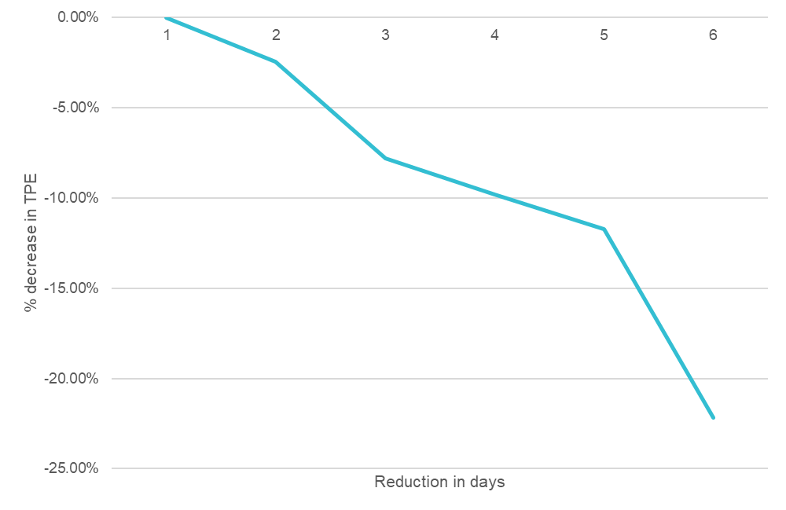
MCWG update to WMS
Evaluate Shortening the Settlement Timeline
For ”x” day reduction in Settlement Timeline:
RTLCNS included 5-x days of estimates
M1 value decreased by x
Impacts MAXRTLE and DALE
M2 value decreased by x
Impacts MAXURTA

Slide 6
MCWG update to WMS
Update on Suspension/Termination Process for a QSE Representing a Resource Entity
Practicability of Virtual QSE Concept for Resource Entities
RE is same Entity as failed or suspended QSE:
Should be technically feasible since same Entity is performing QSE functions
RE is not same Entity as failed or suspended QSE:
Protocols arguably require RE to be designated as a Virtual QSE, but can it act in that role technically (telemetry, MIS, 24/7 operational communications)?
Next Steps
Develop NPRR to clarify rules and align them with ERCOT’s and Market Participants’ capabilities
Eliminate obvious ambiguities and conflicts
Split rules for LSEs and Resource Entities
For each, split rules for same vs. not same Entity as failed or suspended QSE
Consider additional NPRR to add further detail and incorporate desired changes to current practice

Slide 7
MCWG update to WMS
Proposed Surety Bond Form Revisions
Limits
Current (per Protocol Section 16.11.3(1)(c)(iii)):
$10 million per Counter-Party per insurer
Max $100 million per insurer for all ERCOT Counter-Parties
Proposed Change
To be discussed
Credit Rating of Issuer
Current (per Protocol Section 16.11.3(1)(c)(ii)):
Minimum rating of “A-” with S&P, “A-” with Fitch, or “A3” with Moody’s
Proposed Change
Minimum “A” rating from A.M. Best

Slide 8
MCWG update to WMS
Proposed Surety Bond Form Revisions
Timing of Payment
Current:
On or before 5:00 p.m., local time in Austin, Texas, on the first Business Day after receiving notice from ERCOT
Proposed Change
Not later than the first business day following receipt of the ERCOT’s written demand
Termination
Current:
60 day notice by surety, principal to find replacement surety 30 days before date of termination (or provide cash collateral)
Proposed
60 day notice by surety, principal to find replacement surety 50 days before date of termination (or provide cash collateral)

Slide 9
MCWG update to WMS
Proposed Surety Bond Form Revisions
Waiver of defenses
Current (Section 3.02 of Bond):
Broad waiver of defenses by surety; waiver of right to set-off
Proposed Change
No waiver of defenses or right to set-off
Acknowledgments
Current:
Makes clear ERCOT can revise SFA/Protocols, etc. without impacting obligations under bond
Proposed: No such language
Dispute Resolution
Current:
Disputes concerning bond subject to ERCOT ADR
Proposed: No such language

Slide 10
MCWG update to WMS
Treatment of CRR Options in the Future Credit Exposure calculation
DC Energy’s Recommendation
• Our recommendation is to calculate one portfolio adder that includes options and obligations together
• This modification brings symmetry to the portfolio adder by appropriately accounting for the impact of options and obligations in portfolio before determining its worst case
• The change would reflect the risk reducing value of the option product and the actual risk of a portfolio
Detailed example of CRR option/obligation offset found at the end of this presentation:
http://www.ercot.com/content/wcm/key_documents_lists/192842/Item_8A_DC_Energy_ERCOT_Credit_Reform_Feb_2020.pdf

