Slide 1
Battery Storage Capacity Contribution for CDR
Supply Analysis Working Group
Julia Matevosyan
Resource Adequacy
February 20, 2020

Slide 2
Outline and Key Points
Storage capacity contribution is still a topic of ongoing research
ERCOT has reviewed storage capacity contribution studies carried out by the National Renewable Energy Laboratory (NREL), Lawrence Berkeley National Laboratory (LBNL), Electric Power Research Institute (EPRI) and ICF International (ICF)
NREL’s, EPRI’s and ICF’s studies all included ERCOT system as one of their test cases
Even though the methods used in the studies are different, the conclusions are generally very similar

Slide 3
Research Study Findings (NREL, LBNL, EPRI, ICF)
Storage capacity contribution depends on its duration and intended use (i.e. AS or energy arbitrage or both)
Storage duration is determined as maximum energy divided by maximum discharge capacity.
Storage with sufficient duration is expected to contribute with 100 % capacity over peak net load hours, since these will be the hours with the highest prices.
The width of the net load peak is system-specific but as more storage is added to a system the width of peak net load will increase.
Thus, for storage of a given duration there will be a maximum installed capacity after which it is no longer contributing 100% over the entire duration of the net load peak.

Slide 4
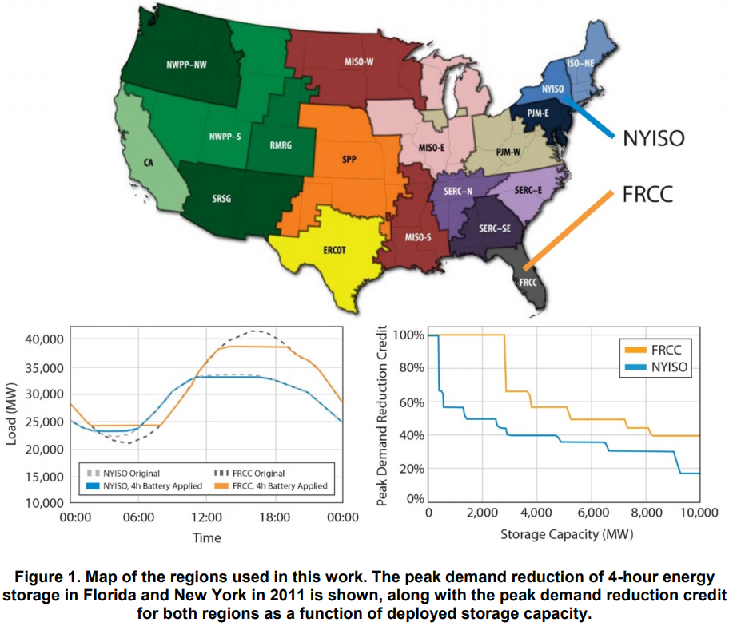
NREL’s Study: The Potential for Battery Energy Storage to Provide Peaking Capacity in the United States
Peaking capacity potential is a function of region’s load shape
4-hour storage typically works best in strongly summer peaking systems with narrow peaks
Ability of 4-hour storage to reduce peak demand drops as net demand shape widens
Source: NREL

Slide 5
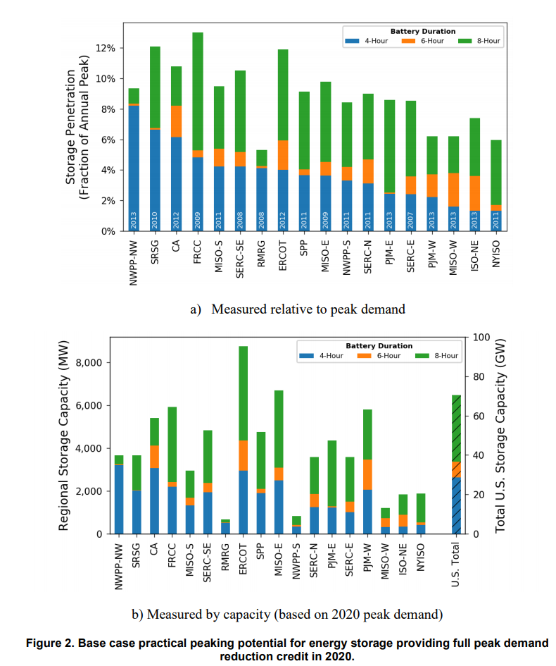
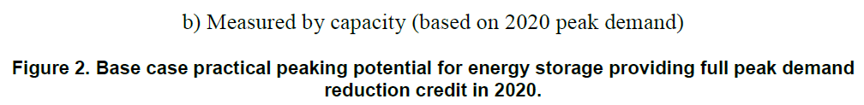
Peaking Capacity Potential is a Function of Region’s Load Shape
Source: NREL
Notes:
Based on NREL study shown on the figure ERCOT numbers are : 4-hour 2948 MW (4%); 6-hour 1420 MW (2%); 8-hour 4390 MW (6%)
Base case did not consider changes in load shapes that occur with wind and solar

Slide 6
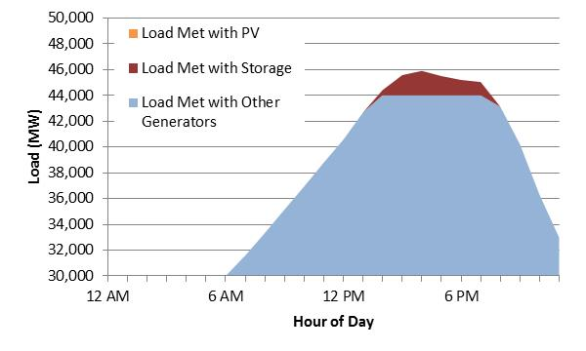
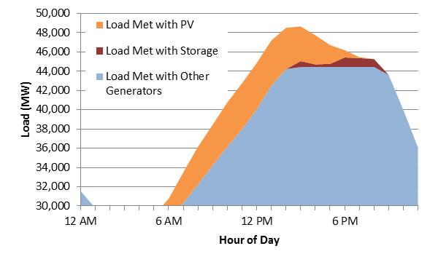
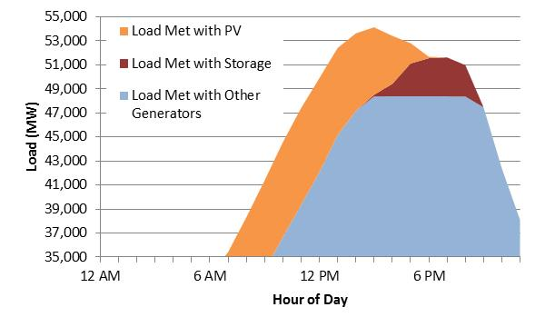
Adding Solar may Increase Storage’s Potential to Provide 100% Capacity over Net Load Peak
Adding solar tends to narrow period of peak demand, potentially increasing the ability of 4-hour storage to act as peaking capacity
The practical potential of 4-hour storage increases as a function of PV deployment in all regions, but with a variety of regional patterns
Zero PV
5% PV
10% PV
Source: NREL

Slide 7
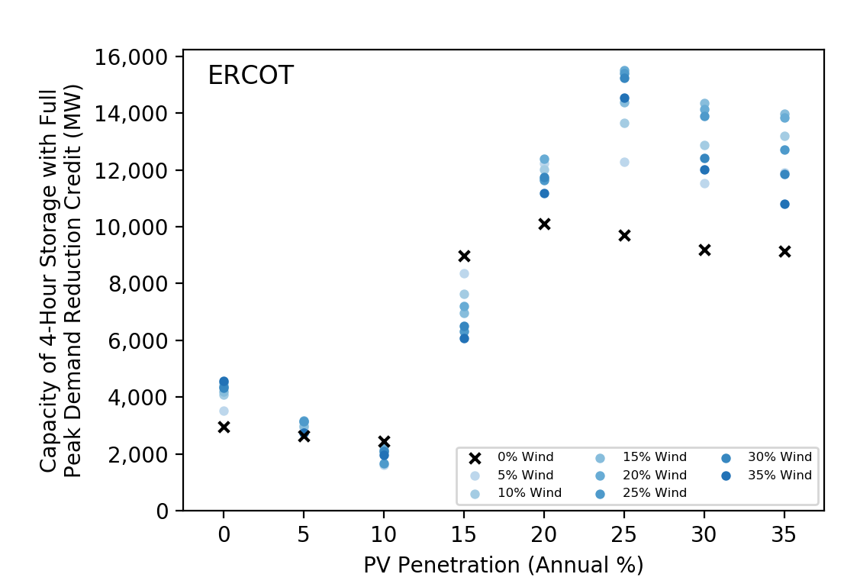
The Potential for Storage to Provide Peaking Capacity in ERCOT at Different Levels of Solar and Wind
Source: NREL
Notes:
NREL’s study (for ERCOT and all other regions) has demonstrated that PV can change the net load shape and potentially increase energy storage’s potential to provide 100% capacity contribution over net load peak or reduce the storage duration needed for 100% capacity contribution. No such correlation with wind has been found.

Slide 8
Current Situation
ERCOT currently uses 0% capacity contribution for battery storage
ERCOT currently does not collect data on storage duration (h) or maximum energy (MWh).
This data will be available once BESTF-5 NPRR “Energy Storage Resource Single Model Registration…” (based on KTC-1) is approved and implemented in RIOO-IS, and Resource Entities update their resource information. This may take 2+ years.
Based on 01/31/2020 GIS Report:
124 MW of installed battery storage capacity
402 MW with SGIA and Financial Security Posted
5.4 GW of battery storage (with FIS started) in the interconnection queue with COD before the end of 2022.

Slide 9
Proposed Way Forward: Interim Solution
To start including storage in the CDR, ERCOT needs storage MWh and duration information prior to BESTF-5 NPRR implementation. EIA data? RFI? Both?
Using this data, ERCOT will include storage in the CDR Resource Scenario Analysis tab, where net load peak hours are considered; ESRs will continue to be excluded from Reserve Margin calculations.
Using historic data, ERCOT will be calculating historic average capacity contributions across peak load hours and net load peak hours, similarly to wind and solar.

Slide 10
Proposed Way Forward: Long Term Solution
Once BESTF-5 NPRR is implemented and Resource Entities provide their ESR duration information, ERCOT will start using this data for CDR Reserve Margin calculation purposes
ERCOT will file an NPRR documenting the methodology for calculating storage capacity contribution
  Using historic data, ERCOT will be calculating historic average capacity contributions across peak load hours and net load peak hours, similarly to wind and solar.
  ERCOT then adjust the capacity contribution of storage in accordance with historic performance

Slide 11
References
EPRI: Energy Storage Capacity Value Estimation, Report 3002013957, January 2019, http://membercenter.epri.com/abstracts/Pages/ProductAbstract.aspx?ProductId=000000003002013491
NREL: The Potential for Battery Energy Storage to Provide Peaking Capacity in the United States, Report, June 2019, https://www.nrel.gov/docs/fy19osti/74184.pdf
LNBL: Drivers of the Resource Adequacy Contribution of Solar and Storage for Florida Municipal Utilities, October 2019, https://emp.lbl.gov/publications/drivers-resource-adequacy
ICF: Unlocking the Hidden (Capacity) Value in Energy Storage, Whitepaper, 2016 https://www.icf.com/insights/energy/unlocking-the-hidden-capacity-value-in-energy-storage

Slide 12

Thank you! Questions?
Julia Matevosyan
jmatevosjana@ercot.com

Slide 13
ERCOT: 2018 Form EIA-860 Data - Schedule 3, 'Energy Storage Data' (Operable Units Only)
Note: Duration (h) is calculated as Energy Capacity (MWh)/Maximum Discharge Rate (MW) and is not part of Form EIA – 860 Data

