Slide 1
Analysis of Load Reductions Associated with 4-CP Transmission Charges and Price Responsive Load/Retail DR
Carl L Raish
Principal Load Profiling and Modeling
Supply Analysis Working Group – February 20, 20

Slide 2
Overview
  Summer 2019 Analysis Update
    Updates to Commission Filing
  Price Response and Retail DR
    Block and Index Pricing (BI)
    Other Load Control (OLC)
    Other Voluntary DR (OTH)
    Peak Rebate (PR)
    Real Time Pricing (RTP)
  NOIE Price Response
  Pure Demand and Price Response
  TOU

Slide 3
Summer 2019 Analysis Update
  Includes ERS-10 reductions for Aug 13
    Was deployed in error and not included in commission filing
  Corrections to properly include ERCOT-read SOG
  For ESIIDs known to be associated with SOG exclude day with export from baseline calculations for the ESIID
  ERCOT has modified and posted the TDSP Read Generator form to include ESIID associated with the Resource Id and will do a mass update for previous submissions
  This will allow allocation of response to SOGs rather than treating the it as load response

Slide 4
Load Reductions by Category / System Level
HE 17 MW Reductions

Slide 5
ESIIDs Reduce by Category / System Level

Slide 6
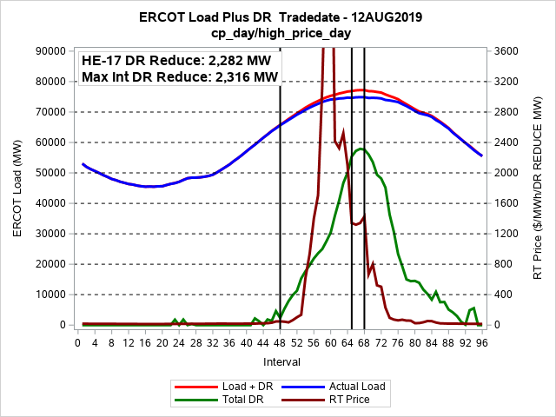
Re-Constituted ERCOT Load

Slide 7
Re-Constituted ERCOT Load

Slide 8
Re-Constituted ERCOT Load

Slide 9
Re-Constituted ERCOT Load

Slide 10
Re-Constituted ERCOT Load

Slide 11
DR/PR Category Results

Slide 12
4CP/NearCP Events
4CP Days
NearCP Days

Slide 13
4CP Load Reductions – August Week

Slide 14
4CP Load Reductions – August Week

Slide 15
4CP Load Reductions – August Week

Slide 16
4CP Load Reductions – August Week

Slide 17
BI Pricing ESIID Participation
Business

Slide 18
BI High Price Events

Slide 19
BI Load Reductions – August Week

Slide 20
BI Load Reductions – August Week

Slide 21
BI Load Reductions – August Week

Slide 22
BI Load Reductions – August Week

Slide 23
BI Load Reductions – August Week

Slide 24
Real-Time Pricing ESIID Participation
Business
Residential

Slide 25
RTP High Price Events

Slide 26
RTP Load Reductions – August Week

Slide 27
RTP Load Reductions – August Week

Slide 28
RTP Load Reductions – August Week

Slide 29
RTP Load Reductions – August Week

Slide 30
RTP Load Reductions – August Week

Slide 31
NOIE Price Response
NOIEs did not report participation in BI or RTP, but did use other categories to respond to price.

Slide 32
NOIE High Price Events

Slide 33
NOIE Price Response – August Week

Slide 34
NOIE Price Response – August Week

Slide 35
NOIE Price Response – August Week

Slide 36
NOIE Price Response – August Week

Slide 37
NOIE Price Response – August Week

Slide 38
Peak Rebate ESIID Participation
Business
Residential

Slide 39
Peak Rebate Events

Slide 40
Peak Rebate Load Reductions – August Week

Slide 41
Peak Rebate Load Reductions – August Week

Slide 42
Direct Load Control ESIID Participation
Business
Residential

Slide 43
Direct Load Control Events

Slide 44
DLC Load Reductions – August Week

Slide 45
DLC Load Reductions – August Week

Slide 46
DLC Load Reductions – August Week

Slide 47
DLC Load Reductions – August Week

Slide 48
ERS Load Reductions – August Week

Slide 49
ERS Load Reductions – August Week

Slide 50
TDSP SOP Load Reductions – August Week

Slide 51
TDSP SOP Load Reductions – August Week

Slide 52
TOU ESIID Participation
Business
Residential
NOIEs reported 3,053 Residential and 1,650 Non-residential customers on TOU

Slide 53
Pure DR/PR
  Pure response:
  Response attributable to a category with no influence from participation in another category.
  Example: An ESIID participates in 4CP and RTP.
  Pure 4CP response for the ESIID would be on 4CP/NearCP days without high prices.

Slide 54
Pure Price Response
ERS & TDSP only deployed on 4CP and high price days, so cannot calculate pure response.
Since both are deployed in EEA, they are likely to be used during high price events.
Peak Rebate and Direct Load Control pure response is only slightly lower than actual response.

Slide 55
Questions?
ON
OFF
craish@ercot.com 512/248-3876

