Slide 1
Review of ERS Restoration Period
TAC Information Session
February 26, 2019

Slide 2
Review of ERS Restoration Period
One of the four ERS related issues that came out of the Summer 2019 Lessons Learned
Reliability deployment price adder ramp

Slide 3
Reliability deployment price adder ramp
Current protocol language added through NPRR626
6.5.7.3.1 Determination of Real-Time On-Line Reliability Deployment Price Adder
(e) Add the deployed MW from ERS to GTBD. The amount of deployed MW is determined from the XML messages and ERS contracts. After recall, an approximation of the amount of un-restored ERS shall be used. After ERCOT recalls each group, GTBD shall be adjusted to reflect the restoration of load using a linear curve over the ten hour restoration period. The restoration period shall be reviewed by TAC at least annually, and ERCOT may recommend a new restoration period to reflect observed historical restoration patterns.

Slide 4
August 13 ERS deployment
Reliability deployment price adder ramp
Total Response (MWs)

Slide 5
August 15 ERS Deployment
Reliability deployment price adder ramp
Total Response (MWs)

Slide 6
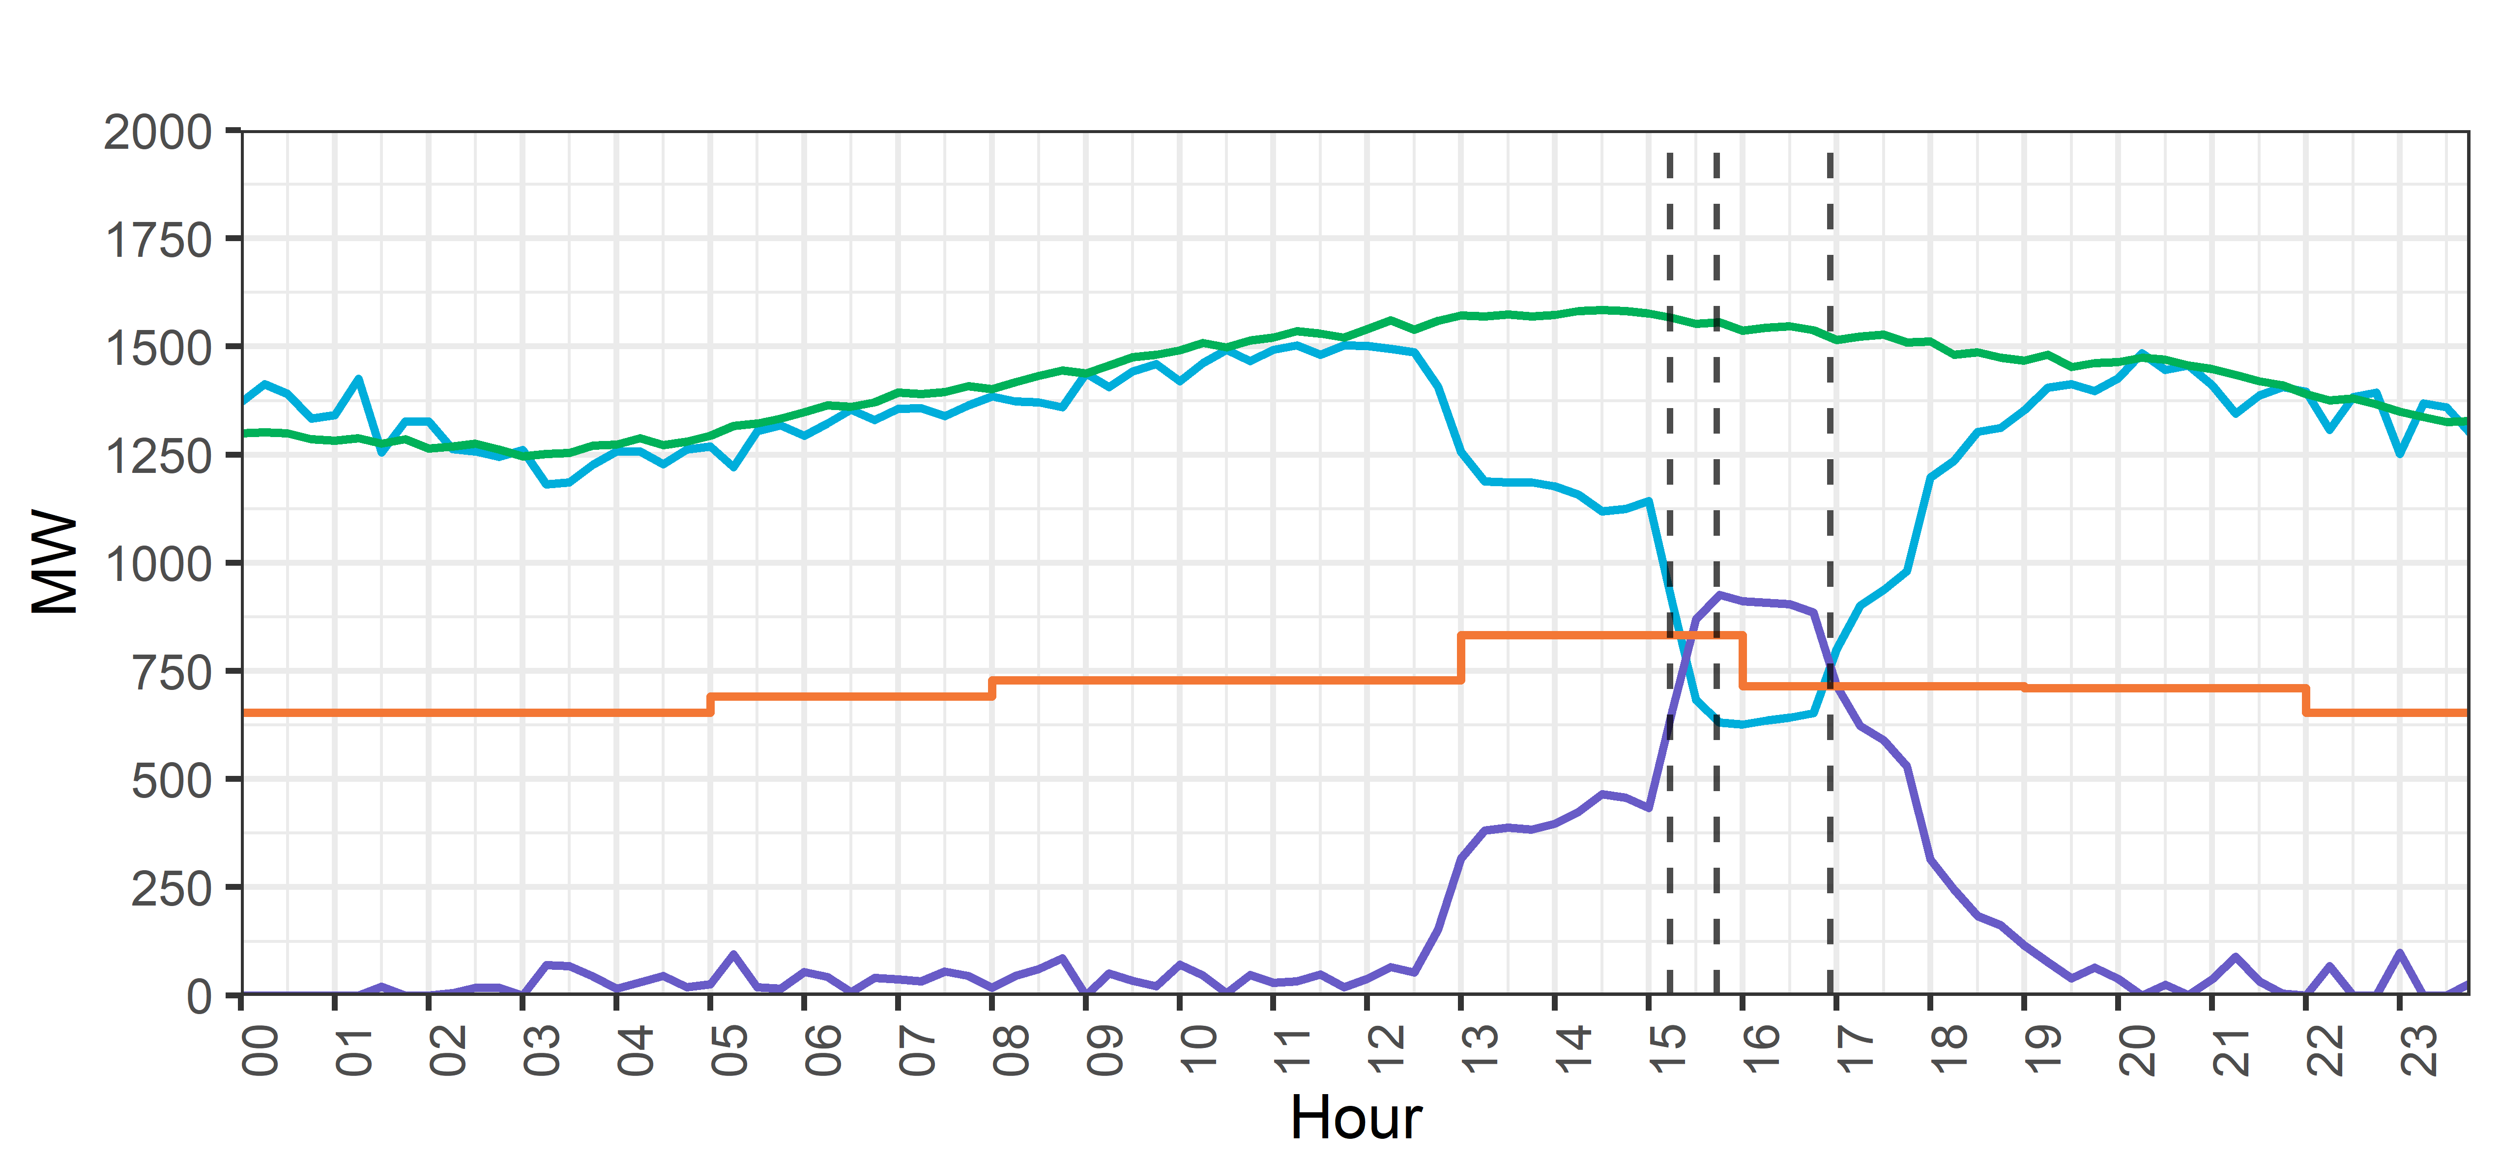
August 15th, 2019 ERS Fleet Deployment (NWS-30, WS-30)
Start Sustained
Response Period
Deployment Instruction
Recall Instruction

Slide 7
Event on Aug 13th, 2019 (ERS Load vs ERS Gen)
Event
10 hour recovery period

Slide 8
Event on Aug 15th, 2019 (ERS Load vs ERS Gen)
Event
10 hour recovery period

Slide 9
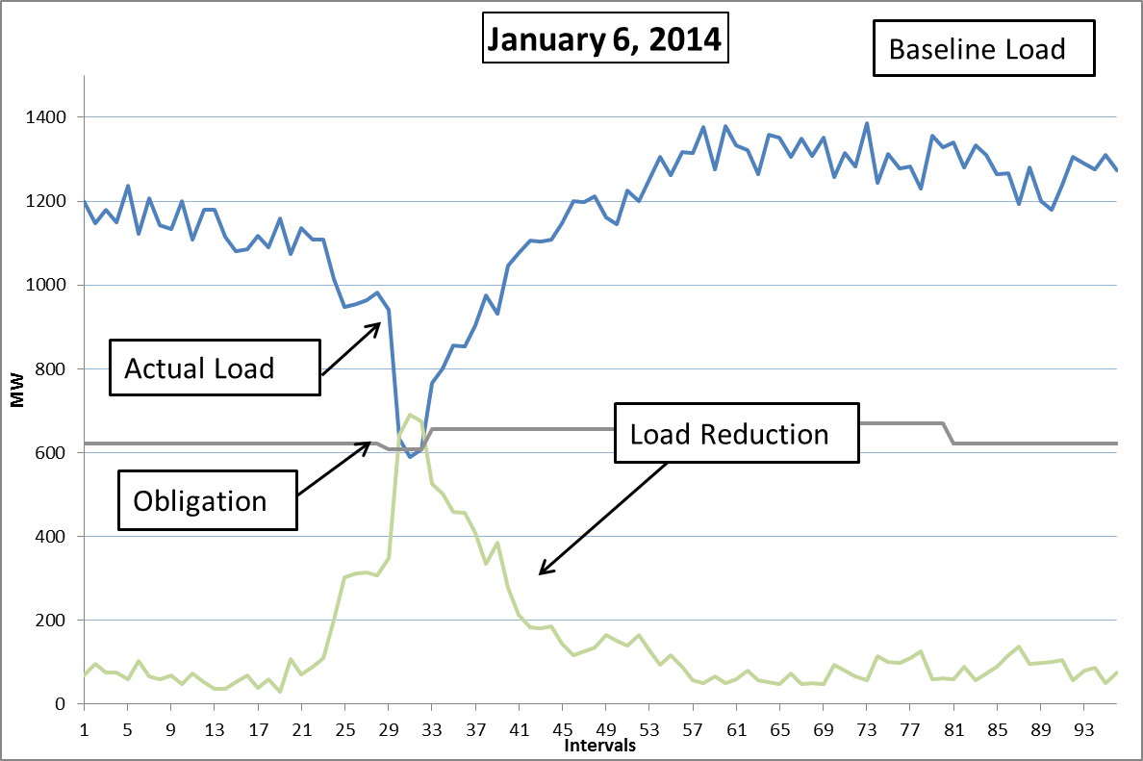
Reliability deployment price adder ramp
January 6, 2014 ERS Deployment

Slide 10
Review of ERS Restoration Period
Item assigned by WMS to WMWG & DSWG
Discussion at January 26, 2020 WMWG/DSWG joint meeting
No recommendation
Observations from the three previous deployments show 10 hour restoration period should be revised
Look to TAC for further instructions on this issue

