Slide 1
SARA Probabilistic Model
Supply Analysis Working Group
Pete Warnken
Resource Adequacy
February 20, 2020
Notes:
Welcome to

Slide 2
Model Features
Simulates a range of summer peak day hours, 1:00 pm – 8:00 pm, rather than just the single peak load hour
Performs Monte Carlo simulations of Capacity Available for Operating Reserves using Oracle Crystal Ball
Risk variables defined using probability distributions and random selection of summer renewable MW output shapes for the eight-hour period
  Probability distributions initially defined for peak load, forced outages, and price responsive demand
Creates an EEA risk profile: For each of the eight hours, the probability of Capacity Available for Operating Reserves being equal to or less than the four EEA declaration thresholds (EEA1, EEA2, EEA3, and EEA3 Load Shed
  Accounts for additional resources available when EEAs are declared

Slide 3
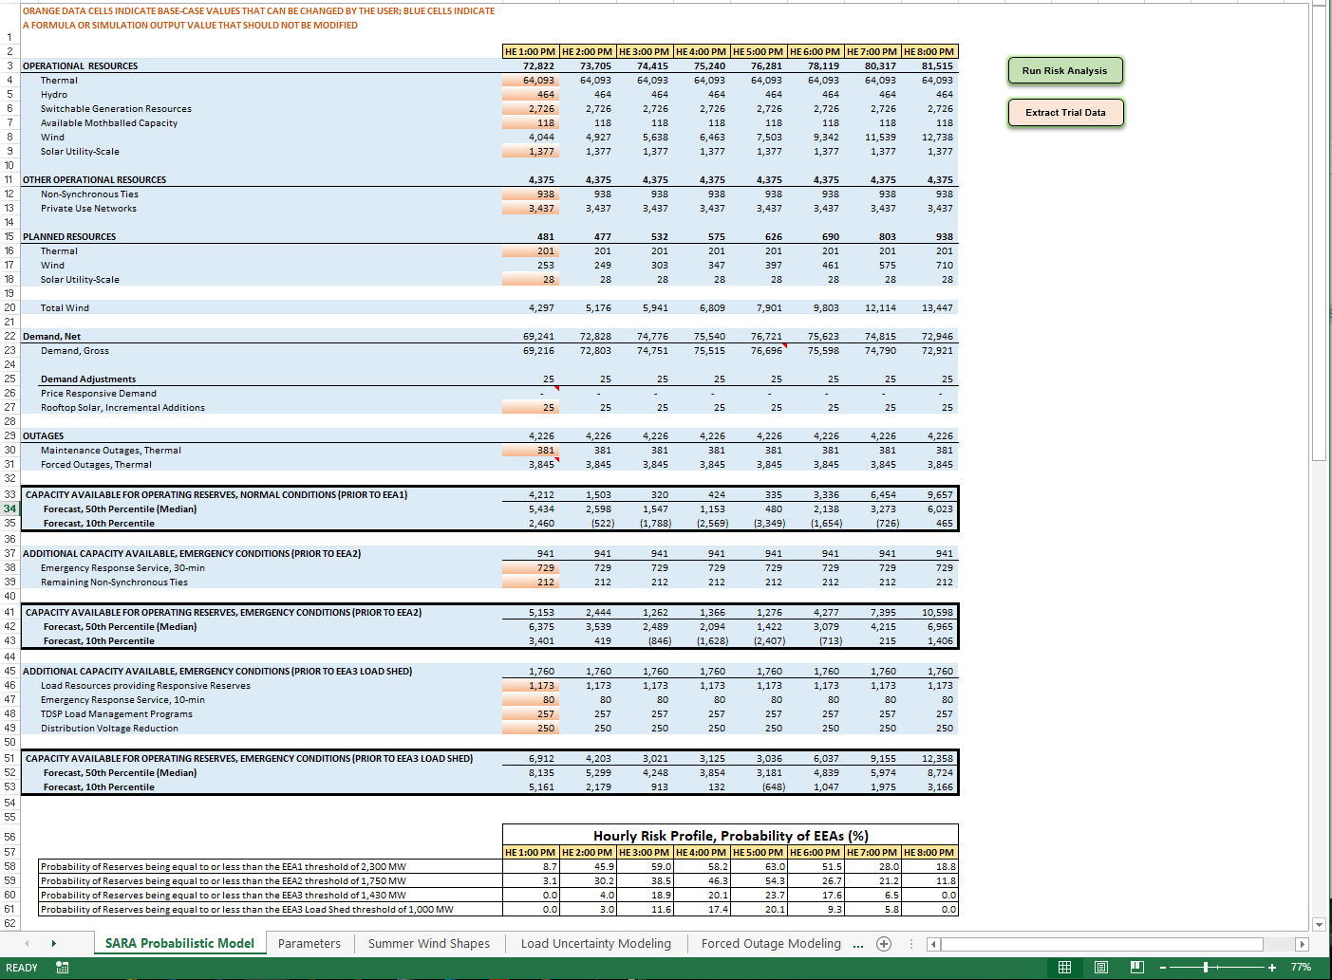
Workbook Structure

Slide 4
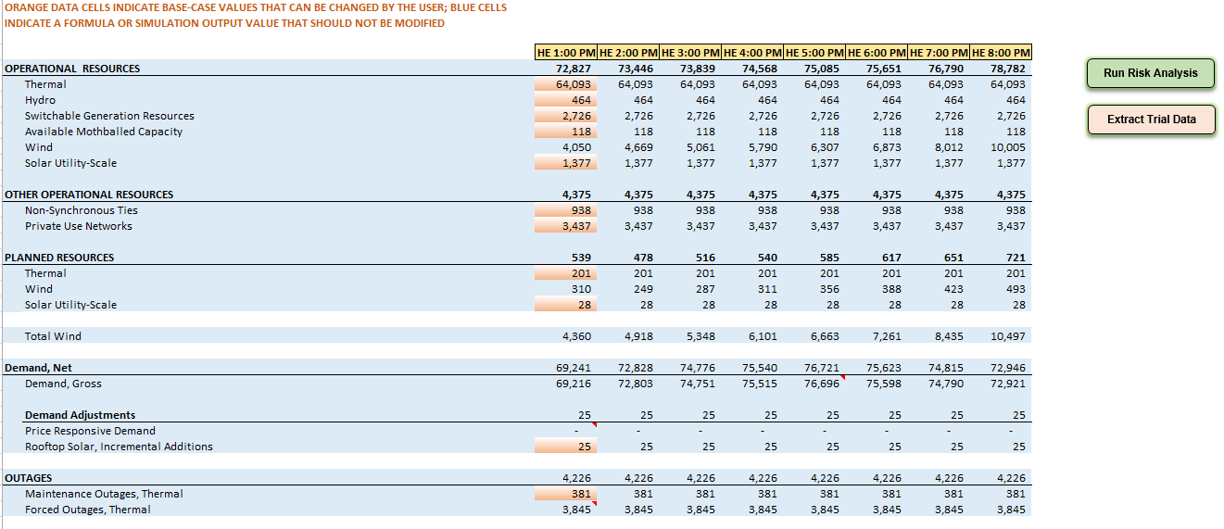
Model Display – Upper Panels

Slide 5
Model Display – Lower Panels

Slide 6
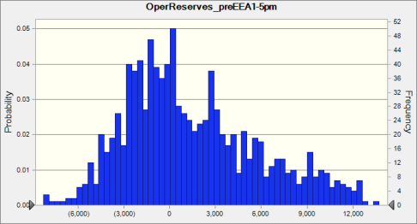
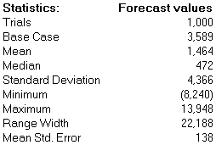
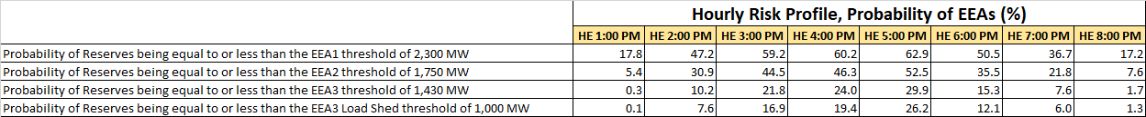
Peak Load Hour Results for a 1,000-trial Simulation

