Slide 1
CDR Planned Projects:
Predicted vs. Actual In-service Dates
Supply Analysis Working Group
Dan Mantena
Resource Adequacy
February 20, 2020

Slide 2
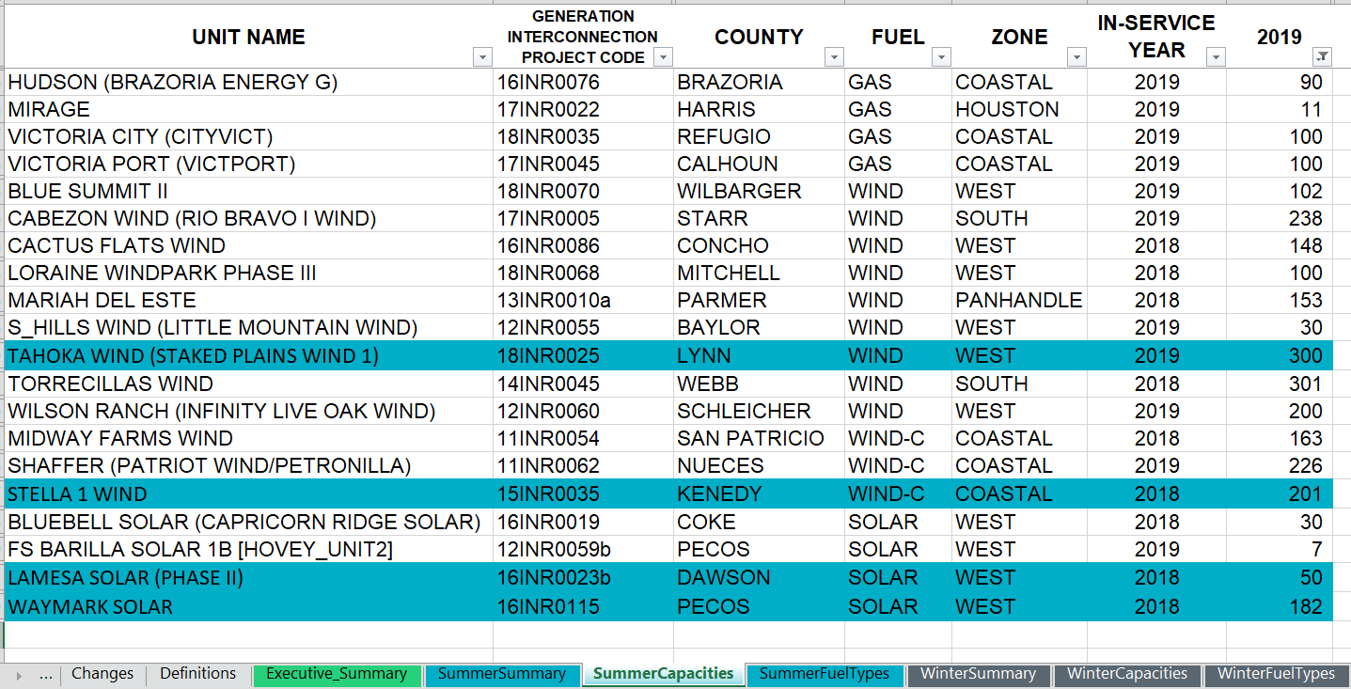
The December 2018 CDR showed 20 planned projects would go online before Summer 2019
Only 4 of the 20 listed projects went operational before June 1st, 2019.

Slide 3
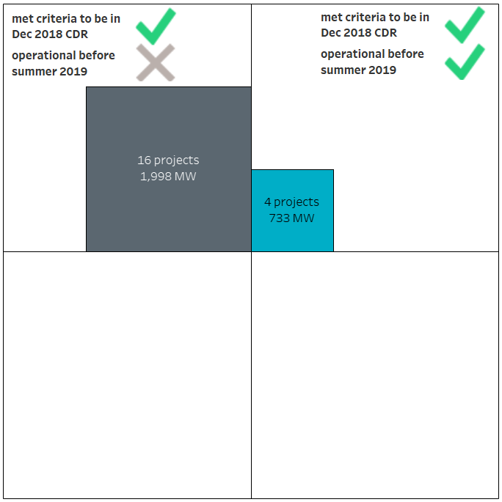
CDR eligible criteria for planned projects
Current criteria used in CDR/SARA reports for planned projects
Signed interconnection agreement with TSP
Additional requirements for thermal projects
Air and GHG Permits from TCEQ
Proof of Adequate Water Supplies
Planned projects listed in Dec 2018 CDR for summer 2019

Slide 4
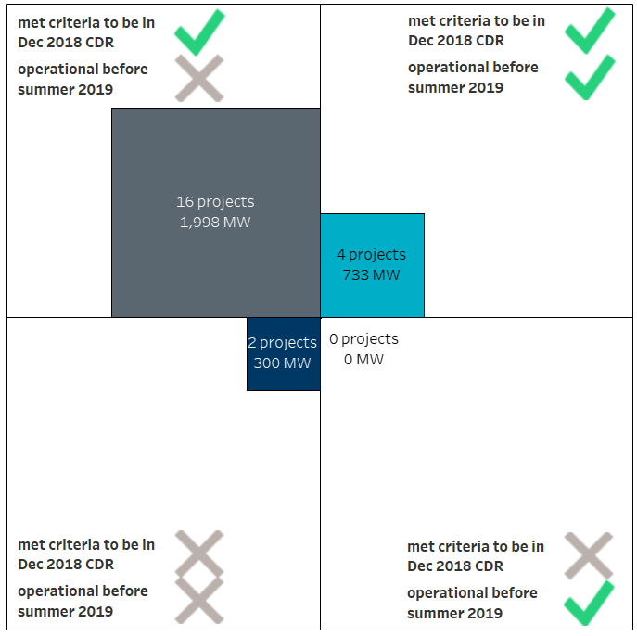
Performance review of December 2018 CDR

Slide 5
Two ways to improve planned project forecast
Reduce false positives
Reduce false negatives

Slide 6
Evaluating different criteria for planned projects

Slide 7
Impact of different criteria on December 2018 CDR planned projects

Slide 8
Criteria sensitivity results for December 2018 CDR
Criteria | # of false positive projects | # of false negative projects | total projects | Rank
+ Commissioning Plan Submitted | 4 | 1 | 5 | 1
+ Part 1 POI Energization | 6 | 0 | 6 | 2
+ Section 6.9 (1) + Full Interconnect Study | 6 | 2 | 8 | 3
+ Financial Security and Notice to Proceed | 7 | 2 | 9 | 4
+ Quarterly System Assessment (QSA) | 13 | 1 | 14 | 5
+ Section 6.9 (1) | 14 | 1 | 15 | 6
+ Full Interconnect Study | 15 | 0 | 15 | 6
Base case (current CDR criteria) | 16 | 0 | 16 | 8

Slide 9
Criteria sensitivity results for recent December CDRs
Top 3 criteria's for each CDR report are highlighted in green.
Criteria | Rank for Dec 2018 CDR (Summer 2019) | Rank for Dec 2017 CDR (Summer 2018) | Rank for Dec 2016 CDR (Summer 2017)
+ Commissioning Plan Submitted | 1 | 1 | 6
+ Part 1 POI Energization | 2 | 1 | 1
+ Section 6.9 (1) + Full Interconnect Study | 3 | 3 | 3
+ Financial Security and Notice to Proceed | 4 | 8 | 6
+ Quarterly Stability Assessment (QSA) | 5 | 6 | 6
+ Section 6.9 (1) | 6 | 3 | 3
+ Full Interconnect Study | 6 | 6 | 1
Base case (current CDR criteria) | 8 | 3 | 5

Slide 10
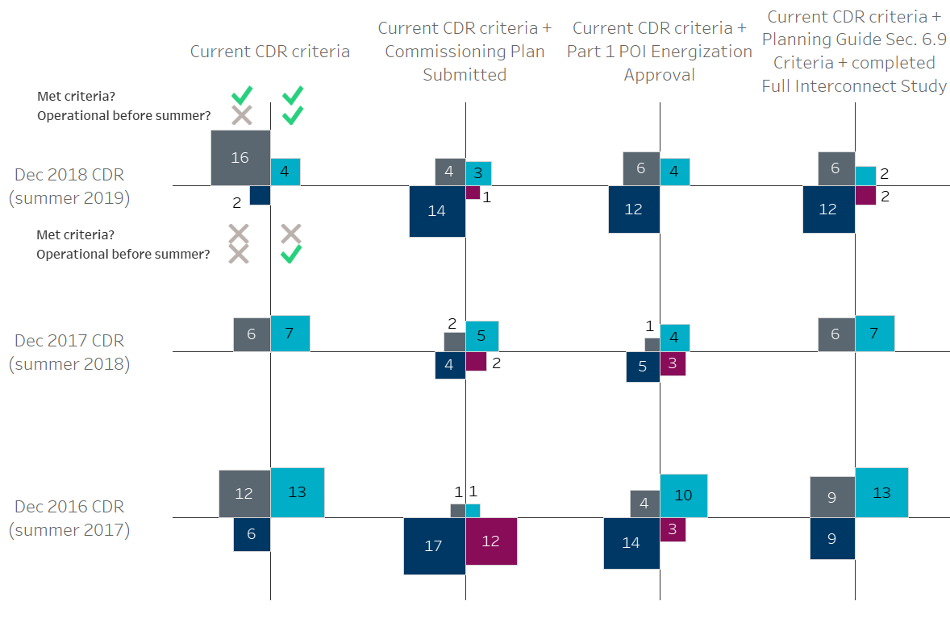
Highlighting most effective criteria’s for December CDRs

Slide 11
Findings
December CDR reports frequently list planned projects that don’t go operational before the start of the upcoming summer
GINR project milestones that have the potential to filter out these projects in future CDR reports
Commissioning Plan Submitted
Part 1 POI Energization Approval
Planning Guide Section 6.9 (1) + Full Interconnect Study

Slide 12
Appendix

Slide 13
Criteria sensitivity results for Dec 2017 CDR
Criteria | # of false positive projects | # of false negative projects | total projects | Rank
+ Part 1 POI Energization | 1 | 3 | 4 | 1
+ Commissioning Plan Submitted | 2 | 2 | 4 | 1
Base case (current CDR criteria) | 6 | 0 | 6 | 3
+ Section 6.9 (1) | 6 | 0 | 6 | 3
+ Section 6.9 (1) + Full Interconnect Study | 6 | 0 | 6 | 3
+ Full Interconnect Study | 6 | 1 | 7 | 6
+ Quarterly Stability Assessment (QSA) | 0 | 7 | 7 | 6
+ Financial Security and Notice to Proceed | 1 | 7 | 8 | 8

Slide 14
Criteria sensitivity results for Dec 2016 CDR
Criteria | # of false positive projects | # of false negative projects | total projects | Rank
+ Part 1 POI Energization | 4 | 3 | 7 | 1
+ Full Interconnect Study | 7 | 0 | 7 | 1
+ Section 6.9 (1) | 9 | 0 | 9 | 3
+ Section 6.9 (1) + Full Interconnect Study | 9 | 0 | 9 | 3
Base case (current CDR criteria) | 12 | 0 | 12 | 5
+ Commissioning Plan Submitted | 1 | 12 | 13 | 6
+ Quarterly Stability Assessment (QSA) | 0 | 13 | 13 | 6
+ Financial Security and Notice to Proceed | 0 | 13 | 13 | 6

