Slide 1
Credit Exposure Update
Spoorthy Papudesi
Credit Work Group
ERCOT Public
February 19, 2020

Slide 2
Monthly Highlights Dec 2019- Jan 2020
Market-wide average TPE slightly decreased from $ 430.2 million to $ 401.2 million
TPE decreased mainly due to lower average Real-Time and Day-Ahead Settlement Point Prices in January compared to December
Discretionary Collateral is defined as Secured Collateral in excess of TPE,CRR Locked ACL and DAM Exposure.
Average Discretionary Collateral increased from $ 1,255.7 million to $1,350.7 million
The increase in Discretionary Collateral is largely due to decrease in CRR Locked ACL
Number of active Counter-Parties increased from 251 to 253
No unusual collateral call activity

Slide 3
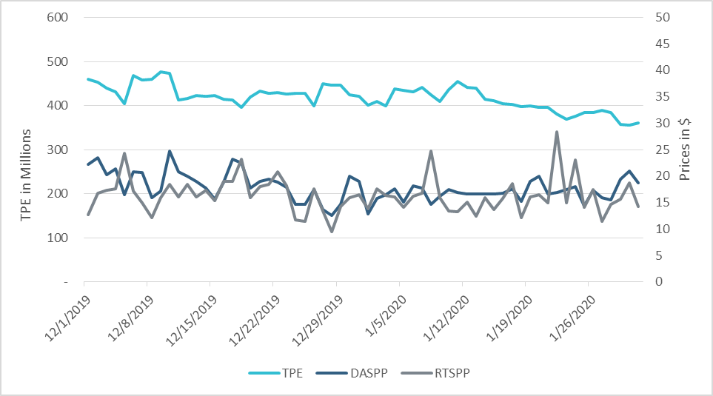
TPE/Real-Time & Day-Ahead Daily Average Settlement Point Prices for HB_NORTH Dec 2019 – Jan 2020

Slide 4
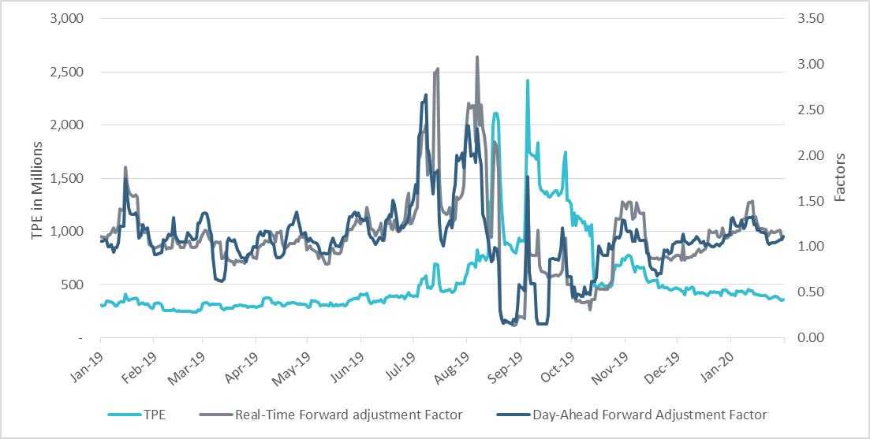
TPE and Forward Adjustment Factors Jan 2019- Jan 2020

Slide 5
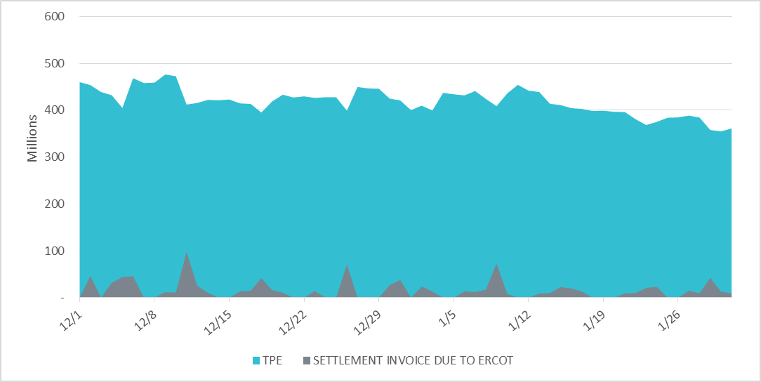
Settlement Invoice Charges/TPE Dec 2019- Jan 2020

Slide 6
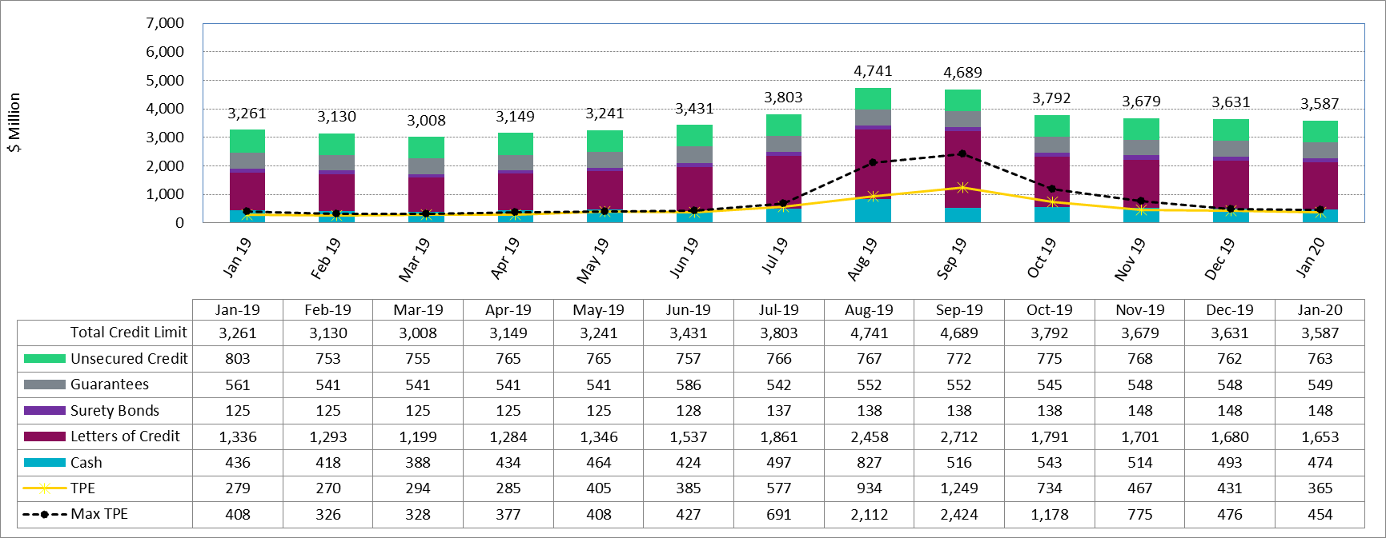
Available Credit by Type Compared to Total Potential Exposure (TPE)
*Numbers are as of month end except for Max TPE

Slide 7
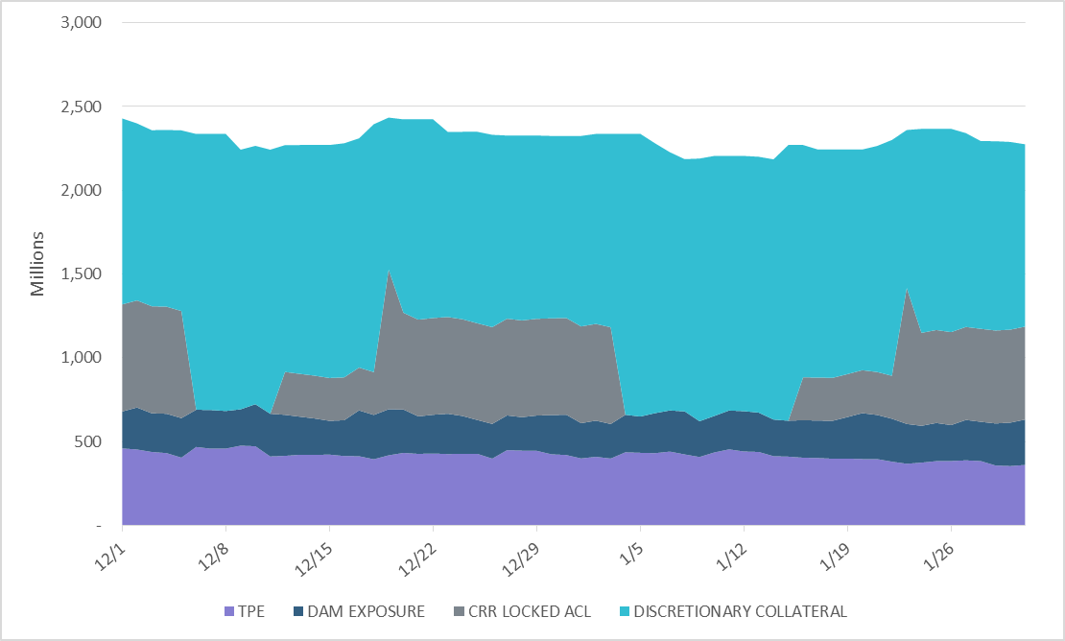
Discretionary Collateral Dec 2019- Jan 2020
At a Counter-Party level, no unusual changes were noted
Note: Discretionary collateral doesn’t include Unsecured Credit Limit or parent guarantees

Slide 8
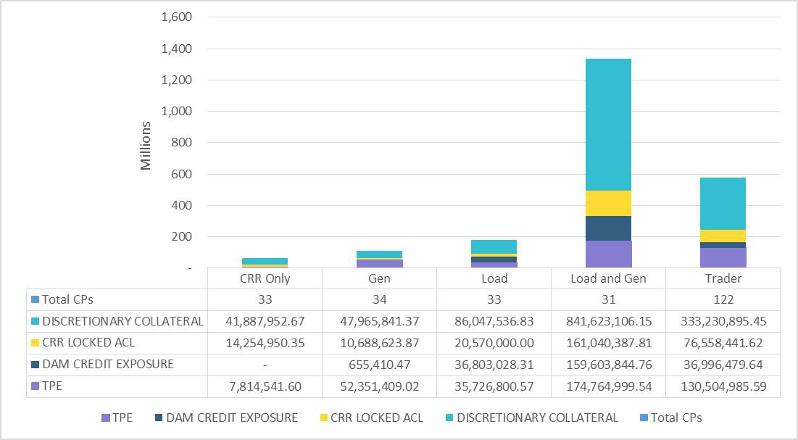
TPE and Discretionary Collateral by Market Segment- Jan 2020
Load and Generation entities accounted for the largest portion of discretionary collateral

Slide 9
Appendix

Slide 10
Summary of Distribution by Market Segment

Slide 11
Summary of Distribution by Rating Group

Slide 12
Distribution of TPE by Rating and Category

Slide 13
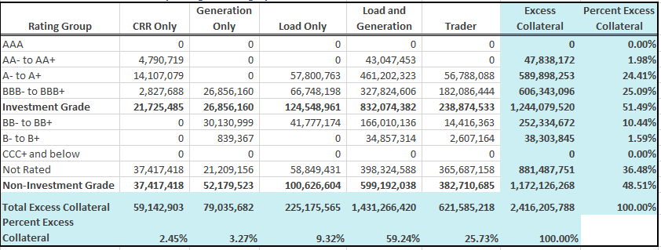
Distribution of Excess Collateral by Rating and Category
Note: Excess collateral doesn’t include Unsecured Credit Limit

Slide 14
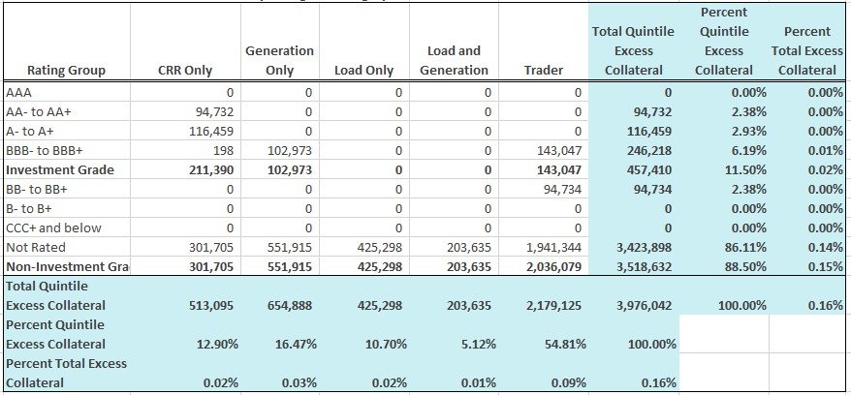
Bottom Quintile Distribution of Excess Collateral by Rating and Category

Slide 15
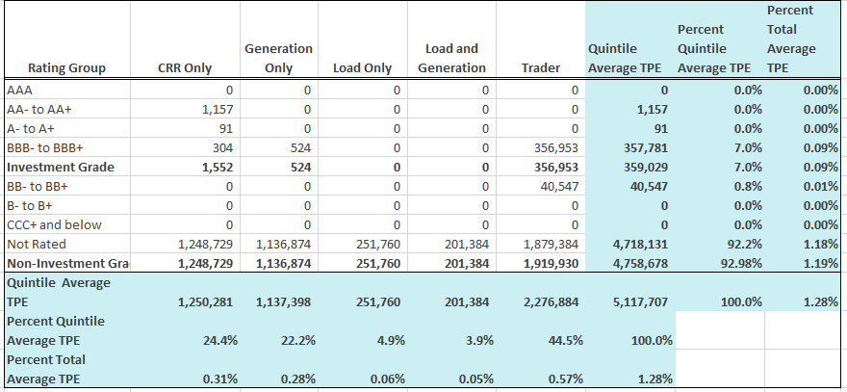
Bottom Quintile Distribution of Average TPE by Rating and Category

Slide 16
Questions

