Slide 1
MIS and ERCOT.com User Workshop
February 19, 2020

Slide 2
Agenda
Introduction
Release Plan
Demo of Internal EMIL Application
Review MIS-Related Wireframes
Upcoming feedback opportunities

Slide 3
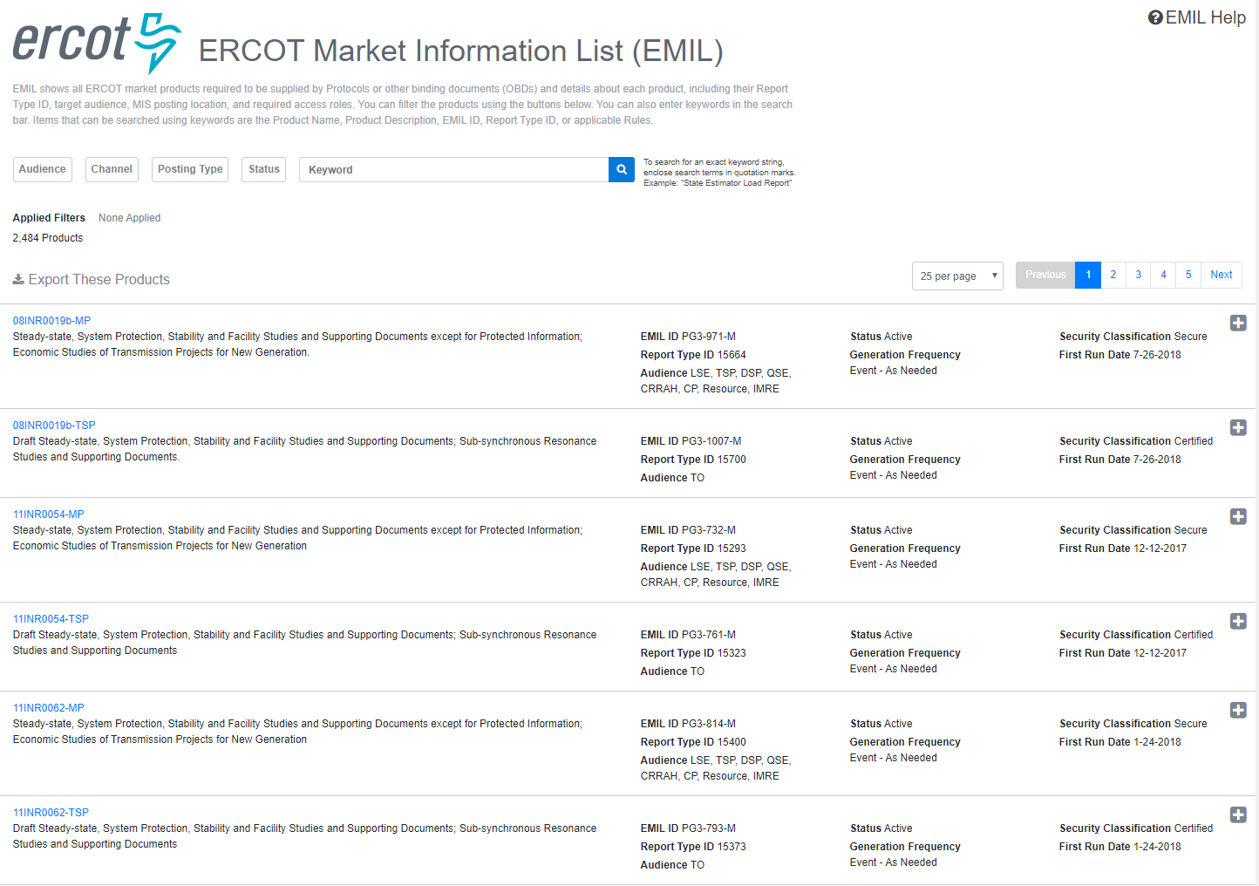
EMIL
mis.ercot.com/emil

Slide 4
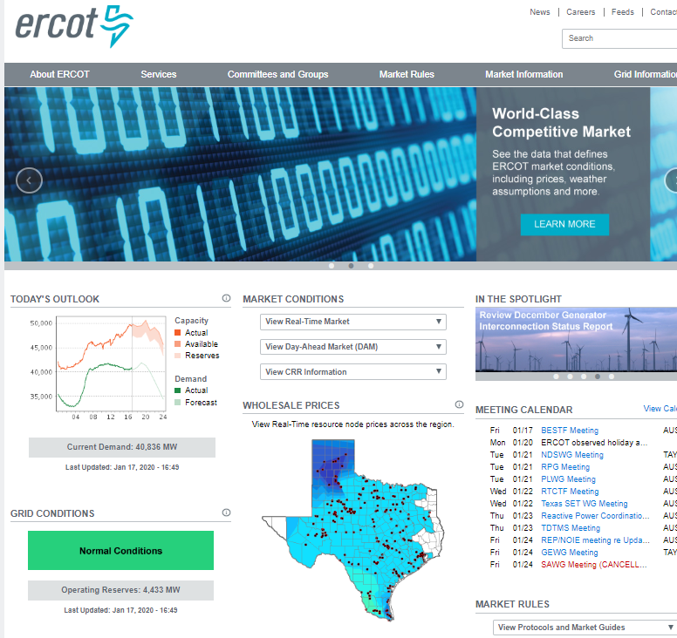
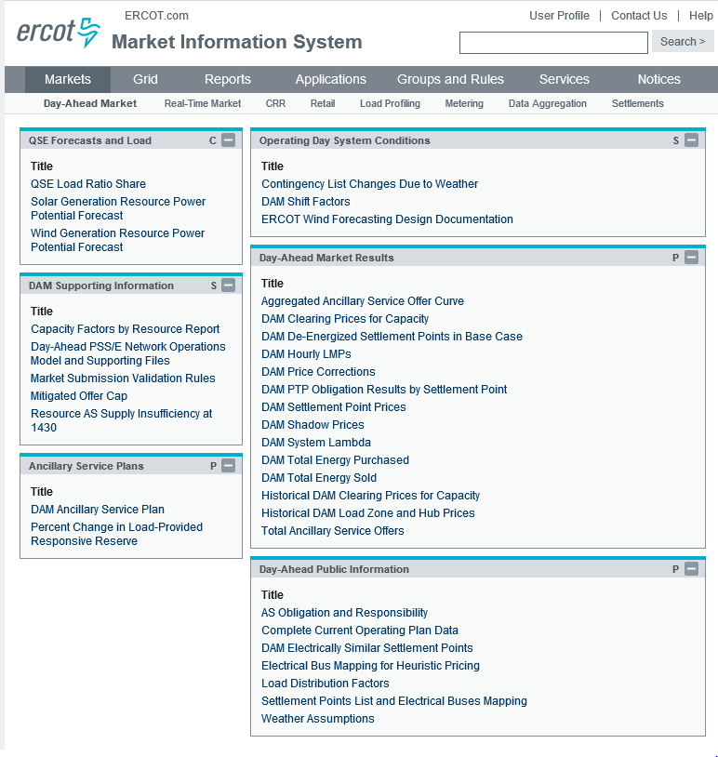
Current State: Separate Channels & Platforms
Notes:
Two different user experiences can introduce confusion and inconsistent communication.
Two different search experiences. Both terrible.
Neither work well on a mobile device.
Both lacking in flexibility
Jumping between the two

Slide 5
Timeline for changes
Feedback, stability, and readiness are key.
January 30: EMIL web interface release
May 2020: Sandbox version of new MIS available for feedback
August 2020: New MIS Production version available for testing
October 2020: New MIS Production go-live
TBD 2021: Sandbox versions of combined ERCOT.com and MIS
TBD: Overlap timeline

Slide 6
Communication Plan
Market Notices to communicate changes
Monthly MIS & ERCOT.com user workshops
Information updates posted on ERCOT.com
Feedback is encouraged by everyone
Webpage available for more information: http://www.ercot.com/about/redesign
Email feedback to webmaster@ercot.com at any time

Slide 7
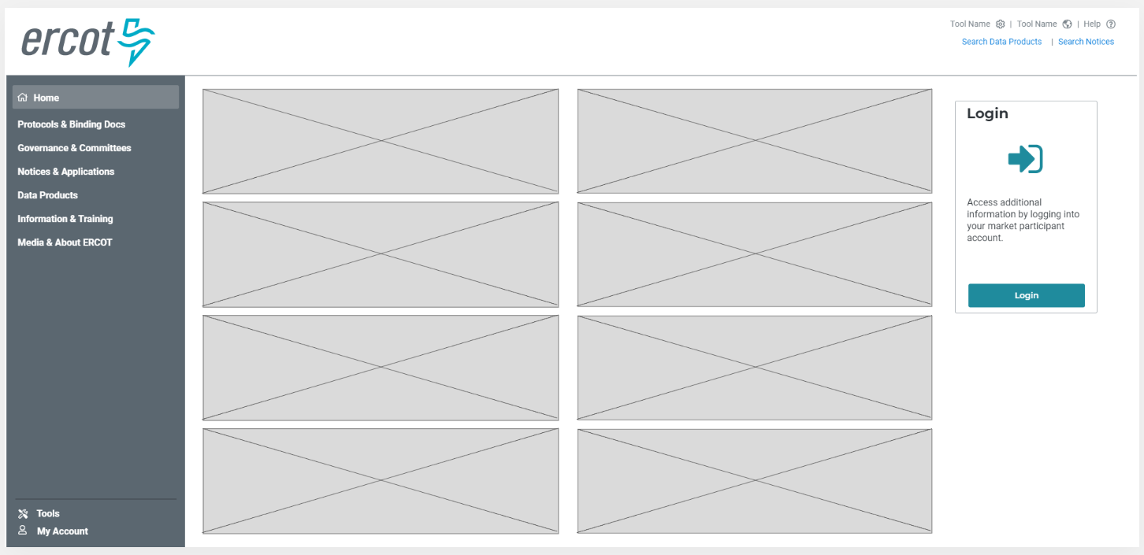
MIS Concept - Unauthenticated Home

Slide 8
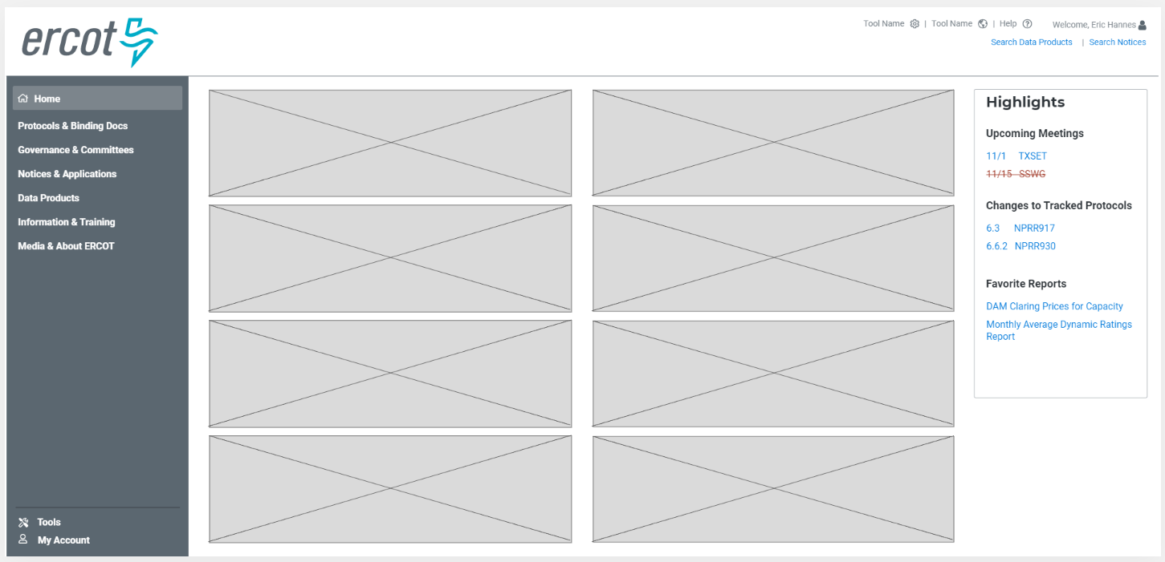
MIS Concept - Authenticated Home

Slide 9
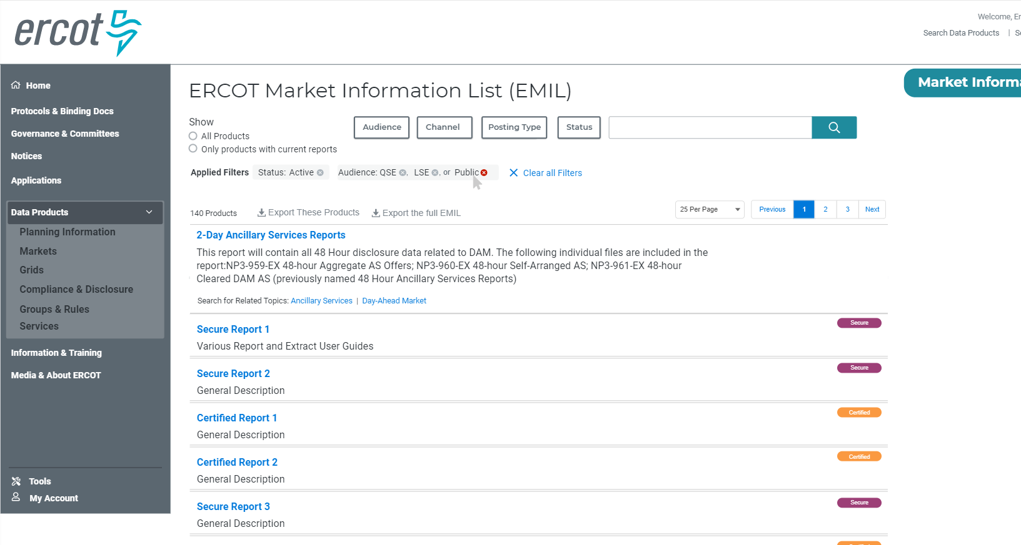
MIS Concept - Report List

Slide 10
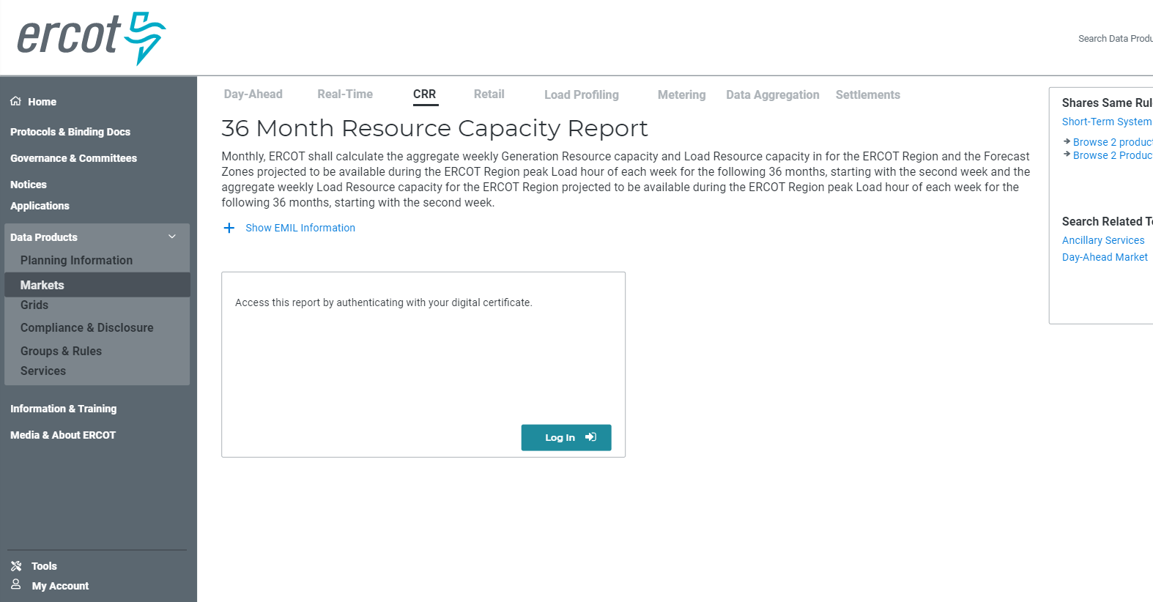
MIS Concept - Unauthenticated Data Detail

Slide 11
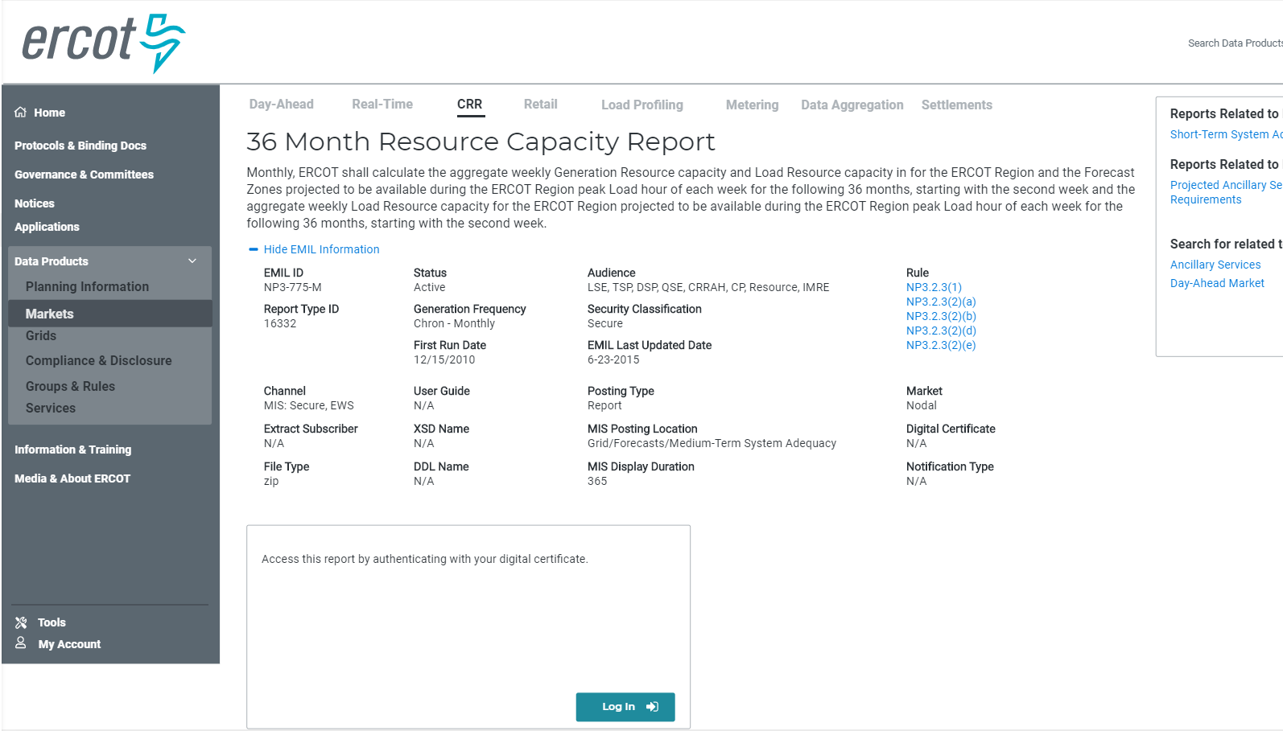
MIS Concept - Data Detail Expanded

Slide 12
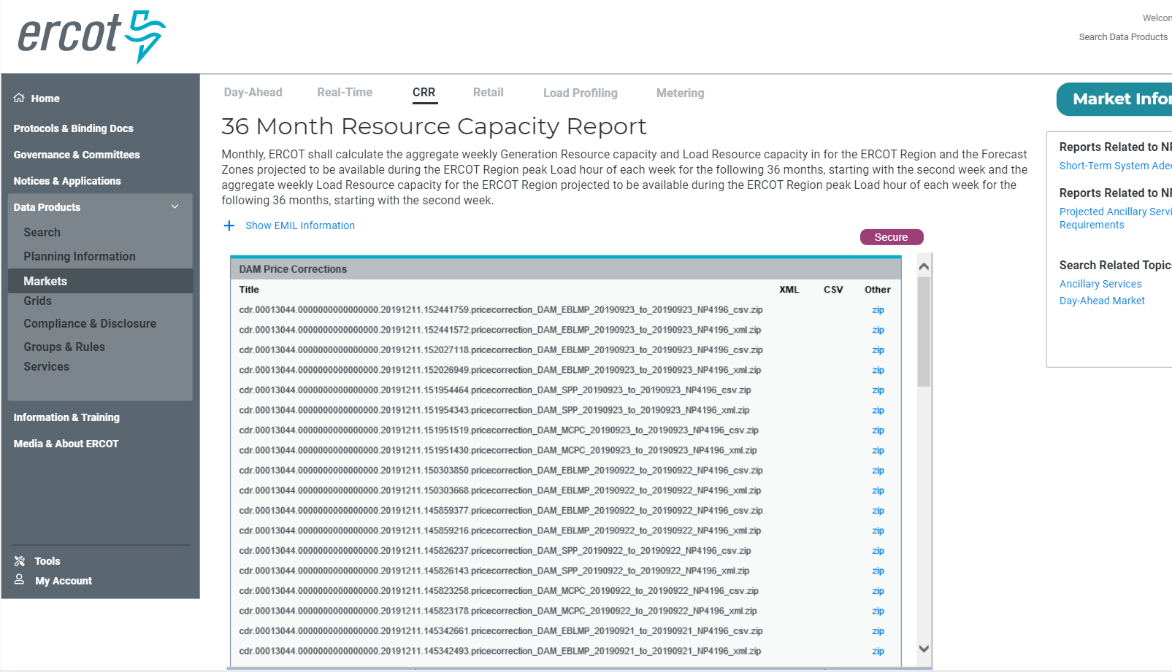
MIS Concept - Data Detail Expanded w/ Links

Slide 13
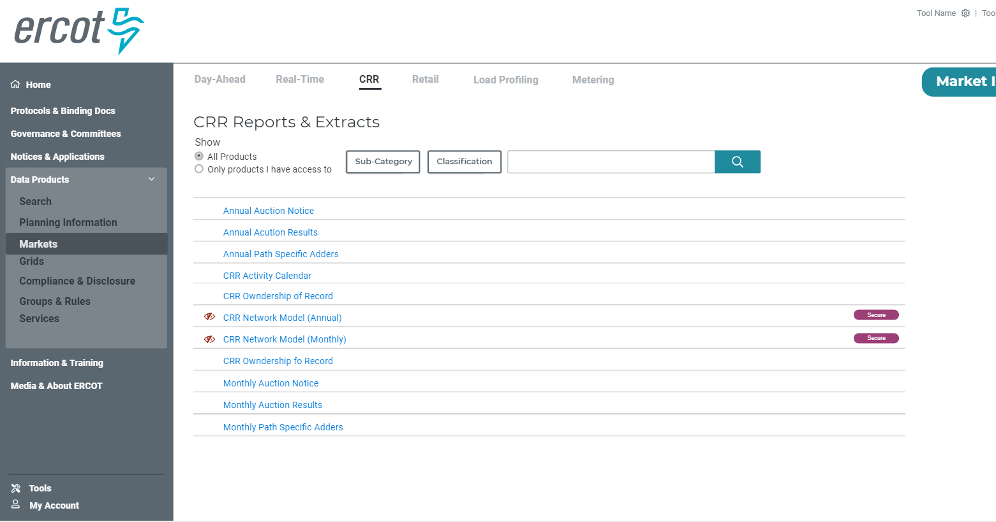
MIS Concept – Sub Category Page

Slide 14
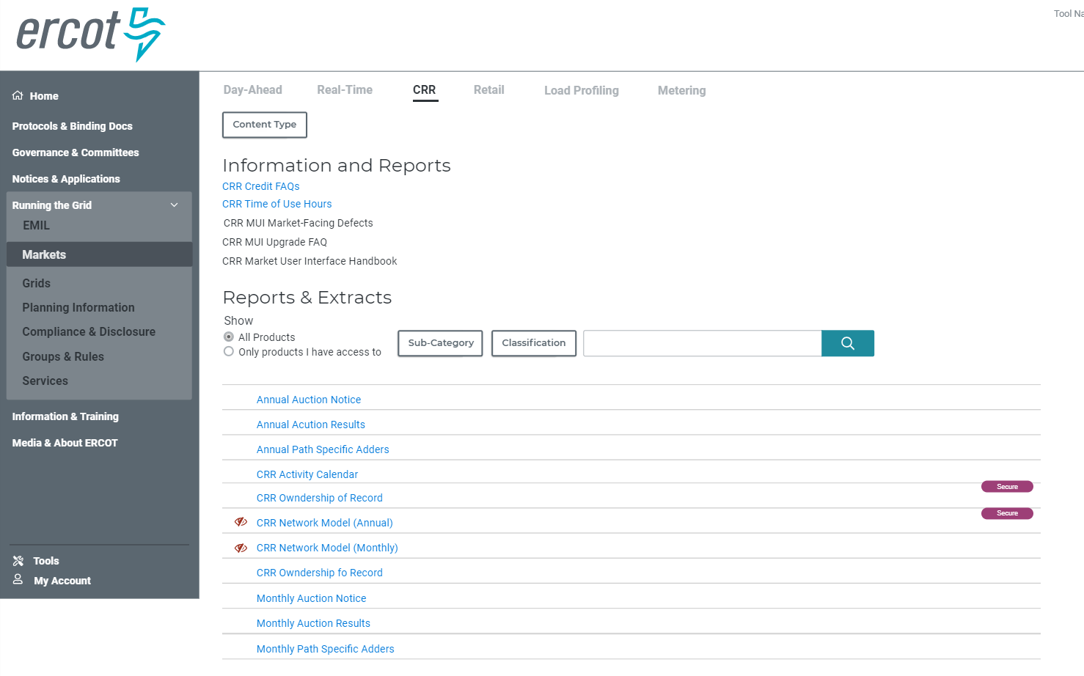
MIS Concept – Sub Categories Future Concept

