Slide 1
Resource Definition Task Force
Resource Framework Status Update
Feb 13, 2020

Slide 2
Summary of Achievements
RTF-1 Establish Generation Framework, eliminate “Non-modeled” term
NPRR889– Approved, Effective 11/2019
RTF-2 Eliminate All-Inclusive Generation
NPRR921 –Approved, Effective 11/2019
RTF-3 Load Resources Framework
NPRR Under Review by ERCOT Legal, IA Delayed
RTF-4 Energy Storage Definition
NPRR 957 Approved 12/201
RTF-5 Clarify Distributed Generation Terms
NPRR under review by ERCOT Legal
RTF-6 Settlement Only Energy Storage
NPRR995 Submitted Jan 2020

Slide 3
Total Framework

Slide 4
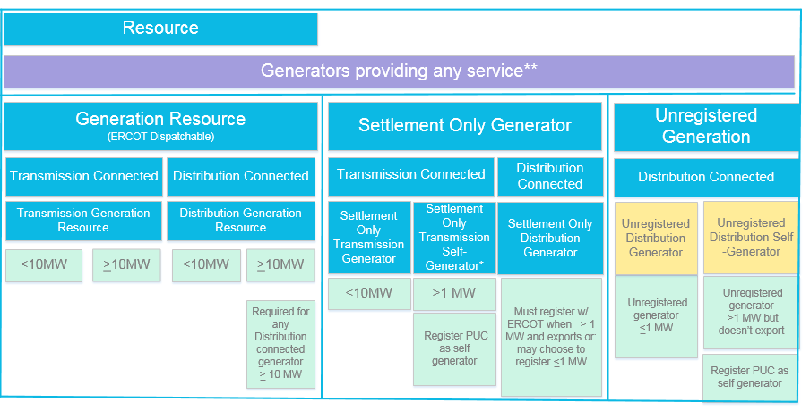
Generation Framework Status
RTF
RTF
RTF-1
RTF-5

Slide 5
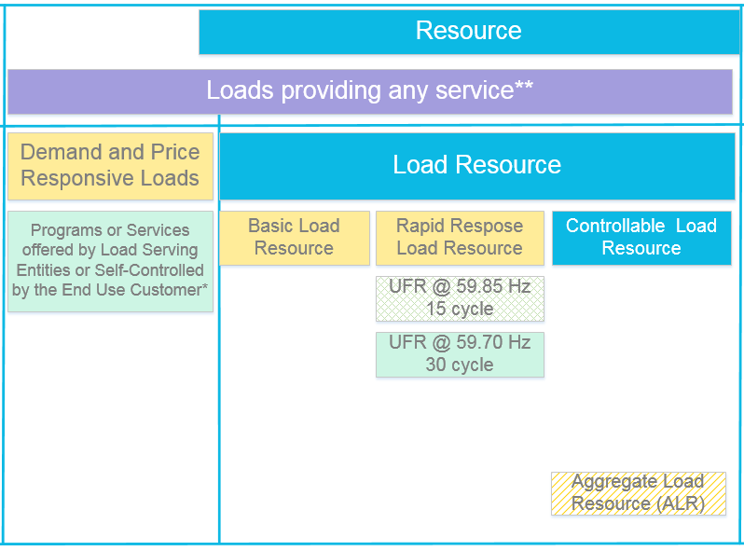
Load Framework Status
RTF
RTF-3

Slide 6
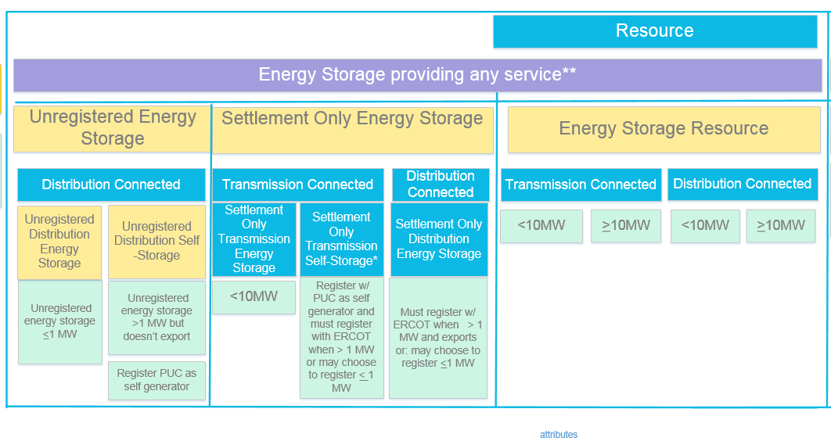
Energy Storage Framework Status
RTF
RTF
RTF-6
RTF-4

