Slide 1
ERCOT Frequency Control Report
January 2020
ERCOT
Operations Planning
PDCWG | February 12th, 2020

Slide 2
Summary of January 2020
CPS1: 174.68%
Current CPS1 12-Month Rolling Average: 174.83%
4 BAAL Exceedances
1 hourly CPS1 score below 100%
BAAL-003 Events have updated through 2019
2018 BAAL-003 FRM Performance: -843.17
2020 RMS1 Statistics
Mean: 15.07 mHz
Min: 13.56 mHz
Max: 16.6 mHz
Energy Statistics
Total Energy: 28,969,595 MWh
Wind Energy: 7,474,690 MWh
Percent Energy from Wind: 25.80%
Solar Energy: 336,423 MWh
Percent Energy from Solar: 1.16%
Minimum System Inertia
Mean: 183,800
Max: 244,162 on Jan 30th
Min: 143,088 on Jan 9th

Slide 3
Frequency Control
CPS1, BAAL, & RMS1

Slide 4
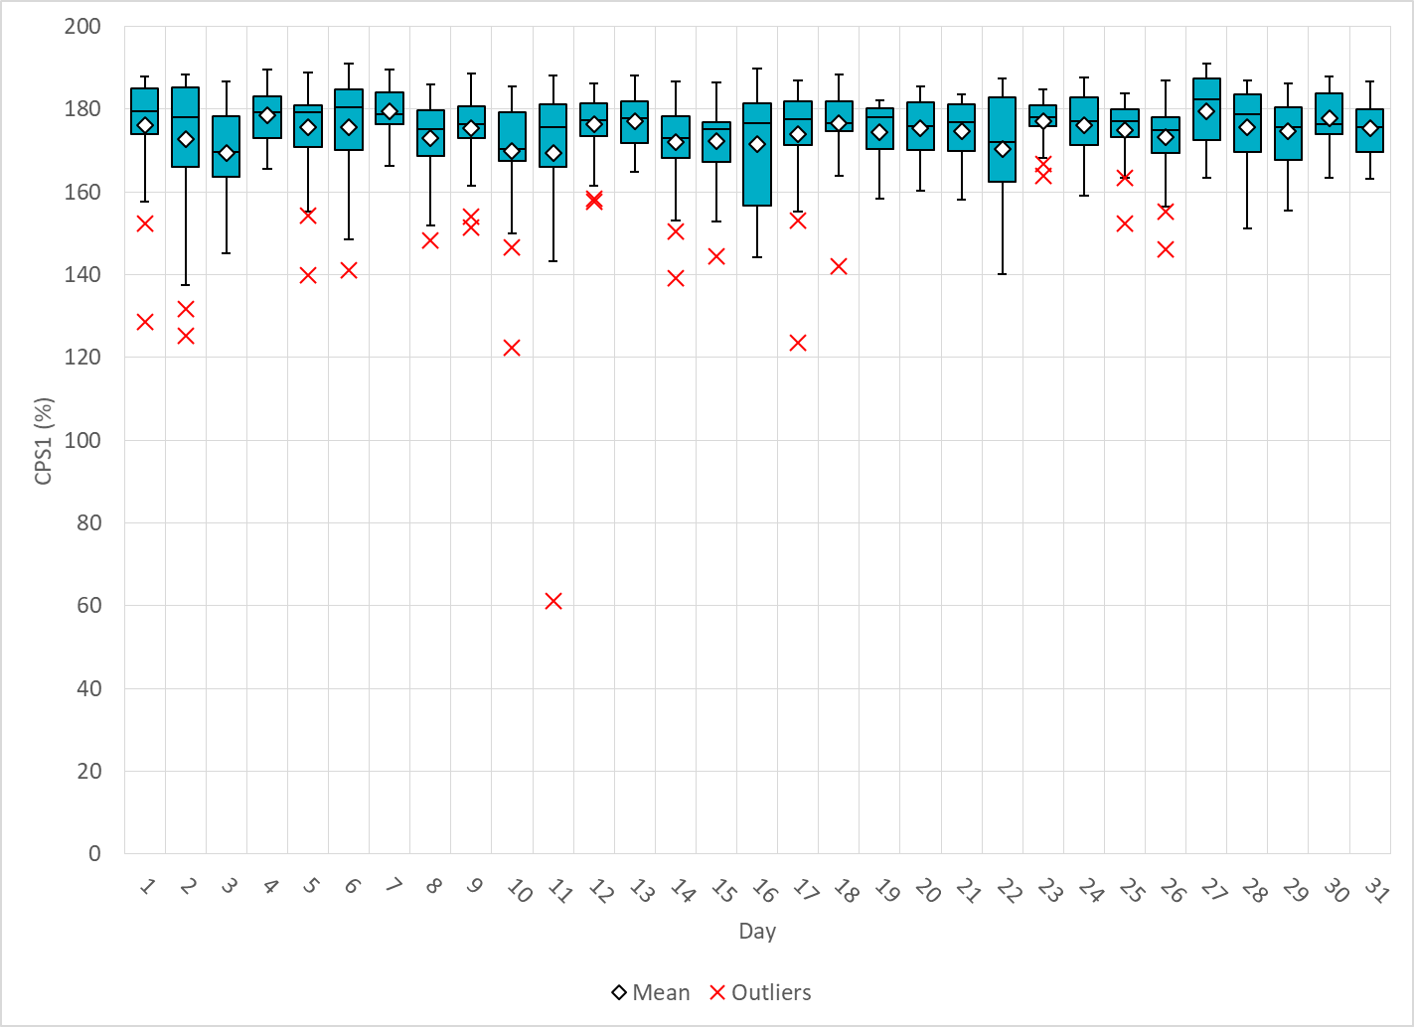
Hourly CPS1 by Day
Jan-20 CPS1 (%): 174.68
Notes:
Outliers:
1/11/2020 10:00 61.2%:
Large deviation generation from wind, significant ramp down during the hour ~54MW/min

Slide 5
BAAL Exceedances & Violations
There were 4 BAAL exceedances in Jan
Notes:
BAAL Exceedances related to the two FMEs on 1/1/2020 and 1/17/2020

Slide 6
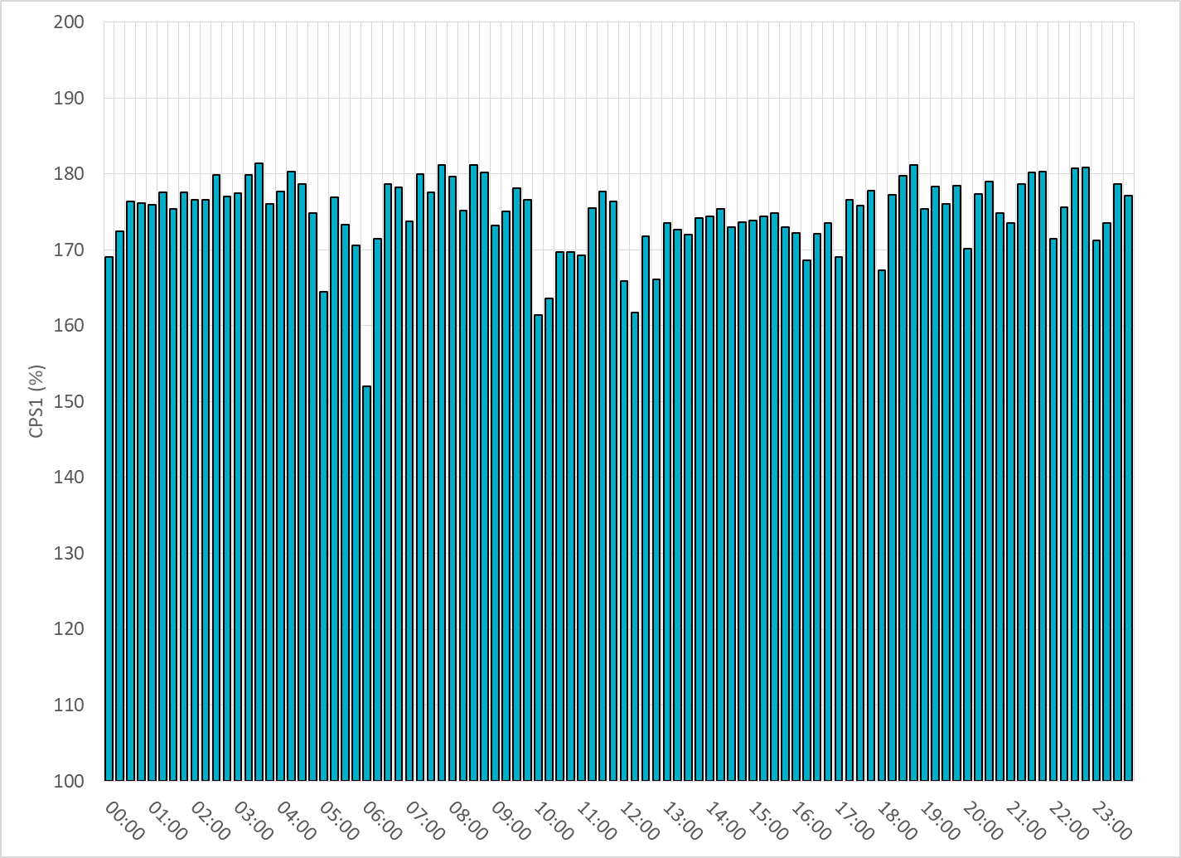
15-Minute Average CPS1%
Jan-20 CPS1 (%): 174.68

Slide 7
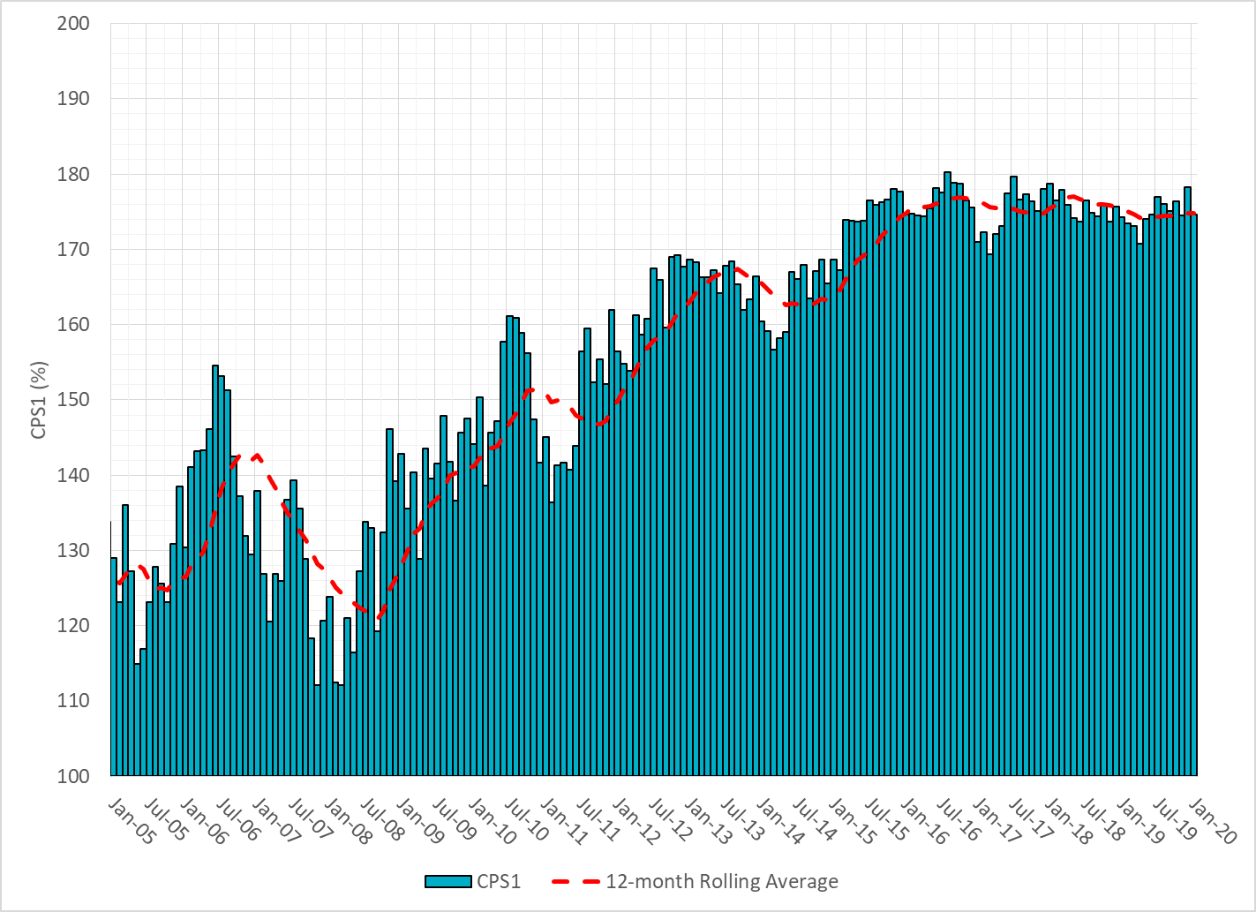
12-Month Rolling Average CPS1
Current 12-Month Rolling Average: 174.83%

Slide 8
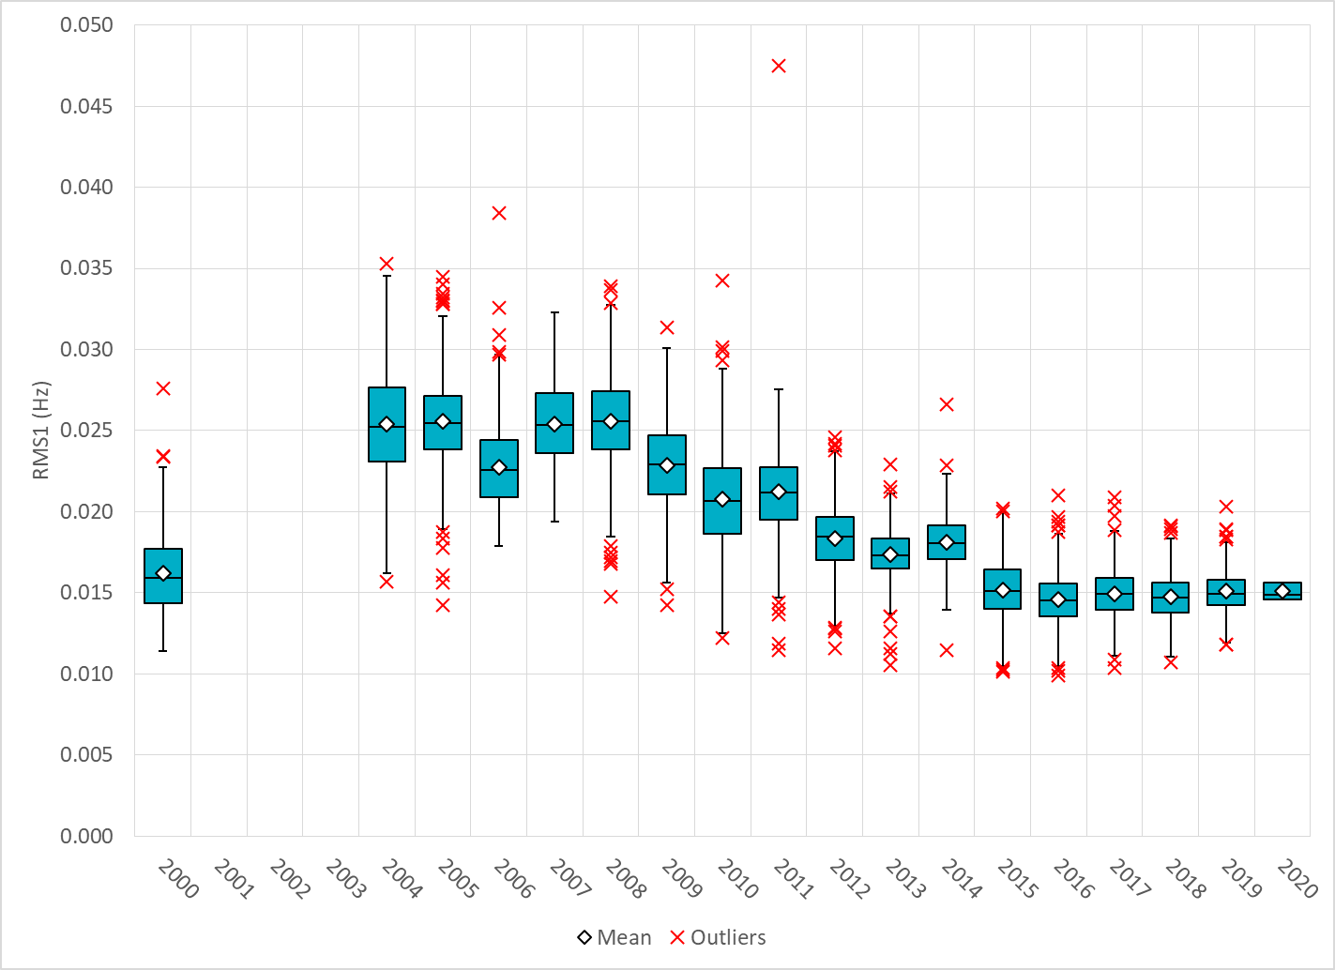
Daily RMS1 of ERCOT Frequency by Year
Notes:
Mean: 15.00 mHz

Slide 9
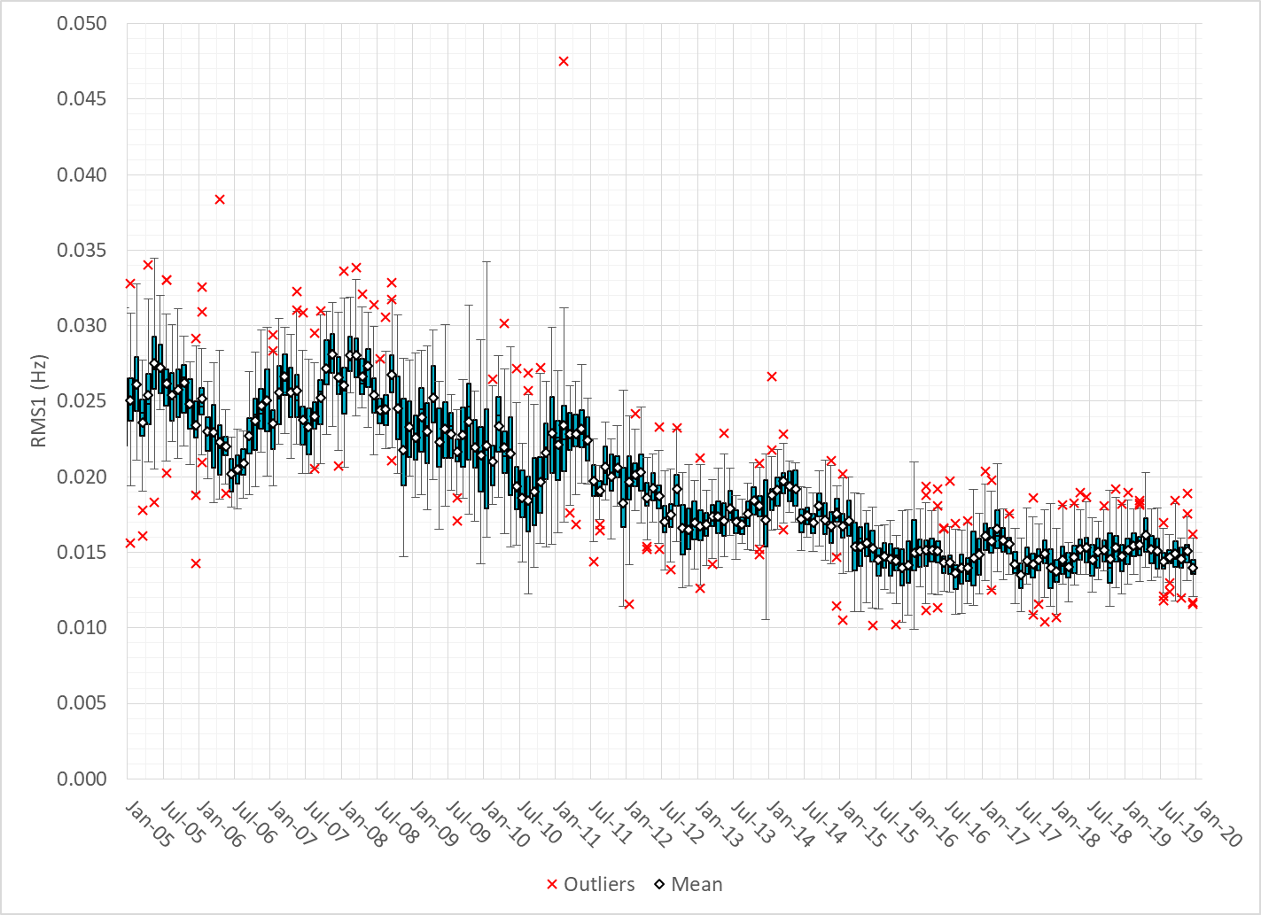
Daily RMS1 of ERCOT Frequency by Month

Slide 10
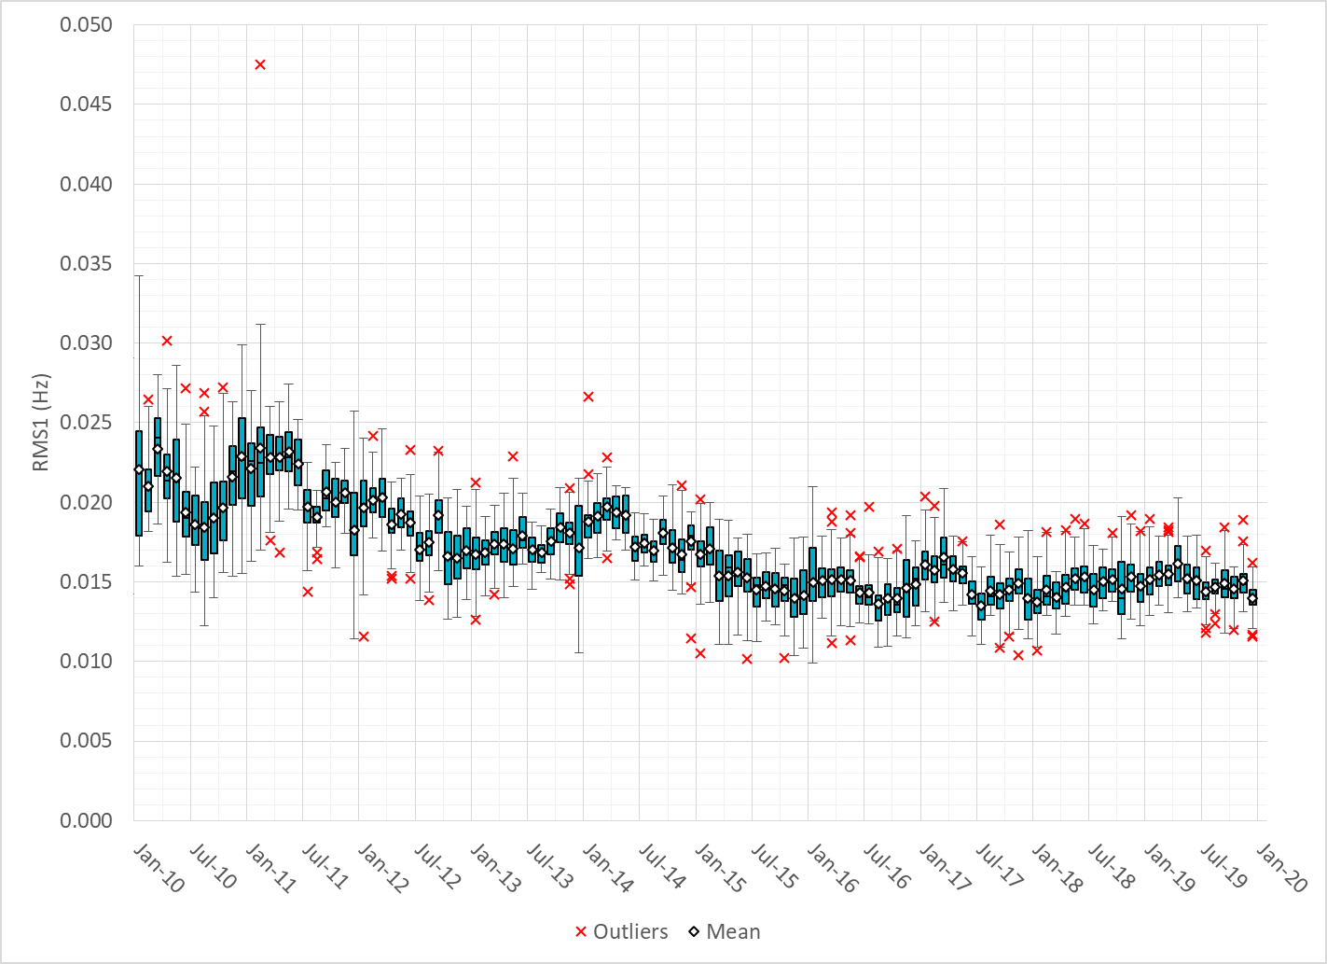
Daily RMS1 of ERCOT Frequency by Month
Notes:
Mean: 15.07 mHz
Min: 13.6 mHz
Max: 16.6 mHz

Slide 11
Frequency Profile Comparison

Slide 12
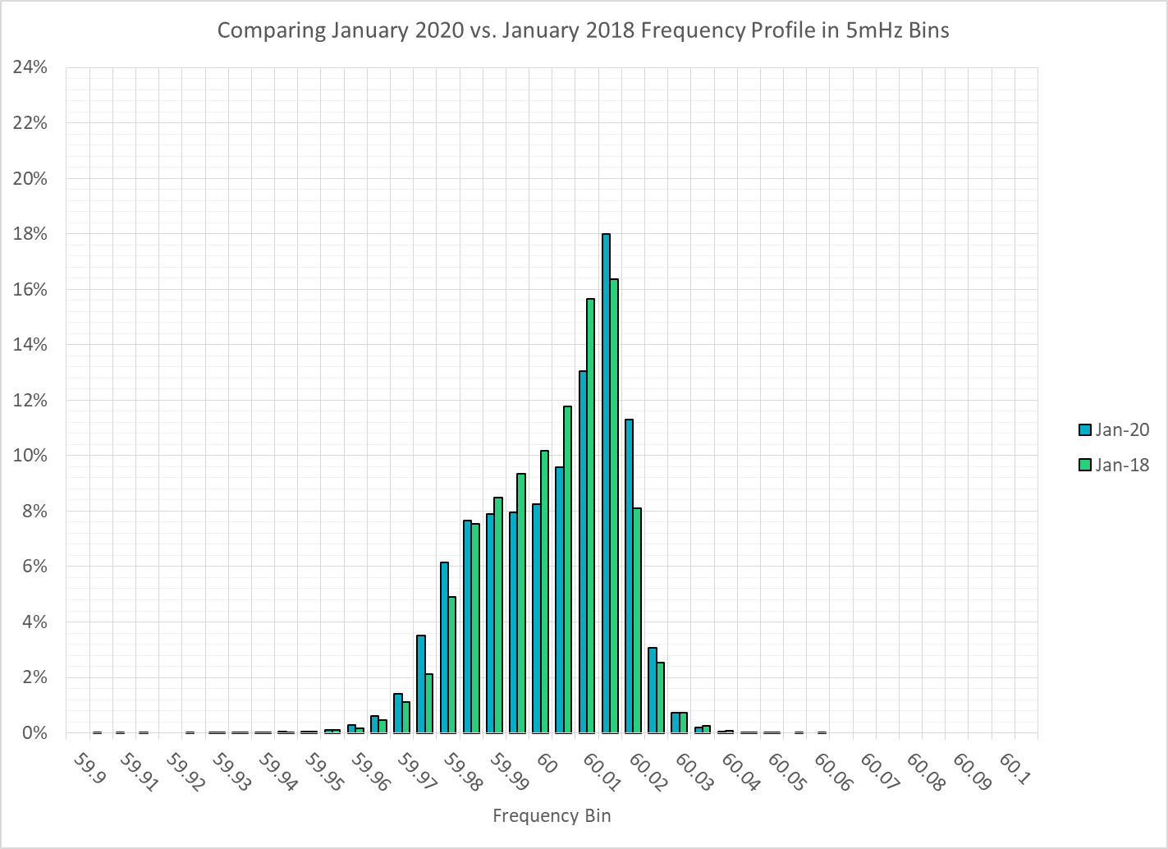
Frequency Profile Comparison

Slide 13
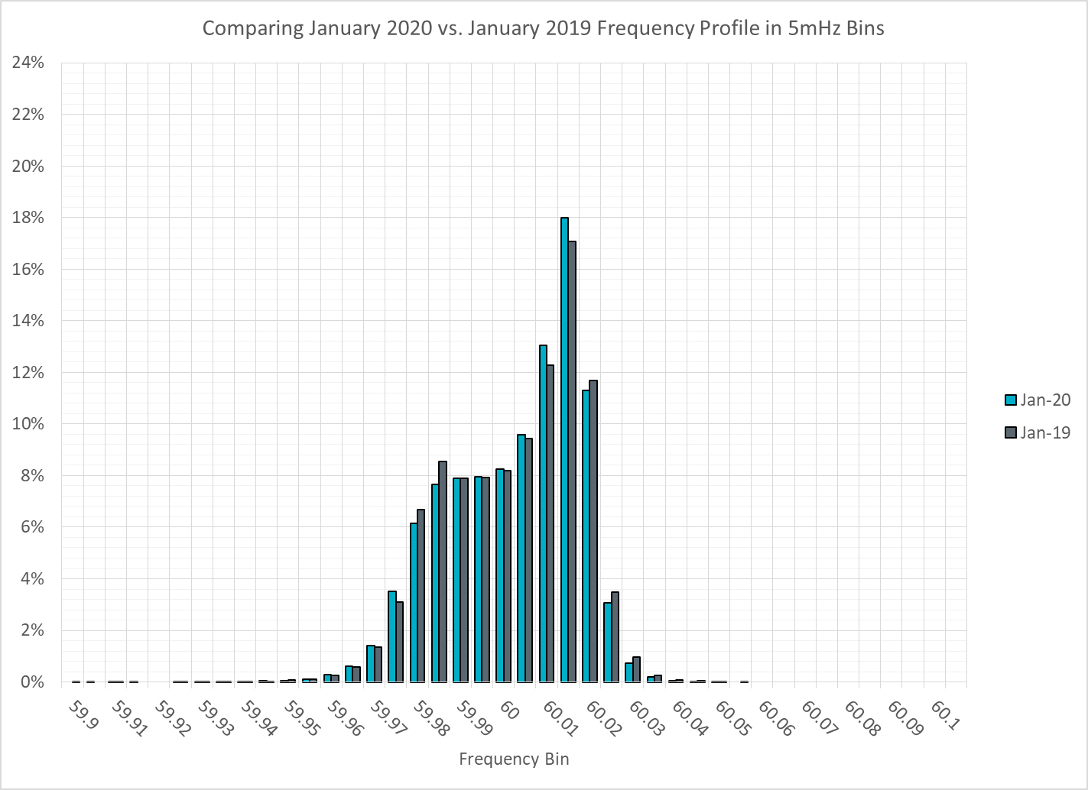
Frequency Profile Comparison

Slide 14
Time Error Correction

Slide 15
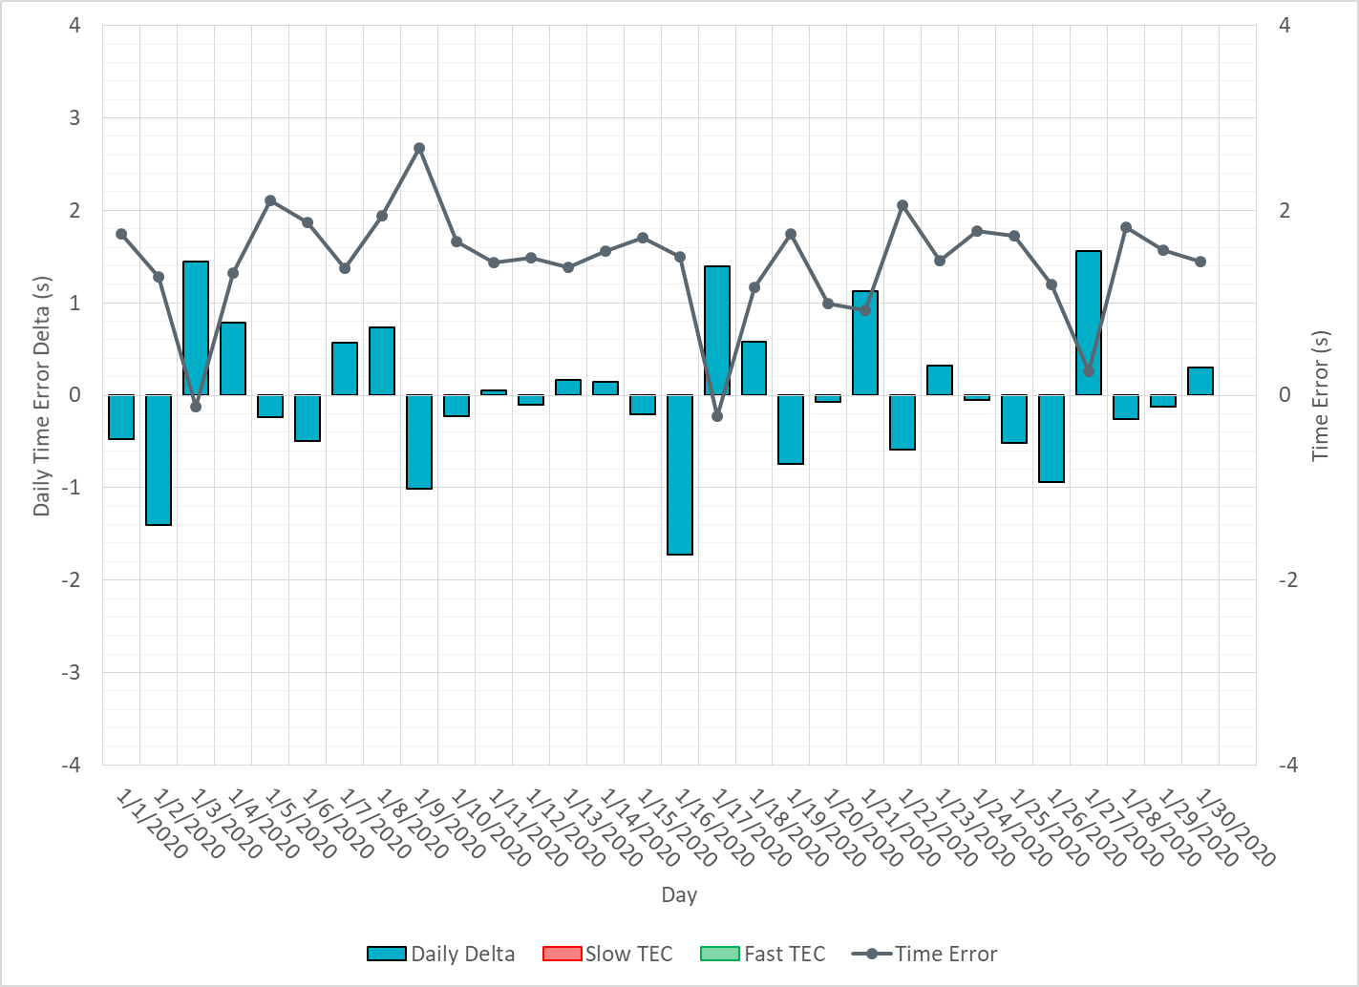
ERCOT Daily Time Error

Slide 16
Time Error Corrections Log Summary
There have been no time error corrections since December 2016

Slide 17
BAL-003 Performance

Slide 18
Op. Year 2018 BAL-003 Selected Events – Update
Notes:
BAL-003

Slide 19
Op. Year 2018 BAL-003 FRM Performance - Update
Notes:
OP2018: FRO = -381.0, FRM_median = -843.17, FRM_average = -959.7
OP2019: FRO = -381.0
OP2020: FRO = -425.0, FRM_median = -811.14, FRM_average = -892.5

Slide 20
ERCOT Energy Statistics

Slide 21
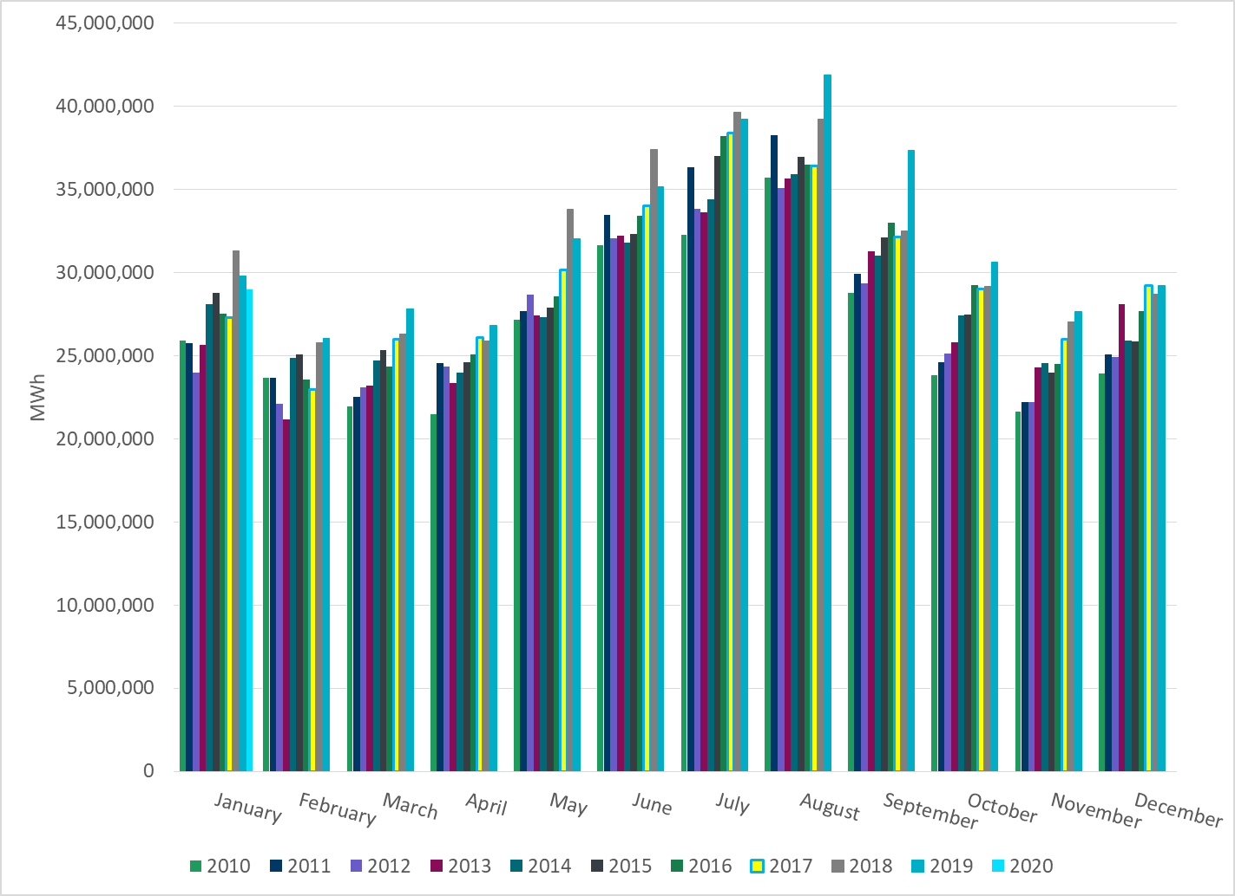
Total Energy
Notes:
28,969,595 MWh

Slide 22
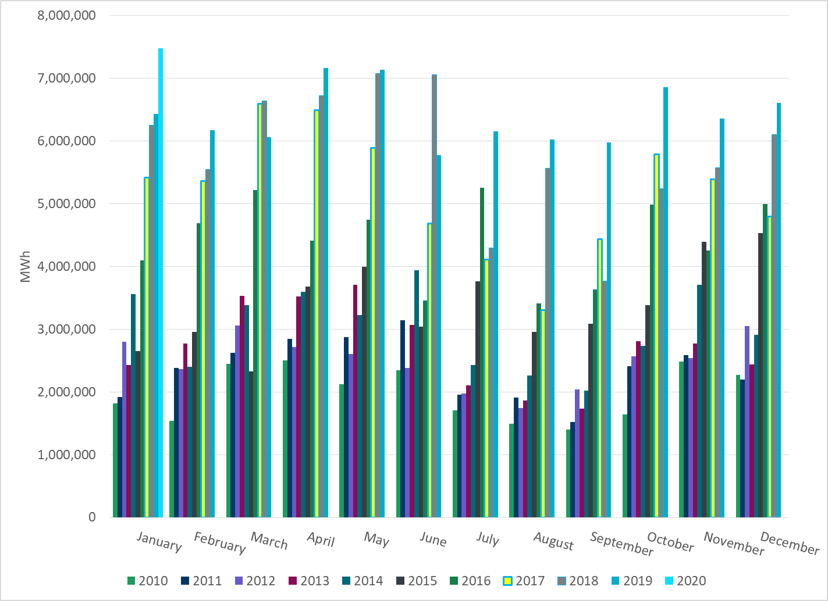
Total Energy from Wind Generation
Notes:
7,474,690 MWh

Slide 23
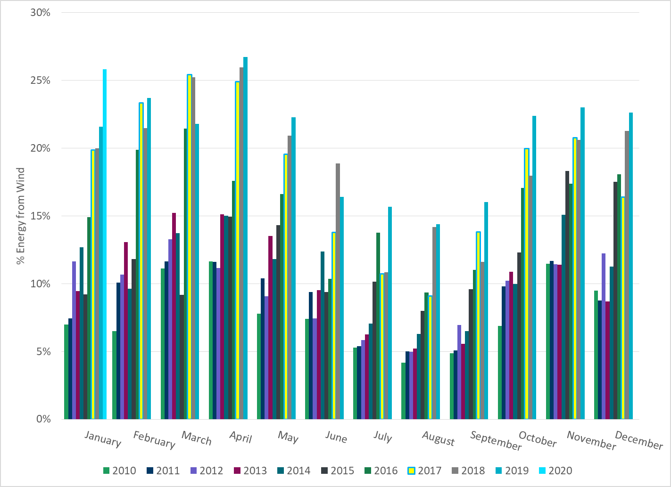
% Energy from Wind Generation
Notes:
25.80%

Slide 24
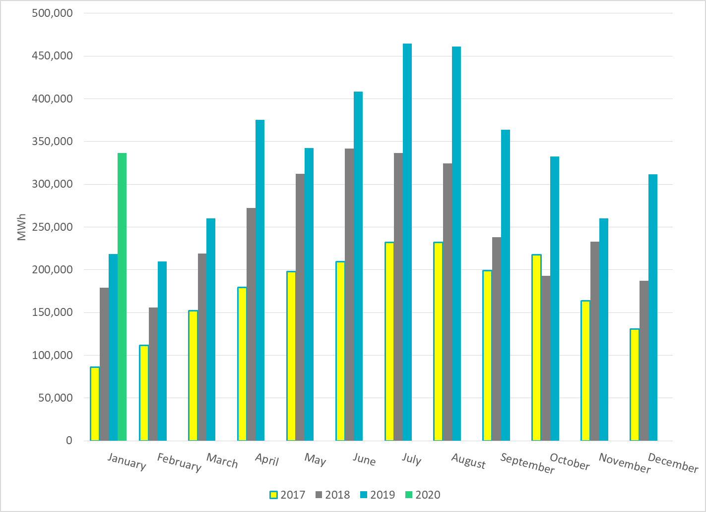
Total Energy From Solar Generation
Notes:
336,423 MWh

Slide 25
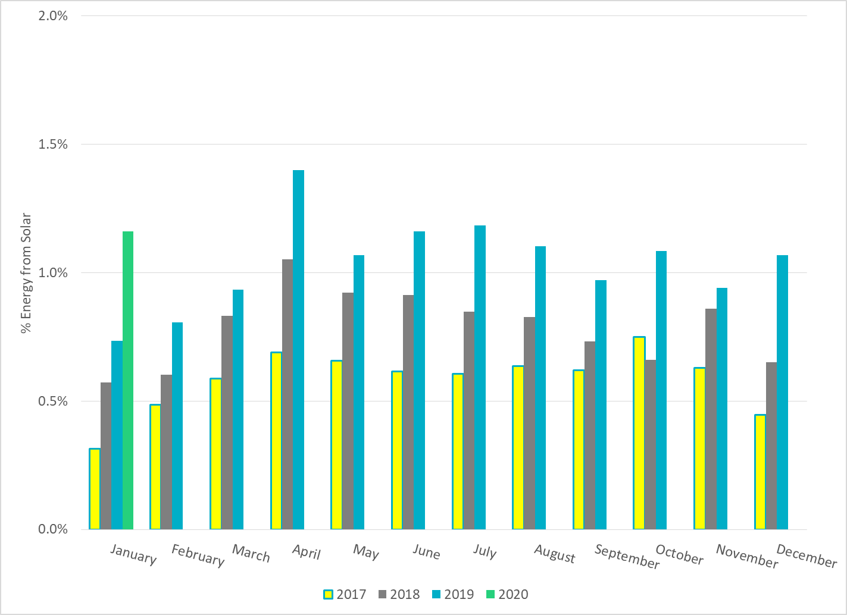
% Energy from Solar Generation
Notes:
1.16%
- Less overall Load compared to last 3 years

Slide 26
ERCOT System Inertia

Slide 27
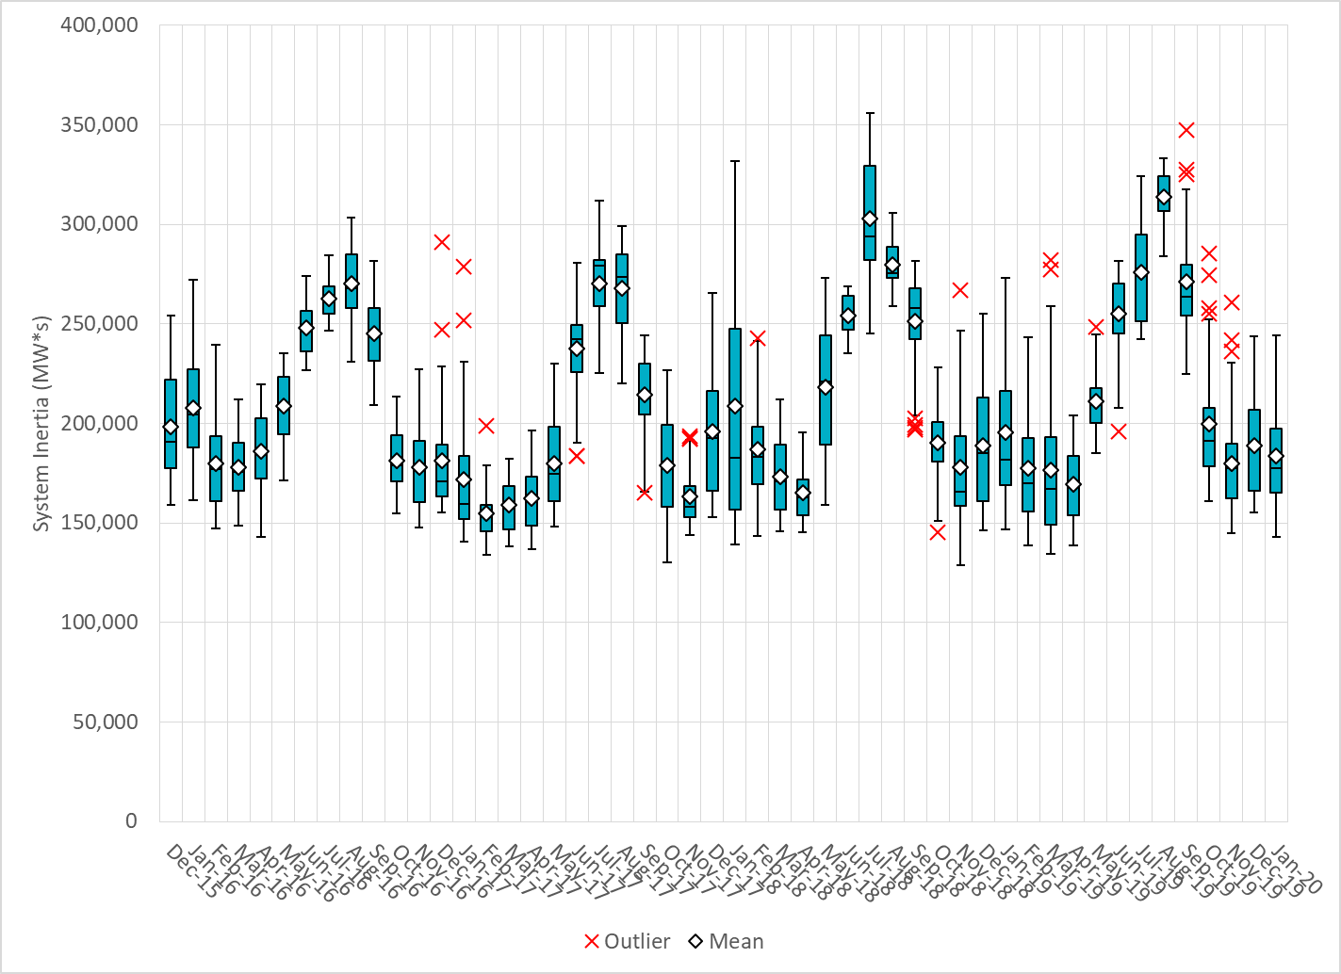
Daily Minimum System Inertia
Notes:
Minimum Inertia = 143,088 MW*s on 1/9/2020
Previous Minimum was 128,759 MW*s on 11/18/2018.
Data:
Mean: 183,800
Max: 244,162 on Jan 30th
Min: 143,088 on Jan 9th

Slide 28
Questions?
Thank you!

