Slide 1
ERCOT Interconnection Inertia Analysis
Julia Matevosyan
Resource Adequacy
ERCOT
02/06/2019

Slide 2
Outline and Key Points
Short review on inertia and inertia monitoring (slides 3,4,5)
Inertia in 2018-2019 does not follow an expected declining trend (slide 6)
This is counterintuitive, since inertia is expected to decline as more inverter-based resources are added to the system (slide 7)
Inertia trend is effected by a combination of factors:
  Higher minimum loads offset higher off-peak wind output resulting in higher minimum net-loads, which also lead to more synchronous units staying committed (slides 8, 9, 10)
  Lower natural gas prices led to more CCs staying committed (slide 11,13)
  Coal retirements led to more Combine Cycle (CCs) staying committed; CCs have higher inertia per committed MW capacity (slides 12, 13, 14)
  Steady inertia contribution from Private Use Networks (slide 15)
  Summary (slide 16, 17)

Slide 3
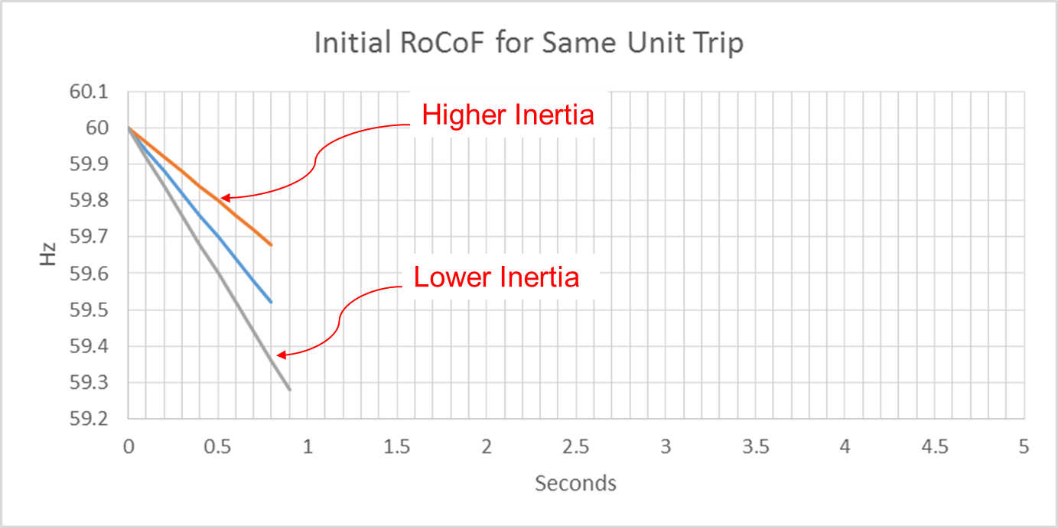
Effect of Synchronous Inertia on System Frequency
With increasing integration of inverter-based generation, there could be periods when total inertia of the system could be low since less synchronous machines will be online.
UFLS trigger
Notes:
UFLS trigger indicates the frequency (59.3 Hz) at which the first stage of involuntary underfrequency load shedding will happen. ERCOT plans and operates the system such that for the simultaneous trip of two largest generating units (2750 MW), UFLS should not be triggered, though it still can happen in some extreme unexpected situations.

Slide 4
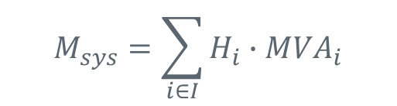
Inertia Calculation
In 2013, as instantaneous wind power penetration reached 30%, ERCOT started analyzing impacts of inverter-based generation on system inertia.
In 2015, ERCOT implemented a real-time inertia calculation using inertia parameters of each individual synchronous generator and its status (on/off) telemetry.
$$M_{sys}=\sum_{i∈I}{H_{i}∙{MVA}_{i}}$$
where I is the set of online synchronous generators or condensers,
MVA_{i} is MVA base of on-line synchronous generator or synchronous condenser i, and
H_{i} is inertia constant for on-line generator or synchronous condenser i in a system (in seconds on machine MVA_{i})

Slide 5
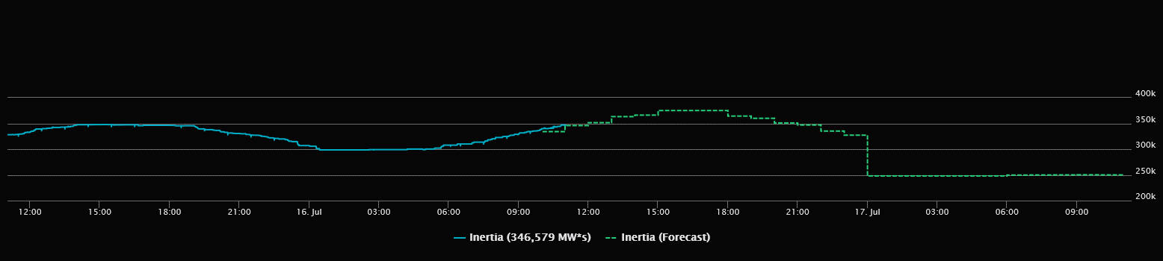

Inertia Monitoring in Real-Time and Forecasting
In 2016, inertia monitoring was implemented in the control room.

Slide 6
ERCOT Inertia 2013-2019
Date and Time | 2013 3/10/13 3:00 AM | 2014 3/30/14 3:00 AM | 2015 11/25/15 2:00 AM | 2016 4/10/16 2:00 AM | 2017 10/27/17 4:00 AM | 2018 11/03/18 3:30 AM | 2019(Jan-Nov) 3/27/2019 1:00 AM
Min synch. Inertia (GW*s) | 132 | 135 | 152 | 143 | 130 | 128.8 | 134.5
System load at minimum synch. Inertia (MW) | 24,726 | 24,540 | 27,190 | 27,831 | 28,425 | 28,397 | 29,883
Non-synch. Gen. in % of System Load | 31 | 34 | 42 | 47 | 54 | 53 | 50
Notes:
For each box, the central mark (red line) is the median, the edges of the box (in blue) are the 25th and 75th percentiles, the whiskers correspond to +/- 2.7 sigma (i.e., represent 99.3% coverage, assuming the data are normally distributed. The corresponding lowest inertia in each year is given in the table.
The circle on each boxplot is showing inertia during time when highest portion of load was served by wind generation in that year. In 2019 it was on November 26 3:52 am, 57.87%.

Slide 7
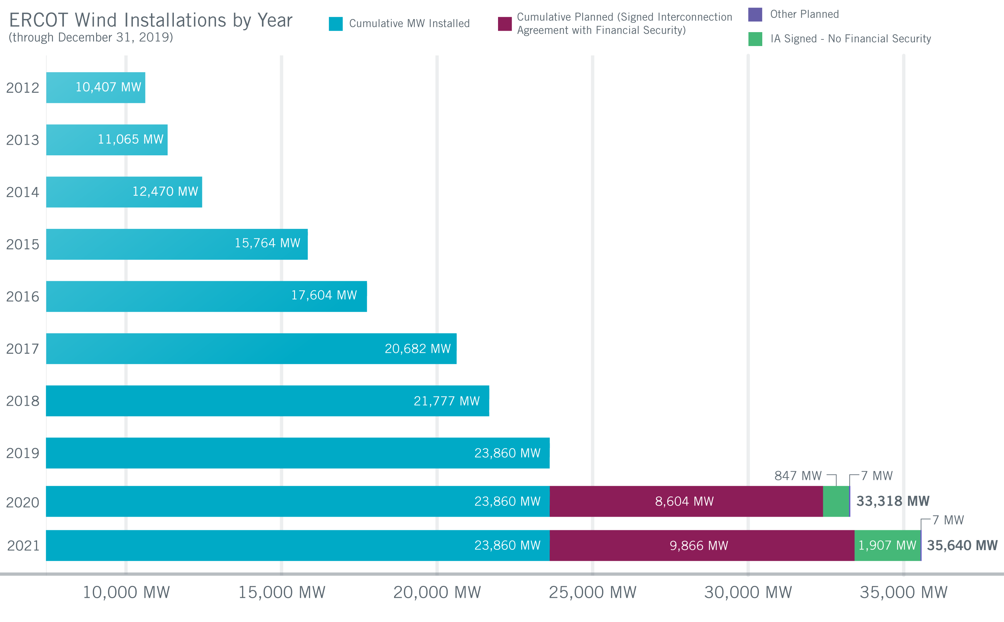
Wind Generation Capacity – December 2019
+1,405 MW
+3,294 MW
+1,840 MW
+3,078 MW
+1,095 MW
+2,083 MW
*Other Planned capacity reflects projects under 10 MW in size that are not included in the Resource Integration and Ongoing Operations Interconnection Services (RIOO-IS) System.

Slide 8
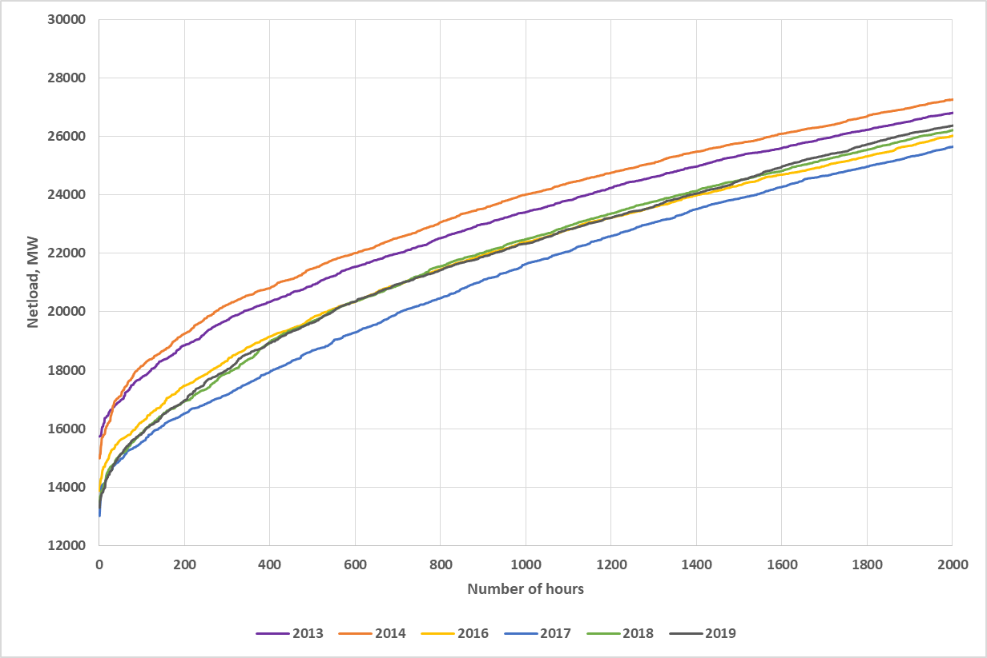
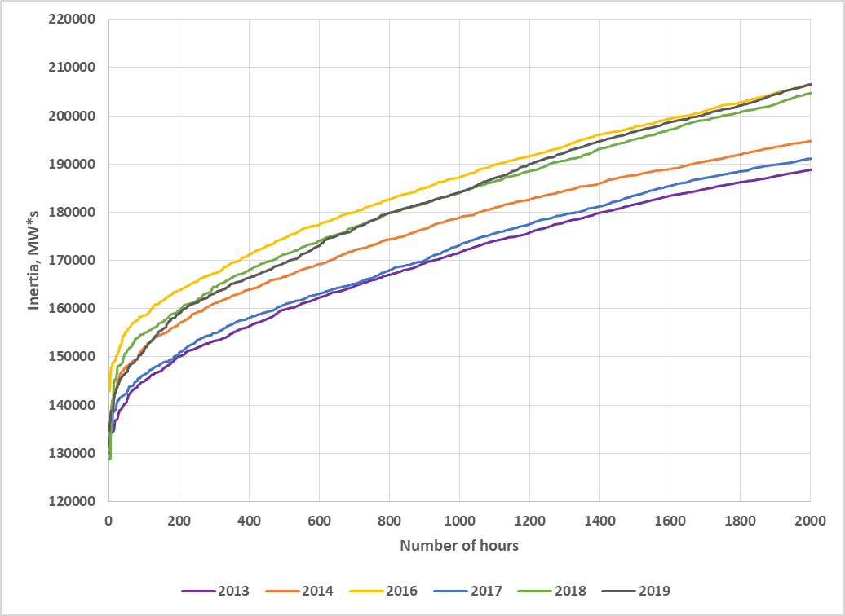
Net-load and Inertia Duration Curves 2013-2019
Net-load=Load minus Wind and PVGR generation
2016-2019 Net-load lower than 2013-2014 due to more installed wind capacity;
2017 Load is lower than 2018-2019 while windiness similar to 2018;
Zooming on lower inertia hours
Similar inertia in 2013 & 2017, the former is due to higher natural gas price/more Coal commitment, the latter due to lower net-load also combined with significant Coal commitment
2014-2016 inertia is higher, due to low gas prices/more Combined Cycle committed instead of Coal
This trend continues in 2018-2019, influenced also by Coal retirements
2015 inertia was higher due to low gas price, and low wind (not included here)
Notes:
In 2018 and 2019 at least 3 nuclear units are on at all times, while in other years (2013-2017) there are times when only 2 nuclear units are committed (on in each plant). One nuclear unit brings about 6 GW*s of inertia, so impact on inertia from having 3 unit on at all times compared to 2 units is significant.

Slide 9
Relative Wind Production Duration Curve 2013-2015 (zoomed)
Actual hourly wind production is normalized by installed capacity at the time and ordered from lowest to highest level for each year to compare how windy each year was.

Slide 10
Load Duration Curves (2013-2019)
Hourly load is ordered from lowest to highest level for each year to illustrate load growth from 2013 t o2019

Slide 11
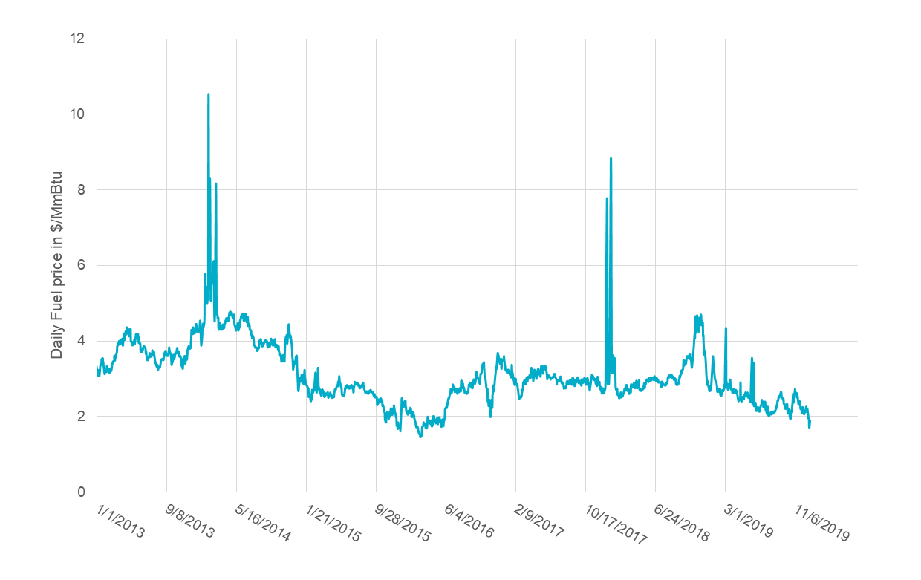
Gas Prices 2013-2019
Gas prices affect unit commitment and therefore inertia
Combined Cycle unit has about 1.5 time higher inertia than a Coal unit with the same capacity.

Slide 12
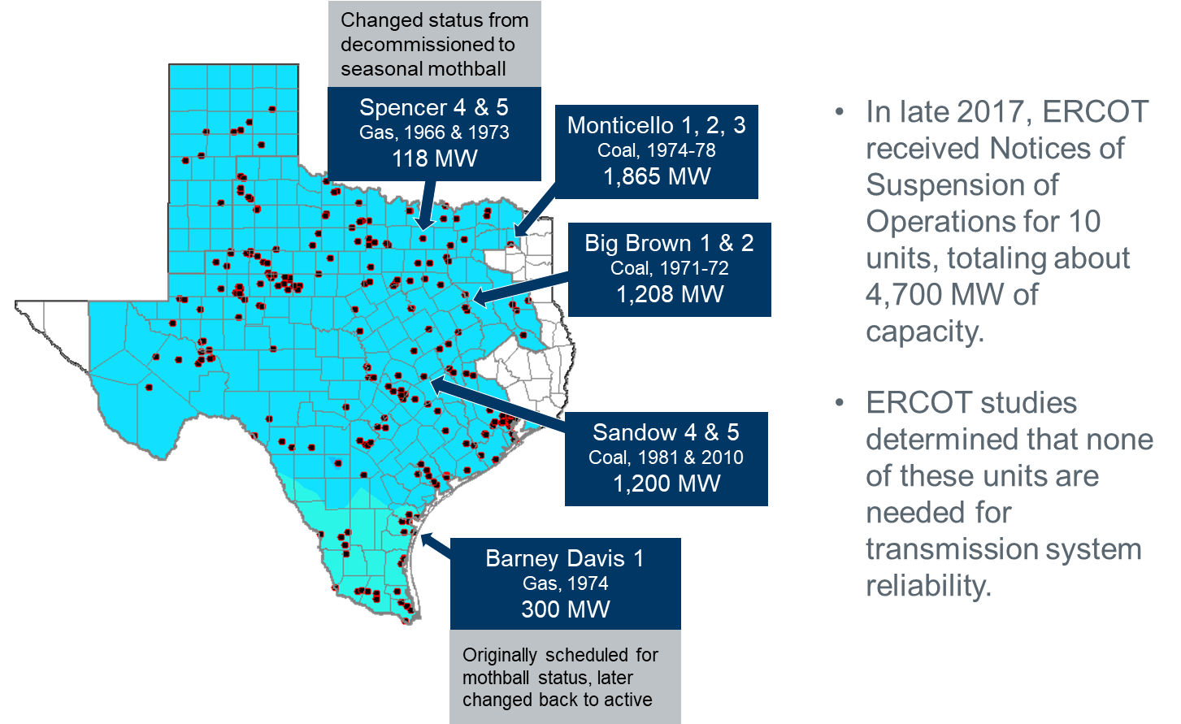
Coal Retirements
Total inertia of retired coal units > 12 GW*s
Additionally, JT Deely 1 & 2 (850 MW) mothballed at the end of 2018
Gibbons Creek 1 (470 MW) mothballed since October 2018 and retired in October 2019
These two unit’s total inertia was >4 GW*s

Slide 13
Combined Cycle Inertia
Jan- Nov

Slide 14
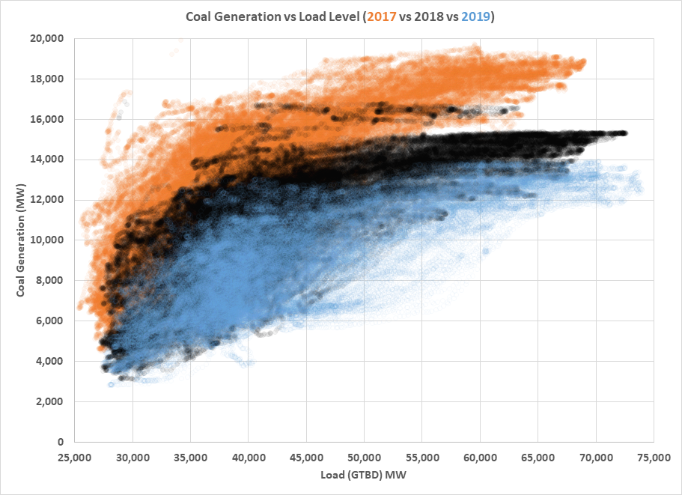
Coal Inertia
Jan- Nov

Slide 15
PUN Inertia
Jan- Nov

Slide 16
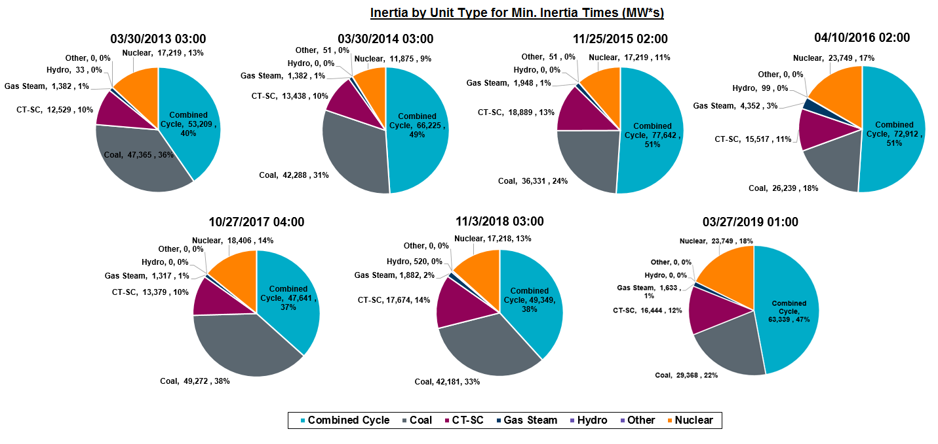
Inertia by Unit Type during Minimum Inertia Hour in Each Year

Slide 17
Summary
All other factors being constant, inertia would decline in proportion to installed capacity of inverter-based generation;
However, ERCOT load is growing, which affects unit commitment and, consequently, inertia trend;
Lower natural gas prices result in more Combined Cycle (CC) generation committed and higher overall inertia. If retired Coal generation is replaced by CCs in unit commitment, then inertia increases as well.
Private Use Networks generation provide significant portion of system inertia and currently does not respond to energy price variations similarly to other Resources
Finally, levels of wind output during low load periods in a given year affects inertia

Slide 18

Thank you! Questions?
Julia Matevosyan
jmatevosjana@ercot.com

Slide 19
Relative Wind Production Duration Curve 2013-2019
Actual hourly wind production is normalized by installed capacity at the time and ordered from lowest to highest level for each year to compare how windy each year was.
This data is not capturing potential production prior to curtailments but rather actual wind generation in any given hour.

Slide 20
2013 Inertia
Higher net load compared to other years, even though it is the windiest year in the 2013-2019 period;
Wind capacity is 11 GW by the end of 2013 and is doubled over the next 6 years (2014-2019);
Lower inertia due to high natural gas price and, thus more Coal generation is committed;
A Coal plant has 1.5 times less inertia than Combined Cycle (CC) plant of the same rating.

Slide 21
2014 Inertia
1.4 GW of wind capacity added compared to 2013
Higher net load compared to 2013 (less windy year compared to 2013, though windier than other years in the period)
Inertia is higher due to low natural gas prices resulting in more CC generation committed instead of
Coal generation.

Slide 22
2015 Inertia
3.2 GW of wind capacity added compared to 2014
Low wind year, the lowest in the entire 2013-2019 period
High net-load as a result
Low natural gas prices result in more CC generation committed, resulting in higher inertia than in any other year of the period (2013-2019)

Slide 23
2016, 2018, 2019 Inertia
Net-load lower compared to 2013-2015 but is similar in all three years;
Even though load is growing, wind additions are also significant with > 5 GW added between 2013 and 2016 and additional > 6 GW from 2016 to 2019;
Natural gas prices are still low in the first half of 2016, resulting in more CC generation committed and higher inertia, during spring time;
In 2018-2019, coal retirements and variation of natural gas price are affecting inertia trends.
In 2018-2019 at least 3 nuclear units are online at all times, while in other years there are times with only 2 nuclear units on (one at each plant). Each nuclear unit on average has ~6 GWs of inertia

Slide 24
2017 Inertia
Net-load is the lowest, since load growth is somewhat slower than wind additions.
Load is lower than in 2018
Relatively windy year, close to 2018
Coal commitment is significantly higher than in other years, caused by higher natural gas prices and, possibly, some effect of pre-retirement.

