Slide 1
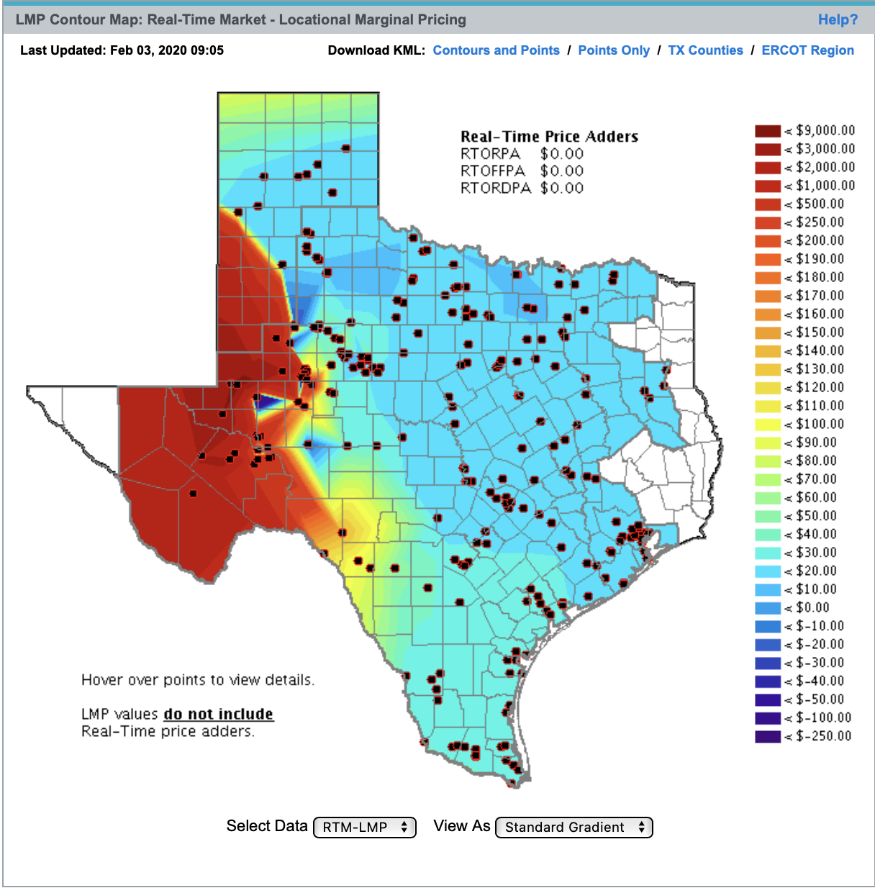
Far West Texas Hub
CMWG Meeting
February 3, 2020

Slide 2
Far West Texas Changes
Dramatic Load Growth
Expansion of Oil and Gas Production.
Natural Gas Pipeline construction to Gulf Coast
Electric Grid
Nodal prices that move dramatically different from the West Hub
Extensive Transmission Upgrades underway
Expansive Inverter Based Generation Development
Volatility
Lubbock joining ERCOT

Slide 3
ERCOT’s New hubs
Panhandle
Provides transparency into congestion and generation activity versus West and North Hub
Valley Hub NPRR
20-month schedule

Slide 4
Need to start Far West Hub development
ERCOT Market needs price transparency in Far West Texas
Forward Curve needed to support investment
Identify Potential Nodes
Refine design after 2020 transmission upgrades are operational

