Slide 1
Electric Transmission Texas Update February 3, 2020 Kip Fox President, ETT Managing Director, Transmission Ventures – West, AEP

Slide 2
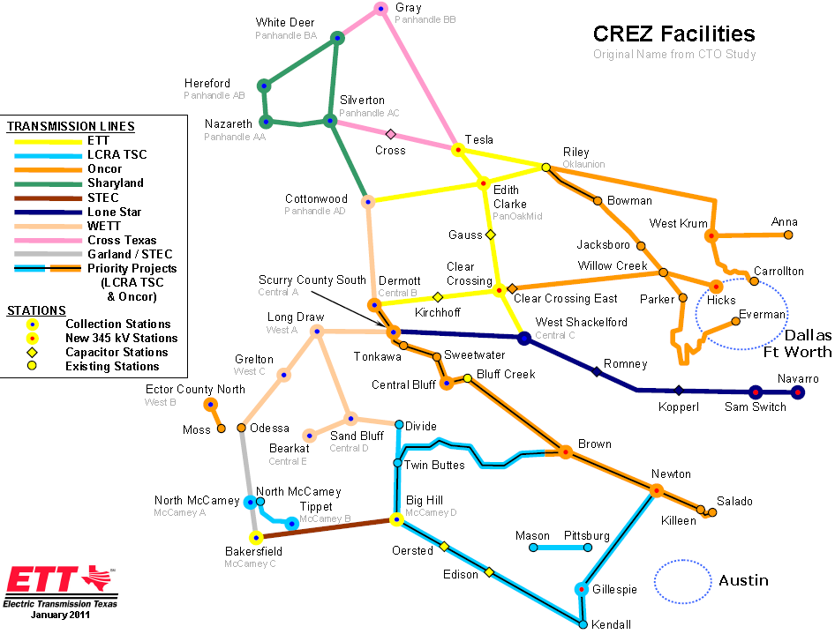

Slide 3
ETT Return to Service Times for West Texas Arms Project
11/21/2017: Riley (R)-Edith Clarke (EC) – Thanksgiving and forecast wind out (return to service for 6 days).
12/1/2017 – 11 A.M.: Handed back R-EC for mobilization to EC-Cottonwood (CW) (energized 3 days early).
12/21/2017: Placed EC-CW line in service for Christmas and bad weather forecast. (14 days)
1/4/2018 – 1 P.M.: Took R-EC line out of service (delayed one day). We were originally scheduled to receive the outage on 1/3/2018 but weather projections delayed taking the outage on time.
3/21/2018 – 11 A.M.: Returned R-EC to service upon request from ETT. Another line had an emergency outage so ETT requested return to service for R-EC for 6 days.
3/27/2018: R-EC out of service (return to outage scheduler plan).
4/19/2018: Returned R-EC back into service 1 day early. (6 days)
4/24/2018 – 1:45 P.M.: Took Clear Crossing (CC)-Dermott (D) line out of service. Originally scheduled to begin the outage on 4/23/2018; delay based on wind out projection.
7/3/2018: Returned to service CC-D for the 4th of July (one day early due to wind out projection). 5 days in-service.
11/20/2018: Returned to service CC-D until 11/26/2018. (6 days)
12/19/2018: Returned to service CC-D. (15 days)

Slide 4
ETT Return to Service Times for West Texas Arms Project
4/18/2019: Returned to service CC-West Shackelford (WS) until 4/23/2019. (5 days)
7/16/2019: Returned to service Tesla – Jim Treece until 7/31/2019. (Arm replenishment and weather reliability due to peak load.) (16 days)
8/10/2019: Returned to service Tesla – Jim Treece until 8/22/2019. (Return to service ahead of schedule.) (12 days)
10/10/2019: Tesla – Jim Treece completed early and returned to service. (18 days)
10/28/2019: Tesla – Edith Clarke taken out of service for scheduled work.
11/22/2019: Returned to service for Thanksgiving holiday (11 days)
12/3/2019: Tesla – Edith Clarke taken out of service to continue work.
12/20/2019: Returned to service for Christmas holiday. (14 days)
1/3/2020: Tesla – Edith Clarke taken out of service to continue work.
1/27/2020: Tesla – Edith Clarke return to service 22 days early.
Total number of days return to service during West Texas Arms Project: 160 days
Total number of outage days for West Texas Arms Project as of 1/27/2020: 871 days

Slide 5
Production Outlook – look ahead for illustration purposes
N
Ckt2
Ckt1
Adjustment to planned outage to accommodate requirements for outages on CC-D and EC-CC:
Feb 19 - Mar 31, 2020: CC-D line (6 weeks)
Change arms
Perform QA check on selected weld repairs on elevated flanges to assess performance 12+ months after repair completed
Perform base flange weld repairs on EC – CW (107 repairs outstanding)
Apr 1 – May 15, 2020: Edith Clark – Coulomb (~ 6 weeks duration): Str # 1 - Str # 131 (ABB Str #1 - 106)
Inspect structures with pole flanges (est. 149 repairs)
Change arms
May 15 – Aug 14, 2020: Coulomb – Smoky Hill (~ 12 weeks duration): Str # 133 - Str # 336 (ABB Str #134 – 329)
Inspect structures with pole flanges (est. 212 repairs)
Change arms
Aug 14 – Sept 30, 2020: Smoky Hill – Clear Crossing (~ 6 weeks duration): Str # 337 – Str # 504 (ABB Str #341 – 504)
Inspect structures with pole flanges (est. 176 repairs)
Change arms
[New]
Str #1
Str #131
138 kV under build Str 114-147
Str #132
Str #133
138 kV under build Str 114-147
Str #263
Cap
Bank
Str #264
Str #336
138 kV under build Str 387-392
Str #337
Str #504
5
Date: 01/20/2020

