Slide 1
Impact of Removing Curtailed Panhandle Wind Capacity from RTOLCAP
ERCOT
Congestion Management Working Group
February 3, 2019

Slide 2
Impact of Panhandle Curtailment on RTORPA
For each SCED interval in 2019 where the Panhandle GTC was binding:
Filtered for wind units that have a >.99 shift factor on the Panhandle GTC
Calculated curtailed Panhandle wind capacity by subtracting Panhandle wind BP from HSL
Reduced RTOLCAP by curtailed Panhandle wind capacity
Recalculated LOLP and RTORPA using reduced RTOLCAP
Results:
Panhandle constraint was binding in 15,352 of 105,753 SCED intervals in 2019 (15%)
Maximum decrease in RTOLCAP was 1,602 MW
Maximum increase in RTORPA was $55.03/MWh
Simple average RTORPA in the binding intervals was $0.09/MWh
Simple average RTORPA in the binding intervals after removing curtailed Panhandle wind capacity was $0.16/MWh
Simple average RTORPA in all of 2019 was $6.44/MWh
Simple average RTORPA in all of 2019 after removing curtailed Panhandle wind capacity was $6.45/MWh
Increase of $0.01/MWh (0.2%)

Slide 3
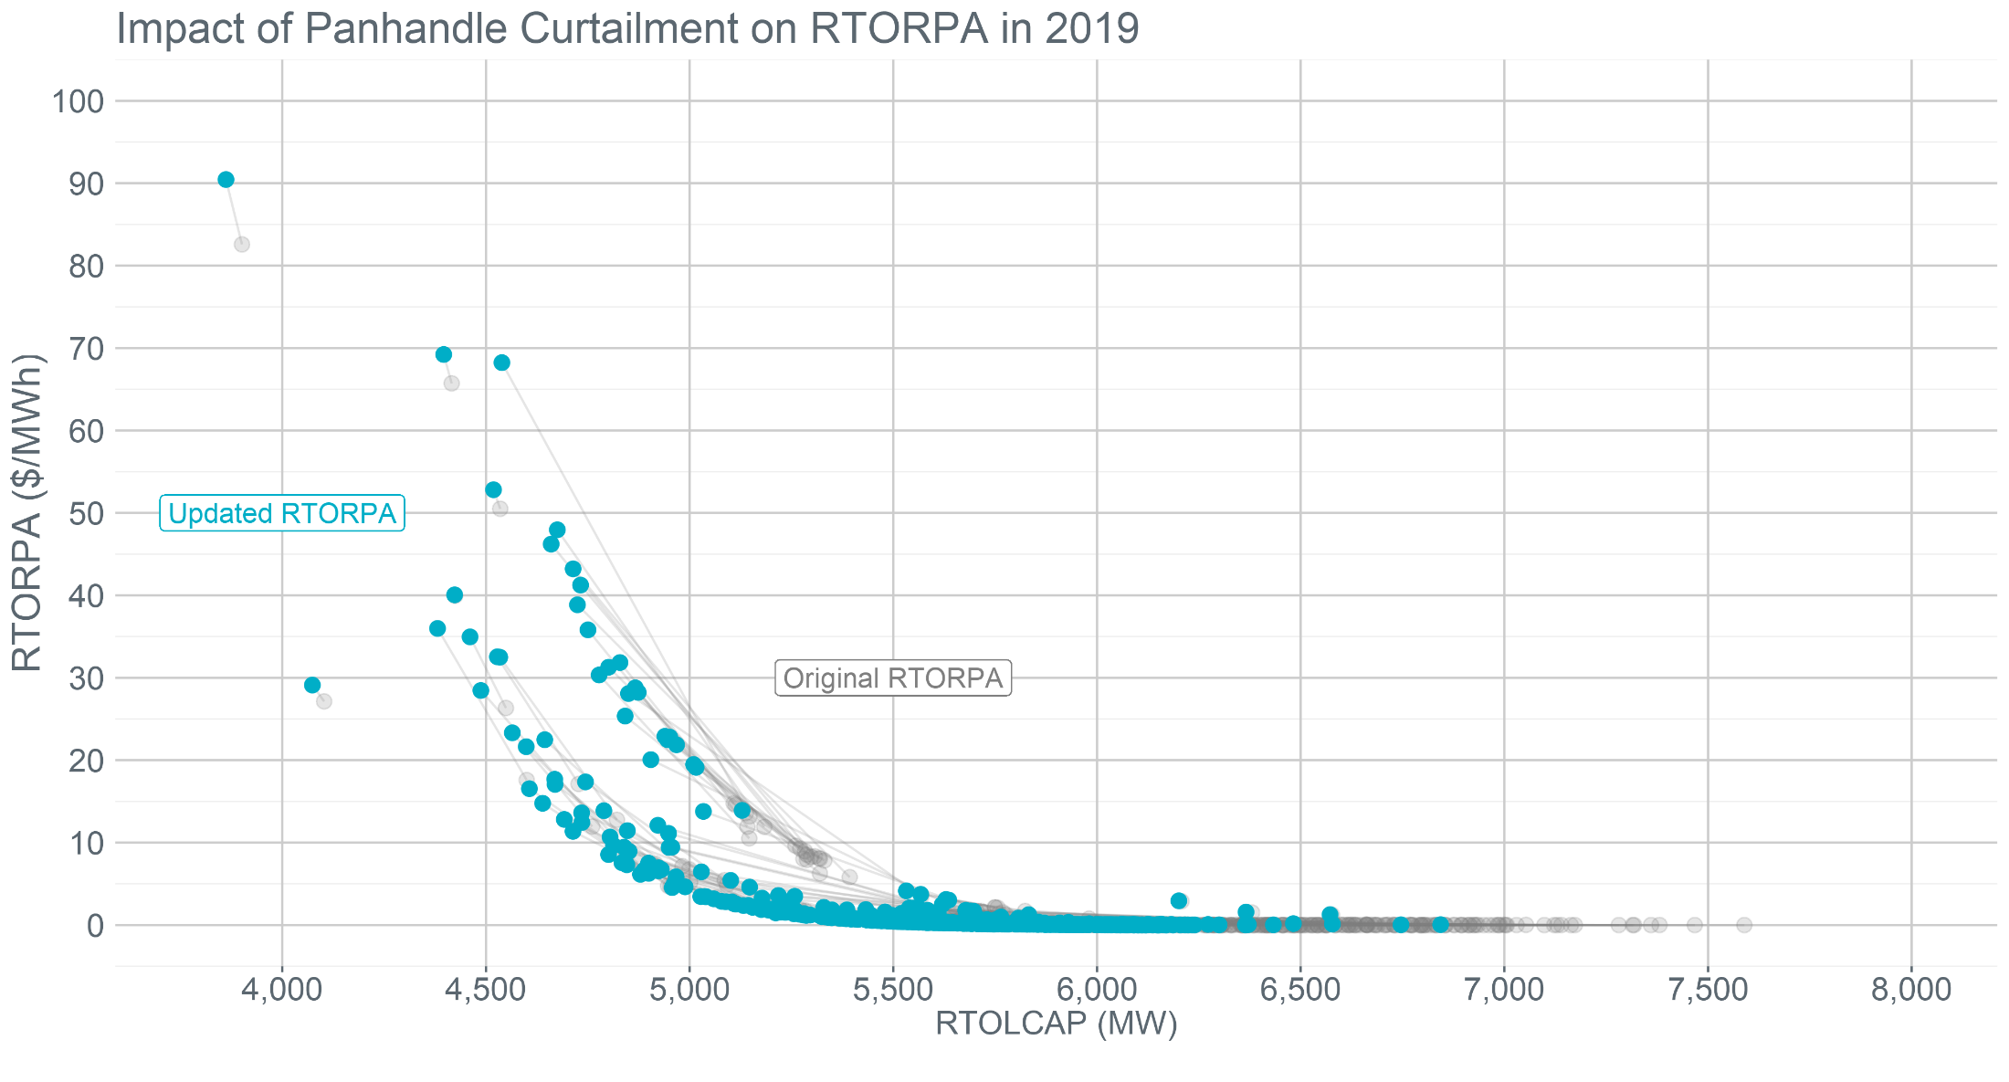
Impact of Panhandle Curtailment on RTORPA

Slide 4
Deliverability under Real-Time Co-optimization
Under the Key Principles, Real-Time Co-optimization (RTC) will not consider deliverability of reserves in awarding AS, except by manual action of the ERCOT operator for a subset of AS types
A change to exclude capacity curtailed for base case violations from RTOLCAP would be therefore would be a throw-away once RTC is implemented

