Slide 1
Analyzing Non-Activated Constraints and Their Potential Impact
ERCOT
Congestion Management Working Group
February 3rd, 2019

Slide 2
Agenda
Review of material presented at the January 13th, 2020 CMWG
Potentially added congestion rent from Top-20 Overloaded Elements relative to actual congestion rent
Overview of New Material and Further Considerations
Potential Increase in Annual Congestion Rent

Slide 3
Introduction
During Real-Time, Real-Time Contingency Analysis (RTCA) identifies base case and post-contingency overloaded elements and displays them in the Transmission Constraint Manager (TCM)
Base case constraints are activated (sent to SCED) as appropriate
Contingency constraints are only activated if the following conditions are met:
Above Loading Threshold: loaded at 98% of Emergency Limit
Shift Factors Available: there exists a Resource Shift Factor ≥ 2% (absolute value)
Not Redundant: a similar constraint is not already activated
Constraints for which Constraint Management Plans (CMPs) have been created are activated (sent to SCED) as appropriate

Slide 4
Top 20 Overloaded Elements (Original)
Elements ranked by approximated congestion rent accumulated between January 2016 and November 2019
Element | Fr. Sub | To Sub. | Eqmt. | Rtg. (MW) | Approximated Cngstn. Rent ($) | Total Hours | Hrs GT 100% | Hrs GT 110% | Hrs GT 125% | Unique Ctg.'s | kV Level | Max Shdw Price ($/MWh) | Weather Zone | County
1370_D | LFSTW | LFPTP | LN | 232 | $ 75,165,533 | 90 | 69 | 21 | - | 2 | 138 | 3,500 | East | Angelina
1370_E | LFKTP | HUDSN | LN | 271 | $ 76,631,333 | 79 | 65 | 14 | - | 2 | 138 | 3,500 | East | Angelina
1370_H | LFKSW | LFKTP | LN | 277 | $ 129,238,142 | 131 | 82 | 49 | - | 2 | 138 | 3,500 | East | Angelina
1370_J | LFPTP | LFSTH | LN | 232 | $ 57,600,317 | 69 | 54 | 15 | - | 2 | 138 | 3,500 | East | Angelina
HARLIN_HARLNS1_1 | HARLIN_1 | HARLNSW | LN | 106 | $ 28,522,480 | 88 | 24 | 55 | 9 | 2 | 69 | 2,800 | Southern | Cameron
HARLNSW_69AH | HARLNSW | HARLNSW | XF | 143 | $ 43,389,179 | 81 | 37 | 38 | 6 | 2 | 138 | 3,500 | Southern | Cameron
G138_10B_1 | MAGNO_TN | SEMINOLE | LN | 210 | $ 119,382,375 | 158 | 113 | 45 | - | 5 | 138 | 3,500 | Coast | Galveston
G138_10C_1 | SEMINOLE | FRDSWOOD | LN | 210 | $ 291,886,875 | 375 | 204 | 135 | 36 | 7 | 138 | 3,500 | Coast | Galveston
G138_8B_1 | SOUSHORE | LEAGCITY | LN | 256 | $ 243,125,648 | 266 | 174 | 90 | 3 | 5 | 138 | 3,500 | Coast | Galveston
G69_BB_1 | TERMINAL | MARTHNOL | LN | 109 | $ 29,713,763 | 91 | 22 | 69 | - | 2 | 69 | 2,800 | Coast | Galveston
G69_BB2_1 | MARTHNOL | CHOCTAW | LN | 109 | $ 29,779,890 | 91 | 22 | 69 | - | 2 | 69 | 2,800 | Coast | Galveston
G69_C_1 | AMOCOTN | TERMINAL | LN | 143 | $ 39,789,750 | 92 | 15 | 76 | 1 | 2 | 69 | 2,800 | Coast | Galveston
G69_E1A_1 | HEIGHTTN | NTHSDTAP | LN | 108 | $ 88,764,748 | 280 | 188 | 85 | 8 | 3 | 69 | 2,800 | Coast | Galveston
G69_E1B_1 | TXCITYMN | NTHSDTAP | LN | 108 | $ 73,935,108 | 234 | 154 | 78 | 2 | 3 | 69 | 2,800 | Coast | Galveston
G69_F2_1 | CHOCTAP | CHOCTAW | LN | 129 | $ 86,762,095 | 229 | 146 | 74 | 9 | 3 | 69 | 2,800 | Coast | Galveston
G69_FA_1 | HEIGHTTN | CHOCTAP | LN | 108 | $ 94,558,683 | 298 | 202 | 83 | 14 | 3 | 69 | 2,800 | Coast | Galveston
PHR_SOU_1 | SOUSHORE | PHR | LN | 287 | $ 528,572,085 | 500 | 284 | 186 | 31 | 3 | 138 | 3,500 | Coast | Galveston
G138_11A_1 | FRDSWOOD | HASTINGS | LN | 336 | $ 29,204,000 | 25 | 25 | - | - | 1 | 138 | 3,500 | Coast | Galveston/Brazoria
INDUST_NUECES1_1 | INDUSTRI | NUECES_B | LN | 103 | $ 49,482,230 | 169 | 147 | 22 | - | 2 | 69 | 2,800 | Southern | Nueces
6332_A | YUCSW | GASPAD | LN | 151 | $ 46,642,954 | 80 | 65 | 15 | - | 12 | 138 | 3,500 | Far West | Ward/Reeves
Total: $ 2.16 B

Slide 5
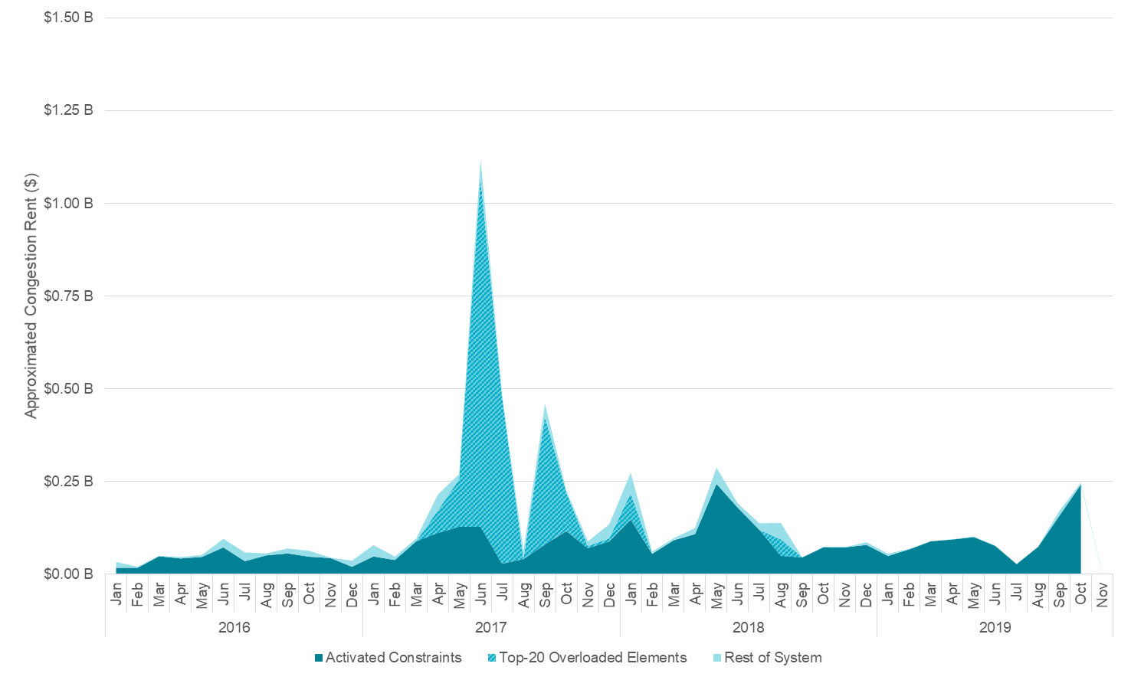
Approximated Congestion Rent from Potentially Activated Constraints Relative to Actual Congestion Rent (Original)
It was asked at the previous CMWG whether or not the approximated congestion rent from potentially activated constraints included constraints that might:
be considered redundant with other potentially activated constraints, or
be an irresolvable constraint that meets the threshold to have its maximum Shadow Price re-evaluated
For the purpose of this study, only the constraint-pairs including the Top-20 potentially activated Overloaded Elements were considered since they accounted for 77% of the potentially added Congestion Rent
Total: $ 2.16 B (top 20)
$ 2.79 B (all)
Original Potentially Activated

Slide 6
Overview of New Material
The following material is a follow-up to some of the concerns that were addressed at CMWG on January 13th, including whether or not the approximated congestion rent from potentially activated constraints included constraints that might:
be considered redundant with other potentially activated constraints, or
be an irresolvable constraint that meets the threshold to have its maximum Shadow Price re-evaluated
New considerations were addressed using the process outlined in the Constraints Not Activated in SCED presentation from the January 13th CMWG (link), with some further considerations…

Slide 7
Further Considerations & Assumptions
Of the Top-20 Overloaded Elements (86 individual contingency-constraint pairs)...
Redundant Constraints
Each day and element was analyzed and constraints that would be considered “redundant” were excluded
Those with the most accumulated Approximated Congestion Rent were kept
Assumed that redundant constraints would be present in TCM at same
Irresolvable Constraints
For the remaining constraints, the hours and days they would have been activated, and irresolvable, are used to determine when they would be meet the trigger for modification of their Shadow Price Cap in SCED per Methodology for Setting … Power Balance Constraints Section 3.6.1
A constraint violation is not resolved by the SCED dispatch or overridden for more than two consecutive hours on more than 4 consecutive Operating Days; or a total of 20 hours in a rolling thirty day period.
Constraints Maximum Shadow Price was set to $2,000/MWh when these conditions were met, and reset at the first of each year
Assumed that constraints would be activated for the same, continuous time block

Slide 8
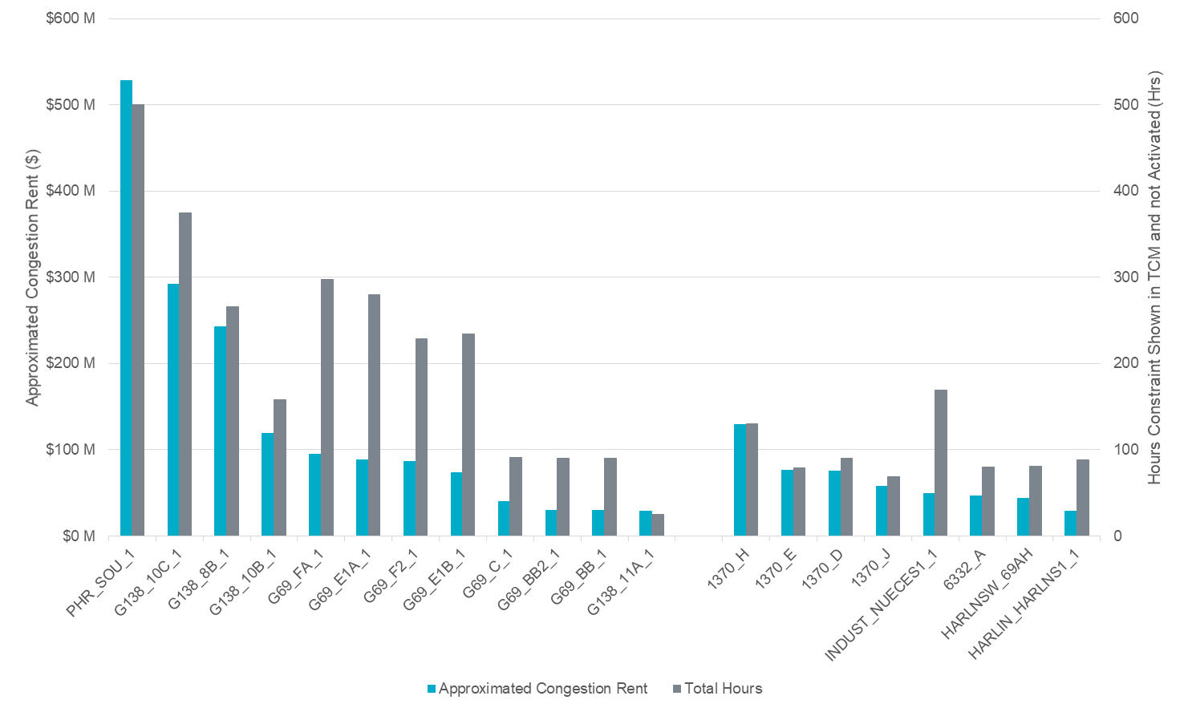
Top 20 Overload Elements (by Approx. Congestion Rent) Original
Overloaded elements ranked by approximated congestion rent accumulated between January 2016 and November 2019
Rest of System
Galveston County

Slide 9
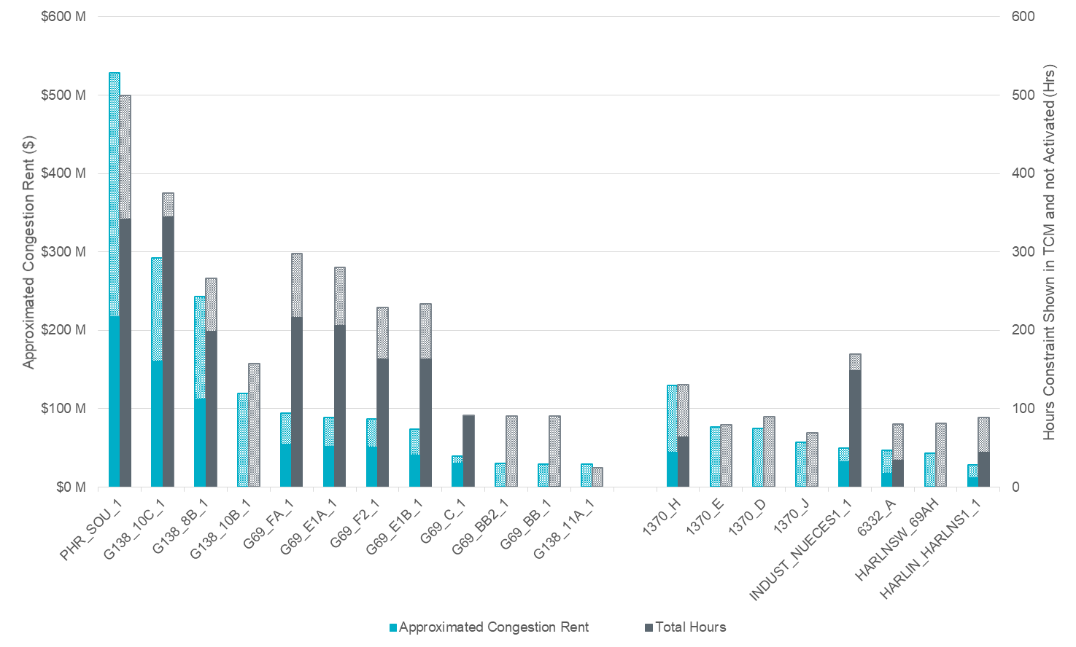
Top 20 Overload Elements (by Approx. Congestion Rent) Considering Redundant & Irresolvable Constraints
Overloaded elements ranked by approximated congestion rent accumulated between January 2016 and November 2019
Rest of System
Galveston County

Slide 10
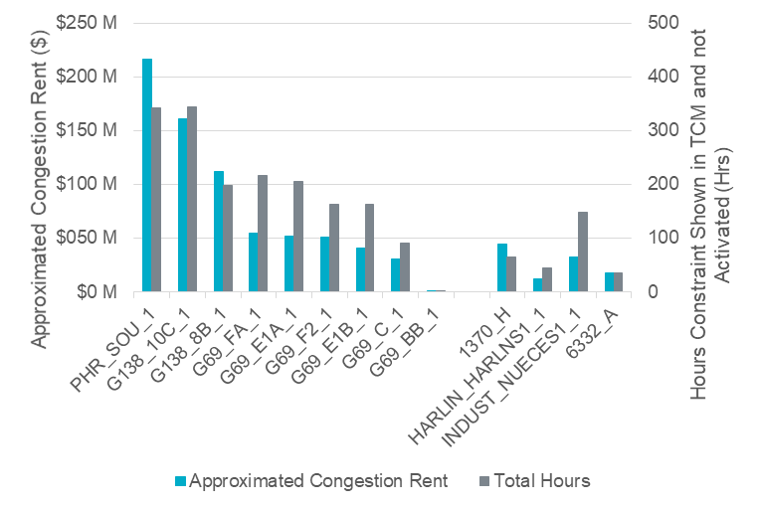
Impact to Top-20
PHR_SOU_1 remains as the most potentially additive Overloaded Element
Total approximated additional congestion rent from Top-20 elements reduced from $2.16 billion to $812 million (62% reduction)
Element | Approximated Cngstn. Rent ($) | Total Hours | Hrs GT 100% | Hrs GT 110% | Hrs GT 125% | Unique Ctg.'s | Max Shadow Price ($/MWh) | % of Hrs SP Set to $2,000/MWh | County
PHR_SOU_1 | $ 214,420,092 | 65 | 40 | 25 | - | 5 | 3,500 | 94% | Galveston
G138_10C_1 | $ 160,503,000 | 35 | 27 | 8 | - | 14 | 3,500 | 94% | Galveston
G138_8B_1 | $ 111,430,625 | 346 | 181 | 129 | 36 | 7 | 3,500 | 90% | Galveston
G69_FA_1 | $ 54,289,097 | 200 | 112 | 85 | 3 | 6 | 2,800 | 74% | Galveston
G69_E1A_1 | $ 50,798,085 | 2 | 2 | - | - | 4 | 2,800 | 76% | Galveston
G69_F2_1 | $ 49,865,188 | 91 | 14 | 76 | 1 | 7 | 2,800 | 66% | Galveston
1370_H | $ 43,508,721 | 207 | 114 | 85 | 8 | 3 | 3,500 | 69% | Angelina
G69_E1B_1 | $ 40,627,585 | 165 | 84 | 79 | 2 | 4 | 2,800 | 74% | Galveston
INDUST_NUECES1_1 | $ 32,123,983 | 165 | 81 | 74 | 10 | 3 | 2,800 | 89% | Nueces
G69_C_1 | $ 30,035,243 | 219 | 123 | 82 | 14 | 2 | 2,800 | 78% | Galveston
6332_A | $ 17,619,329 | 46 | 13 | 28 | 5 | 19 | 3,500 | 22% | Ward/Reeves
HARLIN_HARLNS1_1 | $ 10,186,600 | 149 | 126 | 23 | 0 | 2 | 2,800 | 55% | Cameron
G69_BB_1 | $ 330,633 | 344 | 178 | 135 | 31 | 4 | 2,800 | 0% | Galveston

Slide 11
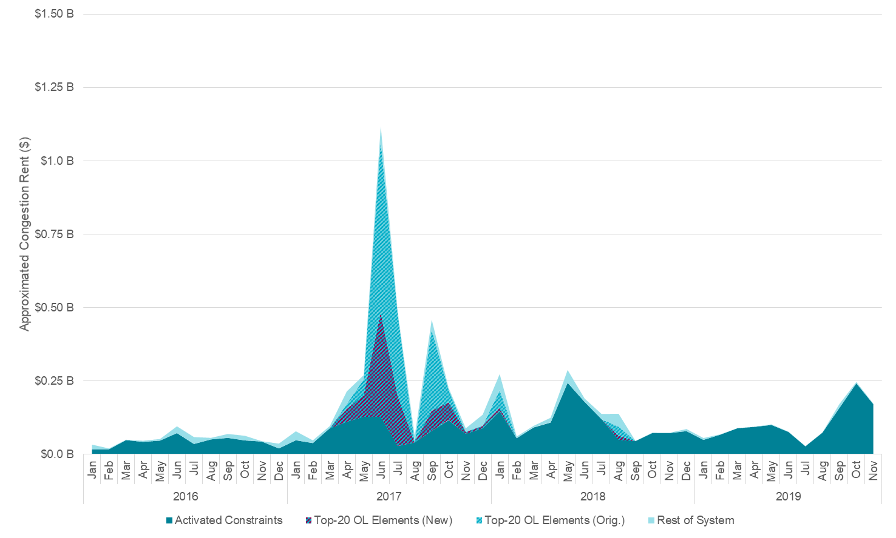
Approximated Congestion Rent from Potentially Activated Constraints Relative to Actual Congestion Rent
Potentially added Congestion Rent from Top-20 Overloaded Elements when considering redundant constraints and constraint irresolvability
Potentially Activated

Slide 12
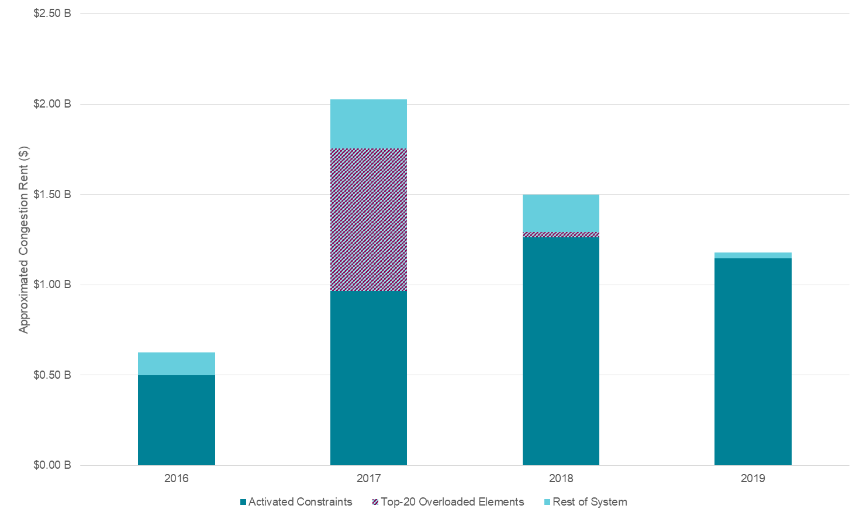
Potential Increase in Annual Congestion Rent
Considering only the Top-20 Overloaded Elements, which have been analyzed for redundancy and irresolvability, the additional constraints could have added potentially 82% more Congestion Rent for 2017
209%
182%
118%
102%
102%
0%
125%
0%

Slide 13
Questions?
Thank you!!

