Slide 1
PDCWG Report to ROS
Chair: Chad Mulholland, NRG
Vice Chair: Jimmy Jackson, CPS
ROS
February 6th, 2020

Slide 2
Report Overview & Notes
Report Overview
Meeting Minutes
BAL-001-TRE-1 FMEs & IMFR
1 FME in the month of December
Frequency Control Report

Slide 3
Meeting Minutes
PDCWG Meeting 1/14/2020
Southern Cross DC Tie – Directive 3, DC Tie Ramping Limits
Discuss Protocol Changes (ERCOT White Paper)
NPRR 863 (Creation of ERCOT Contingency Reserve Service and Revisions to Responsive Reserve) Update from ERCOT
Methodology to Calculate RRS Limits Procedure (Approved August 2019 PDCWG)
NPRR 863 takes effect March 1, 2020
ERCOT Webex on January 28, 2020
Proposal: Limiting Generator RRS Bids/Offers Based on Inertia Forecast (Update from November 2019)
BAL-001-TRE: SAR-12
Regulation & Frequency Control Reports

Slide 4
Frequency Measurable Events Performance

Slide 5
Frequency Measurable Events
There was 1 FME in December
12/29/2019 22:27:23
Loss of 458 MW
Interconnection Frequency Response: 1056 MW/0.1 Hz
6 of 36 Evaluated Generation Resources had less than 75% of their expected Initial Primary Frequency Response.
5 of 36 Evaluated Generation Resources had less than 75% of their expected Sustained Primary Frequency Response.

Slide 6
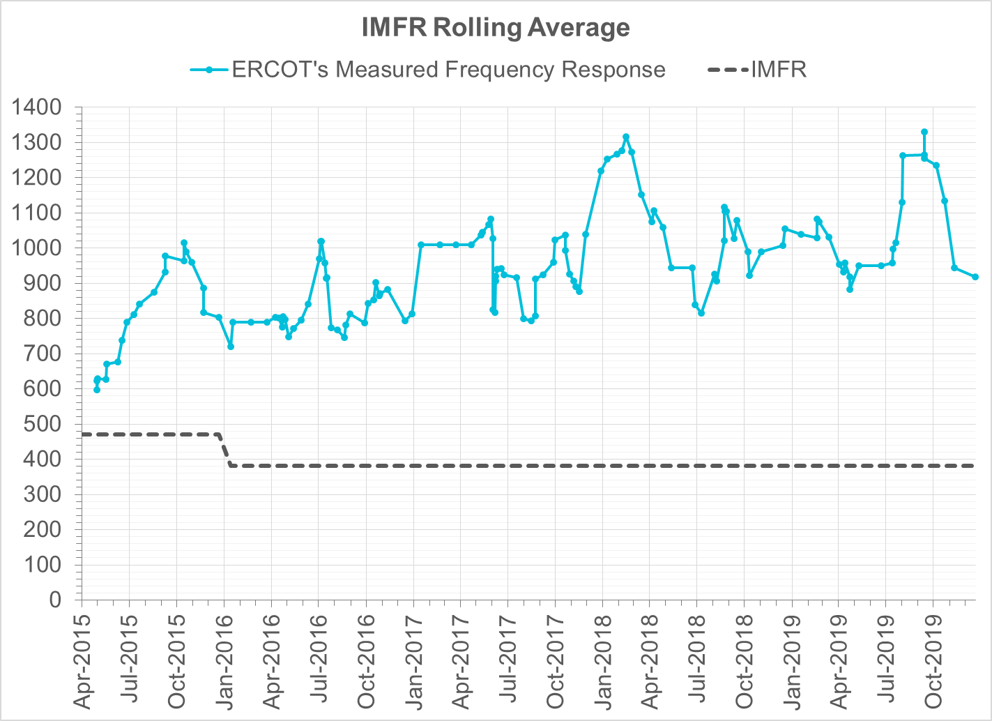
Interconnection Minimum Frequency Response (IMFR) Performance
IMFR Performance currently 918.14 MW/0.1Hz
Frequency Response Obligation (FRO): 381 MW/0.1 Hz

Slide 7
Frequency Control Report
November 2019

Slide 8
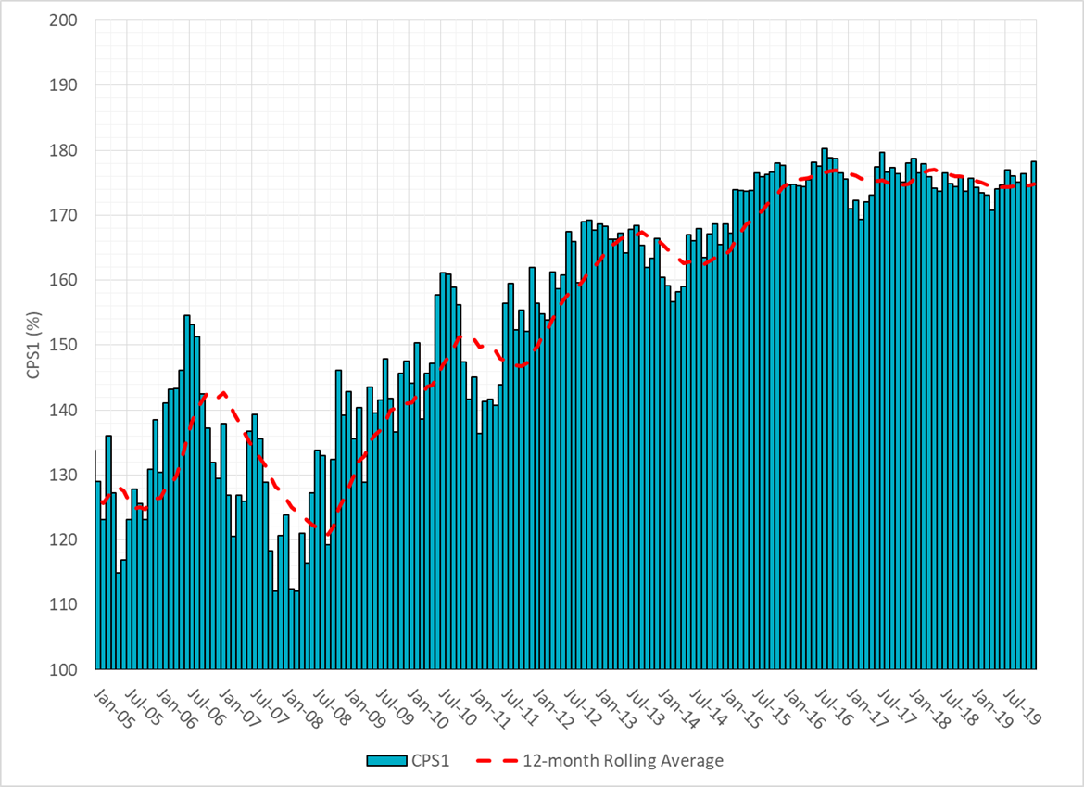
CPS1 Performance

Slide 9
RMS1 Performance of ERCOT Frequency

Slide 10
Frequency Profile Analysis

Slide 11
Time Error Corrections

Slide 12
ERCOT Total Energy

Slide 13
ERCOT Total Energy from Wind Generation

Slide 14
ERCOT % Energy from Wind Generation

Slide 15
ERCOT Total Energy from Solar Generation

Slide 16
ERCOT % Energy from Solar Generation

Slide 17
Questions?

