Slide 1
NDSWG
NPRR953 Post NDSWG Comments
ERCOT
1/30/2020

Slide 2
Topics
Review of Comments
ERCOT’s Comments
New ME Draft

Slide 3
Topics
Review of Comments
ERCOT’s Comments
New ME Draft

Slide 4
Review of Comments
Oncor: Propose removing “Actual” since ERCOT has stated it is not defining the calculation methodology. Some TSPs may intend to use PRC-023 values.
CNP: CNP supports Oncor and AEP in removing the term “Actual” as entities will likely be utilizing different calculation methodology.
AEP: AEP agrees with Oncor’s proposal to remove “Actual”

Slide 5
Review of Comments, Con’t
AEP: Propose using a value that the Planning and Operations models do not currently use to denote or flag an error in a model run.

Slide 6
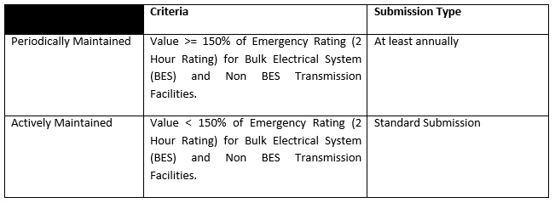
Review of Comments, Con’t
ONCOR:
150% is sufficiently conservative for the “actively maintained” level. The “periodically maintained” should be on an annual basis.
Oncor congestion/constraint tracking data shows that from 12/1/2010 to present, there were 44 events that exceeded 150% of the Emergency/2 Hour rating, for a total of 8,715 minutes. This equates to 0.18% of the time when averaged from 12/1/10 to present.
Theoretical analysis/justification for 150%:
The probability of a post-contingency loading exceeding 150% is very low.
The probability of a relay setting change in a calendar year reducing loadability within the 200% - 150% range is also very low.
The probability that a post-contingency loading issue is related to a specific relay that had its loadability reduced within the calendar year is also extremely low.
The probability of all three of these items happening concurrently is extremely, extremely low. Therefore, 150% of the Emergency/2 Hour Rating is sufficient for the Actively vs Periodically maintained distinction. Oncor’s proposed changes also align with industry and NERC accepted requirements contained in PRC-023.

Slide 7
Review of Comments, Con’t
ONCOR:
We request that the document describe what is expected to be processed through normal NOMCR vs interim NOMCR vs DPC.
From the January 6 workshop, Oncor’s understanding was that ERCOT would classify the changes as follows:
If RLR is changed to become <125% of Load Shed/15 minute rating, TSP would process the change through DPC.
If RLR change occurs, but new value is >125% of Load Shed/15 minute rating, TSP would process as follows:
Minor changes would be processed through normal NOMCR;
Significant changes (value falls below PRC-023 calculated value of 150% of Emergency/2 Hour Rating) would be processed through Interim NOMCR.

Slide 8
Review of Comments, Con’t
AEP:
AEP agrees that the “periodically maintained” should be “at least annually.”
AEP prefers the Emergency Rating, however, our main concern is to maintain consistency by referring to only one of the rating levels for all the decision points, and that mixing emergency and 15 minute ratings should be avoided.
Because the decision mark to perform a Cascading Analysis is at 125%, we believe that 125% of the Emergency/2 Hour Rating for BES and non BES Transmission Facilities is appropriate for both Periodically and Actively Maintained RLRs. The sag response time is actually less than an operator response time if preloaded to 75% and post-contingency will be above this 125%. In other words, the line is likely to sag into something even though the relays would not operate because of loadability settings. Consequently, it’s likely that RLRs >125% would not be the defining decision driver. That said, AEP appreciates Oncor’s viewpoint that 150% is sufficiently conservative for the “actively maintained” level. We suggest that consistency across the levels is an important consideration and could benefit from additional discussion.
AEP requests clarity about what is expected to be processed through NOMCR, Interim NOMCR or DPC. In general, AEP believes that if the RLR is decreasing, the change should be submitted immediately via DPC, while increases in the RLR could be submitted on a different timeline through the various NOMCR processes. We offer the following for consideration and discussion:
If the RLR is changed to become 125% (or 150% if that is the rating level settled upon for the table) of the Emergency/2 Hour Rating, the TSP would process the change through DPC only if the RLR is decreased for existing facilities.
If the RLR is changed and the new value is >125% (or 150% if that is the rating level settled upon for the table) of the Emergency/2 Hour Rating, the TSP would process the changes so that:
Minor, or increased, RLR changes are made at least annually
Significant changes (value falls below PRC-023 calculated value of 125% of Emergency/2 Hour Rating) are made through Interim NOMCR.

Slide 9
Review of Comments, Con’t
CNP:
CNP generally supports the comments by Oncor and AEP for an annual submittal rather than quarterly submittal. As stated in our previous comment above, CNP believes that actively maintaining the relay loadability is not warranted given the unlikely circumstances of a relay loadability reduction and would prefer an annual refresh of the values submitted.

Slide 10
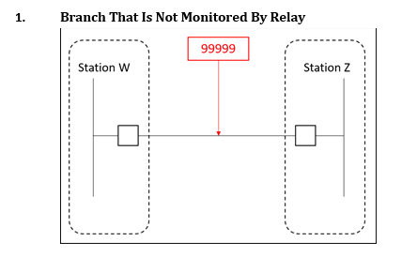
Review of Comments, Con’t
CNP:
CNP does not have branches with in-line breakers that do not have relaying. If this is also the case with all other TSPs we recommend removing this example. Additionally, there is an adequate example of a branch that is not monitored by relay indicated in Example 2 between tap positions such as Station X and Station Y.

Slide 11
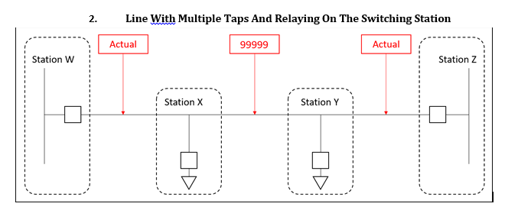
Review of Comments, Con’t
CNP:
Update examples to state “Value” instead of “Actual” since the term “Actual” is recommended to be removed.

Slide 12
Review of Comments, Con’t
CNP:
CNP believes at a minimum ERCOT should specify a voltage and load angle by which entities must submit values. Although we realize these details likely do not belong in the Modeling Expectations, we believe it would be beneficial for ERCOT to define these parameters for the purpose of consistency among TSPs.
CNP would prefer to have a single, annual submittal of relay loadability ratings. The initial submittal per ERCOT’s request and an update at least annually for any changes to relay settings. CNP finds it highly unlikely for any relay settings changes to result in reduction in relay loadability. While not impossible, CNP normally installs microprocessor based systems that have supplemental features to enhance relay loadability. Currently there is no mechanism in place in our current Operations Model update process to track and compare every relay settings change to ensure that it doesn’t impact a previous relay loadability threshold as is suggested in this document. CNP believes that this increased burden is not warranted given the unlikely circumstances of a relay loadability reduction and would prefer an annual refresh of the values submitted. Additionally, for any new positions – entities would need to submit relay loadability prior to energization.

Slide 13
Topics
Review of Comments
ERCOT’s Comments
New ME Draft

Slide 14
ERCOT’s Comments

Slide 15
Topics
Review of Comments
ERCOT’s Comments
New ME Draft

Slide 16
Open Discussion

