Slide 1
MIS and ERCOT.com Enhancements
RMS Presentation
Amy Lofton
Aubrey Hale
February 4, 2020

Slide 2
Changes to MIS & ERCOT.com
Release Plan:
ERCOT Market Information List (EMIL)
MIS
ERCOT.com
Opportunities to engage

Slide 3
Improved way to find ERCOT data
Notes:
EMIL (ERCOT Market Information List) is a catalogue of every Protocol required report/extract/dashboard (2,782)
Web UI is an improvement over spreadsheet format
How will you know how to use it?

Slide 4
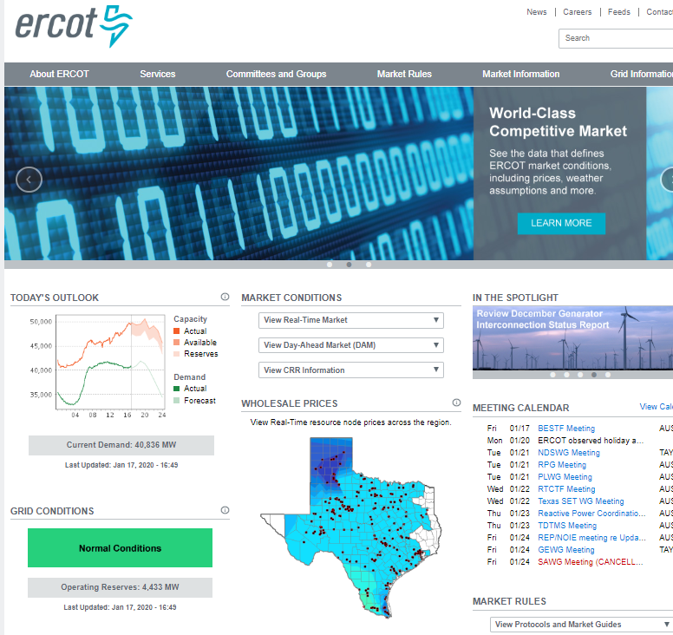
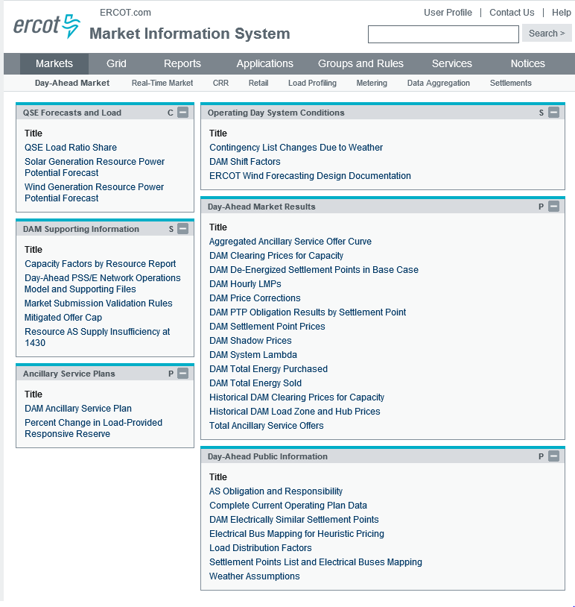
Current State: Separate Channels & Platforms
Notes:
Two different user experiences can introduce confusion and inconsistent communication.
Two different search experiences. Both terrible.
Neither work well on a mobile device.
Both lacking in flexibility
Jumping between the two

Slide 5
One-Stop Information Clearinghouse
Search that works; find information quickly
Combined user platform
Modern user experience
Revision Request tracking
Calendar Improvement
Accessible on any device (responsive design)
Notes:
We’ve been collecting feedback over the years.
Move to a bank website model where there aren’t two sites. Public information is available and if you have an account, you can see your information.
We aren’t taking anything away.
We’re just repackaging it in order to m

Slide 6
Timeline for changes
Feedback, stability, and readiness are key.
January 30: EMIL web interface release
May 2020: Sandbox version of new MIS available for feedback
August 2020: New MIS Production version available for testing
October 2020: New MIS Production go-live
TBD 2021: Sandbox versions of combined ERCOT.com and MIS
TBD: Overlap timeline

Slide 7
Scope
In Scope:
All data/content available today
Revision Request (MIS Public)
Out of Scope:
Digital Certificates replacement for authentication

Slide 8
Communication Plan
Market Notices to communicate changes
Monthly MIS & ERCOT.com user workshops
Information updates posted on ERCOT.com: http://www.ercot.com/about/redesign
Feedback is encouraged by everyone
Email feedback to webmaster@ercot.com at any time

