Slide 1
Settlement Stability
2019 Q4 Update to WMS
Austin Covington
ERCOT
02/05/2020

Slide 2
8.2(2)(c)(i) Track number of price changes
Reporting Period: 2019 Q4
Operating Day | # of Corrected Settlement Point Prices |  |  |  | # of Intervals Affected
 | DASPP | RTSPP | RTRMPR | ORDC Adders | DASPP | RTSPP | RTRMPR | ORDC Adders
09/16/2019 | 15,038 | - | - | - | 24 | - | - | -
09/17/2019 | 14,327 | - | - | - | 24 | - | - | -
09/18/2019 | 14,463 | - | - | - | 24 | - | - | -
09/19/2019 | 14,479 | - | - | - | 24 | - | - | -
09/20/2019 | 13,318 | - | - | - | 24 | - | - | -
09/21/2019 | 14,356 | - | - | - | 24 | - | - | -
09/22/2019 | 12,354 | - | - | - | 24 | - | - | -
09/23/2019 | 12,477 | - | - | - | 24 | - | - | -
10/16/2019 | - | 91 | - | - | - | 20 | - | -
10/17/2019 | - | 235 | 78 | - | - | 41 | 39 | -
10/18/2019 | - | 655 | 92 | - | - | 96 | 48 | -
10/19/2019 | - | 538 | 43 | - | - | 89 | 43 | -
Notes:
There were eight days affected by issues in the network model that were identified and lead to
price corrections that occurred after Settlement Statements had posted for the Operating Day
per M-A100319-02.

Slide 3
8.2(2)(c)(i) Track number of price changes cont.
Reporting Period: 2019 Q4
Operating Day | # of Corrected Settlement Point Prices |  |  |  | # of Intervals Affected
 | DASPP | RTSPP | RTRMPR | ORDC Adders | DASPP | RTSPP | RTRMPR | ORDC Adders
10/20/2019 | - | 717 | 12 | - | - | 95 | 12 | -
10/23/2019 | - | 38 | 16 | - | - | 16 | 16 | -
10/24/2019 | - | 16 | 8 | - | - | 8 | 8 | -
10/26/2019 | - | 20 | - | - | - | 9 | - | -
10/29/2019 | - | 7 | - | - | - | 3 | - | -
10/30/2019 | - | 9 | - | - | - | 3 | - | -
10/31/2019 | - | 25 | - | - | - | 13 | - | -
11/4/2019 | - | - | 6 | - | - | - | 6 | -
11/6/2019 | - | 1 | - | - | - | 1 | - | -
Notes:
There were thirteen days affected by a software error that was identified and lead to
price corrections that occurred after Settlement Statements had posted for the Operating Day
per M-A102419-03.

Slide 4
8.2(2)(c)(iv) Track number of resettlements due to non-price errors
Reporting Period: 2019 Q4
Operating Day Resettled | Reason for Resettlement | Affected Charge Types | Market Notice Number
08/15/2018 | Settlement system interface issue | RTASIAMT, RTRDASIAMT, LAASIRNAMT | M-A100119-01
09/17/2018 | Settlement system interface issue | RTASIAMT, RTRDASIAMT, LAASIRNAMT | M-A100119-01

Slide 5
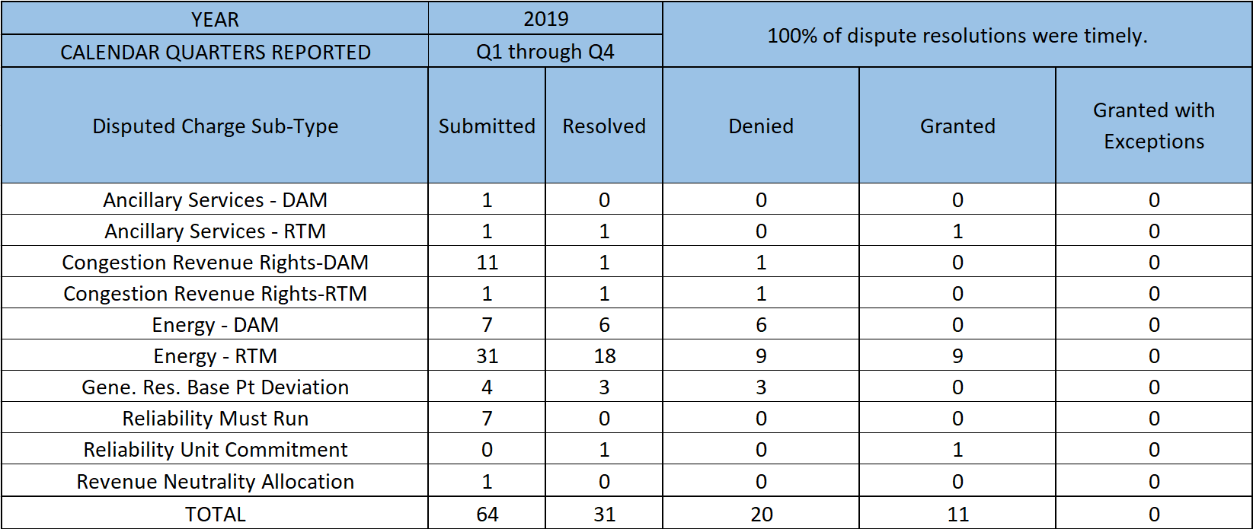
8.2(2)(c)(ii) Track number and types of disputes submitted 8.2(2)(c)(iii) Compliance with timeliness of response to disputes
Submitted but not resolved disputes may be:
Not started
Open
Rejected
Withdrawn

Slide 6
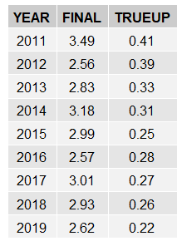
8.2(2)(c)(iv) Other Settlement Metrics
NOTE: ERS Final settlement OD data is not represented in graph.
Average percent change

Slide 7
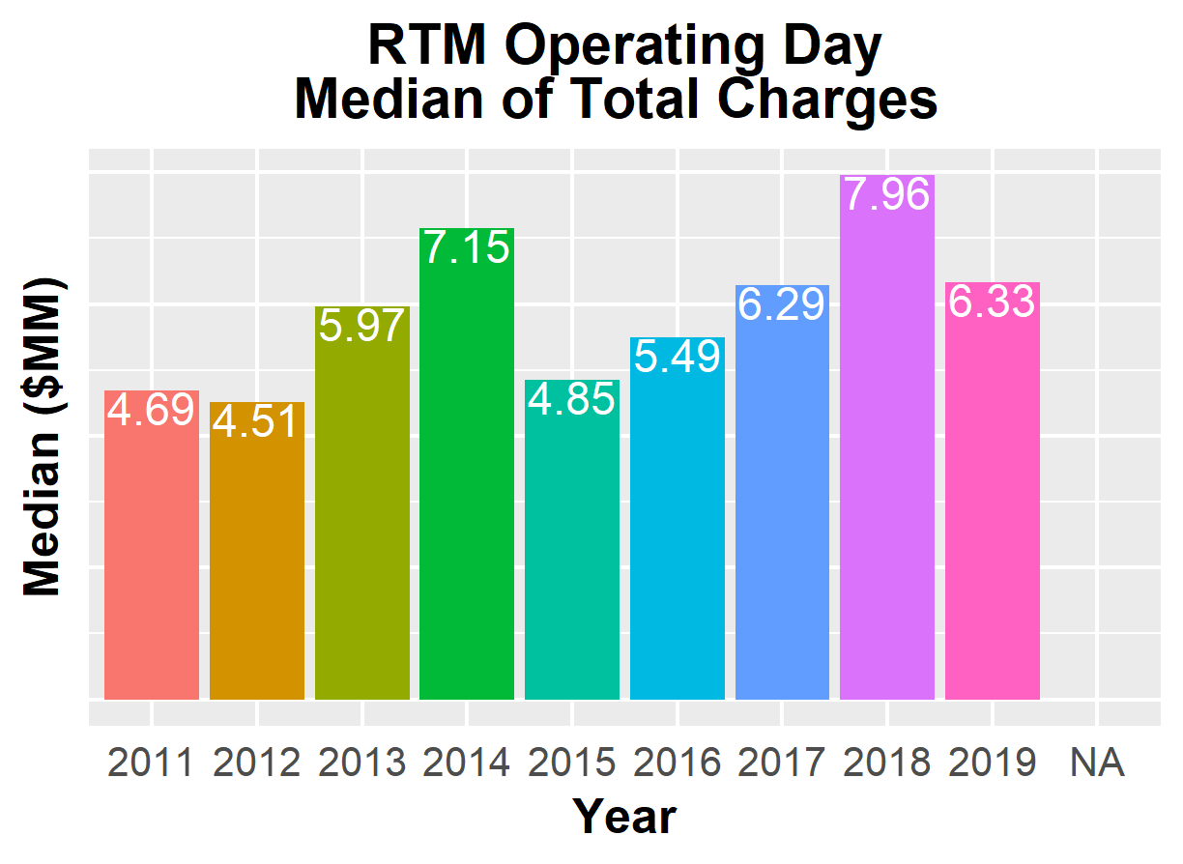
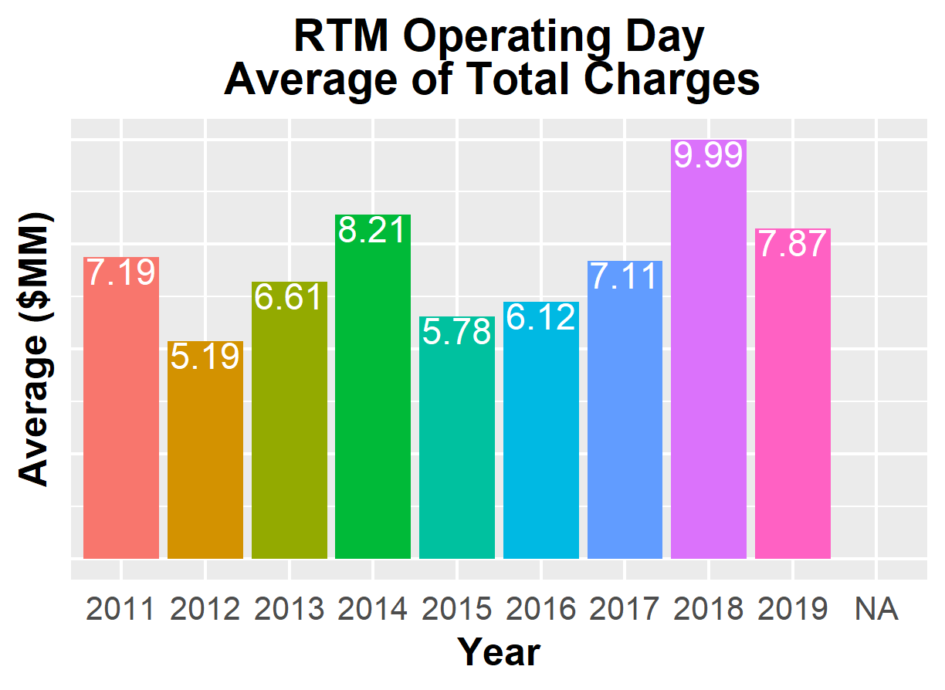
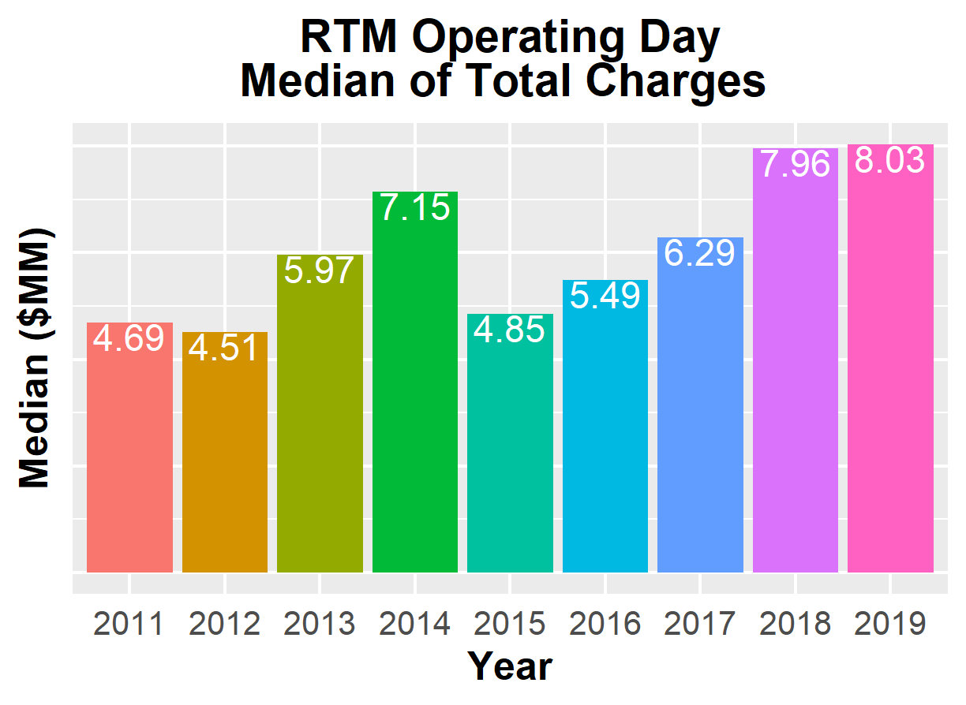
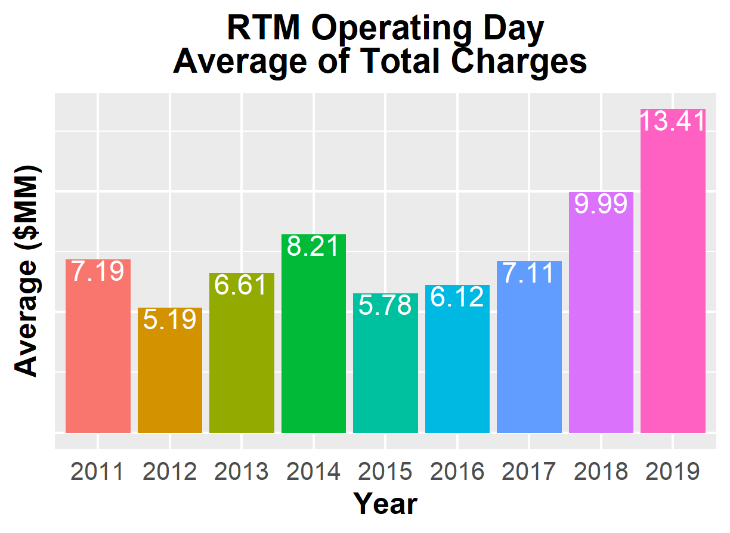
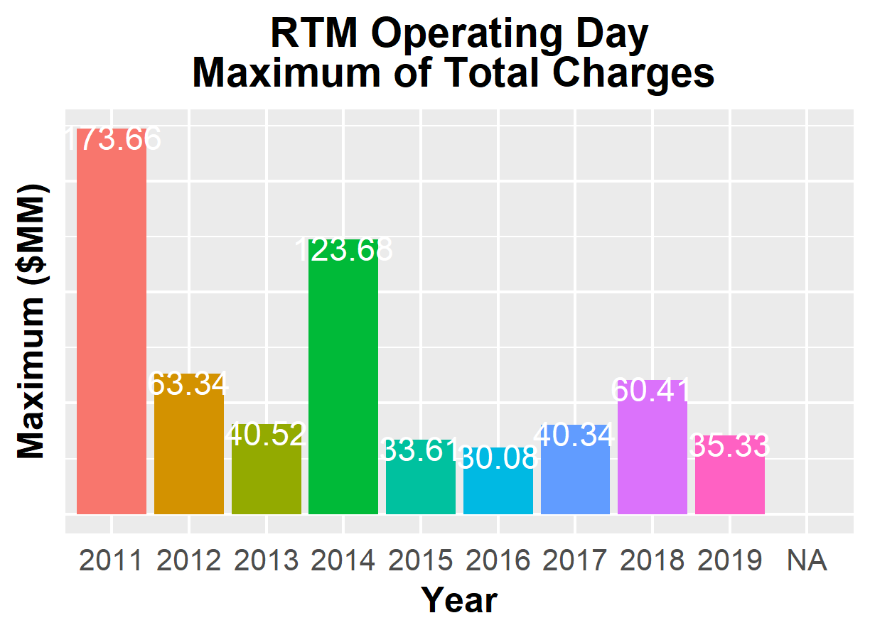
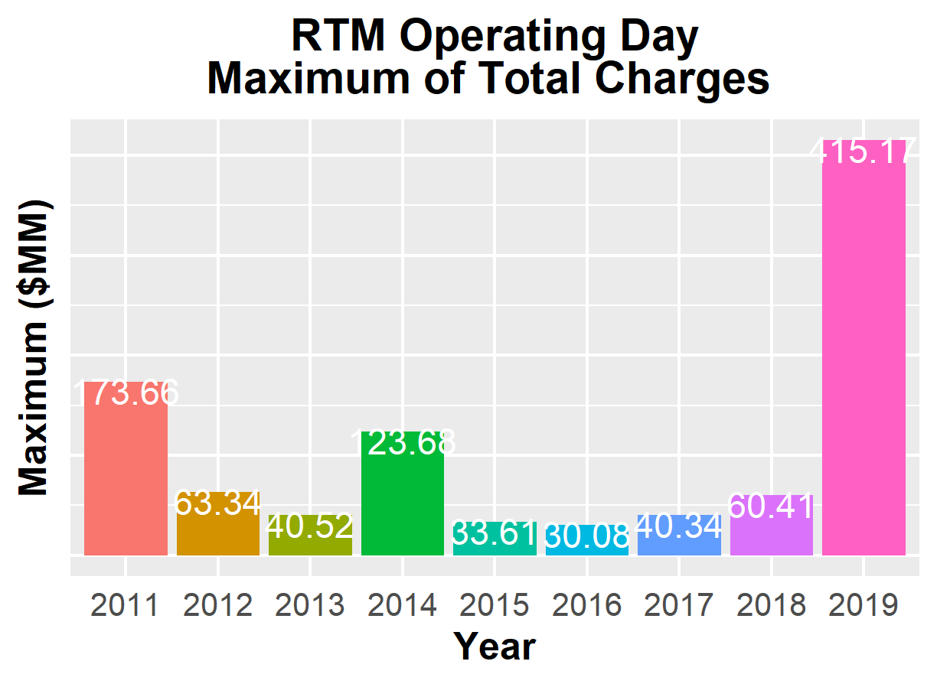
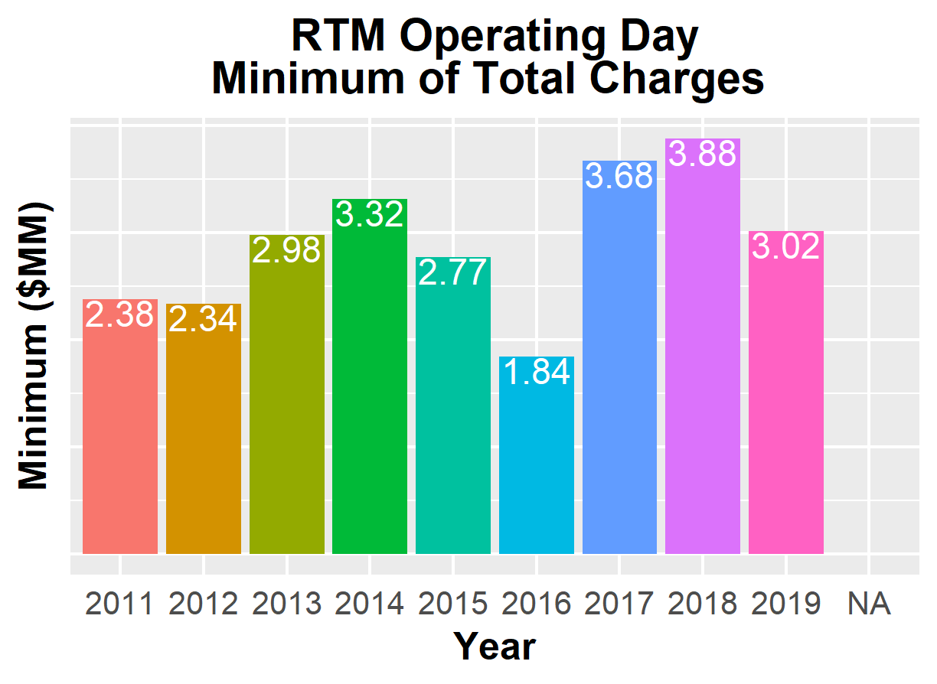
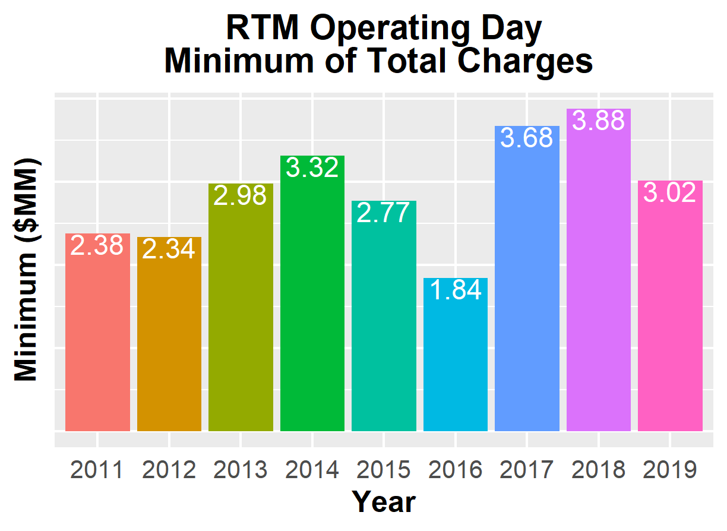
8.2(2)(c)(iv) Other Settlement metrics

Slide 8
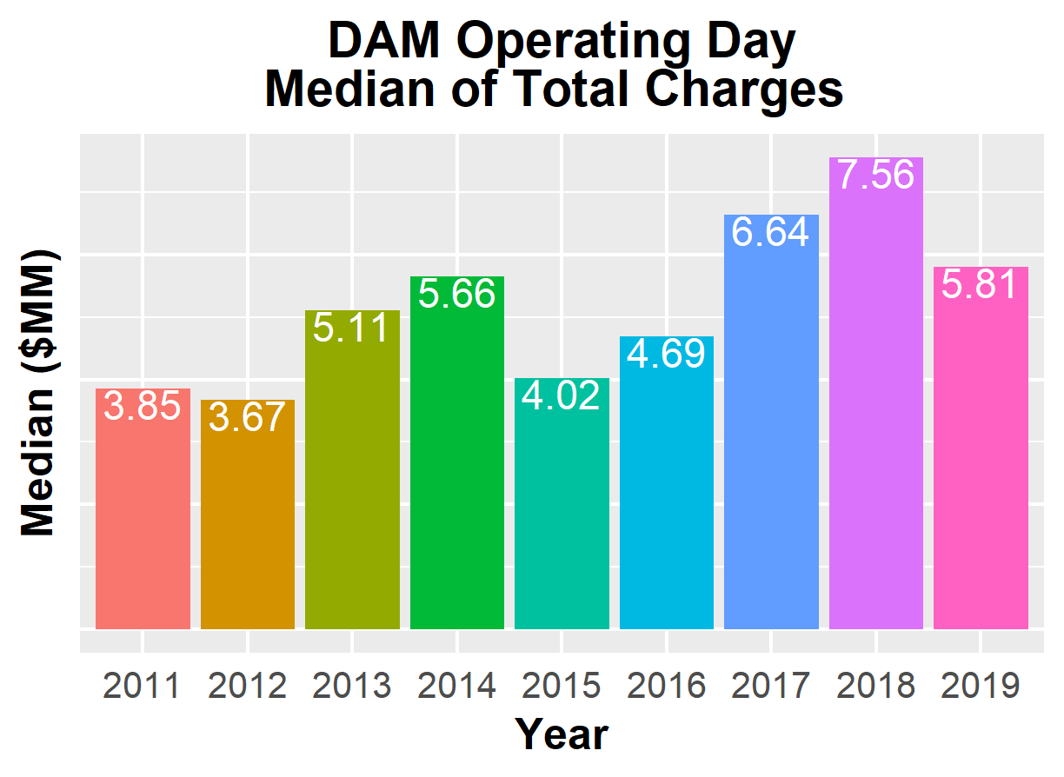
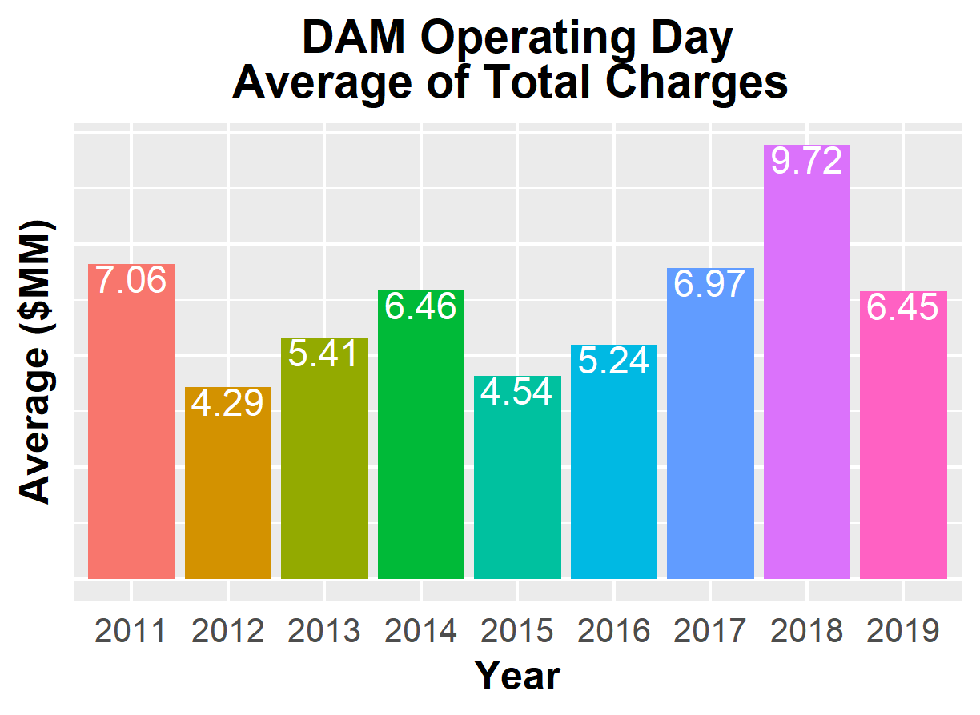
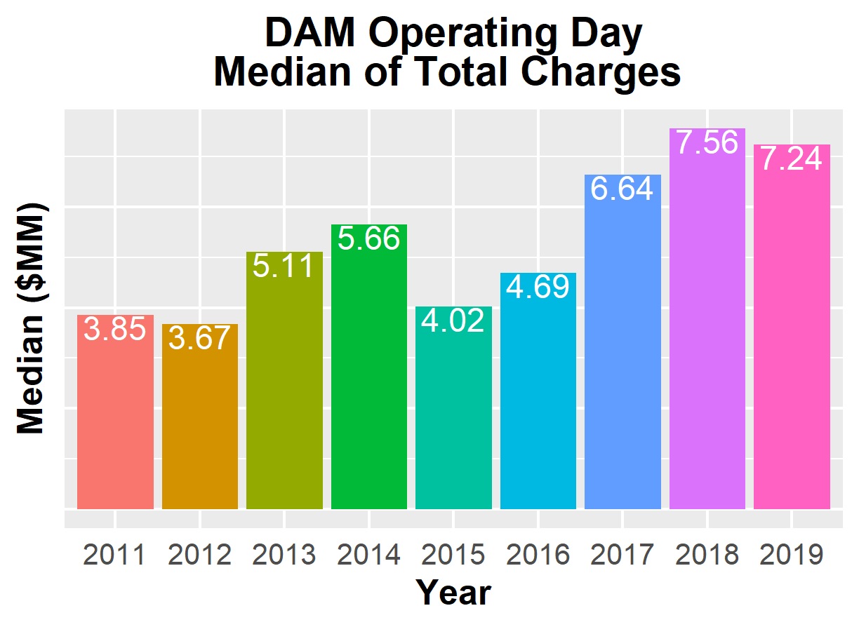
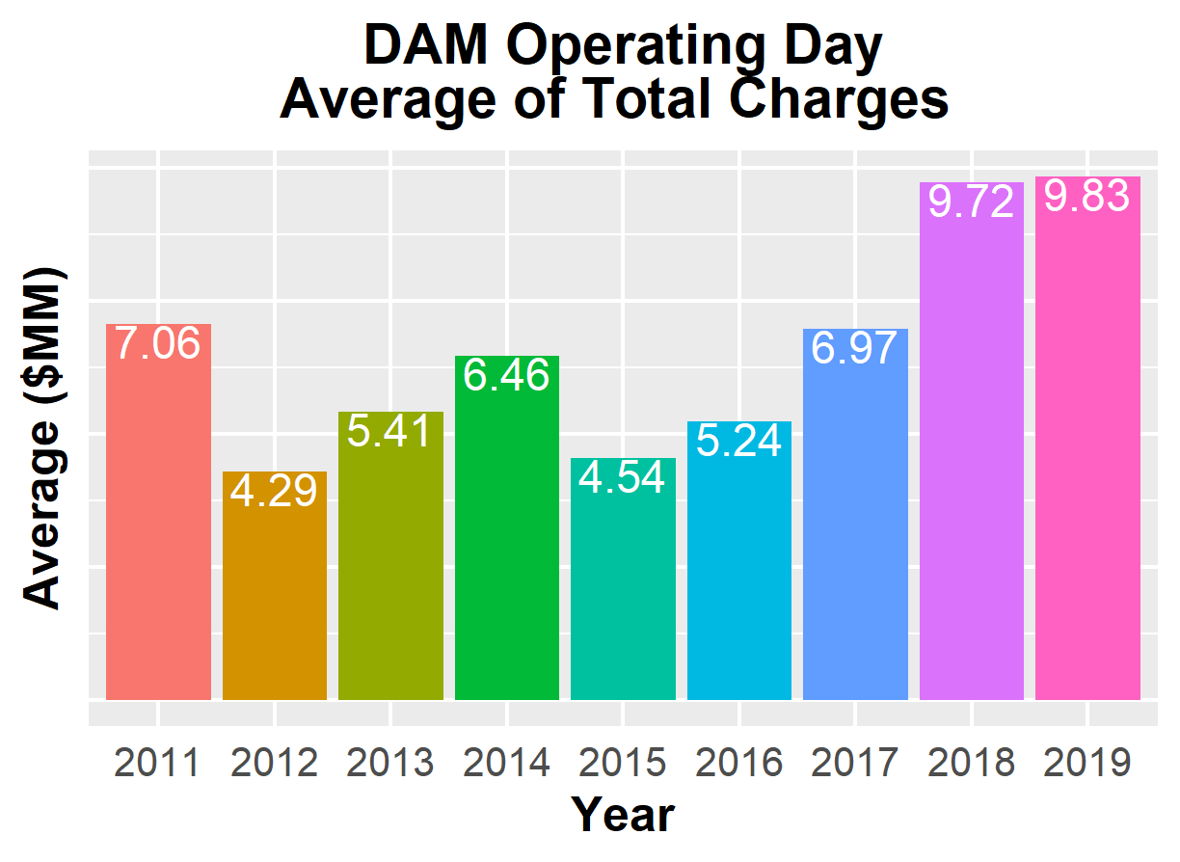
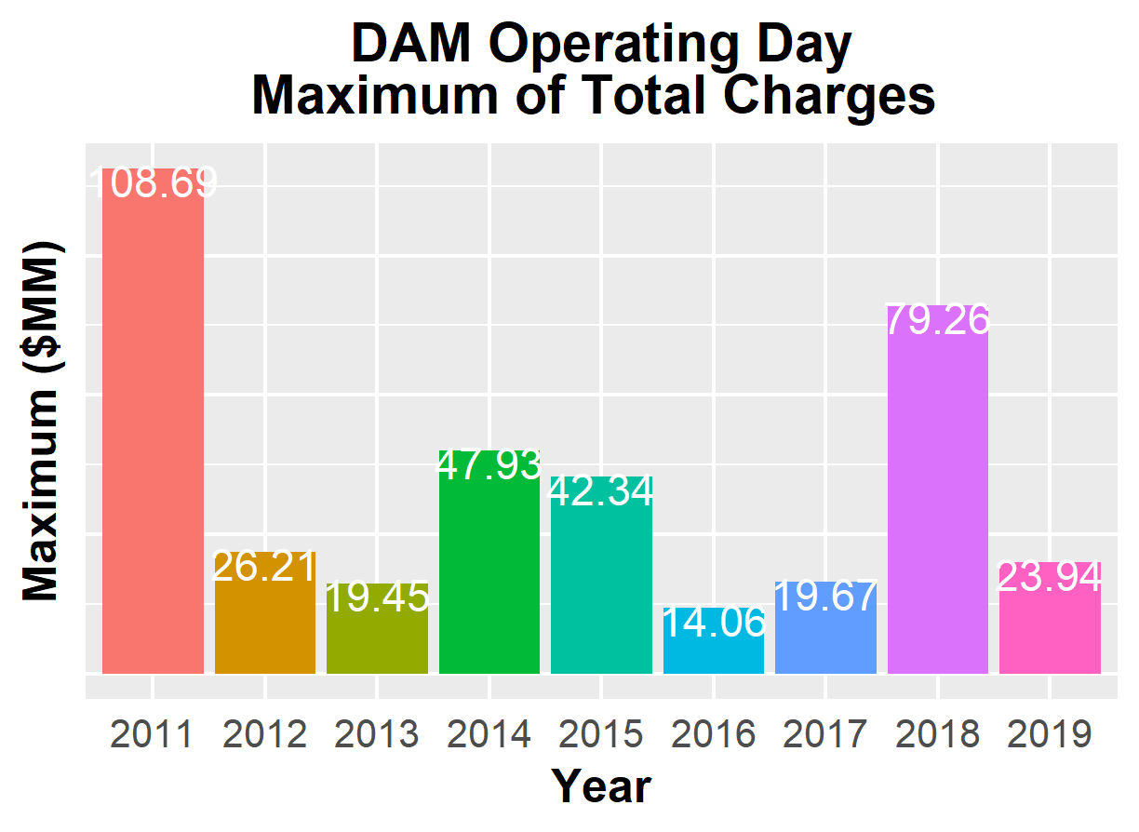
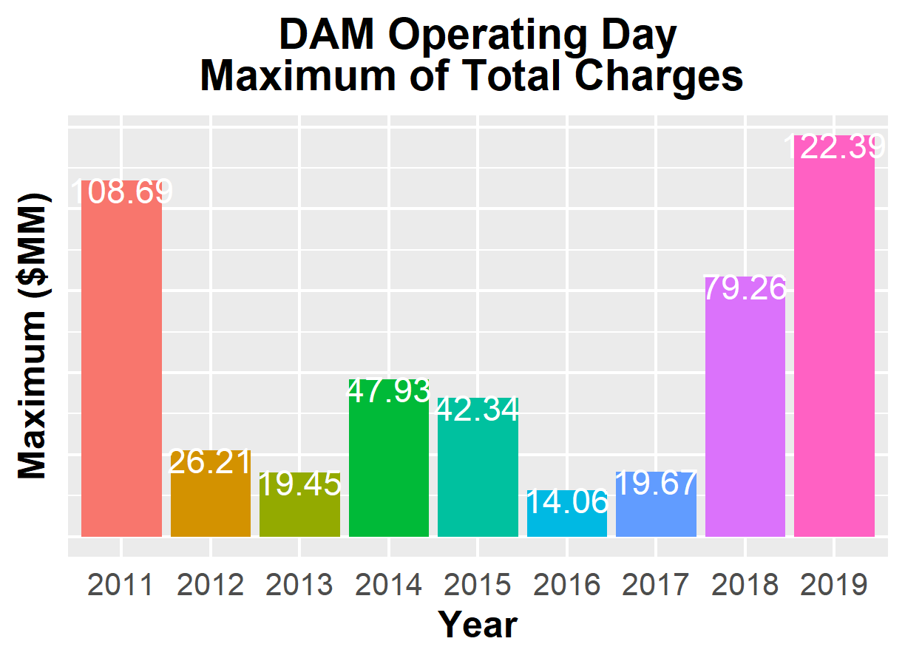
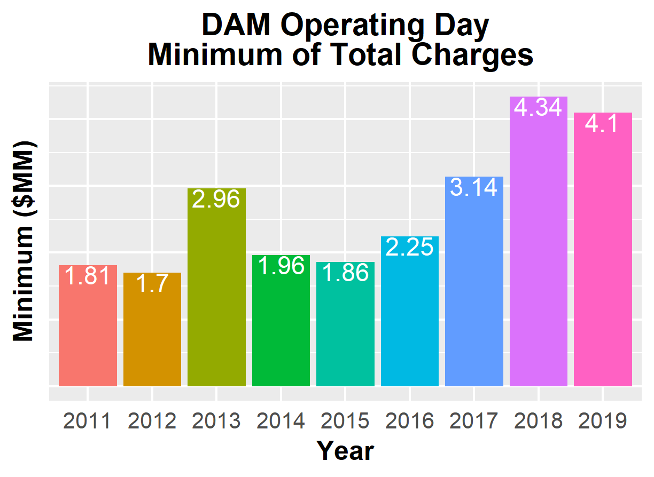
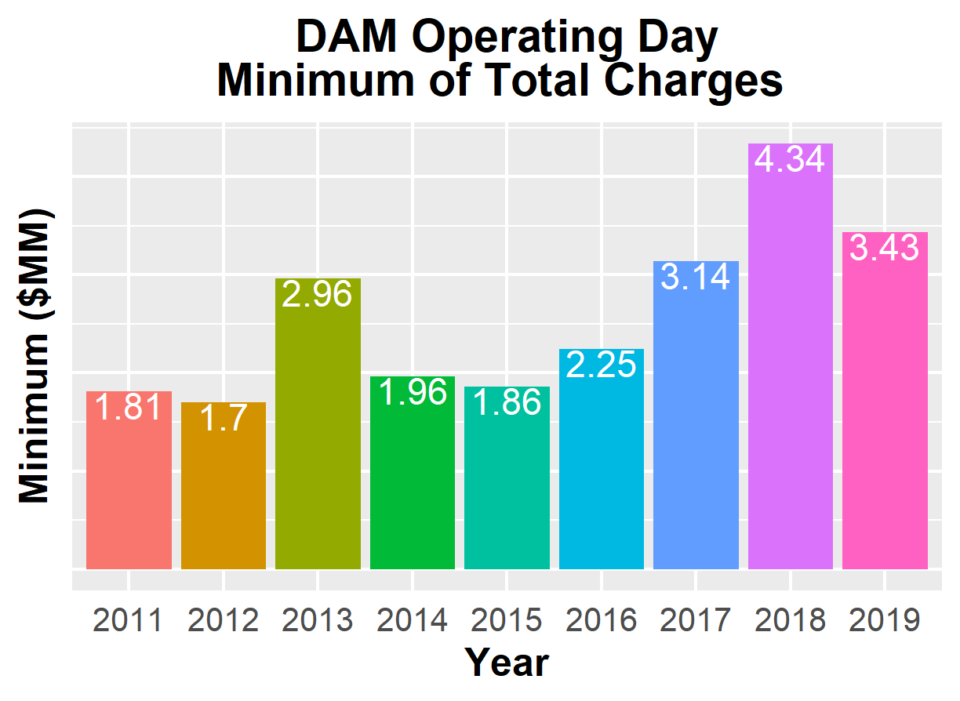
8.2(2)(c)(iv) Other Settlement metrics

Slide 9
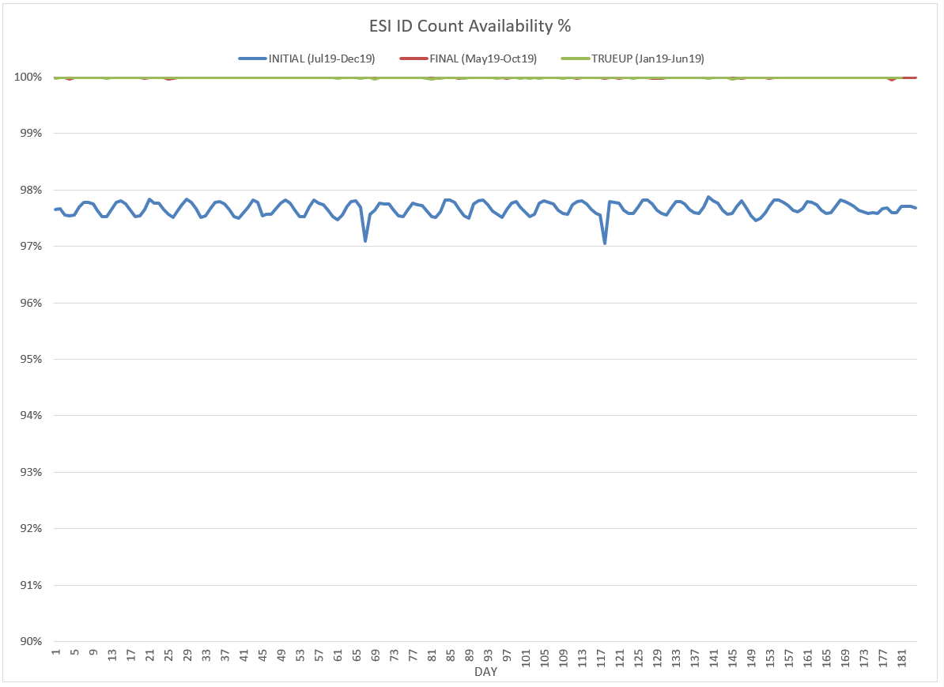
8.2(2)(c)(v) Availability of ESIID consumption data

Slide 10
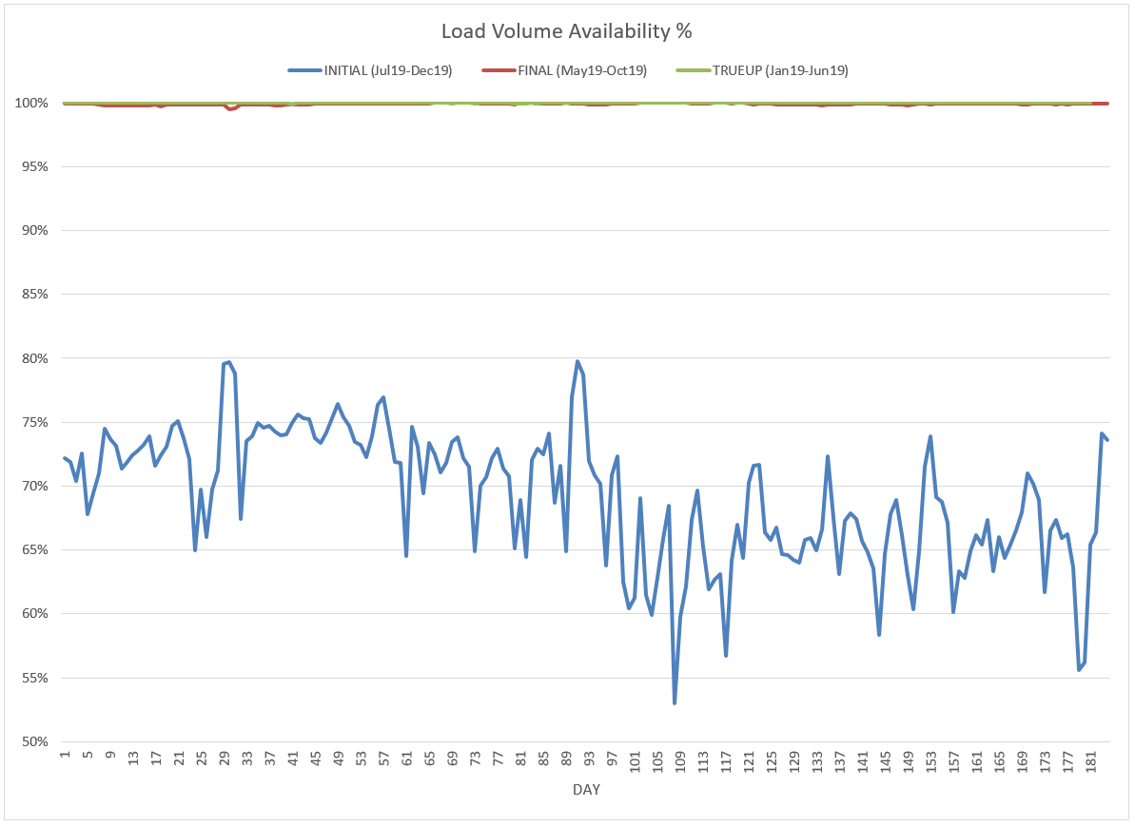
8.2(2)(c)(v) Availability of ESIID consumption data

Slide 11
8.2(2)(g) Net Allocation to Load - Totals and $/MWh
NET ALLOCATION TO LOAD ($M)
 | Dec 2018 | Jan 2019 | Feb 2019 | Mar 2019 | Apr 2019 | May 2019 | Jun 2019 | Jul 2019 | Aug 2019 | Sep 2019 | Oct 2019 | Nov 2019 | Dec 2019
Ancillary Service Settlement | 25.9 | 21.5 | 18.7 | 34.7 | 34.7 | 21.9 | 19.6 | 23.6 | 234.7 | 158.3 | 48.9 | 35.1 | 20.8
Balancing Account Payout to Load | 0.0 | 0.0 | -3.0 | 0.0 | -3.9 | -6.8 | -7.3 | -7.4 | -12.7 | -15.3 | -15.5 | -19.5 | -21.7
Base Point Deviation Payments | -0.2 | -0.2 | -0.1 | -0.2 | -0.2 | -0.2 | -0.3 | -0.2 | -0.7 | -0.4 | -0.3 | -0.2 | -0.1
Black Start Service Settlement | 0.6 | 0.6 | 0.6 | 0.6 | 0.6 | 0.6 | 0.6 | 0.6 | 0.6 | 0.6 | 0.6 | 0.6 | 0.6
Block Load Transfer Settlement | 0.0 | 0.0 | 0.0 | 0.0 | 0.0 | 0.0 | 0.0 | 0.0 | 0.0 | 0.0 | 0.0 | 0.0 | 0.0
Emergency Energy Charges | 0.2 | 0.2 | 0.2 | 0.3 | 0.2 | 0.1 | 0.0 | 0.0 | 0.1 | 0.2 | 3.5 | 0.1 | 0.0
ERCOT Admin Fee Settlement | 16.0 | 16.6 | 14.6 | 15.5 | 14.9 | 17.9 | 19.6 | 21.8 | 23.3 | 20.8 | 17.1 | 15.5 | 16.3
ERS Settlement¹ | 3.9 | 3.9 | 4.5 | 4.5 | 4.5 | 4.5 | 3.5 | 3.5 | 3.5 | 3.5 | 0.0 | 0.0 | 0.0
High Dispatch Limit Override | 0.0 | 0.0 | 0.0 | 0.0 | 0.0 | 0.0 | 0.0 | 0.0 | 0.0 | 0.0 | 0.0 | 0.0 | 0.0
Non-Zonal Auction Distribution | -9.4 | -12.6 | -10.3 | -16.3 | -18.0 | -16.2 | -13.5 | -5.8 | -6.9 | -7.3 | -11.2 | -11.1 | -8.5
ORDC Settlement | 0.2 | 0.0 | 0.0 | 0.2 | 0.5 | 1.2 | 2.0 | 6.6 | 0.5 | 6.9 | 0.6 | 0.2 | 0.0
Revenue Neutrality Total | 6.9 | 2.1 | 3.7 | 13.4 | 8.7 | 5.8 | 1.3 | 0.9 | 2.8 | 0.0 | 5.7 | -4.8 | 9.8
RMR Settlement | 0.0 | 0.0 | 0.0 | 0.0 | 0.0 | 0.0 | 0.0 | 0.0 | 0.0 | 0.0 | 0.0 | 0.0 | 0.0
RUC Settlement | 0.0 | 0.0 | 0.0 | 0.0 | 0.0 | -0.1 | 0.0 | 0.0 | 0.0 | 0.0 | -0.7 | 0.0 | 0.0
Voltage Services Settlement | 0.0 | 0.0 | 0.0 | 0.0 | 0.0 | 0.0 | 0.0 | 0.0 | 0.0 | 0.0 | 0.0 | 0.0 | 0.0
Zonal Auction Distribution² | -24.0 | -37.3 | -29.8 | -32.6 | -34.2 | -40.8 | -49.8 | -56.0 | -51.7 | -40.2 | -35.9 | -32.6 | -33.9
Total Allocation to Load | 20.1 | -5.2 | -0.9 | 20.1 | 7.8 | -12.1 | -24.3 | -12.4 | 193.5 | 127.1 | 12.8 | -16.7 | -16.3
Adjusted Metered Load (TWh) | 28.8 | 30.0 | 26.3 | 27.9 | 26.9 | 32.2 | 35.3 | 39.4 | 42.0 | 37.5 | 30.8 | 27.9 | 29.4
$/MWh³ | 0.7 | -0.2 | 0.0 | 0.7 | 0.3 | -0.4 | -0.7 | -0.3 | 4.6 | 3.4 | 0.4 | -0.6 | -0.6
Note: The Net Allocation to Load amounts provided in this presentation are for informational purposes only and cannot be relied upon for accurate measurements or forecasts of individual QSE charges and payments.
¹The total ERS charges have been evenly allocated across the contract period.
²Zonal Auction Distribution by 2003 Congestion Management Zone, shown below.
³The $/MWh value as calculated per PR 8.2 (2) g
⁴The $/MWh value by 2003 Congestion Management Zone, as calculated per PR 8.2(2) g

Slide 12
8.2(2)(g) Net Allocation to Load - Totals and $/MWh
ZONAL AUCTION DISTRIBUTION PER CONGESTION MANAGEMENT ZONE ($M)
 | Dec 2018 | Jan 2019 | Feb 2019 | Mar 2019 | Apr 2019 | May 2019 | Jun 2019 | Jul 2019 | Aug 2019 | Sep 2019 | Oct 2019 | Nov 2019 | Dec 2019
HOUSTON | -2.7 | -3.5 | -3.0 | -3.6 | -3.7 | -4.2 | -5.6 | -7.6 | -7.5 | -5.6 | -4.0 | -3.6 | -3.8
NORTH | -6.5 | -11.0 | -8.3 | -7.6 | -8.8 | -12.0 | -17.2 | -19.8 | -18.2 | -9.8 | -8.8 | -7.7 | -7.9
SOUTH | -6.4 | -10.6 | -8.6 | -9.7 | -9.9 | -11.8 | -14.3 | -16.5 | -15.4 | -12.4 | -10.7 | -9.2 | -9.8
WEST | -8.4 | -12.2 | -9.9 | -11.7 | -11.8 | -12.9 | -12.7 | -12.1 | -10.5 | -12.3 | -12.4 | -12.2 | -12.3
TOTAL | -24.0 | -37.3 | -29.8 | -32.6 | -34.2 | -40.8 | -49.8 | -56.0 | -51.7 | -40.2 | -35.9 | -32.6 | -33.9
REAL-TIME ADJUSTED METERED LOAD BY CONGESTION MANAGEMENT ZONE (TWh)
 | Dec 2018 | Jan 2019 | Feb 2019 | Mar 2019 | Apr 2019 | May 2019 | Jun 2019 | Jul 2019 | Aug 2019 | Sep 2019 | Oct 2019 | Nov 2019 | Dec 2019
HOUSTON | 7.1 | 7.3 | 6.6 | 7.3 | 7.5 | 9.1 | 9.9 | 10.7 | 11.0 | 9.7 | 8.2 | 7.1 | 7.4
NORTH | 10.6 | 11.4 | 9.8 | 9.9 | 9.0 | 10.7 | 12.0 | 14.0 | 15.1 | 13.6 | 10.4 | 9.8 | 10.5
SOUTH | 7.6 | 7.8 | 6.8 | 7.4 | 7.2 | 8.8 | 9.6 | 10.7 | 11.6 | 10.2 | 8.4 | 7.3 | 7.6
WEST | 3.5 | 3.5 | 3.1 | 3.4 | 3.3 | 3.6 | 3.7 | 4.1 | 4.3 | 3.9 | 3.8 | 3.7 | 3.9
TOTAL | 28.8 | 30.0 | 26.3 | 27.9 | 26.9 | 32.2 | 35.3 | 39.4 | 42.0 | 37.5 | 30.8 | 27.9 | 29.4
ZONAL AUCTION REVENUE PER CONGESTION MANAGEMENT ZONE ($/MWh)
 | Dec 2018 | Jan 2019 | Feb 2019 | Mar 2019 | Apr 2019 | May 2019 | Jun 2019 | Jul 2019 | Aug 2019 | Sep 2019 | Oct 2019 | Nov 2019 | Dec 2019
HOUSTON | -0.4 | -0.5 | -0.5 | -0.5 | -0.5 | -0.5 | -0.6 | -0.7 | -0.7 | -0.6 | -0.5 | -0.5 | -0.5
NORTH | -0.6 | -1.0 | -0.8 | -0.8 | -1.0 | -1.1 | -1.4 | -1.4 | -1.2 | -0.7 | -0.8 | -0.8 | -0.8
SOUTH | -0.8 | -1.4 | -1.3 | -1.3 | -1.4 | -1.3 | -1.5 | -1.5 | -1.3 | -1.2 | -1.3 | -1.3 | -1.3
WEST | -2.4 | -3.5 | -3.2 | -3.4 | -3.6 | -3.6 | -3.4 | -3.0 | -2.4 | -3.2 | -3.3 | -3.3 | -3.2
TOTAL | -0.8 | -1.2 | -1.1 | -1.2 | -1.3 | -1.3 | -1.4 | -1.4 | -1.2 | -1.1 | -1.2 | -1.2 | -1.2
NET ALLOCATION TO LOAD PER CONGESTION MANAGEMENT ZONE ($/MWh)⁴
 | Dec 2018 | Jan 2019 | Feb 2019 | Mar 2019 | Apr 2019 | May 2019 | Jun 2019 | Jul 2019 | Aug 2019 | Sep 2019 | Oct 2019 | Nov 2019 | Dec 2019
HOUSTON | 1.1 | 0.6 | 0.6 | 1.4 | 1.1 | 0.4 | 0.1 | 0.4 | 5.1 | 3.9 | 1.1 | 0.1 | 0.1
NORTH | 0.9 | 0.1 | 0.3 | 1.1 | 0.6 | -0.2 | -0.7 | -0.3 | 4.6 | 3.8 | 0.8 | -0.2 | -0.2
SOUTH | 0.7 | -0.3 | -0.2 | 0.6 | 0.2 | -0.4 | -0.8 | -0.4 | 4.5 | 3.3 | 0.3 | -0.7 | -0.7
WEST | -0.9 | -2.4 | -2.1 | -1.5 | -2.0 | -2.7 | -2.7 | -1.9 | 3.4 | 1.3 | -1.7 | -2.7 | -2.6
TOTAL | 0.7 | -0.2 | 0.0 | 0.7 | 0.3 | -0.4 | -0.7 | -0.3 | 4.6 | 3.4 | 0.4 | -0.6 | -0.6

