Slide 1
ERS Event Analysis – 10 hour recovery period Discussion
ERCOT Staff

Slide 2
Outline
Event Analysis
  6 Jan 2014
  13 Aug 2019
  15 Aug 2019

Slide 3
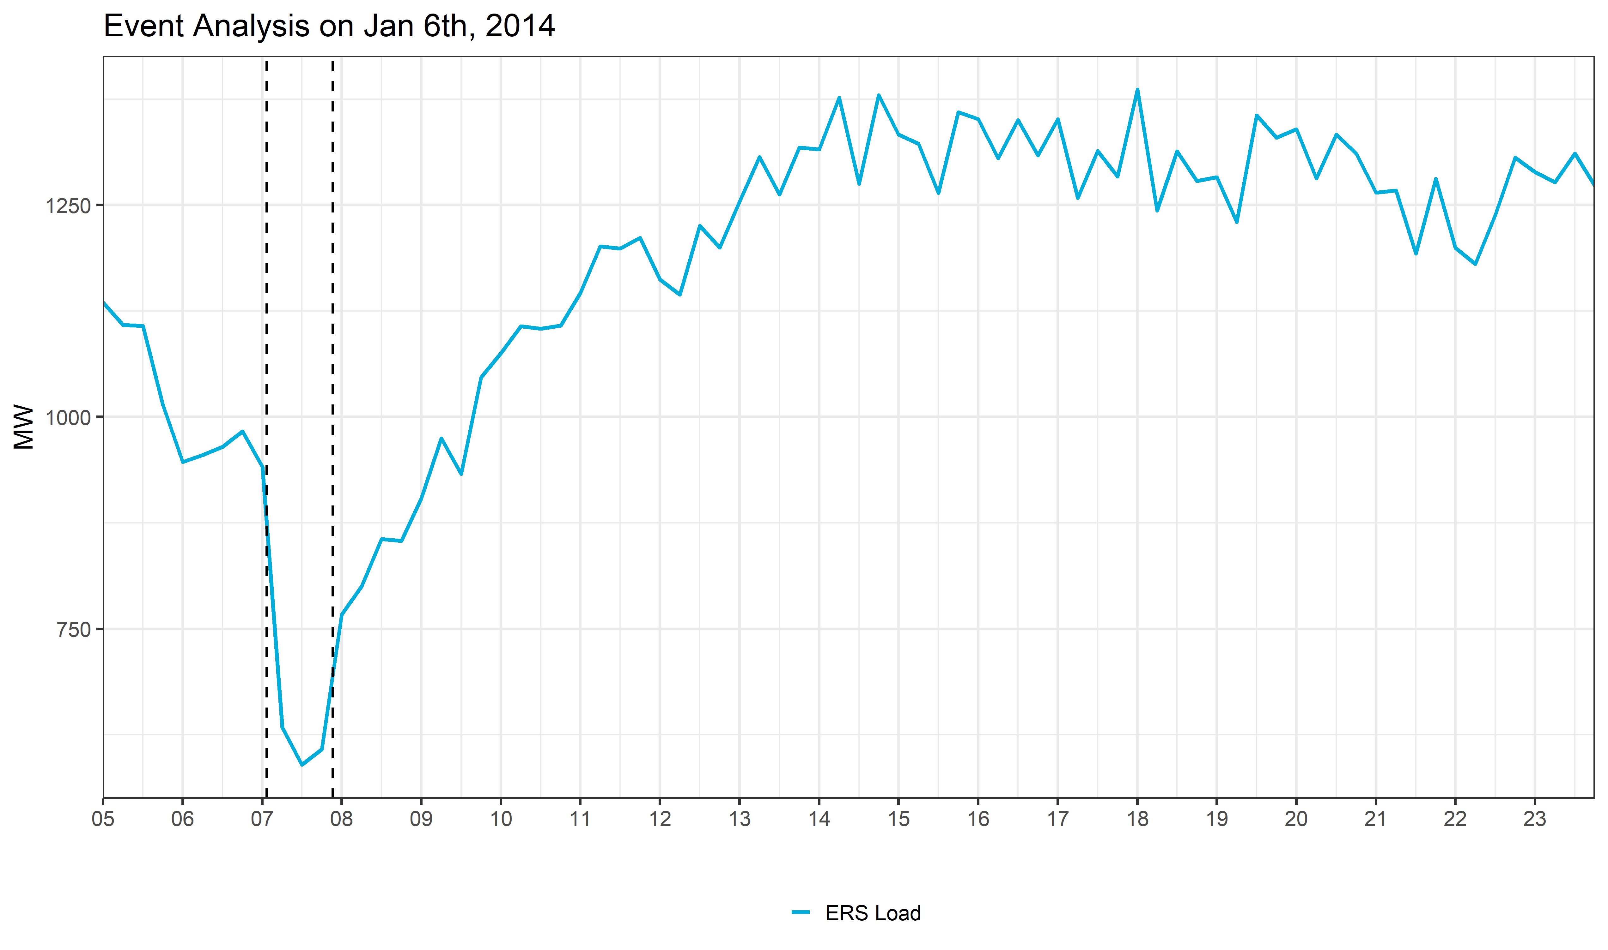
Event on Jan 6th, 2014
Event
10 hour recovery period

Slide 4
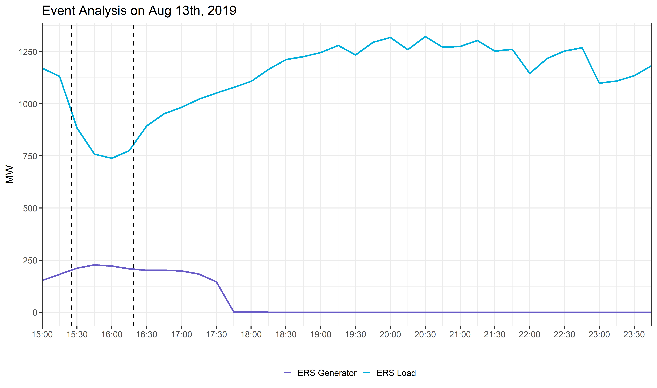
Event on Aug 13th, 2019
Event
10 hour recovery period

Slide 5
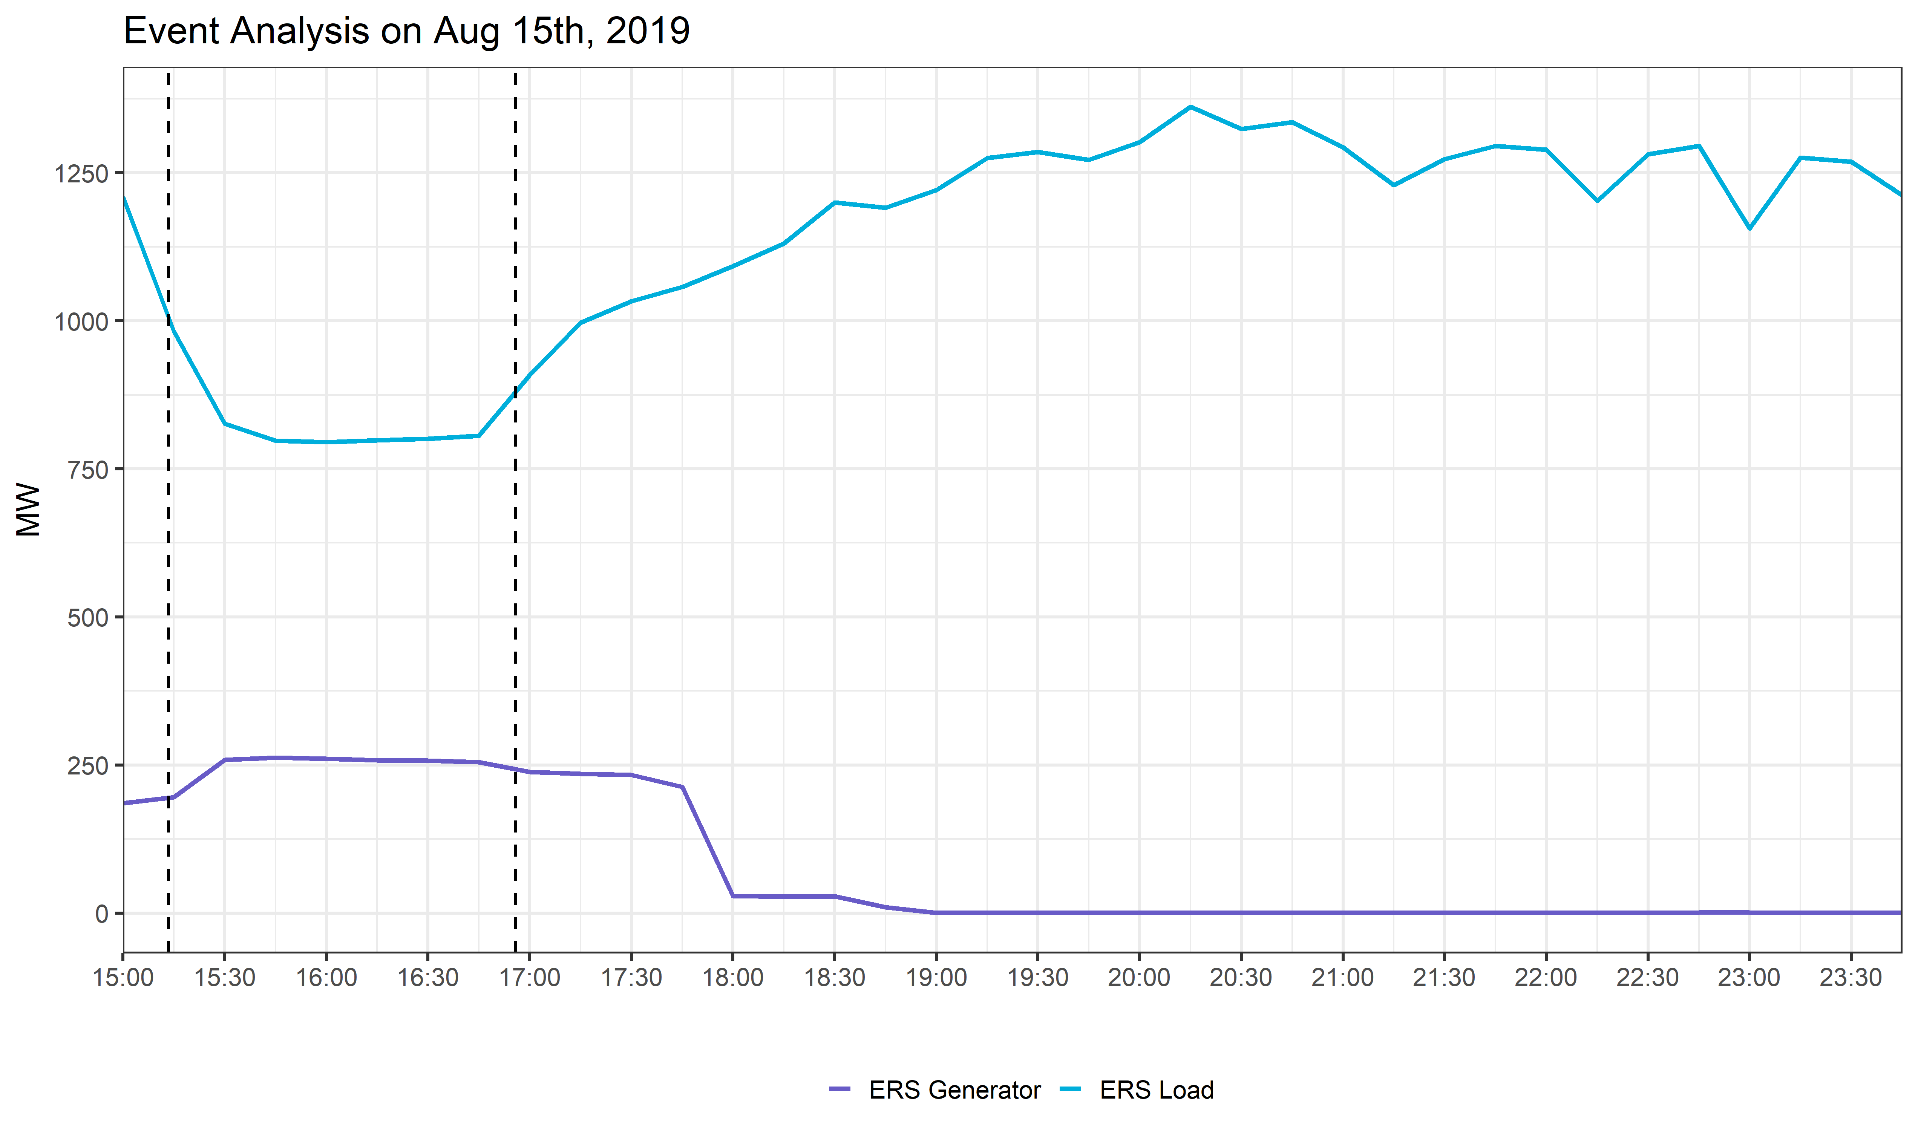
Event on Aug 15th, 2019
Event
10 hour recovery period

