Slide 1
Steve Reedy
Acting Director, ERCOT IMM
sreedy@potomaceconomics.com
512-225-7139
WMWG
January 27, 2020

Slide 2
IMM Concerns with RTRDPA during ERS deployment
The RTRDPA is meant to be a “but for” pricing calculator
I.e. what would the system lambda have been ‘but for’ the reliability action taken by ERCOT
The current RTRDPA overstates the ERS MWs to be used in the RTRDPA calculation
Does not account for ERS resources that ‘self-deployed’, or stopped consuming prior to the ERS deployment
Inaccurately uses a 10 hour ramp back

Slide 3
IMM simulated RTRDPA under two different scenarios for ERS days
MWs used in calculation reflect non ‘self-deployed’ ERS resources and 3-hour ramp back period.
MWs used in calculation reflect only 3-hour back period.

Slide 4
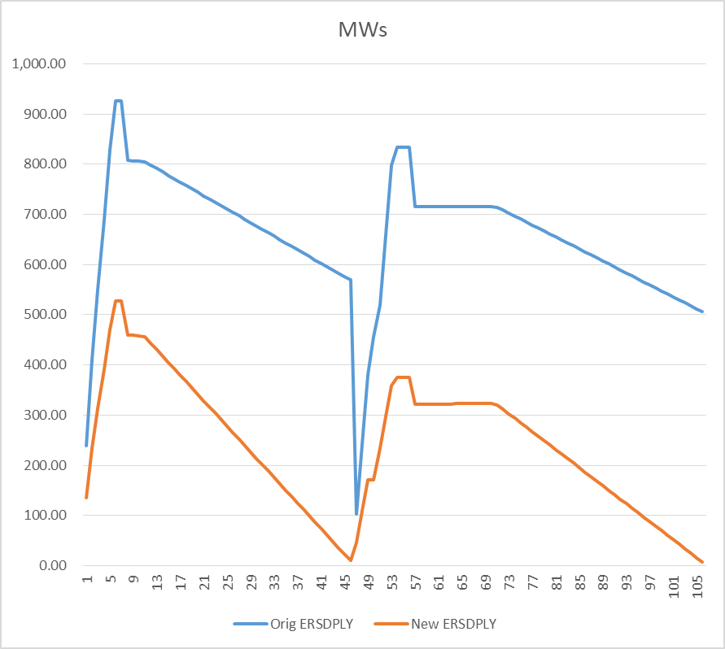
Non Self Deployed and 3-Hour Ramp Back

Slide 5
Non Self Deployed and 3-Hour Ramp Back

Slide 6
Non Self Deployed and 3-Hour Ramp Back

Slide 7
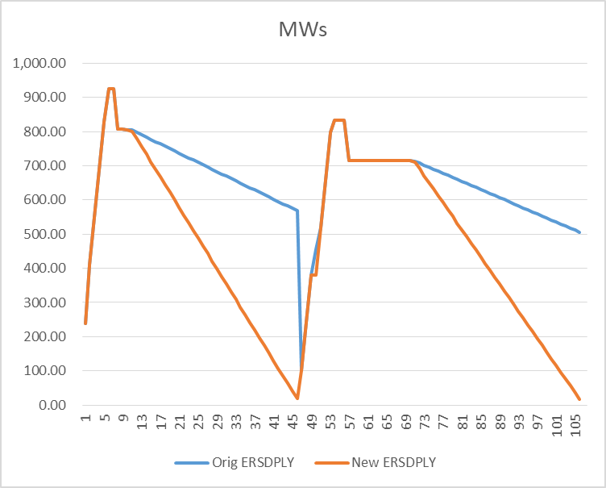
3-Hour Ramp Back

Slide 8
3-Hour Ramp Back

Slide 9
3-Hour Ramp Back

Slide 10
Total Estimated Impact
Non Self Deployed and 3-Hour Ramp Back
$410M
3-Hour Ramp Back
$83M

Slide 11
Summary
The current method of calculating ERS MWs in the RTRDPA is not producing an accurate “but for” price adder.
Both the 10-Hour Ramp Back and the inclusion of self deployed resources create significant inaccuracies.
The inclusion of self deployed resources was the more significant of the two inaccuracies in the 2019 ERS deployments.

