Slide 1
Effect of LASCED Shutdown Logic on Price Predictions and Potential Benefit of Using Persistence
Andrew Reimers
Market Analysis and Validation
DSWG Meeting
January 28, 2020

Slide 2
Contents
Current LASCED Implementation
Effect of shutdown logic on price predictions
Results from running LASCED with persistence
Data presented includes all of 2019

Slide 3
How does LASCED work?
LASCED is run for 11 five minute intervals starting with the current SCED interval
$LASCED GTBD\left(i\right)=\left\{\begin{aligned}SCED GTBD i=1 \\ TelemMW_{0}+\left(STLF_{i}−STLF_{0}\right)+\left(DCTie_{i}−DCTie_{0}\right) i>1\end{aligned}\right.$
Intervals are solved in series, and outputs from LASCED interval n are used as inputs to interval n+1
First LASCED interval sees the same inputs as SCED
Current wind and solar HSL are used for all 11 LASCED intervals
Constraints persist through all 11 LASCED intervals

Slide 4
Effect of LASCED Shutdown Logic on Price Predictions

Slide 5
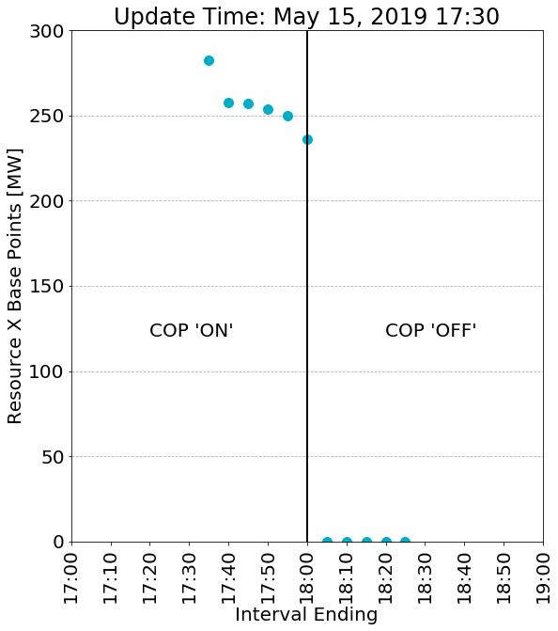
LASCED shuts off units based on changes in submitted COP status
If a unit’s COP status changes from online to offline across an hour boundary, LASCED turns the unit off immediately in the first interval of the following hour
In practice, units typically perform a more gradual shutdown or may stay online into the next hour

Slide 6
LASCED shutdown logic can result in under-forecasting capacity and over-estimating prices
LASCED under-forecasts dispatchable capacity for cross-hour intervals, increasing the prevalence of ramp constraints and under-generation.
LASCED also under-forecasts online reserves for cross-hour intervals, increasing the prevalence of high ORDC price adders.
The consequence of these trends is that LASCED tends to over-estimate cross-hour prices, particularly during evening shutdown.

Slide 7
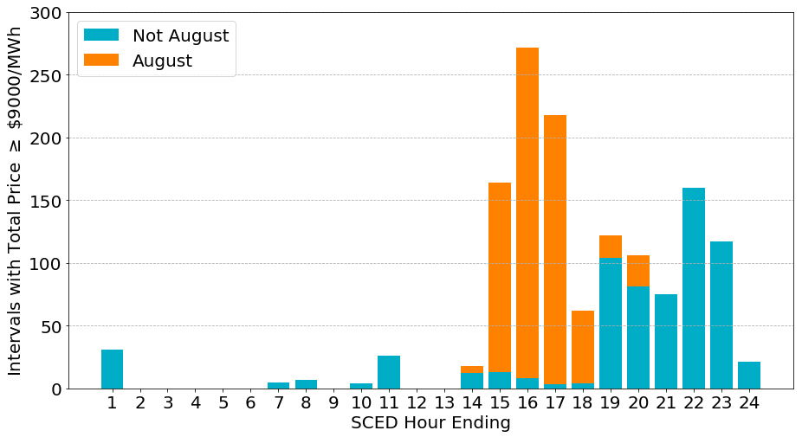
Outside of August, LASCED intervals with total price of ≥ $9000/MWh are disproportionately during evening shut down

Slide 8
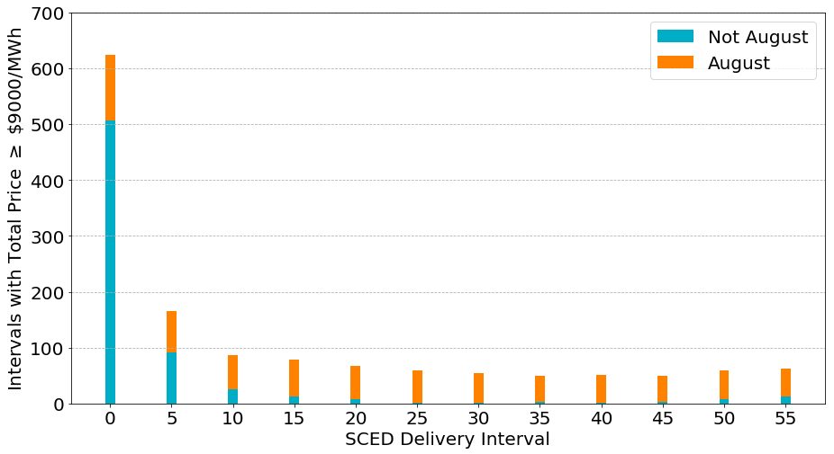
Outside of August, LASCED intervals with total price of ≥ $9000/MWh are disproportionately associated with SCED timestamps close to the beginning of an hour

Slide 9
Using Telemetry Persistence for All LASCED Intervals

Slide 10
Using persistence instead of COP status could improve the LASCED price forecasts
LASCED currently uses COP as the input for commitment status and AS responsibilities across hour boundaries
Alternatively, LASCED can use telemetry persistence for all intervals, i.e., commitment status and AS responsibilities will stay the same for all LASCED intervals

Slide 11
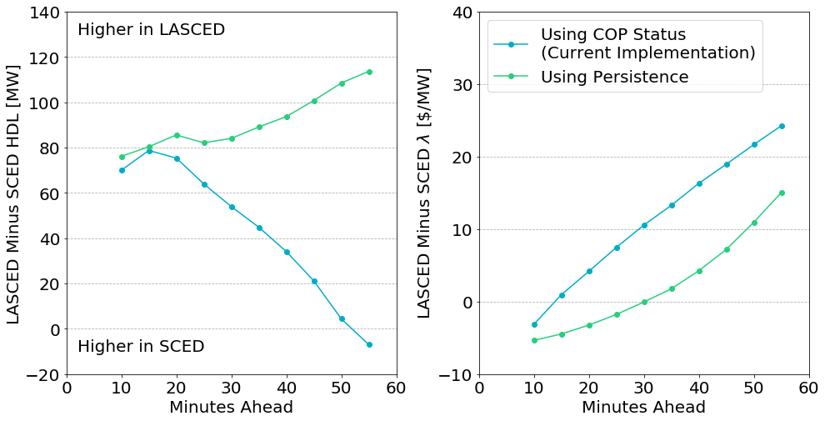
HDL is higher on average and System Lambda lower on average for LASCED with persistence

Slide 12
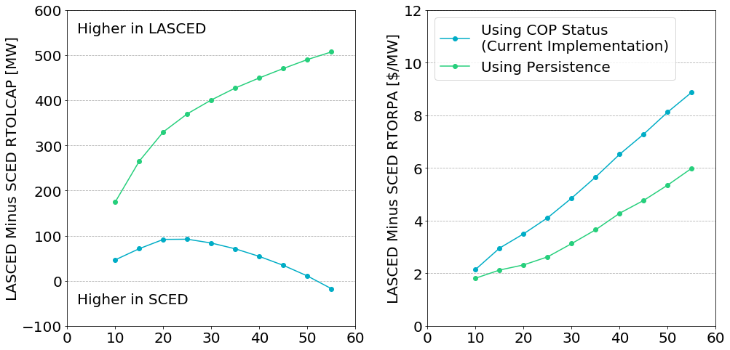
Online reserves are higher on average and ORDC price adder lower on average for LASCED with persistence

Slide 13
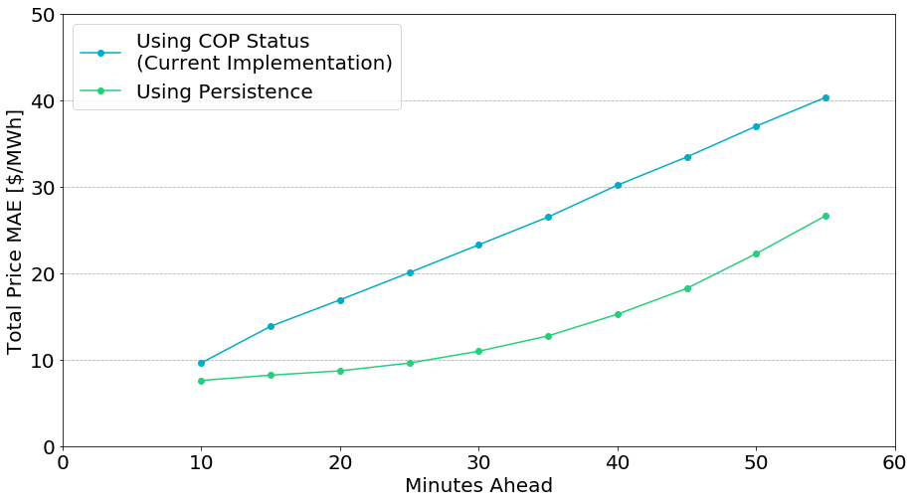
Mean absolute error (MAE) of total online price in LASCED is improved with persistence

Slide 14
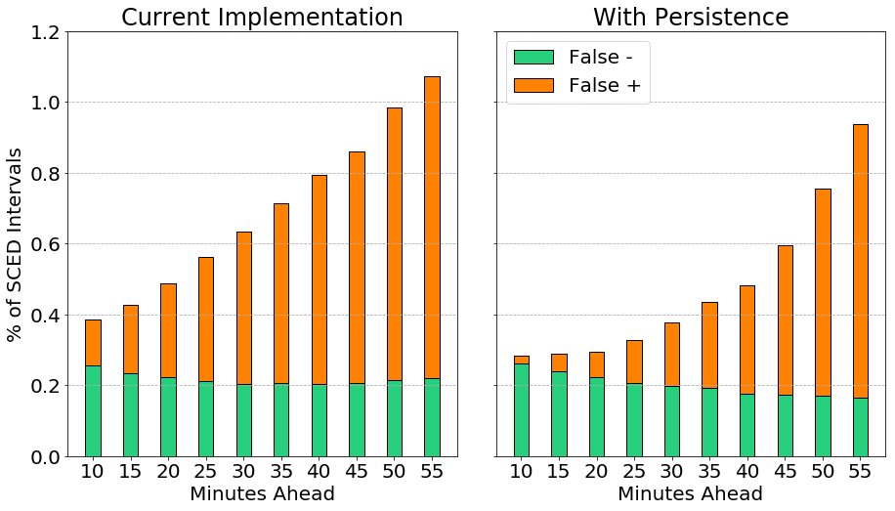
Persistence results in fewer false positive price spikes overall (Example: Total Price ≥ $500/MWh)

Slide 15
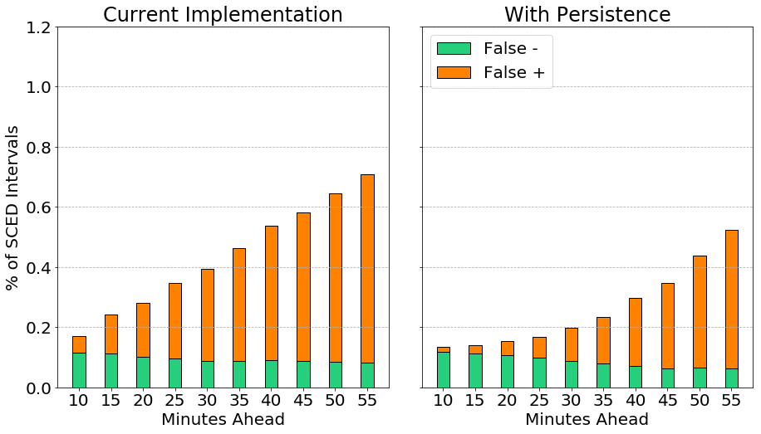
Persistence results in fewer false positive price spikes overall (Example: Total Price ≥ $1000/MWh)

Slide 16
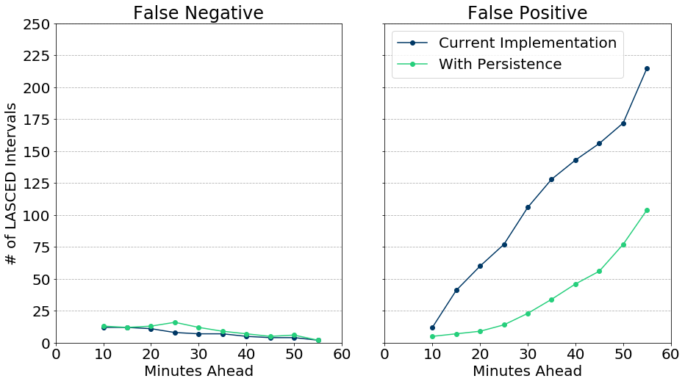
Persistence results in fewer intervals with false predictions of ≥ $9000/MWh

Slide 17
Changing LASCED to use Persistence
Persistence is an option available within the current implementation
ERCOT can make this change if requested by stakeholders
ERCOT would send a market notice to announce when this change has been made
More complicated modifications such as cross-hour changes in AS responsibility would require a System Change Request and more discussion about implementation details

