Slide 1
Summer 2019 Lessons Learned Discussion Topics (ERS Items)
WMWG Meeting
January 27, 2019

Slide 2
Summer 2019 Lessons Learned Discussion Topics
Emergency Response Service (ERS):
  Reliability deployment price adder ramp.
  Crossover between procurement time periods and calculation of the adder.
  Self-deployment of ERS.
  Communicating ERS Deployment
Items were assigned by WMS to WMWG & DSWG

Slide 3
Reliability deployment price adder ramp
Original Language added through NPRR626
6.5.7.3.1 Determination of Real-Time On-Line Reliability Deployment Price Adder
(e) Add the deployed MW from ERS to GTBD. The amount of deployed MW is determined from the XML messages and ERS contracts. After recall, an approximation of the amount of un-restored ERS shall be used. After ERCOT recalls each group, GTBD shall be adjusted to reflect the restoration of load using a linear curve over the ten hour restoration period. The restoration period shall be reviewed by TAC at least annually, and ERCOT may recommend a new restoration period to reflect observed historical restoration patterns.

Slide 4
August 13 ERS deployment
Reliability deployment price adder ramp
Total Response (MWs)

Slide 5
August 15 ERS Deployment
Reliability deployment price adder ramp
Total Response (MWs)

Slide 6
Reliability deployment price adder ramp
ERS-30 Deployment
3 hours after recall
Graph is based on 15-minute interval data.
Performance is based on a prorated obligation for the 1st partial interval only (11.57 minutes) therefore prorated obligation for 1st partial interval was 86.11 MW

Slide 7
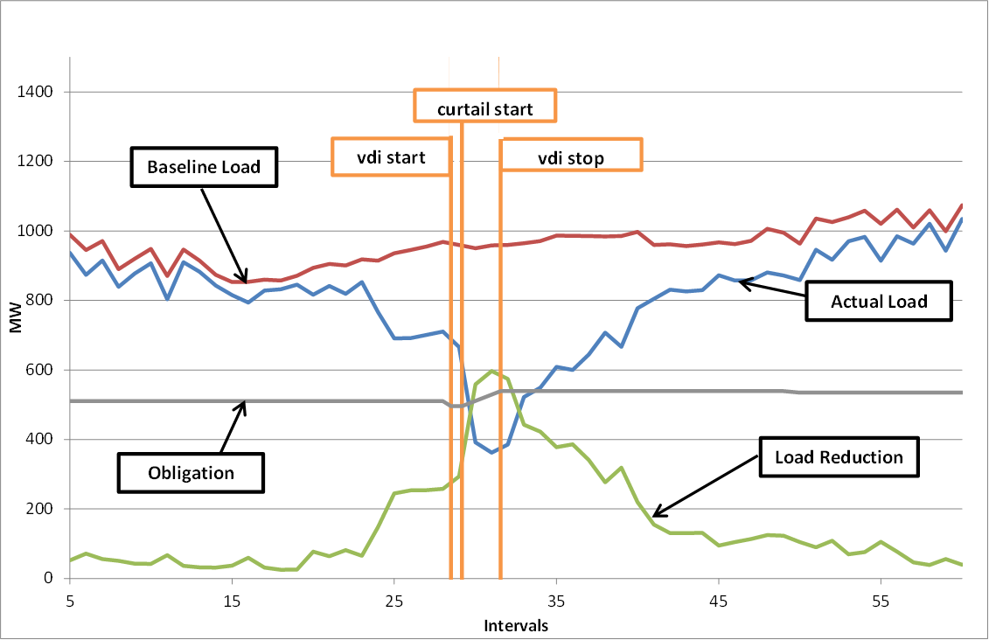
Reliability deployment price adder ramp
January 6, 2014 ERS-10 Deployment
3 hours after recall
Graph is based on 15-minute interval data.
Performance is based on a prorated obligation for the 1st partial interval and one full interval.
1 Resource had prescheduled unavailability from HE0900 - 1600 on the day of the event (14.6 MWs)

Slide 8
Crossover between procurement time periods and calculation of the adder
Current methodology uses the contracted capacity in each ERS Time Period
  Contracted capacities are not reduced by self deployments amounts
The ramp out of the adder is currently based on the contracted capacity for the ERS Time Period in which the recall instruction was issued.

Slide 9
Self-deployment of ERS
This is the deployment of ERS Resources prior to an instruction from ERCOT and may be in response to other signals such as 4CP, pricing, etc.
  May impact Resource/QSE availability/payment
  Current process obligates the ERS Resource to deploy upon instruction, or if self deployed, remain deployed until recalled by ERCOT or resource no longer has an obligation
  Issue discussed in detail during initial rulemaking with commission agreeing with ERCOT and other parties that this is a benefit to ERCOT and therefore allowed.
  ERCOT operations feels self-deployment is a benefit to the system by delaying or even avoiding further action.
  No changes recommended by ERCOT

Slide 10
Communicating ERS Deployment
Communication to the interested stakeholders that ERS has been deployed.
  Currently the only communication of an ERS Deployment to the market is through the operator notes
  ERCOT working on solution that would automatically post message to the “Operations Messages” page on ERCOT.com
Provide information to the ERCOT control room concerning the available ERS capacity still undeployed
  Issue raised during October 2019 DSWG meeting
  Discussed with ERCOT control room and this information would not alter control room procedures during an emergency event
  Complicated issue to solve and solution not warranted

