Slide 1
KTC #13 Self-Limiting Generation Interconnection and Change Request (GINR).
Sandip Sharma/Jay Teixeira
ERCOT
BESTF January 17, 2020

Slide 2
Acronym
KTC – Key Topic and Concept related to BESTF
ESS – Energy Storage Systems
POI – Point of Interconnection
IE – Interconnecting Entity
IA – Interconnection Agreement
INR – Interconnection and Change Request
BESS – Battery Energy Storage System
WGR – Wind Generation Resource
PVGR – Photo-Voltaic Generation Resource
ESR – Energy Storage Resource

Slide 3
Background
Stakeholders at the Battery Energy Storage Task Force (BESTF) had identified a need to review existing GINR process as developers are proposing to add batteries at an existing generation site to only enhance (not increase previously studied Pmax in the IA) the capability of existing Resources. This issue was captured as Key Topic and Concept (KTC) #13.
Also, Monthly Generator Interconnection Status (GIS) Reports at the end of Dec 31, 2019, shows new 32 co-located energy storage projects totaling 2994 MW.
  Some of these new projects expressed their interest to be self-limiting

Slide 4
Example GINR #1 (Greater Capacity Factor, more on-peak)
Scenario 1: New Solar/wind + storage projects, solar = 200MW, storage = 200MW, but the IE only wants to deliver a total of 200MW to the grid.
  Example: ##INR**** Solar, 200MW ##INR**** Storage, 200MW
  AC connected, currently at Screening Study stage. IE only wants to deliver 200MW to ERCOT.

Slide 5
Example #2:
Scenario 2: Existing Generation site with a Combustion Turbine that wants to add Battery without increasing the Pmax in the IA.
AC connected
ESR and CTs are behind the same POI
Addition of ESR is to enhance the capability of the CT to participate in additional AS

Slide 6
Example GINR #3: (Change in technology, more on-peak)
Scenario 3: Existing wind farms, IE wants to install a battery but the total output of the wind/battery is equal to or smaller than the original Pmax.
  Example: ##INR**** Wind Repower, 46.2MW (originally 63MW)
  ##INR**** BESS, 16.8MW
  AC connected, currently at FIS stage. Replace the existing 3 MW turbines with 2.2 MW turbines. There are 21 total, so there’s a net change of -16.8 MW. Radial line.

Slide 7
Assumptions for Self-Limiting Facilities
The addition of energy storage to an existing generation site that is not intended to increase amount of MW that can be injected at the POI. Pmax in at the POI in the IA does not change.
A new energy storage capacity co-located with a new generation site with Pmax in the IA lower than total installed MW capacity behind the POI. (Note that ERCOT does not currently reflect the IA limits in the network model.)
Installed AC/DC MW capacity behind the POI may exceed inverter rating or the IA, but the power injected into ERCOT grid will always be limited to the Pmax in the IA.
As a part of GINR process, Interconnecting Entity (IE) shall provide all details of the physically-limiting elements (e.g. inverters and GSUs) and/or power plant controller that will enforce the limit. TSP may install additional schemes to ensure adequate protection.
Self-Limiting concept only applies to Resources behind the same POI.

Slide 8
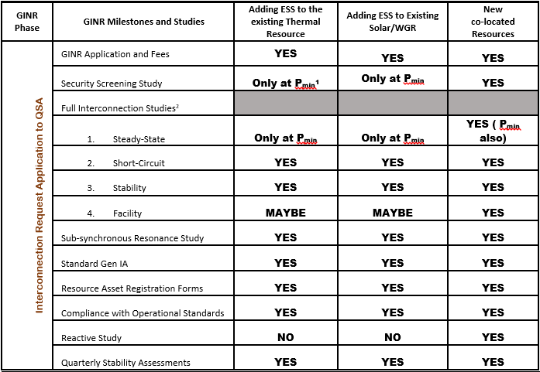
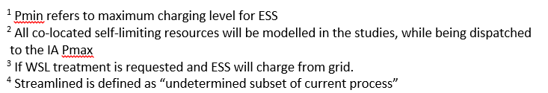
GINR Milestones

Slide 9
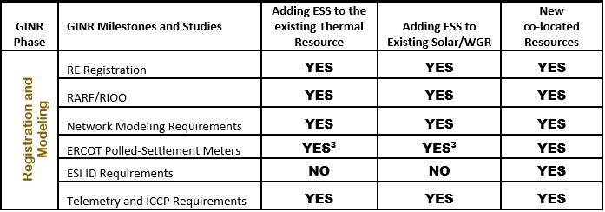
GINR Milestones

Slide 10
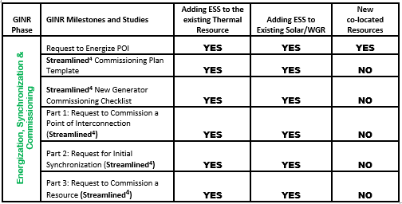
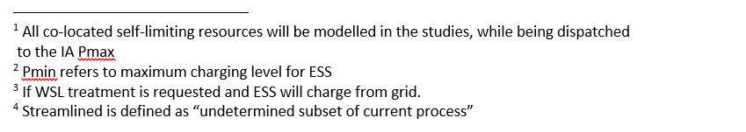
GINR Milestones

Slide 11
Next steps and Questions
After the fact review and reporting and/or “Real-time alarms”?
  Today there is a High Reasonable Limit guard rail on each resource but not a limit on generation site
  Pmax established in the IA needs to be strictly enforced
  Self-Limiting generation facility that exceeds their IA Pmax or Pmin shall have to go through the interconnection process
QSEs should be responsible for limiting their combined COP HSL, Telemetered HSL, and total generation into ERCOT grid to not exceed their IA Pmax
IE should be required demonstrate that they will be installing a generation limiting scheme that would ensure the plant’s output would not exceed their Pmax

Slide 12
Next steps and Questions
These self-limited capacity and generation site are not represented in the ERCOT EMS today (System changes will be required)
How will self-limited generators be represented in the planning model and dispatched in the planning studies?
How will self-limited generators be captured in Resource Adequacy Reporting, both during interconnection phase (GIS) and commercial operation (CDR, SARA)?
What is the reactive requirement for the new inverter based resource if the existing resource is offline? In this case, would the new IBR have to comply with the same CURL as the existing resource?

Slide 13


Slide 14
GIS, Battery Project Details (as of Dec 31)
 | Number of Projects | Storage Capacity, MW | % of Total MW of Batteries with FIS Started | Min Project Size, MW | Max Project Size, MW | Average Project Size, MW
Co-located with new PVGR | 28 | 2,702 | 53% | 20 | 504 | 97
Co-located with new WGR | 4 | 292 | 6% | 50 | 120 | 73
Co-located with existing CT | 1 | 260 | 5% | 260 | 260 | 260
Stand-alone Batteries | 23 | 1,846 | 36% | 20 | 209 | 80
* Co-located means the same Point of Interconnection (POI)

