Slide 1
ERCOT Frequency Control Report
December 2019
ERCOT
Operations Planning
PDCWG | January 14th, 2020

Slide 2
Summary of December 2019
CPS1: 178.28%
Current CPS1 12-Month Rolling Average: 174.80%
0 BAAL Exceedance
0 hourly CPS1 score below 100%
BAAL-003 Events have updated through 2018
2018 BAAL-003 FRM Performance: -843.17
2019 RMS1 Statistics
  Mean: 13.96 mHz
  Min: 12.1 mHz
  Max: 15.96 mHz
Energy Statistics
  Total Energy: 29,226,166 MWh
  Wind Energy: 6,609,062 MWh
  Percent Energy from Wind: 22.61%
  Solar Energy: 311,813 MWh
  Percent Energy from Solar: 1.04%
Minimum System Inertia
  Mean: 188,904
  Max: 243,903 on Dec 18th
  Min: 154,996 on Dec 6th
Notes:
Mean: 188,904
Max: 243,903 on Dec 18th
Min: 154,996 on Dec 6th

Slide 3
Frequency Control
CPS1, BAAL, & RMS1

Slide 4
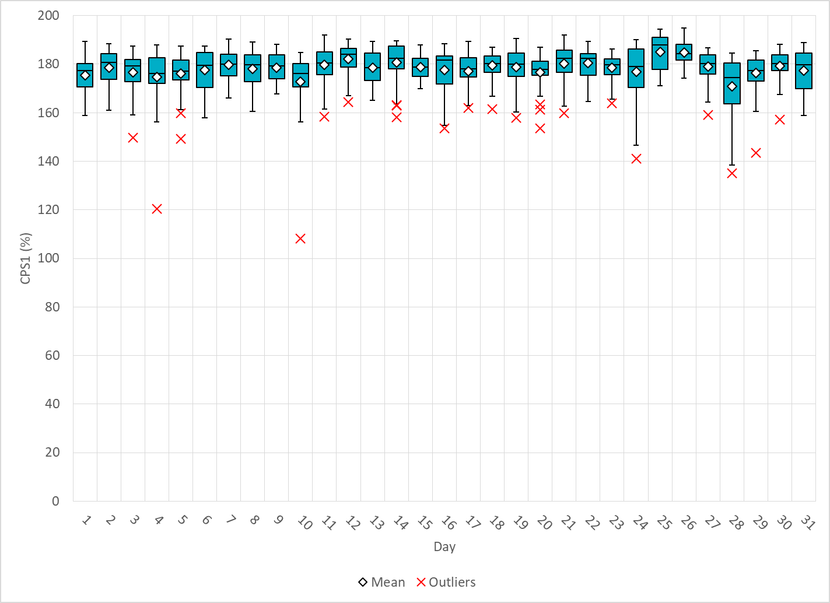
Hourly CPS1 by Day
Dec-19 CPS1 (%): 178.28
Notes:
Outliers:
12/10/2019 06:00 108.4%
Generation deviation due to steep up ramp rate from wind

Slide 5
BAAL Exceedances & Violations
There was 0 BAAL exceedances in Dec

Slide 6
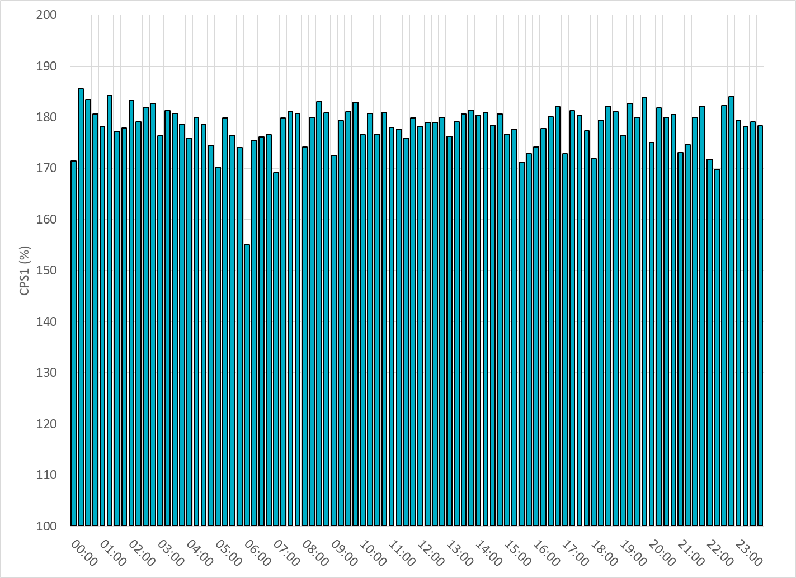
15-Minute Average CPS1%
Dec-19 CPS1 (%): 178.28

Slide 7
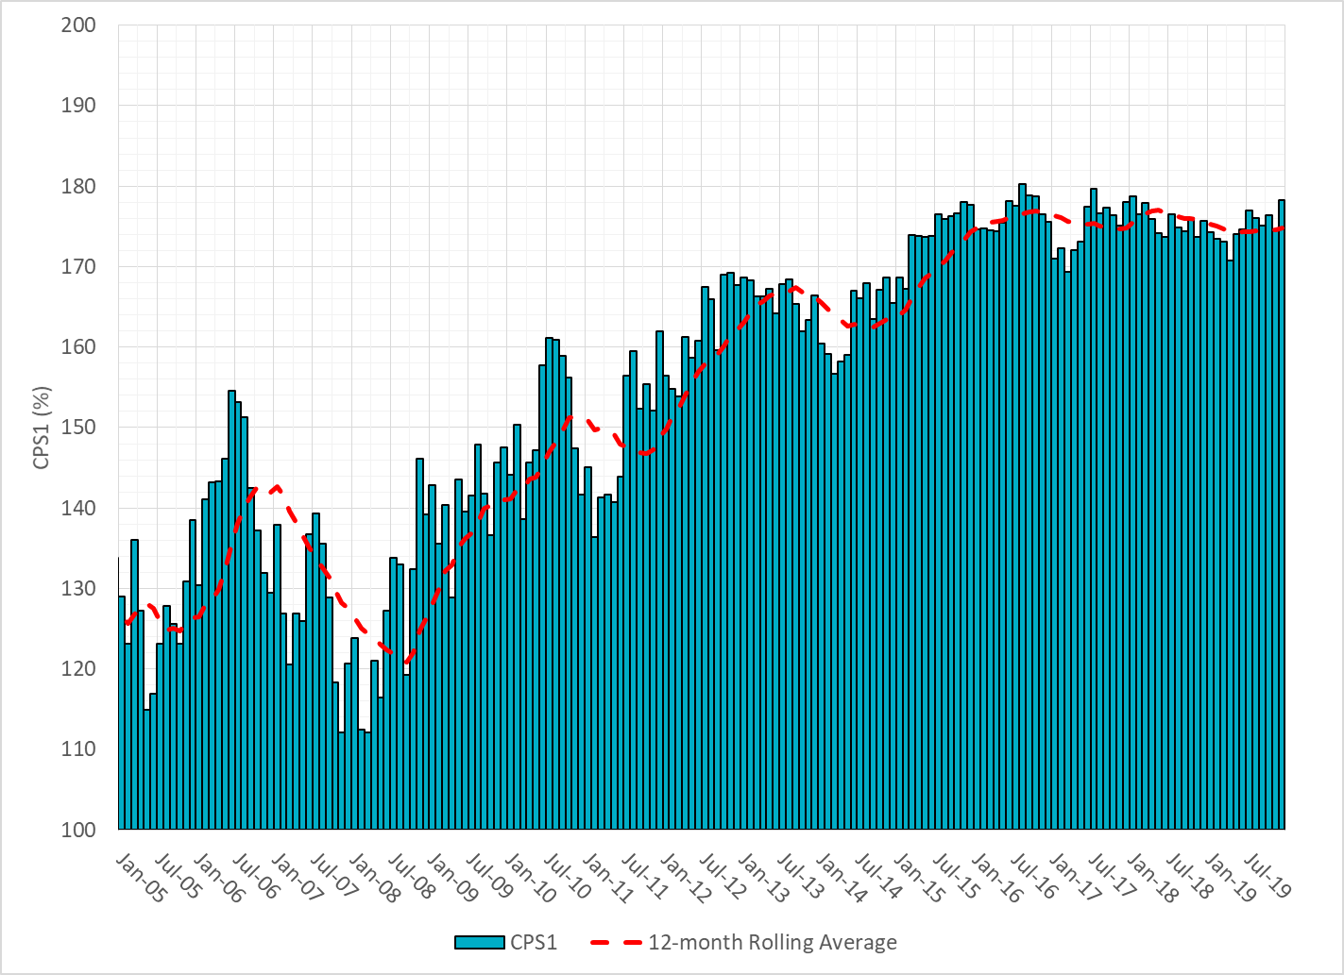
12-Month Rolling Average CPS1
Current 12-Month Rolling Average: 174.80%

Slide 8
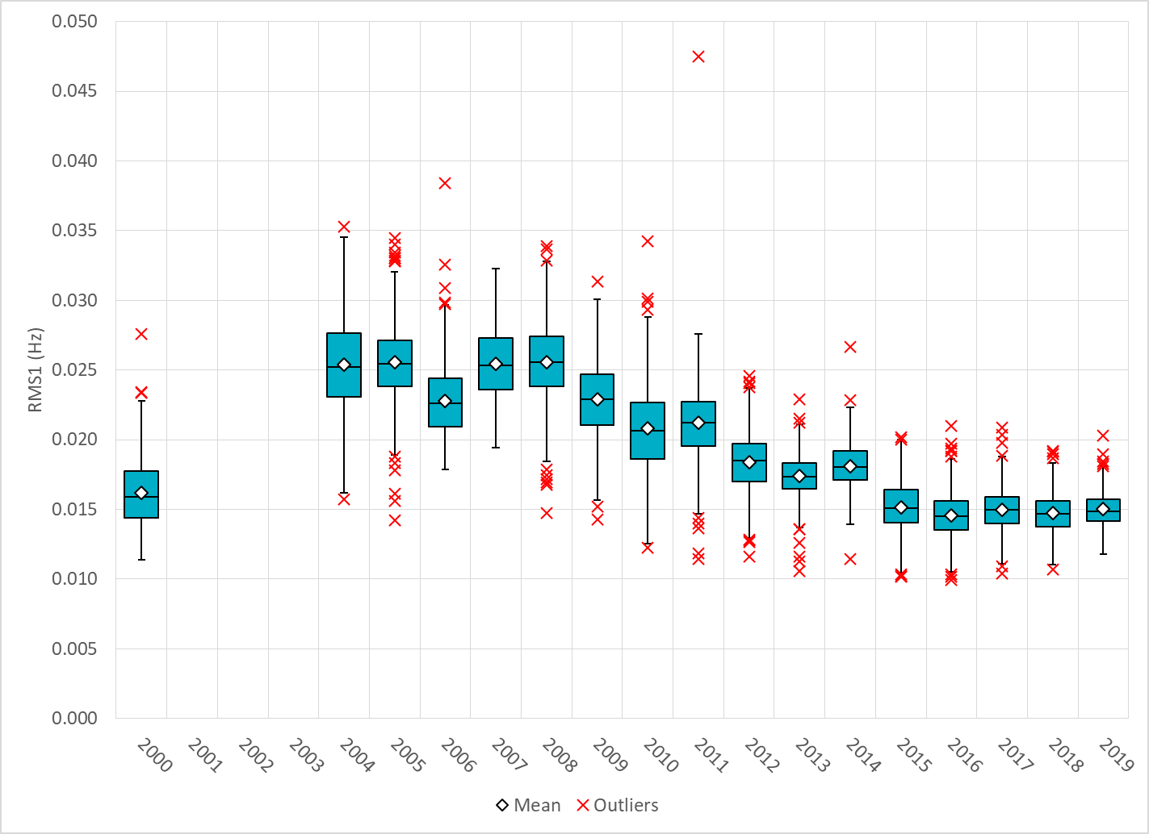
Daily RMS1 of ERCOT Frequency by Year
Notes:
Mean: 15.00 mHz

Slide 9
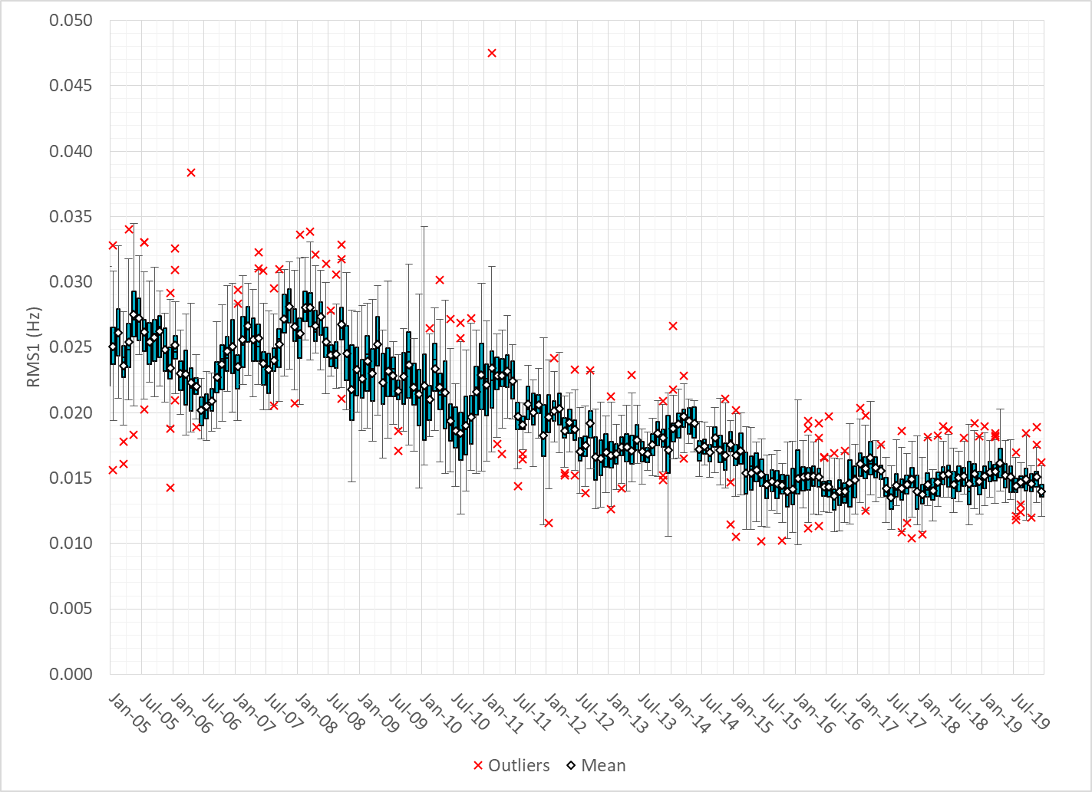
Daily RMS1 of ERCOT Frequency by Month

Slide 10
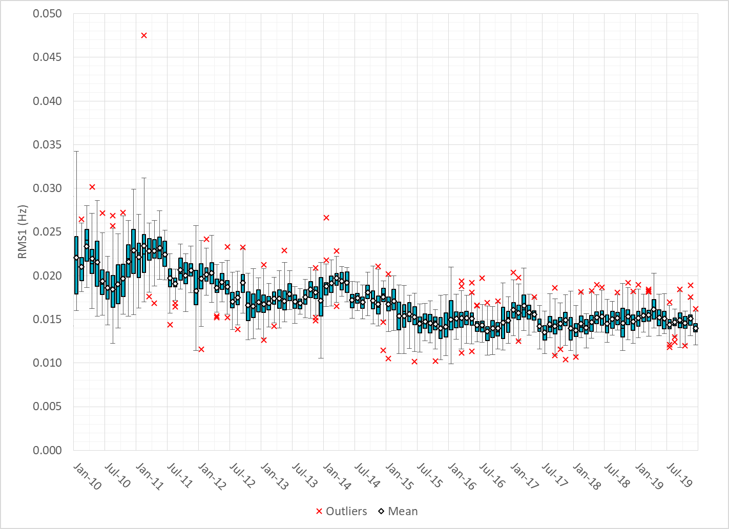
Daily RMS1 of ERCOT Frequency by Month
Notes:
Mean: 13.96 mHz
Min: 12.1 mHz
Max: 15.96 mHz

Slide 11
Frequency Profile Comparison

Slide 12
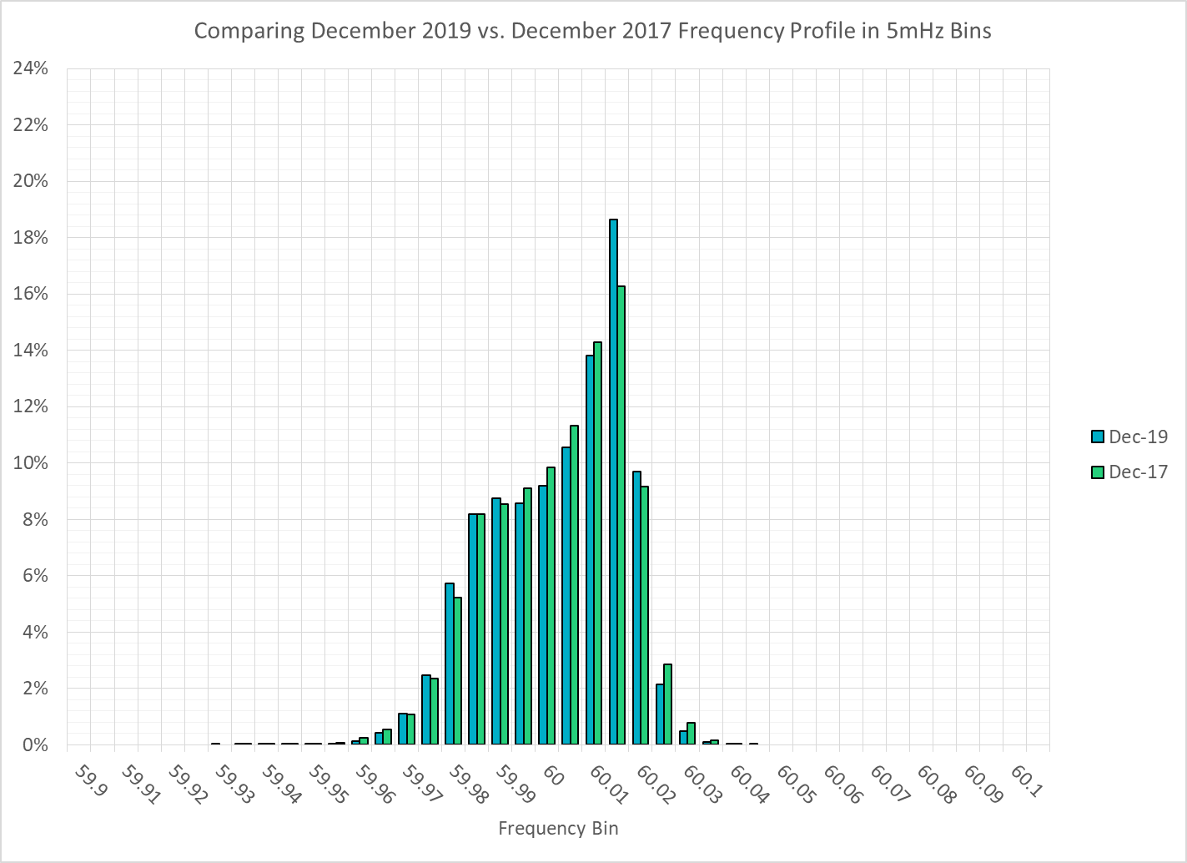
Frequency Profile Comparison

Slide 13
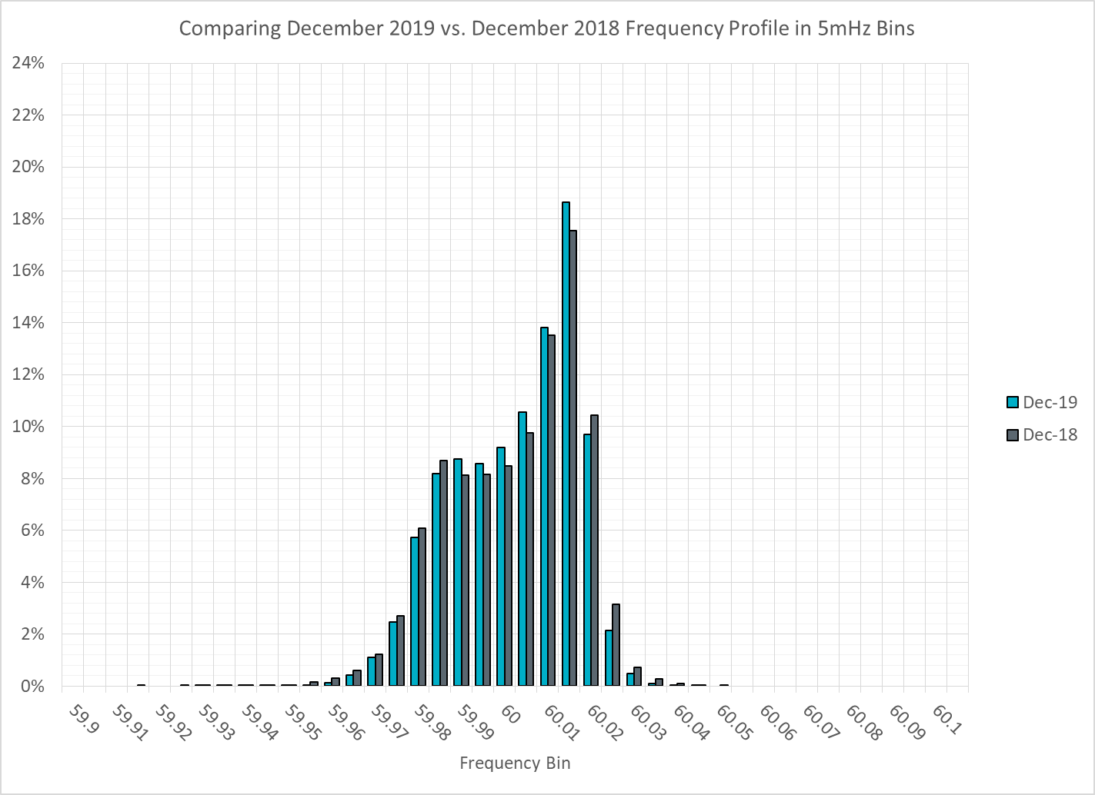
Frequency Profile Comparison

Slide 14
Time Error Correction

Slide 15
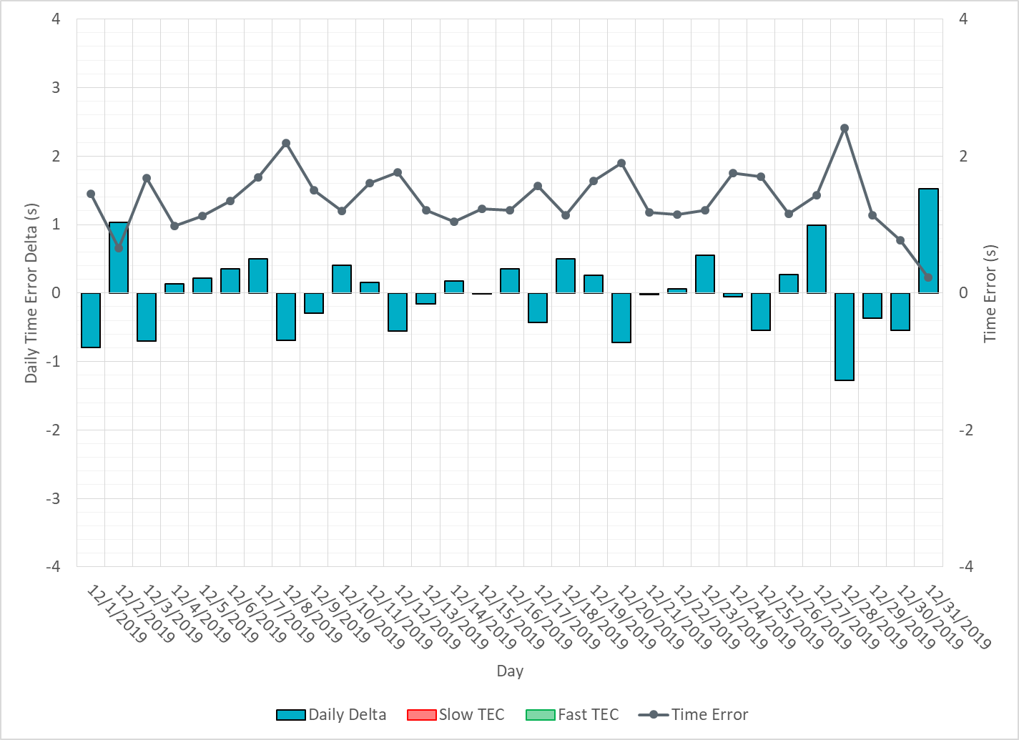
ERCOT Daily Time Error

Slide 16
Time Error Corrections Log Summary
There have been no time error corrections since December 2016

Slide 17
BAL-003 Performance

Slide 18
Op. Year 2018 BAL-003 Selected Events – Update
Notes:
BAL-003

Slide 19
Op. Year 2018 BAL-003 FRM Performance - Update

Slide 20
ERCOT Energy Statistics

Slide 21
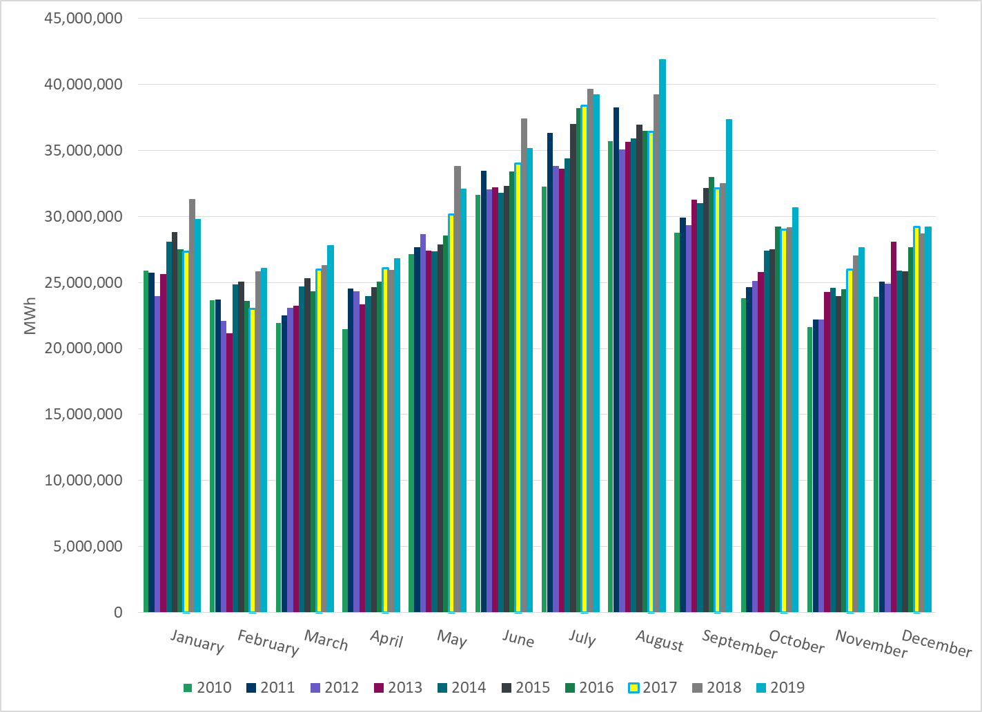
Total Energy
Notes:
29,226,166 MWh

Slide 22
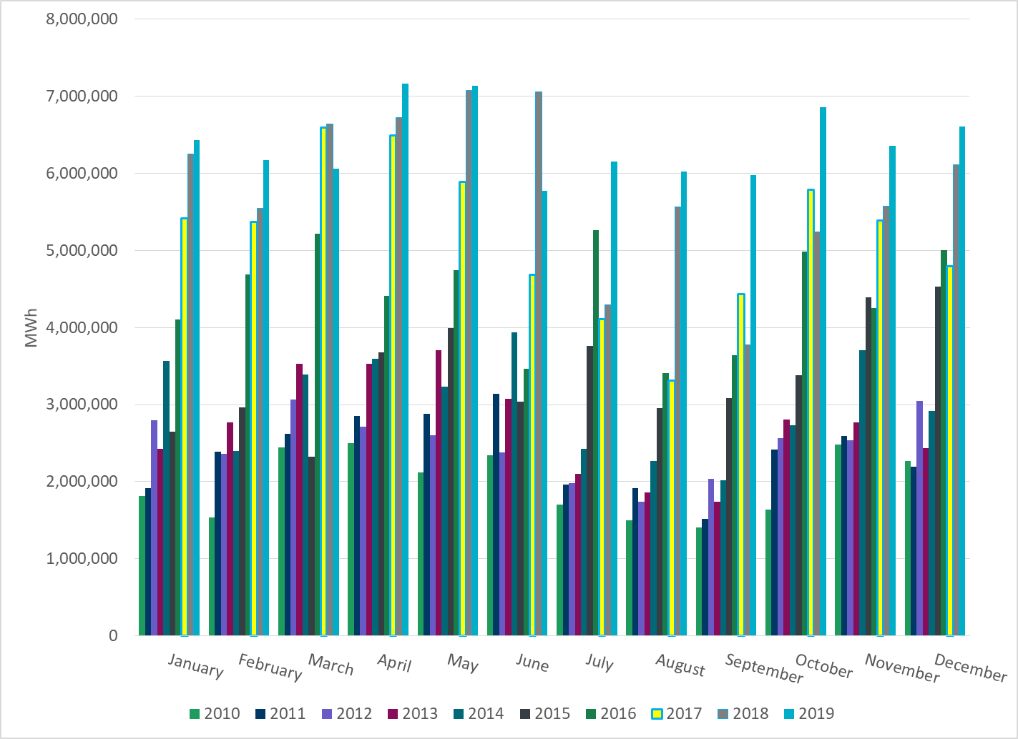
Total Energy from Wind Generation
Notes:
6,609,062 MWh

Slide 23
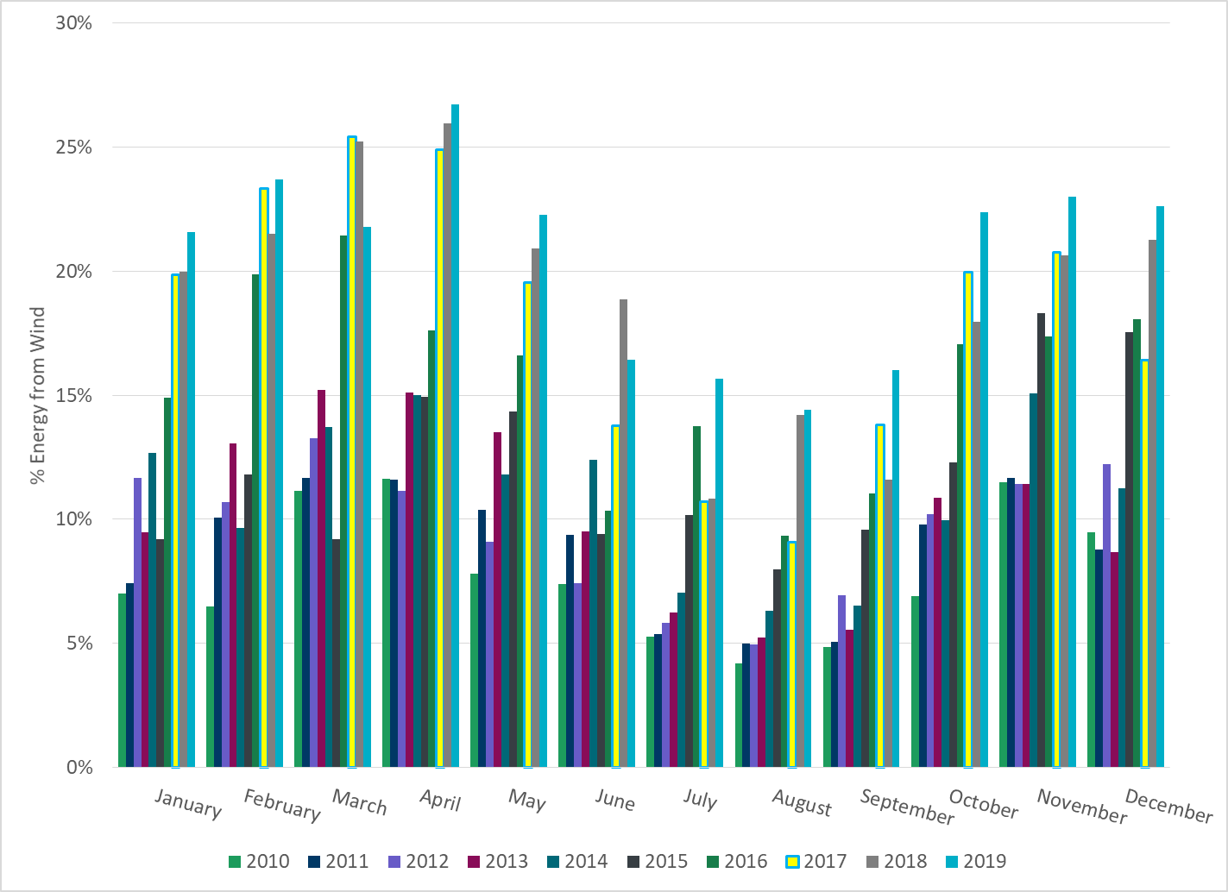
% Energy from Wind Generation
Notes:
22.61%

Slide 24
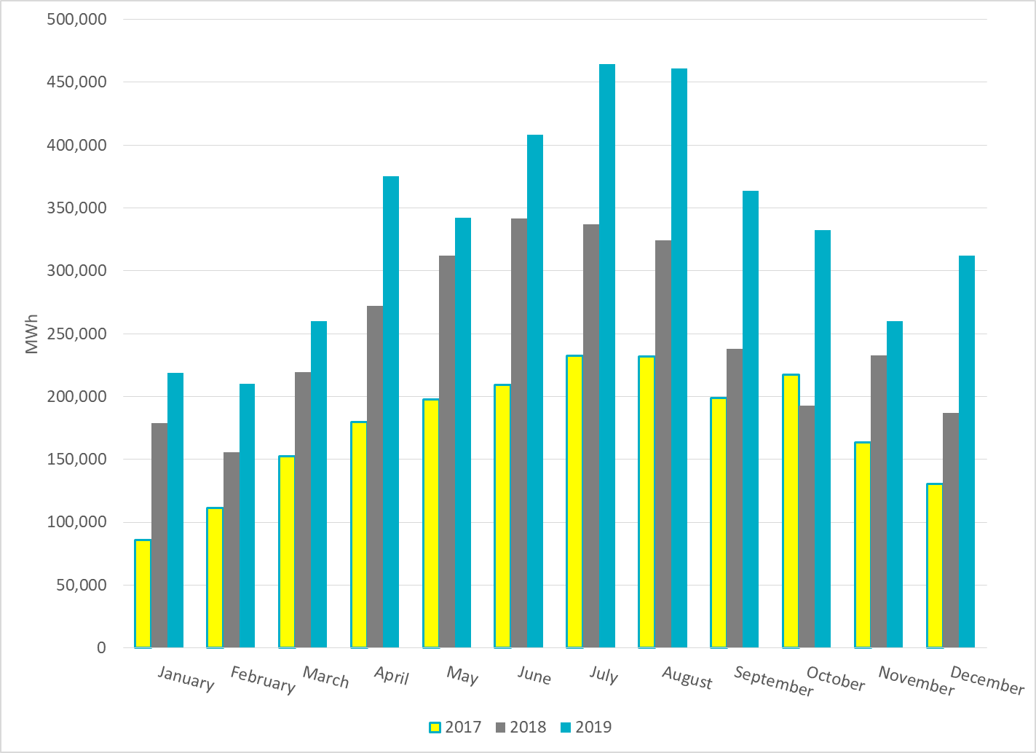
Total Energy From Solar Generation
Notes:
311,813 MWh

Slide 25
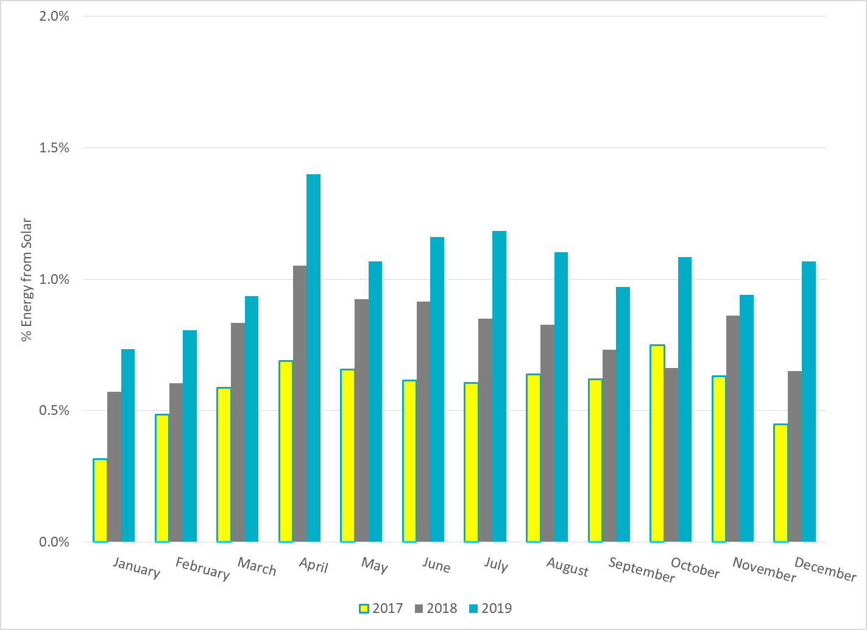
% Energy from Solar Generation
Notes:
1.07%

Slide 26
ERCOT Energy Statistics for the Decade

Slide 27
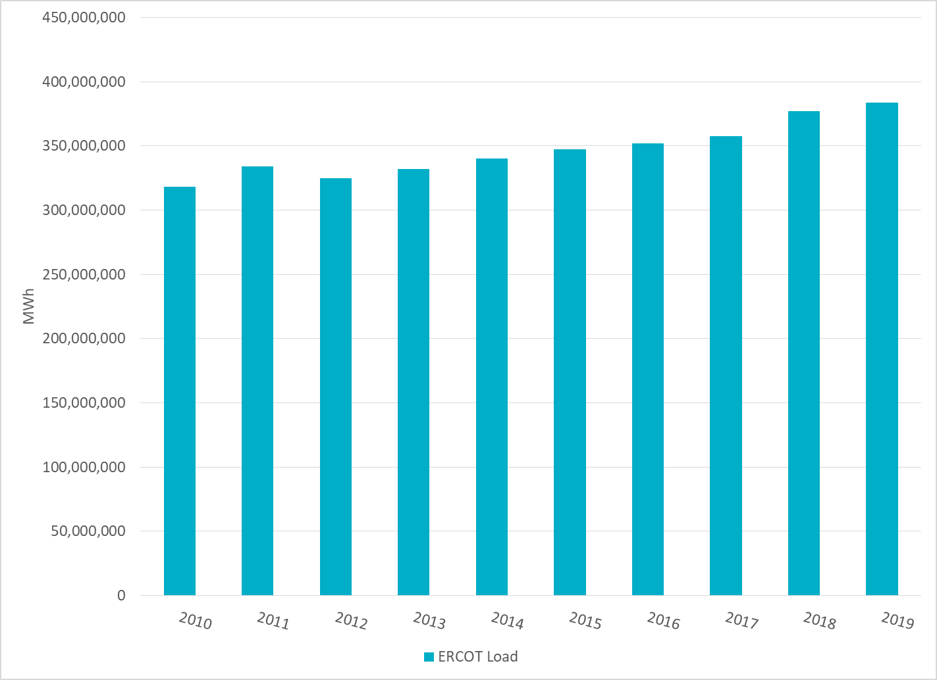
Total Energy

Slide 28
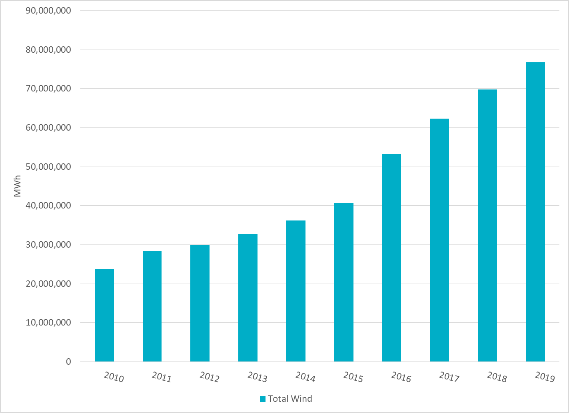
Total Energy from Wind Generation

Slide 29
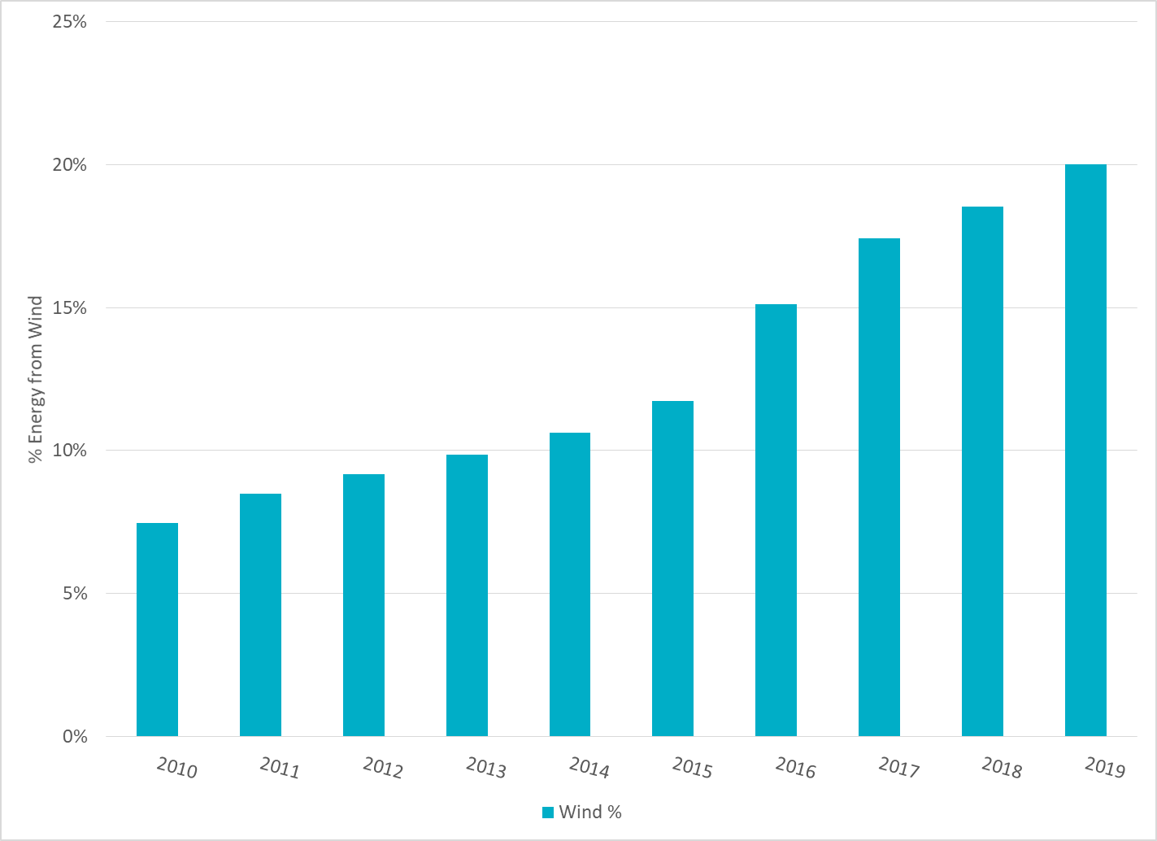
% Energy from Wind Generation

Slide 30
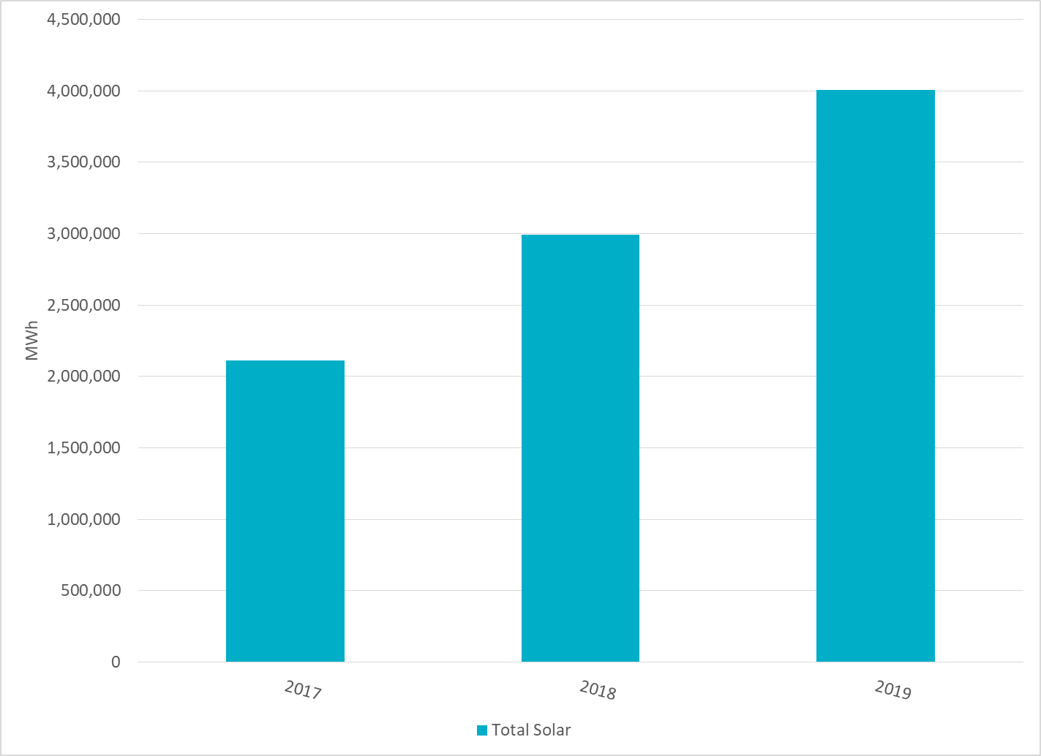
Total Energy From Solar Generation

Slide 31
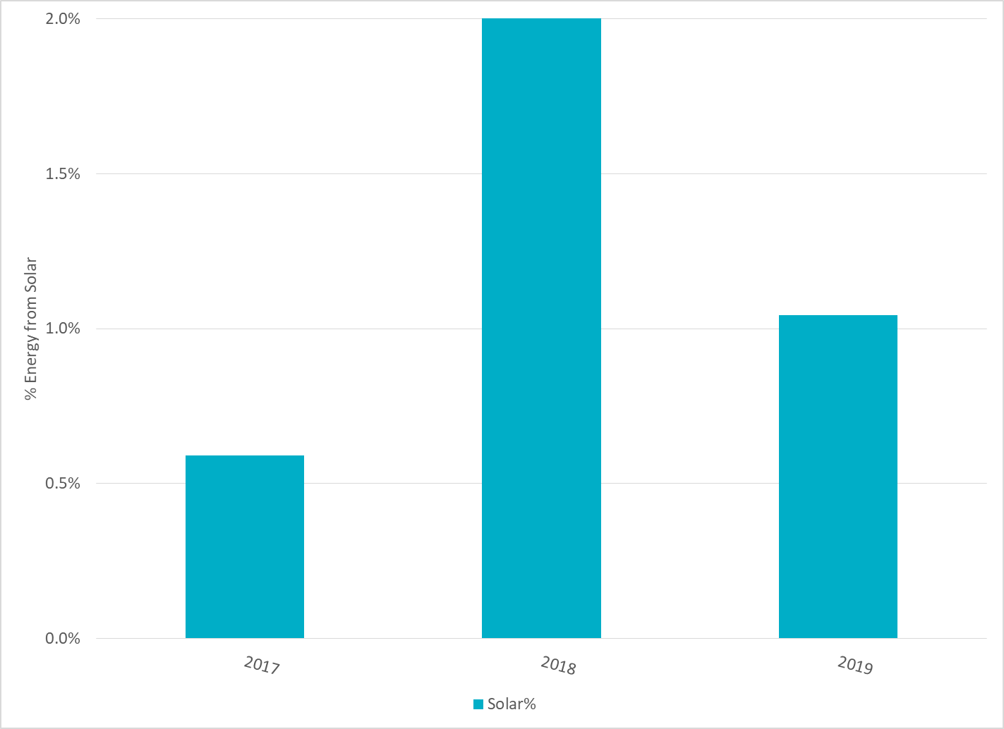
% Energy from Solar Generation
Notes:
Larger Total Energy for 2019 compared to 2018

Slide 32
ERCOT System Inertia

Slide 33
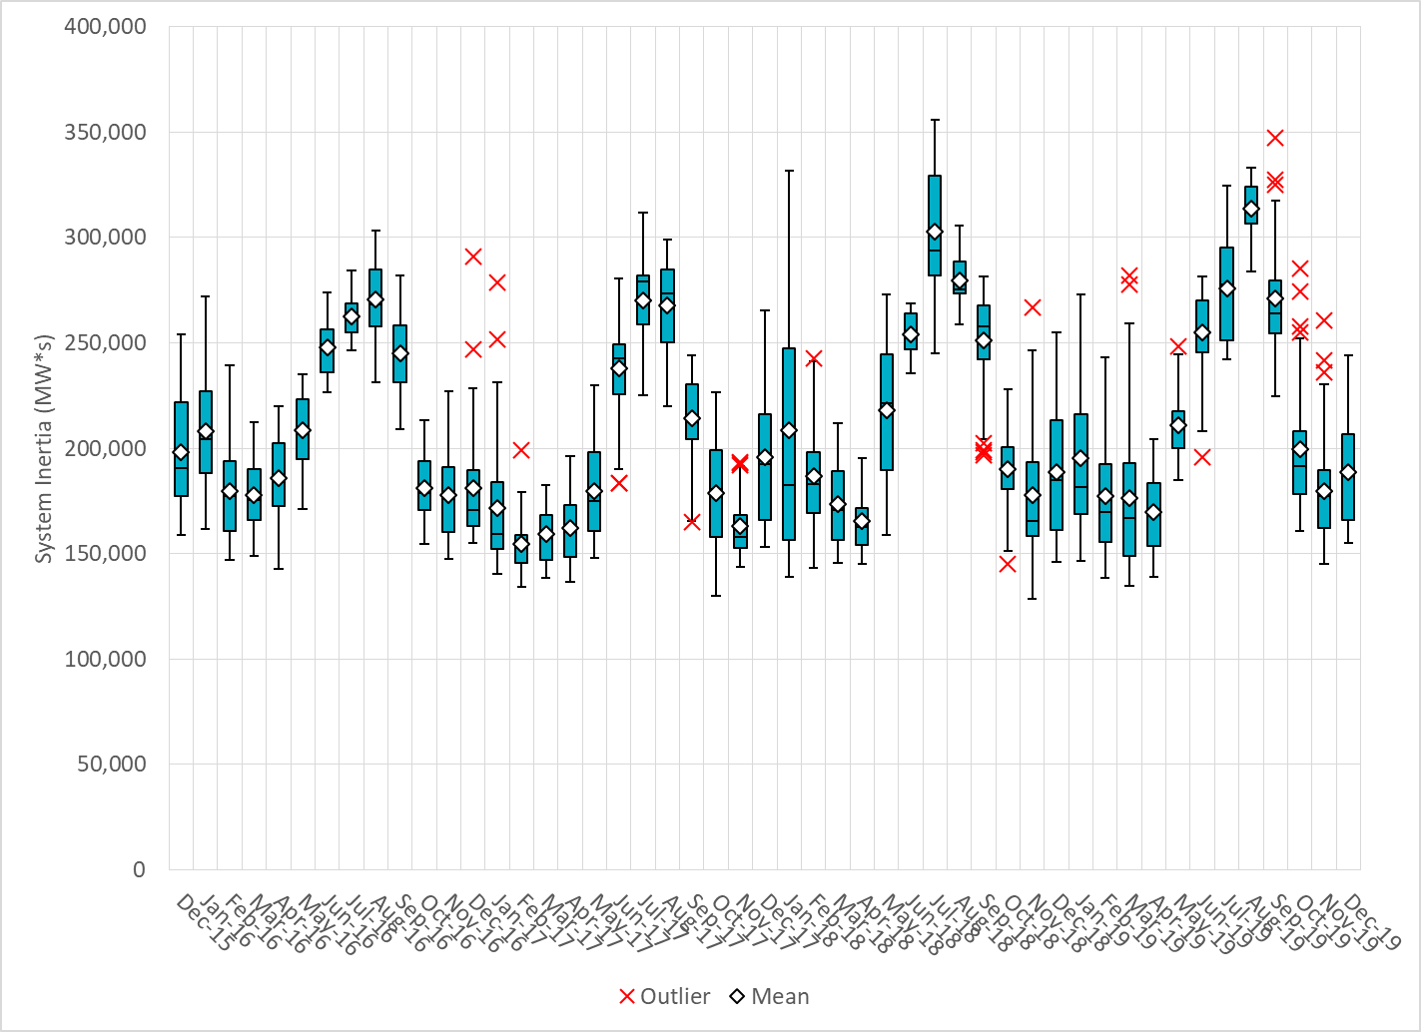
Daily Minimum System Inertia
Notes:
Minimum Inertia = 154,997 MW*s on 12/06/2019
Previous Minimum was 128,759 MW*s on 11/18/2018.
Data:
Mean: 188,904
Max: 243,903 on Dec 18th
Min: 154,996 on Dec 6th

Slide 34
Questions?
Thank you!

