Slide 1
NOGRR 195
Freddy Garcia
January 15, 2020

Slide 2
Voltage Set Point tolerances
Currently Voltage Set Point tolerances, +/- 2%, can be more than a 14 kV spread for Generation Resources connected to 345kV POI’s.
Difficult to maintain reliability when Resource allowed to drift far from set point.
Using whole numbers easier for operators to determine when out of range rather than having to calculate a band that changes dynamically because of being in %.
PDCWG recommended 1%
NPRR 776 implemented common point of measurement eliminating metering differences between the TO and GR.
Nominal Voltage | Tolerance Band KV
345 | +/- 4kV
230 | +/- 3kV
138 | +/- 2kV
115 | +/- 2kV
69 | +/- 1kV

Slide 3
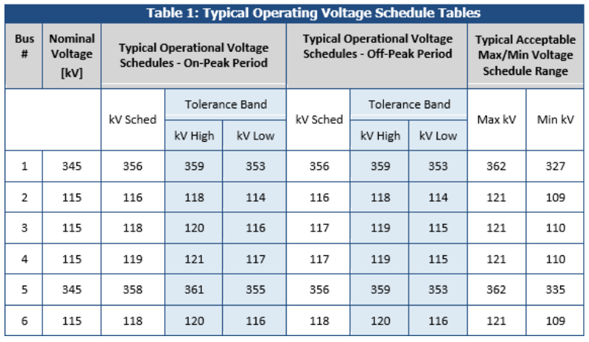
Generator Voltage Set Point tolerances
NERC Reliability Guideline Reactive Power Planning December 2016, p 23

Slide 4
Reliability Risks
Single or multiple Plants don’t hold voltage set point
Other Plants & dynamic devices exhausting reactive to compensate
Less dynamic reactive to respond to contingency

Slide 5
Reliability Risk

Slide 6
Reliability Risks: Example 1
Color key:
KVM = solid blue
KVT = dotted dark blue
MVAR = solid red
MVAR Min. = dotted dark red

Slide 7
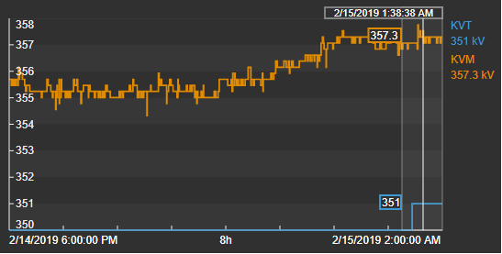
Reliability Risks: Example 2
High Voltages
Reported High Voltages
Arcing conductors, transformer issues
Within 2% tolerance, outside 4kV

Slide 8
Reliability Risks: In Conclusion
Poor voltage control can lead to sustained low/high voltages and:
Decreased Dynamic Reactive Reserves
Tripping of generating units due to low auxiliary voltage
Increased reactive load from motor stalling and automatic substation LTC actions
Reduced reactive support from capacitors, SVCs and line charging

Slide 9
Questions

Slide 10
Change in Voltage Target (KVT) with limited to no Unit MVAR Response

Slide 11
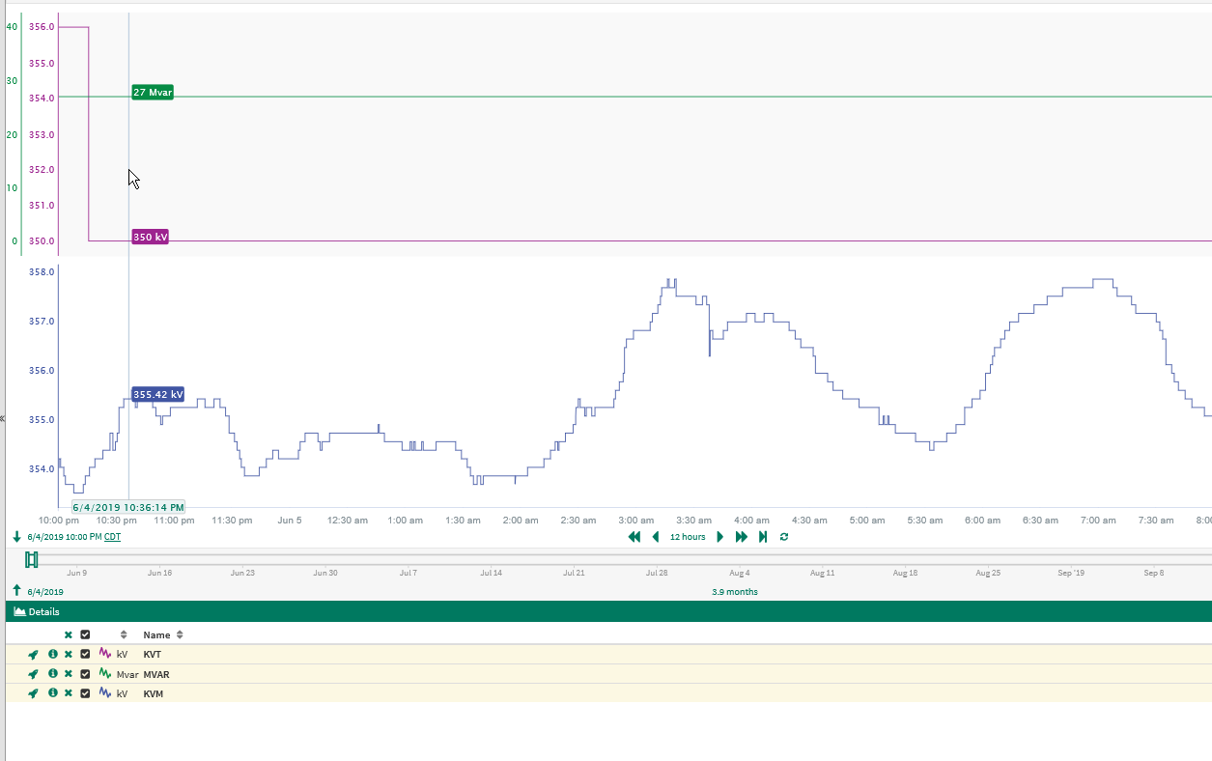
Example 1

Slide 12
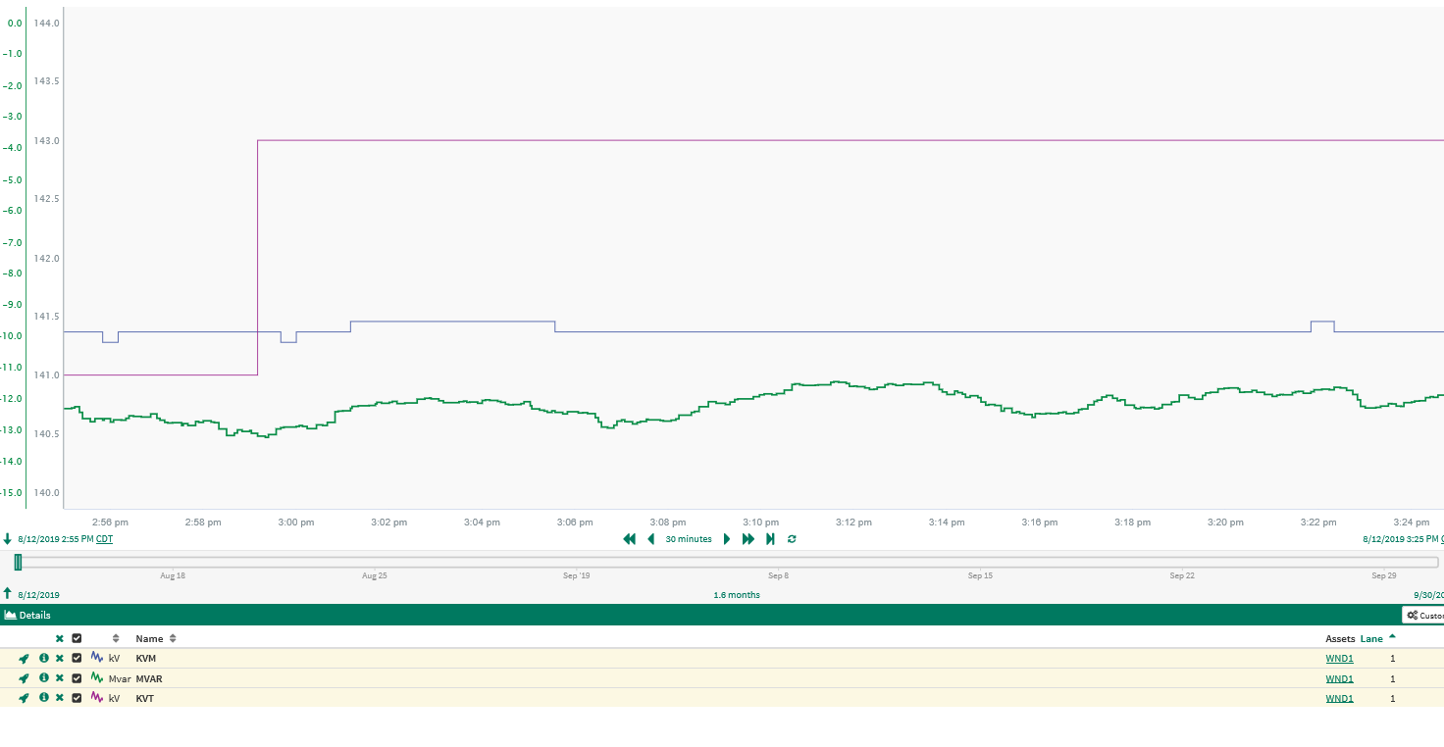
Example 2

Slide 13
Change in Point of Interconnect Voltage(KVM) with no Unit MVAR Response

Slide 14
Example 1

Slide 15
Example 2

Slide 16
Example 3

Slide 17
Unit operating at or near 2% tolerance band

Slide 18
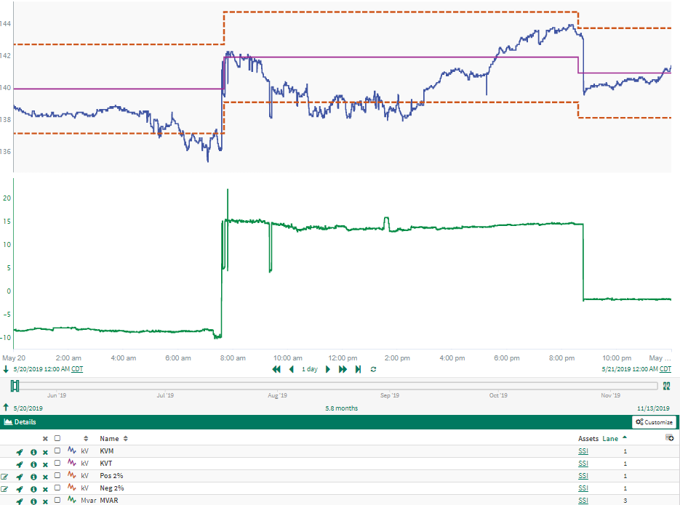
Example 1

Slide 19
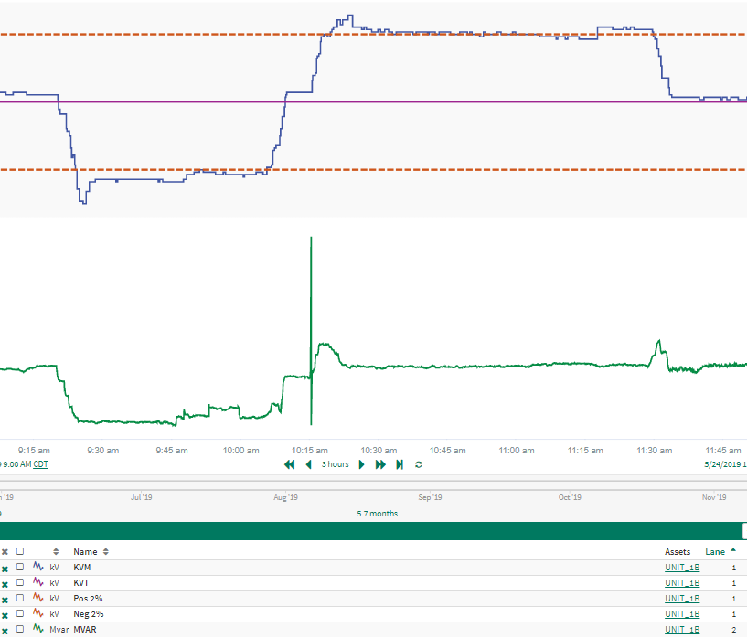
Example 2

Slide 20
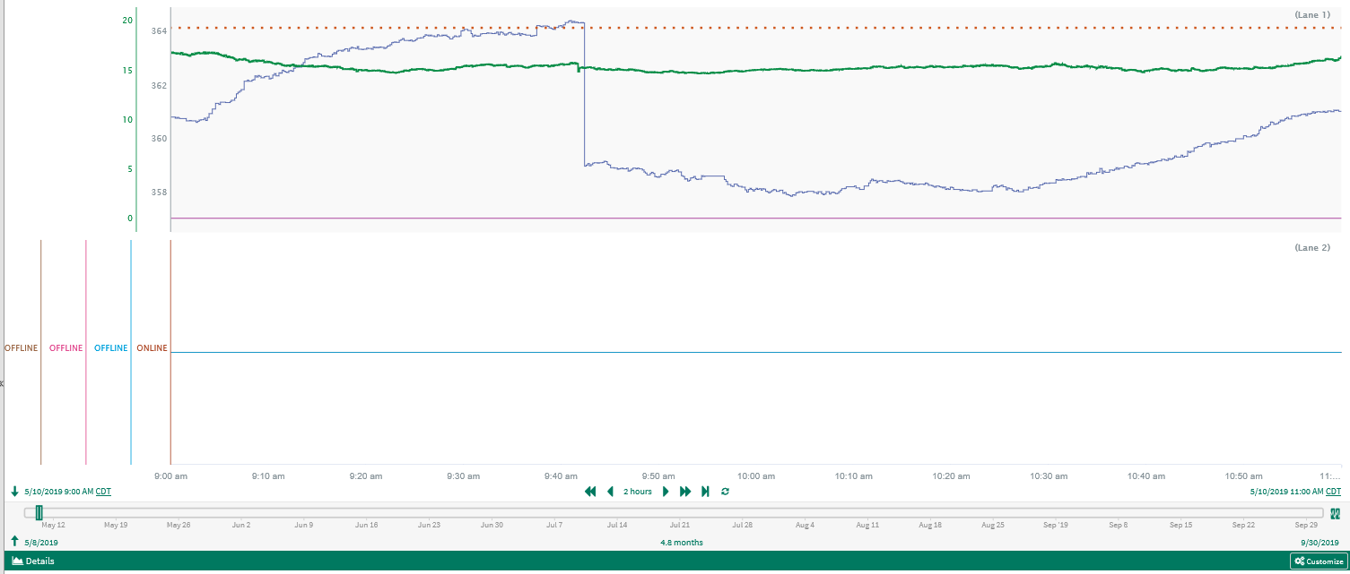
Example 3 - from presentation with Capacitor status

