Slide 1
Credit Exposure Update
Spoorthy Papudesi
Credit Work Group
ERCOT Public
January 15, 2020

Slide 2
Monthly Highlights Nov 2019- Dec 2019
Market-wide average TPE decreased from $ 569.9 million to $ 430.2 million
  TPE decreased mainly due to lower Real-Time and Day-Ahead Settlement Point Prices in December compared to November
Discretionary Collateral is defined as Secured Collateral in excess of TPE,CRR Locked ACL and DAM Exposure.
  Average Discretionary Collateral decreased from $ 1,272.5 million to $1,255.7 million
  The decrease in Discretionary Collateral is largely due to decrease in Secured Collateral and increase in CRR Locked ACL
Number of active Counter-Parties remained flat at 251
No unusual collateral call activity

Slide 3
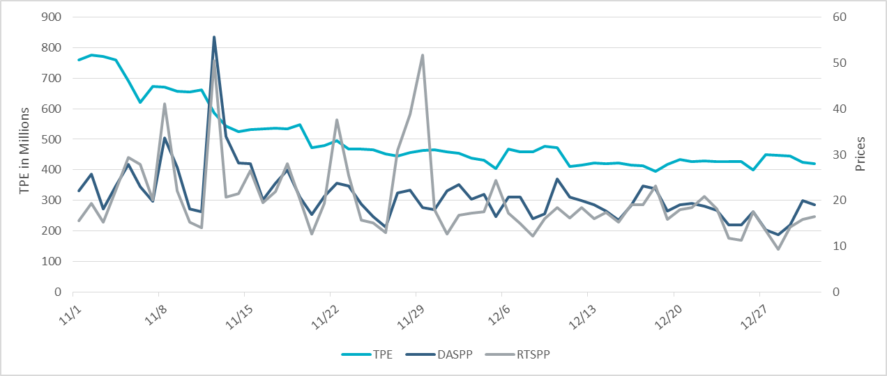
TPE/Real-Time & Day-Ahead Daily Average Settlement Point Prices for HB_NORTH
No 2019- Dec 2019

Slide 4
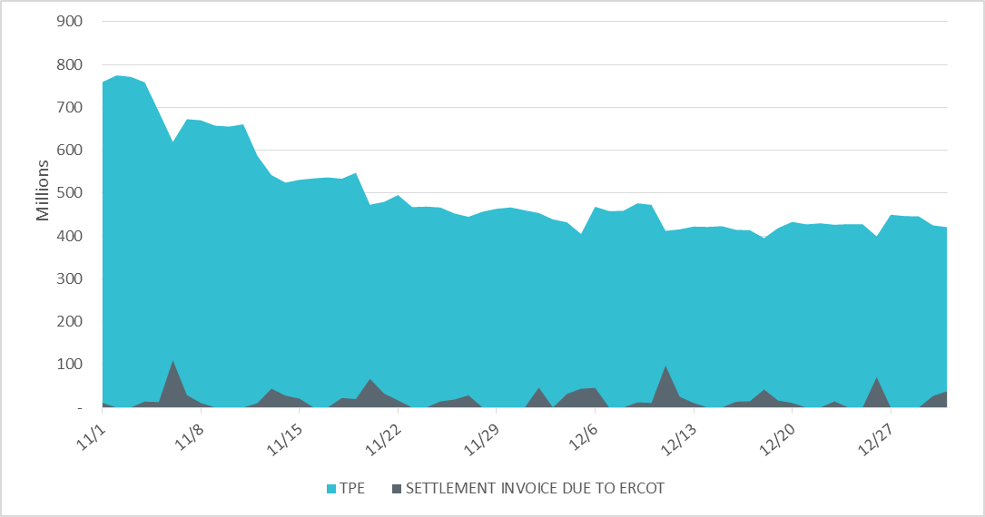
Settlement Invoice Charges/TPE Nov 2019- Dec 2019

Slide 5
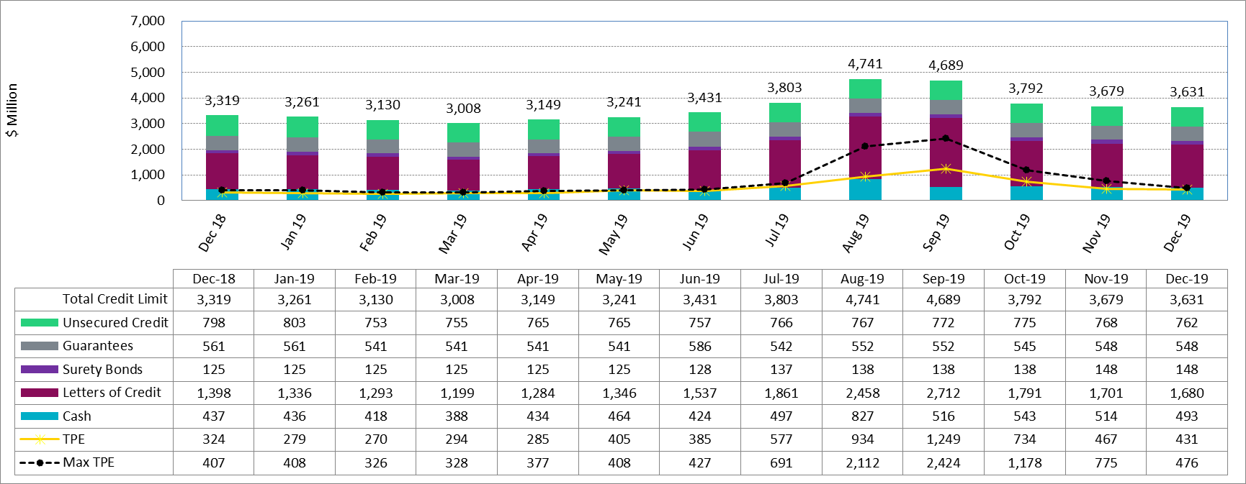
Available Credit by Type Compared to Total Potential Exposure (TPE)
*Numbers are as of month end except for Max TPE

Slide 6
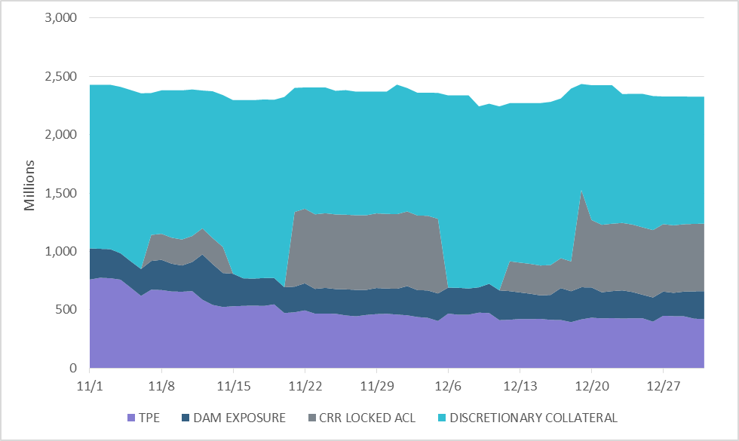
Discretionary Collateral Nov 2019- Dec 2019
At a Counter-Party level, no unusual changes were noted
Note: Discretionary collateral doesn’t include Unsecured Credit Limit or parent guarantees

Slide 7
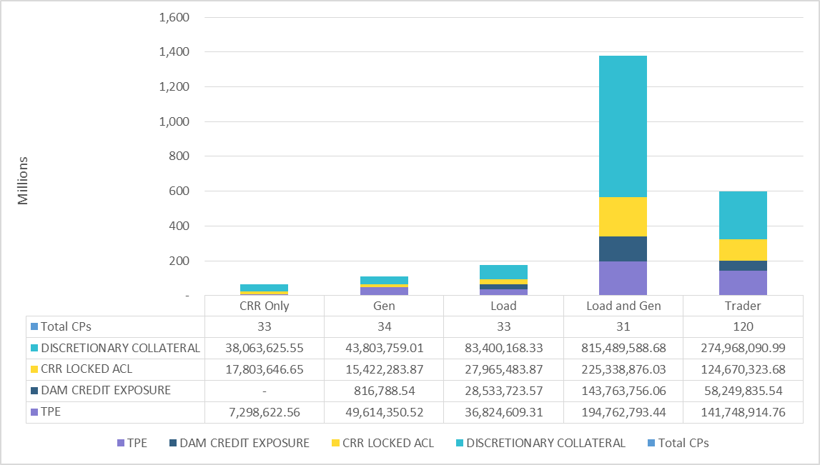
TPE and Discretionary Collateral by Market Segment- Dec 2019
Load and Generation entities accounted for the largest portion of discretionary collateral

Slide 8
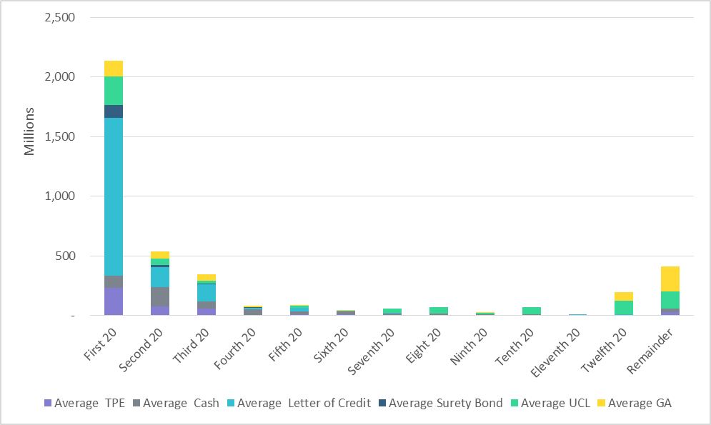
Secured Collateral and Unsecured Credit Limit (UCL) distribution/ TPE- Dec 2019
TPE in the last few buckets is mostly covered by Guarantees and UCL

Slide 9
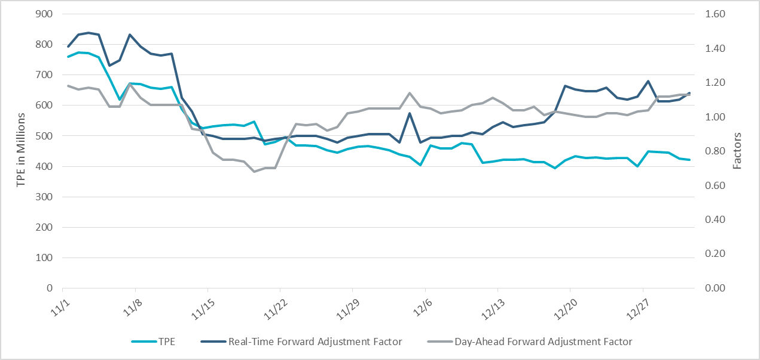
TPE and Forward Adjustment Factors Nov 2019- Dec 2019

Slide 10
Appendix

Slide 11
Summary of Distribution by Market Segment

Slide 12
Summary of Distribution by Rating Group

Slide 13
Distribution of TPE by Rating and Category

Slide 14
Distribution of Excess Collateral by Rating and Category
Note: Excess collateral doesn’t include Unsecured Credit Limit

Slide 15
Bottom Quintile Distribution of Excess Collateral by Rating and Category

Slide 16
Bottom Quintile Distribution of Average TPE by Rating and Category

Slide 17
Questions

