Slide 1
Analyzing Non-Activated Constraints and Their Potential Impact
ERCOT
Congestion Management Working Group
January 13th, 2019

Slide 2
Introduction
During Real-Time, Real-Time Contingency Analysis (RTCA) identifies base case and post-contingency overloaded elements and displays them in the Transmission Constraint Manager (TCM)
Base case constraints are activated (sent to SCED) as appropriate
Contingency constraints are only activated if the following conditions are met:
  Above Loading Threshold: loaded at 98% of Emergency Limit
  Shift Factors Available: there exists a Resource Shift Factor ≥ 2% (absolute value)
  Not Redundant: a similar constraint is not already activated
Constraints for which Constraint Management Plans (CMPs) have been created are activated (sent to SCED) as appropriate

Slide 3
Methodology
Using Congestion Reports between January 2016 and November 2019
Non-activated constraints were analyzed to determine 1) the reason why they were NOT activated and 2) to determine the potential impact of activating them
There were 4 main reasons constraints were not activated
  No Shift Factors ≥ 2%
  Similar constraint already activated (redundant)
  Remedial Action Scheme (RAS) available
  Other
    Short duration (one or two SCED intervals), loading < 98% of Emergency Limit
    Switching actions
    SCADA/model/contingency/data error
    PUN (excluded from analysis)
Approach: constraints that were not activated due to no shift factor were included as constraints that would be activated if the 2% rule were removed

Slide 4
Approximating Congestion Rent
For analysis, congestion rent for non-activated constraints was approximated using data available in Daily Real-Time Congestion Report - Exceeded Constraints Not Activated report found on MIS (link)
Example:
Contingency DBEFAI58 overloading 138 kV element 56T379_1 (rating: 269MW)
Hours constraint “potentially” activated based on GT 100%, GT 110%, and GT 125%
  These columns represent the # of 5-min intervals constraint appears in TCM loaded at levels greater than (inclusive) 100%, 110%, and 125%, respectively
  Inclusive: # of intervals GT 125% ALSO in GT 110% and GT 100%
Loading (MW) of constraint calculated by multiplying rating by “GT XXX%” bucket
  Line rated at 269MW loaded at 125%: Flow = 336.25
Mmm XX, YYYY
FST_RTCA | DST Flag | CONSTRAINT | FRST | TOST | GT 100% | GT 110% | GT 125% | TYPE | RAS | Worst Post Ctg MVA | Worst Post Ctg OL% | Rating
05:43:34 | s | DBEFAI58_55T207_1 | GILLES | WOLFCR | 4 | 2 |  | LN |  | 299 | 1.11 | 269
05:43:34 | s | DBEFAI58_56T379_1 | FREDER | GILLES | 74 | 27 | 14 | LN |  | 356 | 1.32 | 269
05:43:34 | s | DBEFAI58_72T120_1 | HOLLMI | KENDAL | 4 | 3 | 3 | LN |  | 402 | 1.35 | 297
05:43:34 | s | DBEFAI58_73T120_1 | FREDER | HOLLMI | 6 | 4 | 3 | LN |  | 373 | 1.39 | 269
 | GT 100% | GT 110% | GT 125%
# of 5-min Intervals (inclusive) | 74 | 27 | 14
# of 5-min Intervals* | 61 | 13 | 14
Hours | 5.08 | 1.08 | 1.17
Loading (MW) | 269 | 295.9 | 336.25
Congestion Rent | $4,785,958 | $1,121,954 | $1,373,021
Total Congestion Rent | $7,280,933
* Intervals in each bucket (GT 100%, …) adjusted so that they represent the intervals the constraint was loaded exclusively in that bucket

Slide 5
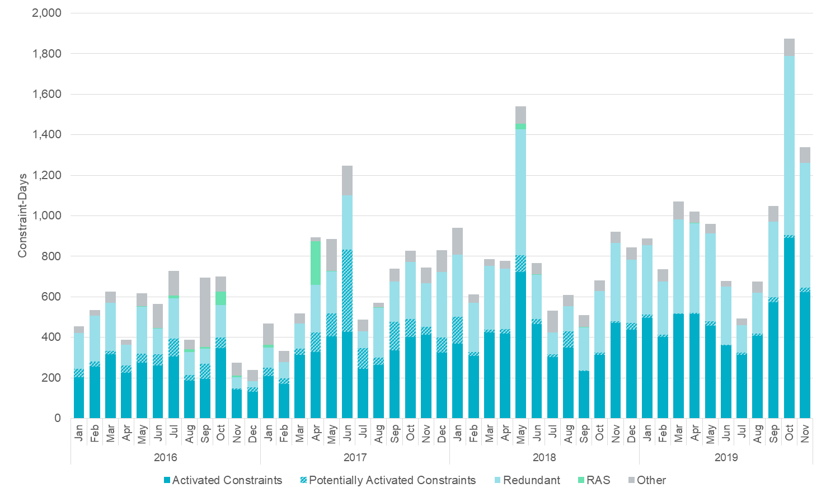
Increase in the Number of Constraints by Month
* Constraint-Days represents the # of days any given constraint was monitored in TCM
Constraints
Not Activated

Slide 6
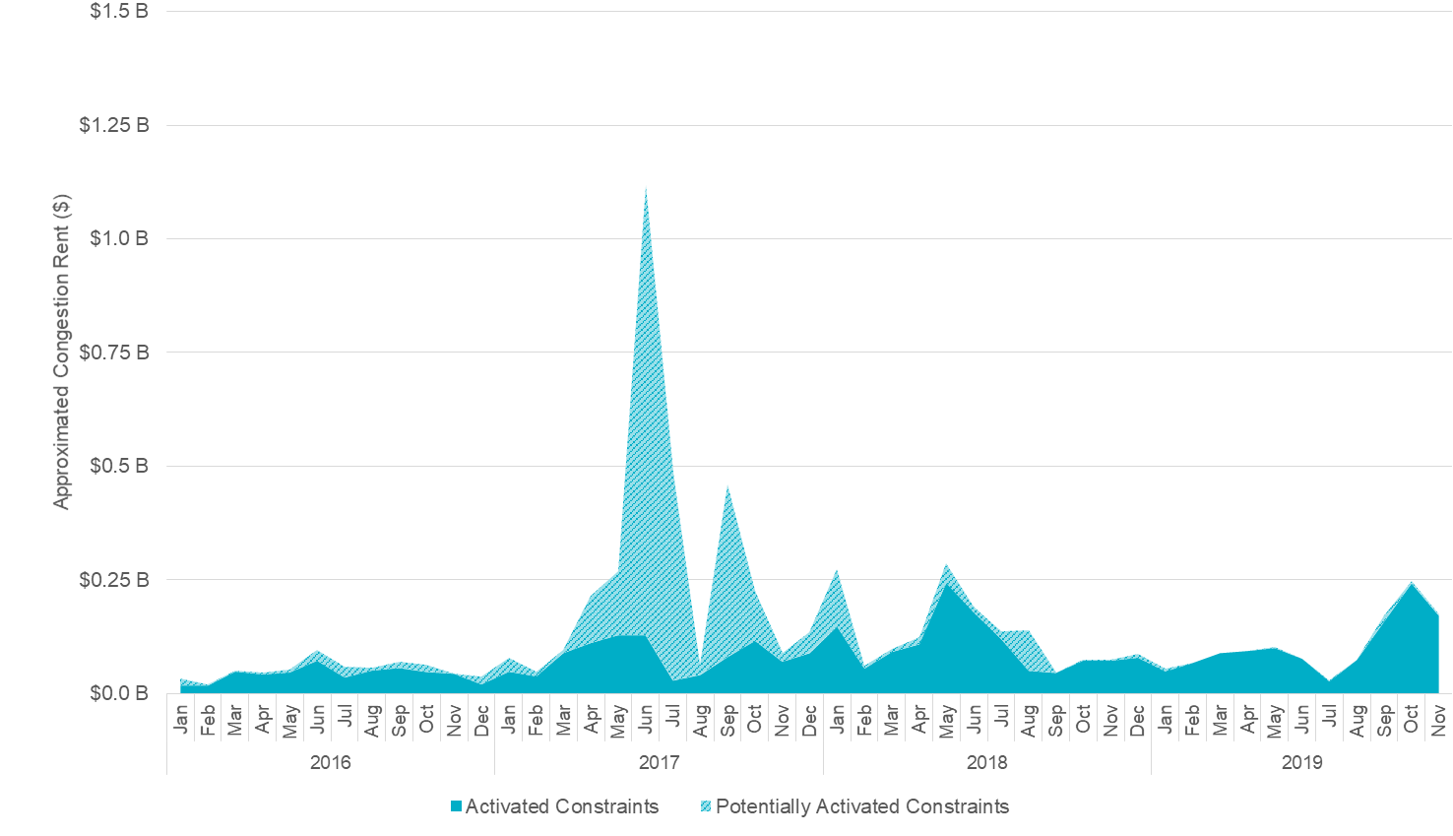
Approximated Congestion Rent from Potentially Activated Constraints Relative to Actual Congestion Rent

Slide 7
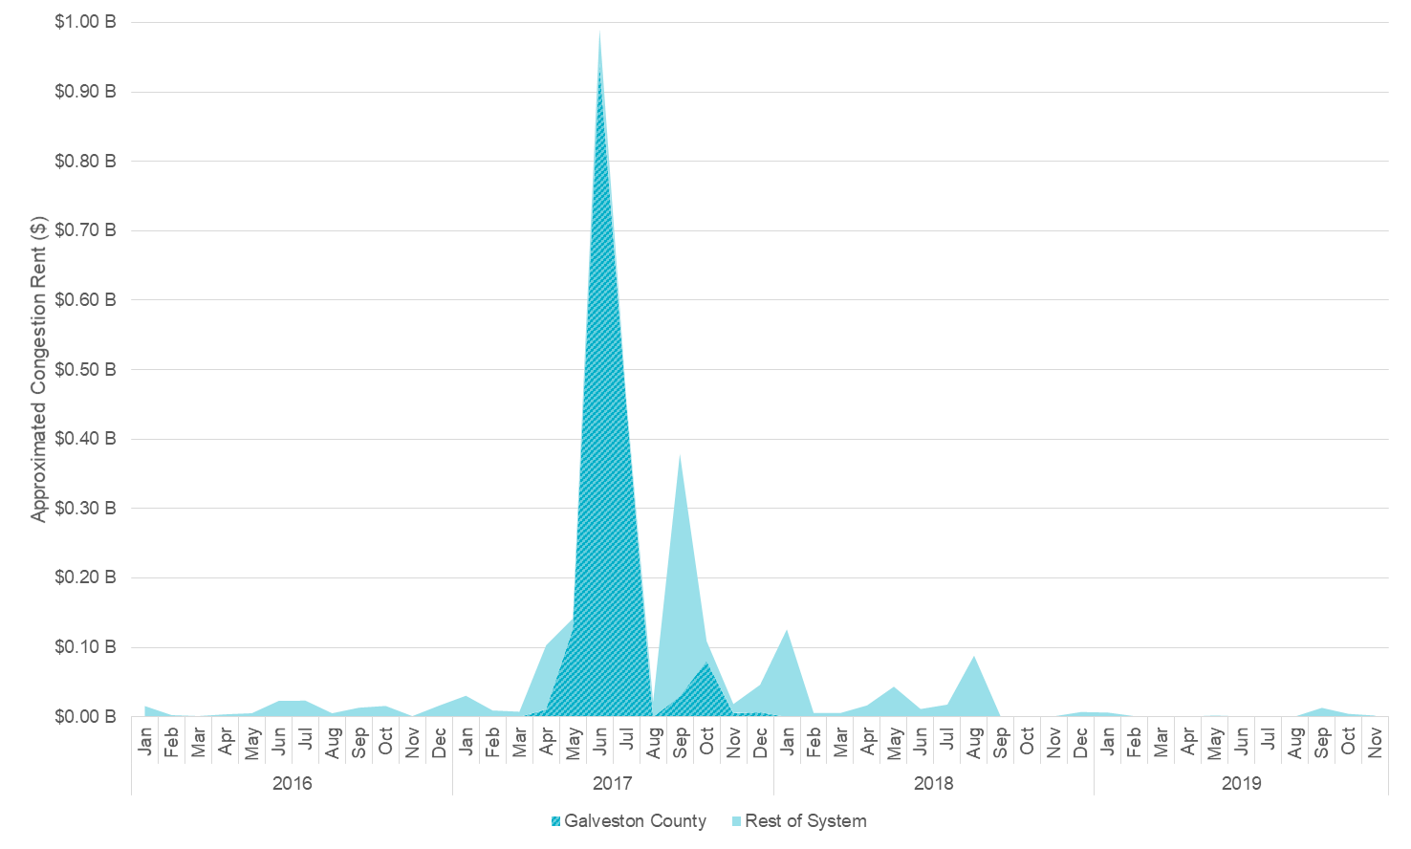
High Approximated Congestion Rent in Summer 2017
Majority additional Approximated Congestion Rent during Summer of 2017 is due to congestion in the Galveston area
Congestion in the Galveston area during this period accounts for 60% of total additional Approximated Congestion Rent between January 2016 and November 2019
34% of total additional Approximated Congestion Rent came from constraints in the Galveston area in June 2017
Congestion in the Galveston area was due primarily to planned 138kV outages in the area

Slide 8
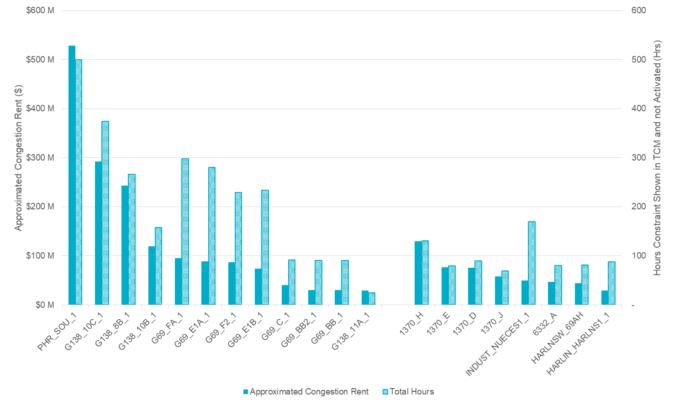
Top 20 Overload Elements (by Approx. Congestion Rent)
Overloaded elements ranked by approximated congestion rent accumulated between January 2016 and November 2019
Rest of System
Galveston County

Slide 9
Top 20 Overloaded Elements
Elements ranked by approximated congestion rent accumulated between January 2016 and November 2019
Element | Fr. Sub | To Sub. | Eqmt. | Rtg. (MW) | Approximated Cngstn. Rent ($) | Total Hours | Hrs GT 100% | Hrs GT 110% | Hrs GT 125% | Unique Ctg.'s | kV Level | Max Shdw Price ($/MWh) | Weather Zone | County
PHR_SOU_1 | SOUSHORE | PHR | LN | 287 | $ 528,572,085 | 500 | 284 | 186 | 31 | 3 | 138 | 3,500 | Coast | Galveston
G138_10C_1 | SEMINOLE | FRDSWOOD | LN | 210 | $ 291,886,875 | 375 | 204 | 135 | 36 | 7 | 138 | 3,500 | Coast | Galveston
G138_8B_1 | SOUSHORE | LEAGCITY | LN | 256 | $ 243,125,648 | 266 | 174 | 90 | 3 | 5 | 138 | 3,500 | Coast | Galveston
1370_H | LFKSW | LFKTP | LN | 277 | $ 129,238,142 | 131 | 82 | 49 | - | 2 | 138 | 3,500 | East | Angelina
G138_10B_1 | MAGNO_TN | SEMINOLE | LN | 210 | $ 119,382,375 | 158 | 113 | 45 | - | 5 | 138 | 3,500 | Coast | Galveston
G69_FA_1 | HEIGHTTN | CHOCTAP | LN | 108 | $ 94,558,683 | 298 | 202 | 83 | 14 | 3 | 69 | 2,800 | Coast | Galveston
G69_E1A_1 | HEIGHTTN | NTHSDTAP | LN | 108 | $ 88,764,748 | 280 | 188 | 85 | 8 | 3 | 69 | 2,800 | Coast | Galveston
G69_F2_1 | CHOCTAP | CHOCTAW | LN | 129 | $ 86,762,095 | 229 | 146 | 74 | 9 | 3 | 69 | 2,800 | Coast | Galveston
1370_E | LFKTP | HUDSN | LN | 271 | $ 76,631,333 | 79 | 65 | 14 | - | 2 | 138 | 3,500 | East | Angelina
1370_D | LFSTW | LFPTP | LN | 232 | $ 75,165,533 | 90 | 69 | 21 | - | 2 | 138 | 3,500 | East | Angelina
G69_E1B_1 | TXCITYMN | NTHSDTAP | LN | 108 | $ 73,935,108 | 234 | 154 | 78 | 2 | 3 | 69 | 2,800 | Coast | Galveston
1370_J | LFPTP | LFSTH | LN | 232 | $ 57,600,317 | 69 | 54 | 15 | - | 2 | 138 | 3,500 | East | Angelina
INDUST_NUECES1_1 | INDUSTRI | NUECES_B | LN | 103 | $ 49,482,230 | 169 | 147 | 22 | - | 2 | 69 | 2,800 | Southern | Nueces
6332_A | YUCSW | GASPAD | LN | 151 | $ 46,642,954 | 80 | 65 | 15 | - | 12 | 138 | 3,500 | Far West | Ward/Reeves
HARLNSW_69AH | HARLNSW | HARLNSW | XF | 143 | $ 43,389,179 | 81 | 37 | 38 | 6 | 2 | 138 | 3,500 | Southern | Cameron
G69_C_1 | AMOCOTN | TERMINAL | LN | 143 | $ 39,789,750 | 92 | 15 | 76 | 1 | 2 | 69 | 2,800 | Coast | Galveston
G69_BB2_1 | MARTHNOL | CHOCTAW | LN | 109 | $ 29,779,890 | 91 | 22 | 69 | - | 2 | 69 | 2,800 | Coast | Galveston
G69_BB_1 | TERMINAL | MARTHNOL | LN | 109 | $ 29,713,763 | 91 | 22 | 69 | - | 2 | 69 | 2,800 | Coast | Galveston
G138_11A_1 | FRDSWOOD | HASTINGS | LN | 336 | $ 29,204,000 | 25 | 25 | - | - | 1 | 138 | 3,500 | Coast | Galveston/Brazoria
HARLIN_HARLNS1_1 | HARLIN_1 | HARLNSW | LN | 106 | $ 28,522,480 | 88 | 24 | 55 | 9 | 2 | 69 | 2,800 | Southern | Cameron

Slide 10
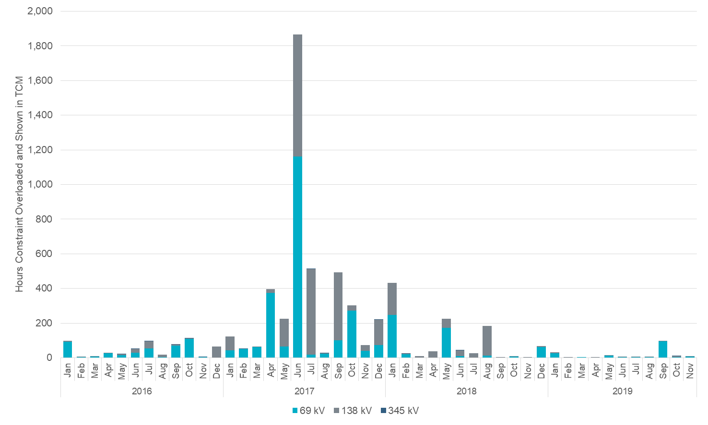
Hours by Voltage Level
Voltage Level (kV) | Max Shadow Price ($/MWh)
69 | 2,800
138 | 3,500
345 | 4,500
Base Case Max Shadow Price for all Voltage Levels | 5,000 (before June 2018) 9,251 (after June 2018)

Slide 11
Questions?
Thank you!!

