Slide 1
Pick-up Shift Factor Calculation with Generation Ramping-back RAS
Market Analysis and Validation
CMWG
Jan 13th, 2020

Slide 2
Mitchell Bend RAS
The RAS is installed to manage the potential loading conditions on the Mitchell Bend – Rocky Creek 345 kV line or the Mitchell Bend – DeCordova 345 kV line, by automatically reducing generation at Wolf Hollow II (WHCCS2) if the flow on these lines exceeds their emergency rating.
The RAS actions are defined as opening the breakers to disconnect CT5 and STG6, and ramping back the generation on CT4 to certain pre-set level.
Congestions have been observed in RTM with RAS actions triggered under post-contingency conditions.

Slide 3
Pick-up shift factor calculation for the resources disconnected in contingency
When a generating resource is disconnected in the post-contingency condition, instead of getting “0” shift factor, a pseudo shift factor will be calculated for that resource, using the “pick up effect” calculation.
When generation loss occurs in the contingency, other generators will have to pick up the lost generation. So the generation amount carried by the contingency-disconnected resource can have some impact on the post-contingency constraint.

Slide 4
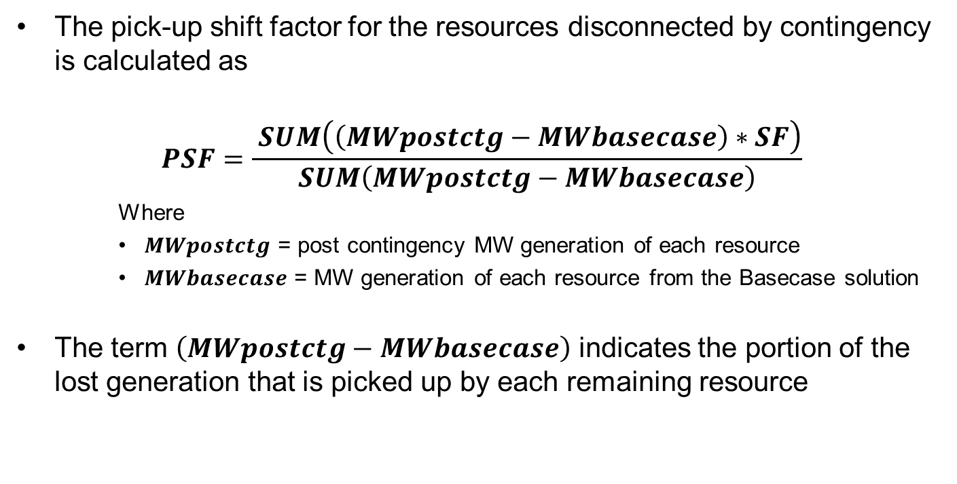
Pick-up shift factor calculation for the resources disconnected in contingency
The pick-up shift factor for the resources disconnected by contingency is calculated as
$$PSF=\frac{ SUM\left(\left(MWpostctg−MWbasecase\right)∗SF\right)}{SUM\left(MWpostctg−MWbasecase\right)}$$
    Where
    $MWpostctg$ = post contingency MW generation of each resource
    $MWbasecase$ = MW generation of each resource from the Basecase solution
The term $\left(MWpostctg−MWbasecase\right)$ indicates the portion of the lost generation that is picked up by each remaining resource

Slide 5
Pick-up shift factor calculation with Mitchell Bend RAS
The contingency itself does not open any resources. However, with RAS actions triggered in the post-contingency condition, CT5 and STG6 will be disconnected and CT4 will be ramped back. So pick-up shift factors will be calculated for CT5 and STG6.
With the existing pick-up shift factor calculation, the “Ramping Back” action on CT4 causes extra impact in pick-up shift factor calculation:
  The lost generation due to the ramping back action must also be picked up by other resources
  As CT4 is still on-line, it is also considered as one of “other resources” in the calculation

Slide 6
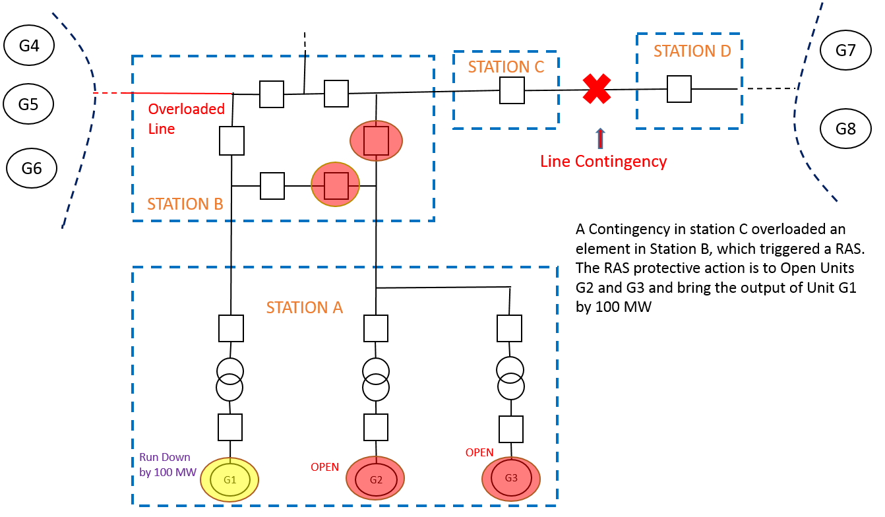
Example: Contingency with generation ramping-back RAS
UNIT | BC_MW | CTG_MW | WMX | SF
G1 | 200 | 100.00 | 300 | 0.5
G2 | 50 | 0.00 | 100 | PSF
G3 | 50 | 0.00 | 100 | PSF
G4 | 60 | 105.07 | 160 | -0.2
G5 | 50 | 78.17 | 100 | -0.2
G6 | 10 | 38.17 | 100 | -0.1
G7 | 150 | 206.34 | 200 | 0.2
G8 | 15 | 57.25 | 150 | 0.1
BC_MW = Basecase MW
CTG_MW = Post CTG MW
WMX = Max MW
SF = Shift Factor
PSF = Pick up Shift Factor

Slide 7
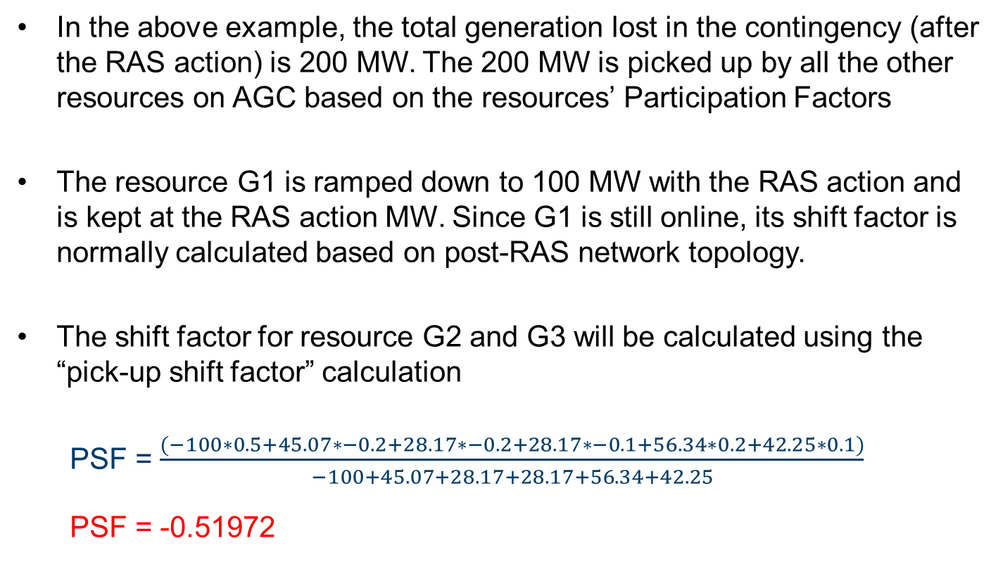
Example: Pick-up shift factor calculation in current EMS
In the above example, the total generation lost in the contingency (after the RAS action) is 200 MW. The 200 MW is picked up by all the other resources on AGC based on the resources’ Participation Factors
The resource G1 is ramped down to 100 MW with the RAS action and is kept at the RAS action MW. Since G1 is still online, its shift factor is normally calculated based on post-RAS network topology.
The shift factor for resource G2 and G3 will be calculated using the “pick-up shift factor” calculation
  PSF = $\frac{(−100∗0.5+45.07∗−0.2+28.17∗−0.2+28.17∗−0.1+56.34∗0.2+42.25∗0.1)}{−100+45.07+28.17+28.17+56.34+42.25}$
  PSF = -0.51972

Slide 8
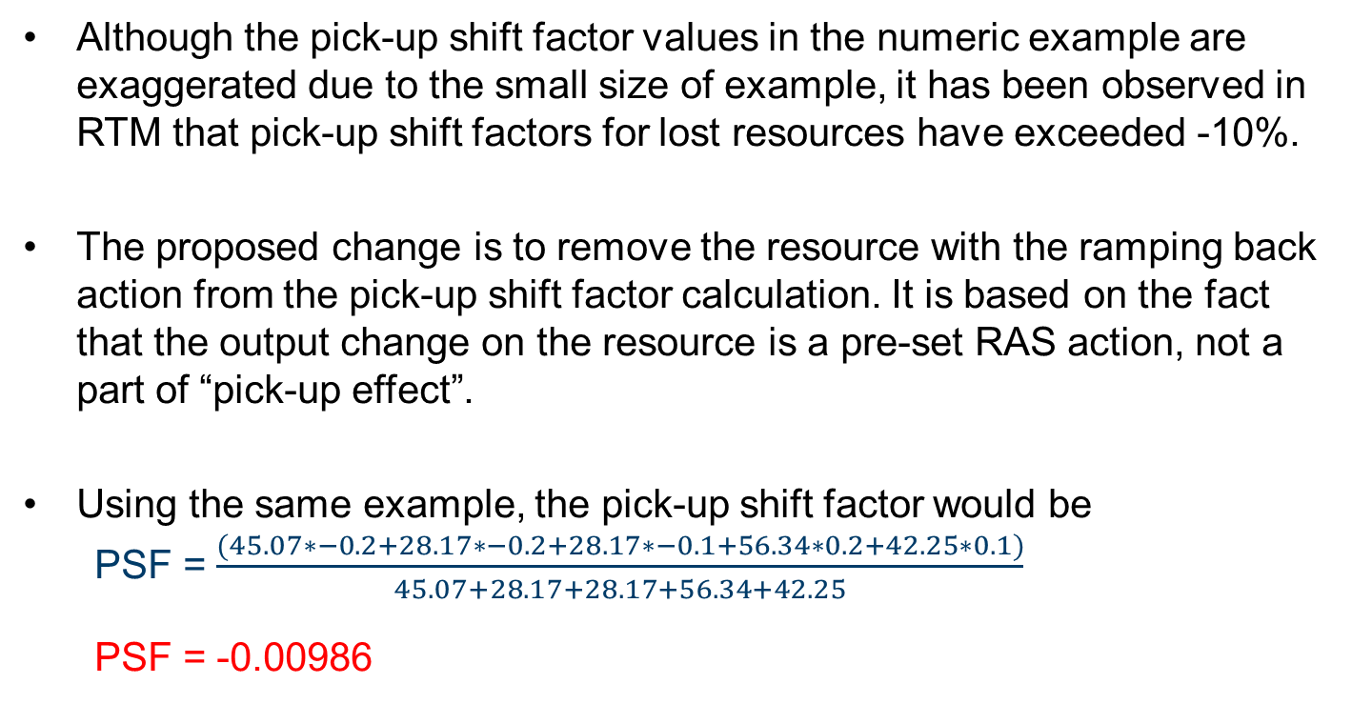
Proposed change to the pick-up shift factor calculation
Although the pick-up shift factor values in the numeric example are exaggerated due to the small size of example, it has been observed in RTM that pick-up shift factors for lost resources have exceeded -10%.
The proposed change is to remove the resource with the ramping back action from the pick-up shift factor calculation. It is based on the fact that the output change on the resource is a pre-set RAS action, not a part of “pick-up effect”.
Using the same example, the pick-up shift factor would be
  PSF = $\frac{(45.07∗−0.2+28.17∗−0.2+28.17∗−0.1+56.34∗0.2+42.25∗0.1)}{45.07+28.17+28.17+56.34+42.25}$
  PSF = -0.00986

Slide 9
Impact of the proposed change
The proposed change reflects the fact that MW output change on the resource with ramping back action is not part of “pick-up” effect, and should be excluded from pick-up shift factor calculation. And the new calculated pick-up shift factor can better represent the impact on the post-RAS flow when new base points are dispatched on the contingency-disconnected resources.
The proposed change will only impact the pick-up shift factor calculation on the contingency-disconnected resources, when generation ramping back action is triggered in EMS post-contingency analysis.

Slide 10
Impact of the proposed change
The pick-up shift factors are also used to calculate the RT settlement point prices of the physical resource nodes, when both resource nodes and resources are disconnected by the contingency and/or RAS action.
In this case, CT4, CT5 and STG6 are part of the combined cycle. The shift factors of a combined cycle are calculated based on the shift factors of individual physical resources. So the change will also indirectly impact the dispatch and price of the combined cycle.
ERCOT internal EMS development team can work on this change and implement it in next available EMS software release.

