Slide 1
Supply Analysis Working Group Report to WMS
January 8, 2020

Slide 2
SAWG Open Action Items from WMS
TAC Assignment: Review Methodology used to determine Peaker Net Margin (PNM)
Language needs to be changed to “Review Methodology used to determine CONE”
Status: in progress; update later in report
Review impacts on CDR from monthly generation interconnection report
Status: Start discussions in 2020 meetings
Review of Resource Adequacy forecasts and development of a Net Load forecast
Status: Have begun various discussions at SAWG; update later in report

Slide 3
SAWG December Meeting – ERCOT Load Forecast
ERCOT presented a detailed Long-term Forecast
http://www.ercot.com/calendar/2019/12/13/172748-SAWG
Of Note:
Used in the most recent CDR but not the most recent SARA
See slides 42-56 for Peak Forecast; lower peak seen driven by lower peak forecasts in the Coastal and South regions
See slides 60-62 for Load Forecast Adjustments
Lubbock added to North Forecast from 2021 on, based on Lubbock’s Peak Forecast of its growth (~470 MW)
Rayburn added to East Forecast from 2020 on, based on Rayburn’s Actual Seasonal Peaks from 2019 (~120 MW Summer; ~190 WM Winter)
Adjustments for Large Industrial facilities:
Coast, 425-650 MW phased in over time
South, 75-93 MW phased in over time
Far West, 400 MW

Slide 4
SAWG December Meeting – December CDR Report
CDR released on December 5th
Planning reserve margin for Summer 2020 is forecasted to be 10.6%, 2% higher than Summer 2019
Of Note:
Increase attributed to:
About 1% increase to reserve margin due to wind capacity calculation changes from NPRR 958, which changed the wind and solar capacity calculations and NPRR 959, which created the panhandle region for wind capacity calculations
Additional installations of Wind, Solar and small natural gas
Load forecast decline based on previously mentioned Long-Term Load Forecast
Remaining questions to Pete Warnken Pete.Warnken@ercot.com

Slide 5
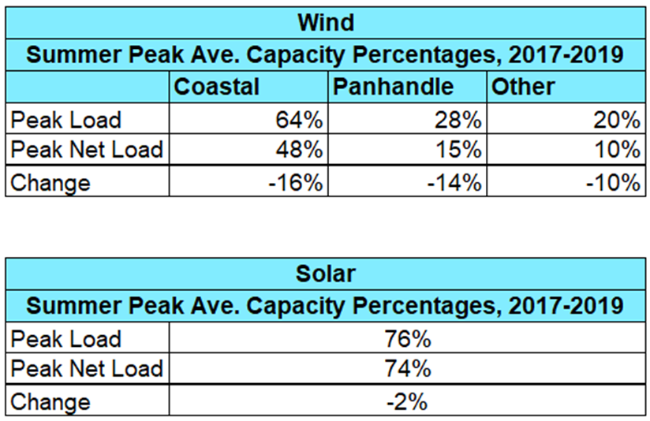
SAWG December Meeting – Comparative Analysis of Peak Average Capacity Contributions based on Net Load Hours
ERCOT presented an update on IRR Contribution Comparisons and the difference in Peak Load versus Peak Net Load for both Summer and Winter Peaks
Summer 2017-2019

Slide 6
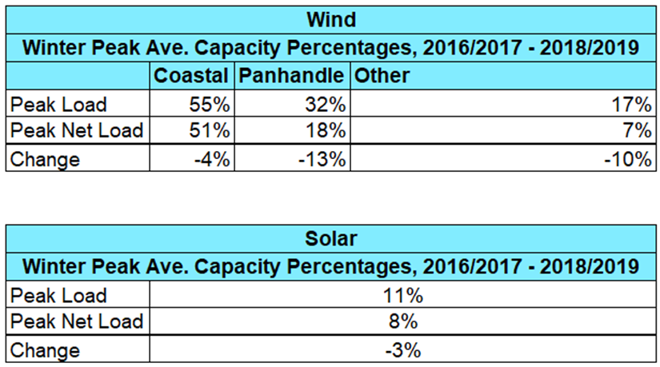
SAWG December Meeting – Comparative Analysis of Peak Average Capacity Contributions based on Net Load Hours
ERCOT presented an update on IRR Contribution Comparisons and the difference in Peak Load versus Peak Net Load for both Summer and Winter Peaks
Winter 2016/2017 – 2018/2019

Slide 7
SAWG December Meeting – Discussions on Development of a Net Load Forecast
SAWG discussed a probabilistic modeling approach for assessing hourly operating reserve shortage risks
ERCOT currently provides similar information in an aggregated monthly forma for NERC
SAWG will continue to discuss building a report to understand correlations related to risk of reserved shortages to increase renewables through different variables

Slide 8
CONE Study Methodology Write-up – Request for Feedback
ERCOT presented language for a “CONE Study Methodology Draft” to be part of the “ERCOT Study Process and Methodology Manual for EORM MERM http://www.ercot.com/calendar/2019/12/13/172748-SAWG
Background:
ERCOT previously presented a timeline for the study to be done in coordination with every other LTSA (= every 4 years) and to feed into the Reserve Margin Study
Requesting comments on this Draft and a possible NPRR for a week ahead of February SAWG – due February 20th

Slide 9
Next Meetings
January 24, 2020
February 27, 2020

