Slide 1
SMT 2.0 Implementation Review
RMS – 01/07/2020
Presented by: Bobby Roberts, TNMP
Esther Kent, CenterPoint

Slide 2
Topics
Implementation Review
Performance Reports
Integration Requirements for IT Vendors
Focus for 2020

Slide 3
Implementation Review

Slide 4
Implementation Review
SMT 2.0 went live on Dec 10, 2019 as planned.
No Severity 1 issues were reported and only minor non-functional defects have been found, which will be address in the Jan 18, 2020 maintenance window.
Hyper-Care period will end on Jan 13, 2020 as previously communicated.
Market Participants have been actively engaged and continuing to utilize existing as well as new SMT 2.0 functionalities.

Slide 5
Implementation Review – Integration Snapshot
As Of 01/01/2020
Participants | Category
28 | REPs that are directly integrated to FTPS
81 | REPs that are integrated to FTPS via an external IT Vendor
5 | REP that is directly integrated to API (others in process)
2 | REPs that are integrated to API via an external IT vendor
10 | CSPs that are directly integrated to FTPS
6 | CSPs that are directly integrated to API (others in process)
9 | Open tickets for Residential FTPS/API integration
119 | Total Market Participants integrated * This is not a summation of the above as many REPs/CSPs are duplicated.

Slide 6
Implementation Review – Activity Summary
Activity from 12/10/2019 to 01/01/2020
Utilization | Feature
1,111 | New Residential and Business User Accounts
27 | New REP/CSP User Accounts
10 | New entities established (7 CSPs and 3 REPs)
2,139 | Data Sharing Agreements Created
19,050 | Ad-Hoc Reports Generated:
10,142 | Total ODRs Requested:
276 | Total Subscriptions Created:
Residential | Business | REP | CSP | TDSP
4,690 | 734 | 1,085 | 12,340 | 201
Residential | Business | REP | CSP | TDSP
9,906 | 191 | 20 | 3 | 22
Residential | Business | REP | CSP
265 | 4 | 1 | 6

Slide 7
Implementation Review – Early User Feedback
“Thanks for the new look. I really like the simple interface, and the new API data consumption feature, this will be really useful in tracking my energy usage.”
- PR in Plano
“Good job on your new Smart Meter website! It now displays additional info all on the same page that I use to have to do several mouse clicks to get.”
- SL in Pearland
“LOVE your new website. Very fast, lots of usable tracking data. Good job!”
- DD in Houston
“Wow, this was quite an upgrade. Well done!”
- CB in Fort Worth
“I like the new website. I especially like the way the "Get Current Meter Read" automatically updates the reading instead of the old website that required me to click a small "here" button target to change it from updating to read. I have not tried the new website on my mobile phone yet. Please do not limit the "Get Current Meter Reading" to only once/hr like it was the last month on the old website. I use it often to see amount of current load my appliances are using.”
- SW in Mansfield
“OK I've used Smart Meter Texas for several years now and it been good to get my usage data when I needed it and use it in my tracking/charting spreadsheet. But it's been a few months and this is the first time I've logged in to get my data usage and experienced the new website/application. In short this is a great update. The data is there and retrieval is fast and easy. Great job on the update!!!”
- GD in Corinth
“New website is fantastic...You just don't need anything else that is not here readily at hand... GOOD JOB!!!”
- SG in Millersview

Slide 8
Performance Reports

Slide 9
Performance Reports – Overview
Reports that were previously distributed via the RMS ListServ, will no longer be distributed.
Typically came from Esther Kent, CenterPoint Energy.
Final distribution was on Thursday, 12/19/2019
For SMT 2.0, all reporting available in accordance with Docket No. 47472, will be posted to an unauthenticated page on www.smartmetertexas.com.
Reporting Requirement Summary:
All info will be consolidated into a single Excel file and published within 15 calendar days after each month-end.
Timing | Category | # Reqs.
Monthly | Activity (Specific) | 3
Monthly | Performance (General) | 15
Annually | Cost (Budget) | 2

Slide 10
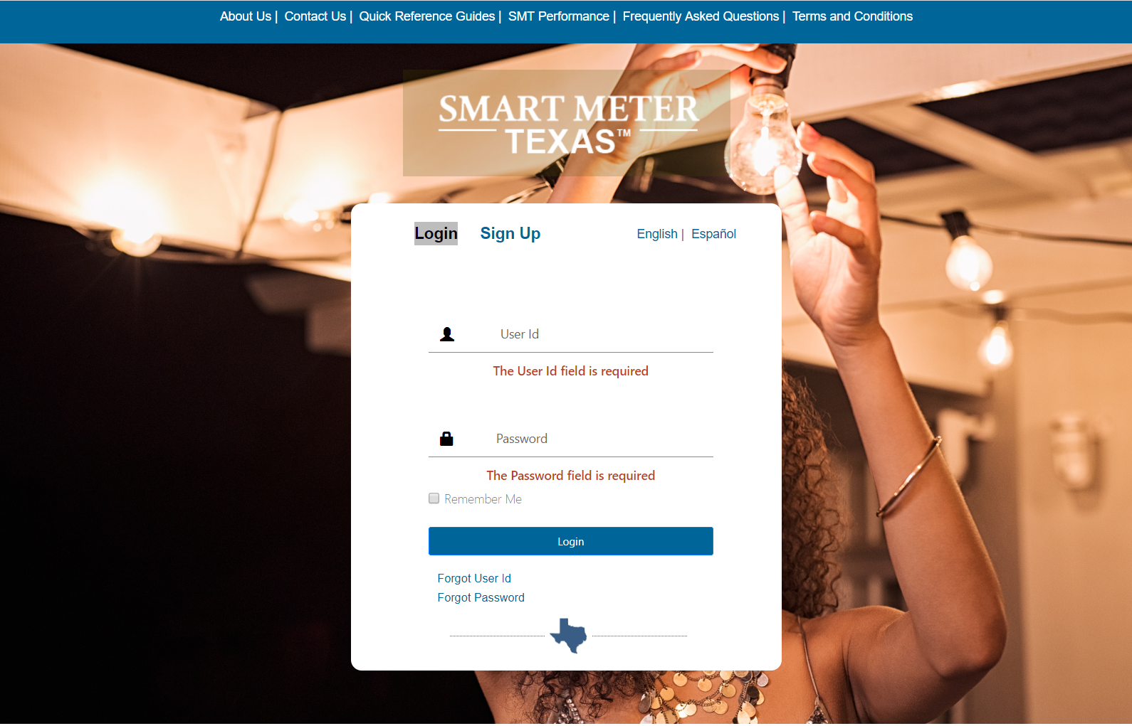
Performance Reports – Accessing (1/2)
The “SMT Performance” page is only available from the unauthenticated Home Page.

Slide 11
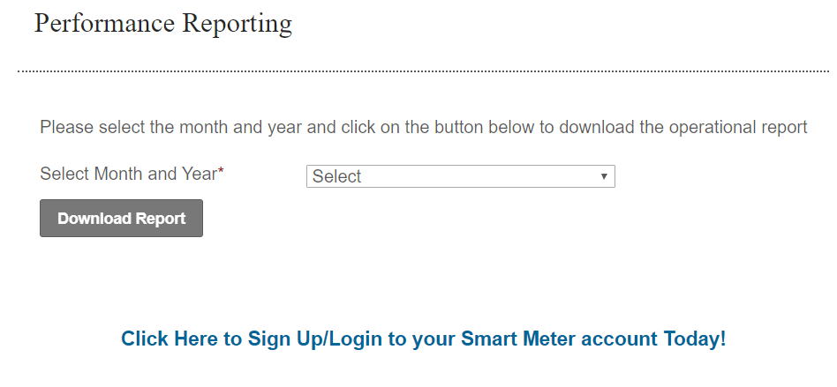
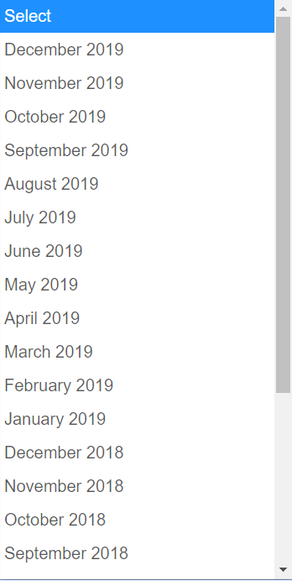
Performance Reports – Accessing (2/2)
Two years of reports will be available in accordance with the SMT data retention requirement.

Slide 12
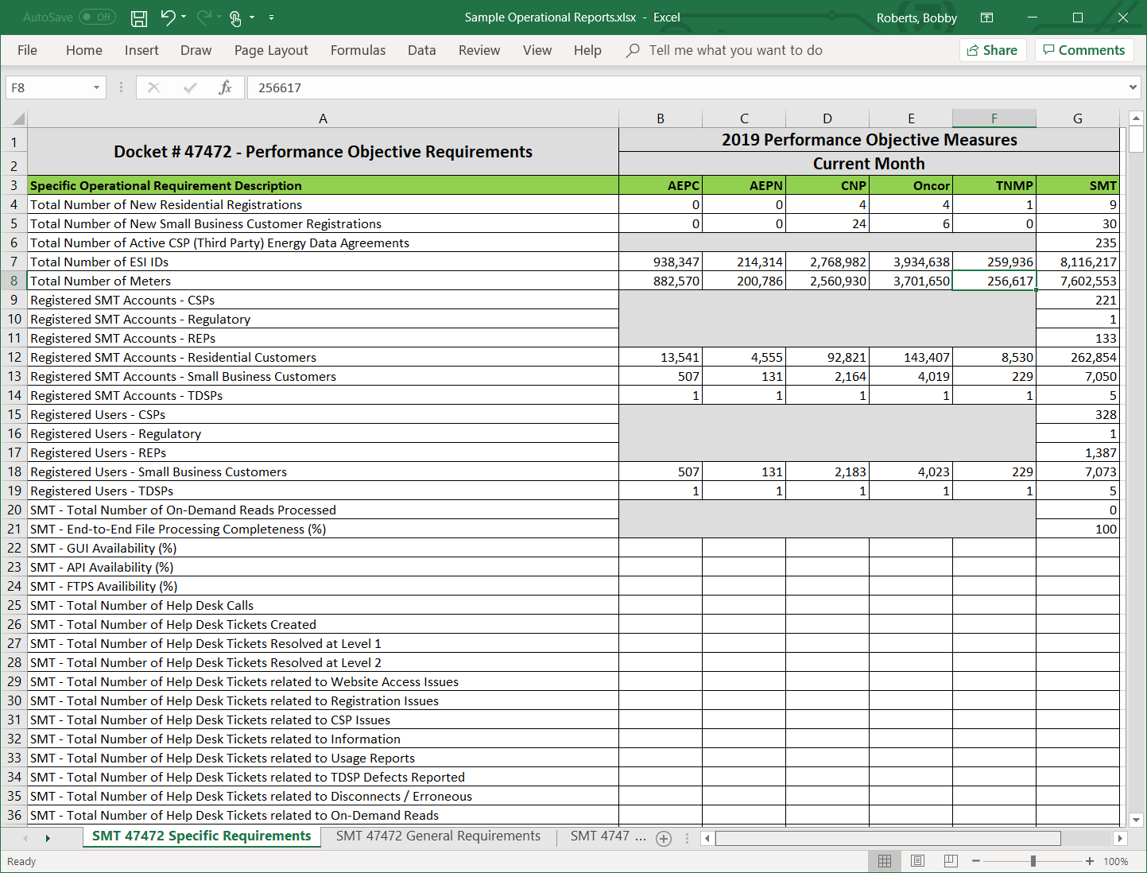
Performance Reports – Example: Activity (1/2)

Slide 13
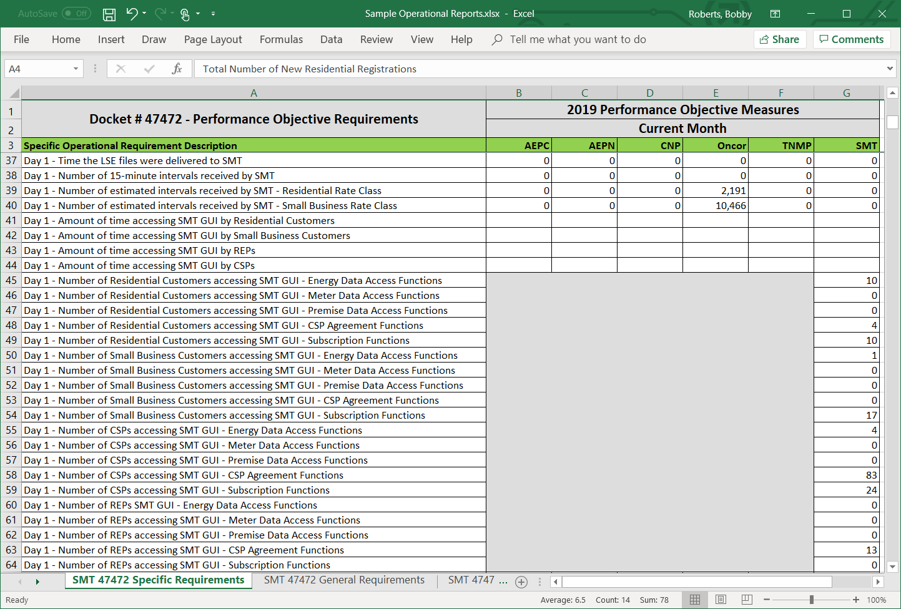
Performance Reports – Example: Activity (2/2)
This section is repeated for each day of the Reporting Month.

Slide 14
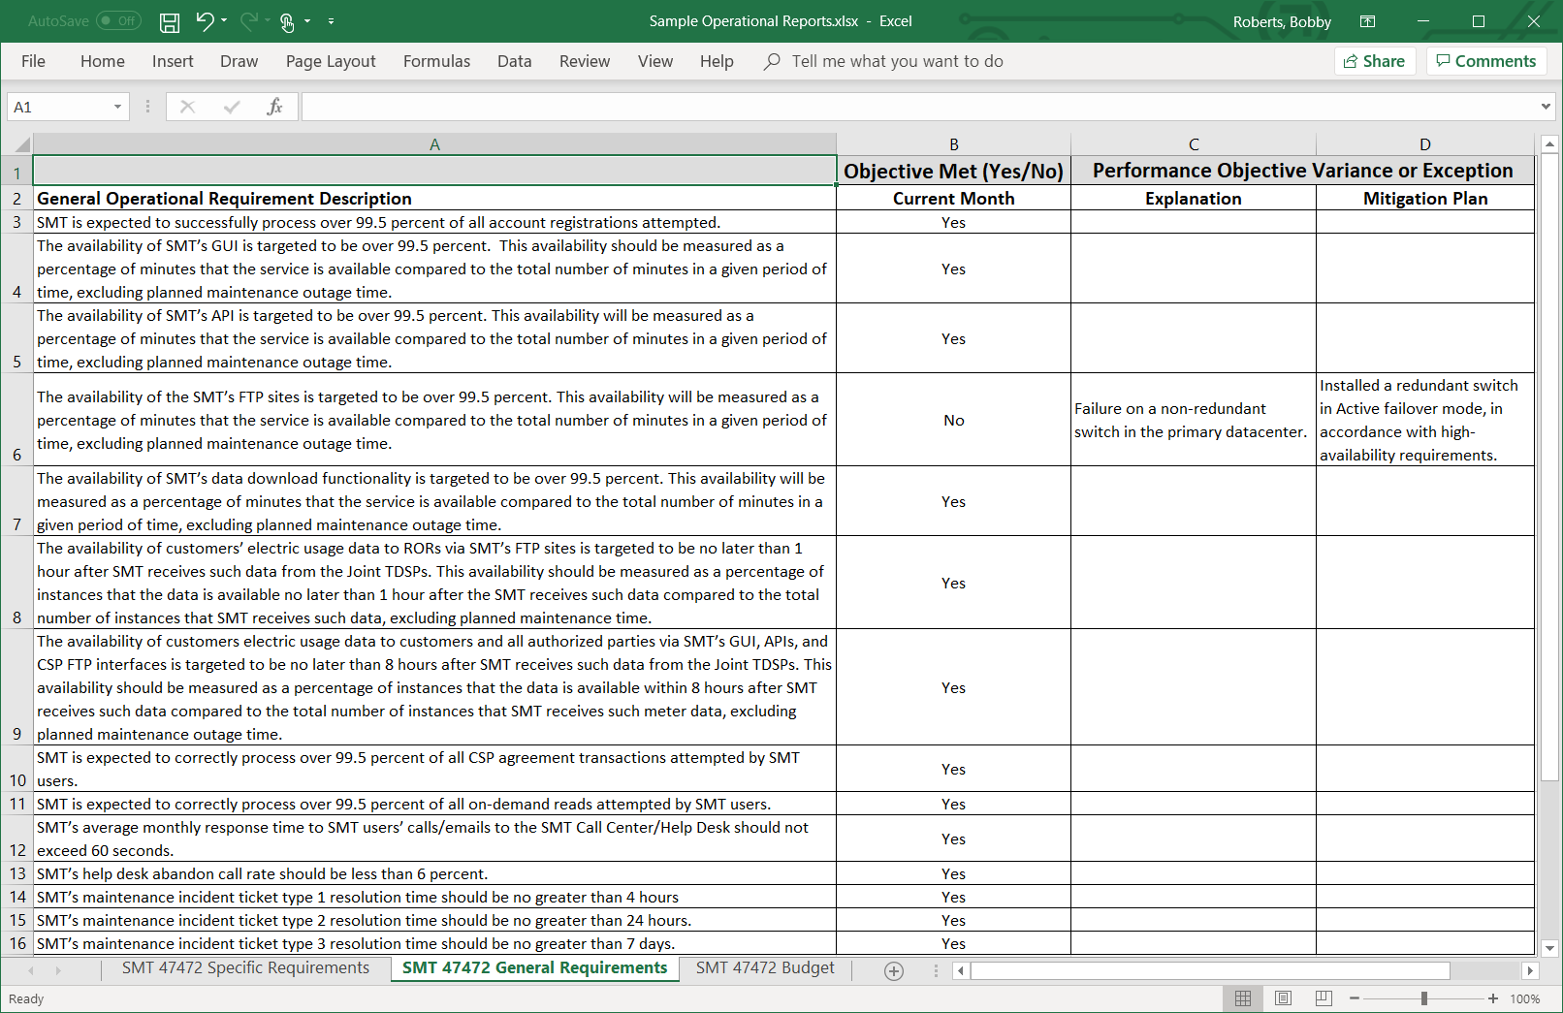
Performance Reports – Example: Performance

Slide 15
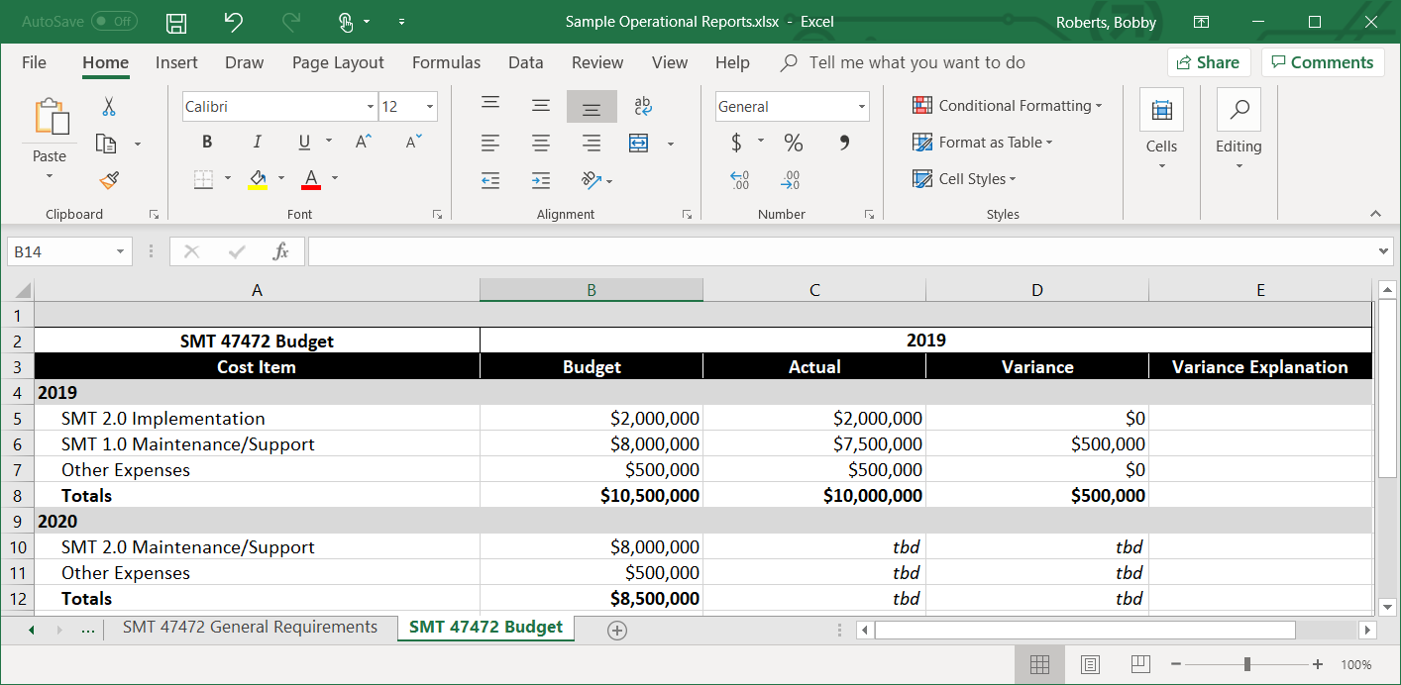
Performance Reports – Example: Cost
The Budget tab of the reports package is still under review/development, however the final version will comply with Requirements 71 & 72 as approved in Docket No. 47472

Slide 16
Performance Reports – Wrap-Up
The published report package may look slightly different than the examples presented in this deck and may change over time, as ongoing automation efforts may necessitate minor adjustments.
The 1st report package will be available on/before Feb 15, 2020.
Reports will no longer be distributed via the RMS ListServ.
A rolling two years of report packages will be available for download.
Tracking/trending of any relevant metrics will be at each user’s discretion.

Slide 17
Integration Requirements for IT Vendors

Slide 18
Integration Requirements for IT Vendors
In the SMT 2.0 model, IT Vendors will need a User Account established under each REP/CSP they support.
SMT is hosting a walkthrough of 2.0 integration requirements for REPs/CSPs that use external IT Vendors on January 27, 2020 @ 1:00 PM.
Please make sure to include participation from your IT Vendor.
All integration to external IT Vendors is expected to be migrated to the SMT 2.0 model by March 31, 2020.

Slide 19
Focus for 2020

Slide 20
Focus for 2020 – Red-Flag Behaviors (1/2)
In addition to our regular security controls, the requirements defined in Docket No. 47472 introduced the concept of “red-flag” behaviors. Requirement 80 set forth the following as examples:
“……..may include, but not be limited to, the following: (a) interfering with or falsifying customer affirmation; (b) receiving customer data that has not been authorized by the customer; (c) falsifying IP addresses; (d) failure to terminate data access at customer direction or customer termination; (e) sharing, selling or distributing customer data without customer authorization; and (f) modifying or altering customer data.”
Throughout 2020, the SMT Management team will actively monitor and enforce compliance to these guidelines.
Violations will be evaluated on a case-by-case basis, but may result in a Market Participant’s loss of access to SMT.
Using SMT as intended, will help us to ensure that we maintain a stable,
high-performing platform to meet YOUR ongoing business needs.

Slide 21
Focus for 2020 – Red-Flag Behaviors (2/2)
SMT 2.0 Access Controls
With SMT 2.0, we have the ability to control REP/CSP access using one (or more) of several methods:
Block all traffic to/from a specific IP addresses
Invalidating the SSL certificates used by a given entity
Suspending the FTP or API credentials used by a given entity
SMT 2.0 will disallow all automation (“bot” traffic) against the GUI itself.
Automation will still be allowed against the FTPS folders and the APIs.
SMT 2.0 Assisted Controls
SMT will assist the Residential or Small Business Customer with establishing an SMT account so that they can revoke a Data Sharing Agreement
SMT will suspend or disable CSP accounts for fraudulent business practices, only if it is brought to the attention of the SMT Management Committee by the PUCT
SMT will document through help desk tickets customer complaints concerning CSPs and will be available to the PUCT upon request.
Note: SMT will not be managing any contractual relationships between a REP/CSP and the end-use customer.

Slide 22
Focus for 2020 – DR Exercise
As a part of the SMT 2.0 implementation, the entire technology stack has been refreshed, including the DR environment.
1st DR exercise for SMT 2.0 is scheduled for Feb 29 to Mar 7, 2020.
As in previous exercises, SMT will declare a “disaster” and flip over to the DR environment in Columbus, OH.
Production operations will run on DR for 7 days to ensure adequate performance.
On Mar 7, production operations will flip back to the PROD environment in Dallas, TX.
No actions are needed from REPs/CSPs.
An FTPS outage of ~1 hour should be expected…..to be coordinated later.

Slide 23
Contact Info
For general SMT-related questions:
Andrea O’Flaherty
SMT Operations Manager
andrea.oflaherty@solutionscubegroup.com
For SMT issues or requests:
SMT Help Desk
+1 (888) 616-5859
support@smartmetertexas.com

